Slide 1
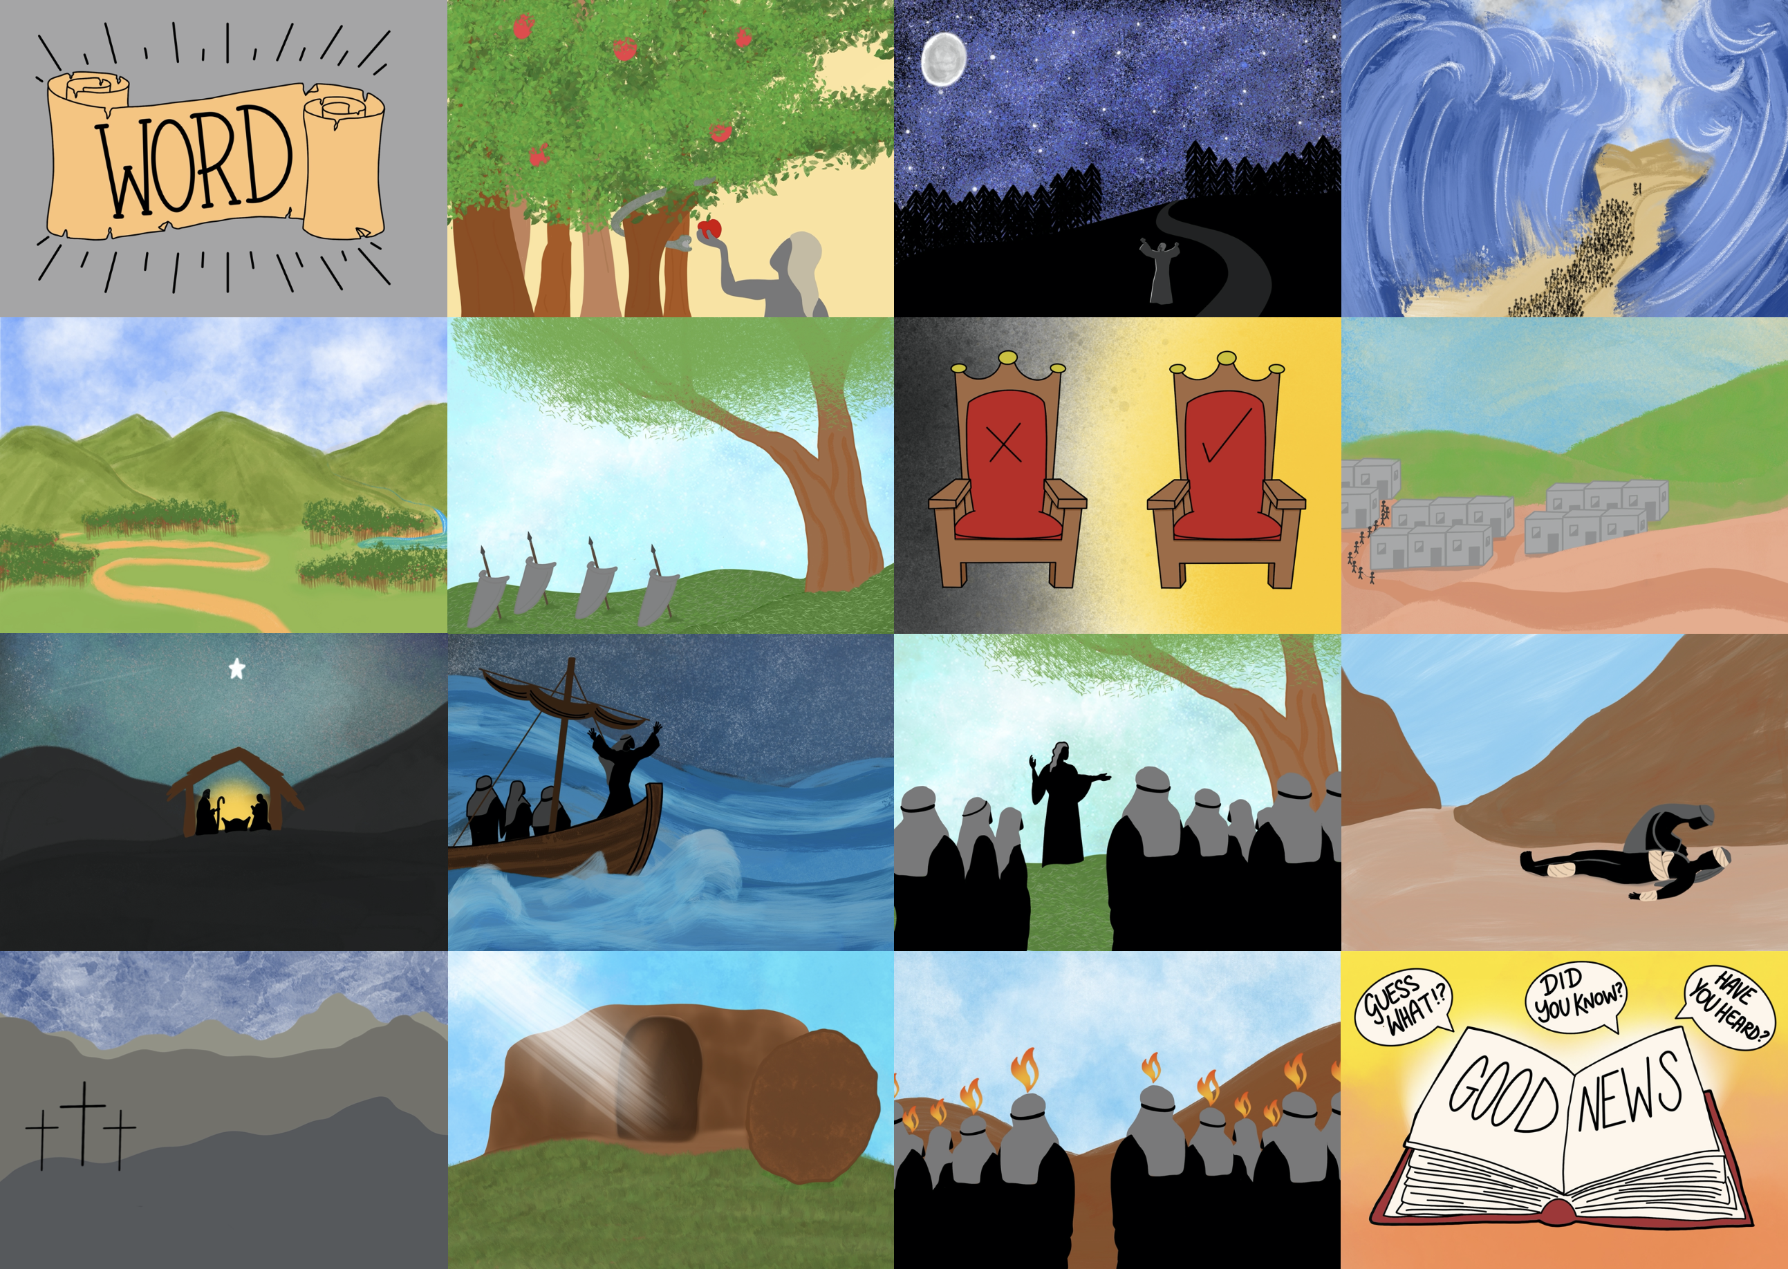



Slide 3


Slide 4
to spread the Good News until He comes again!

Slide 5
God offers his love and friendship as a gift

Slide 6
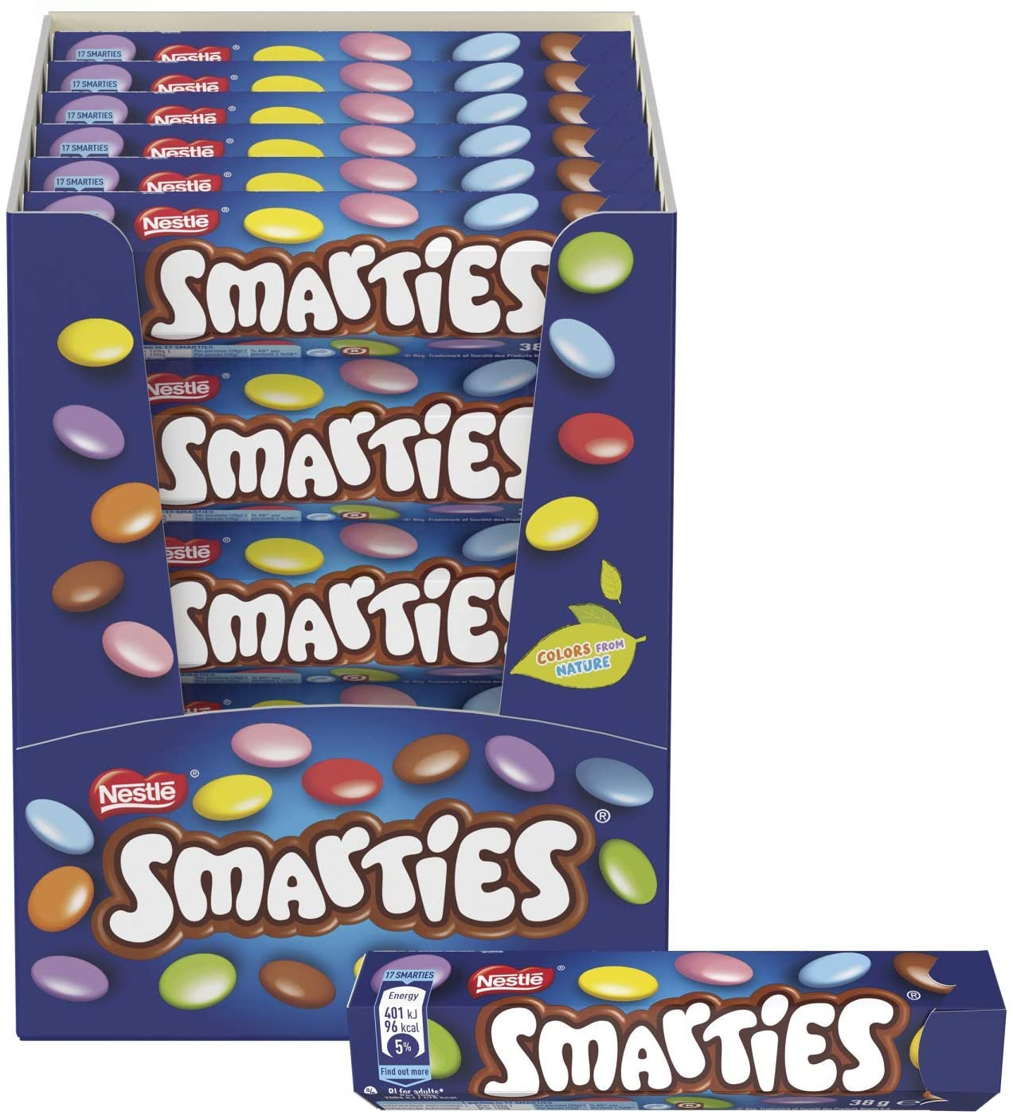

Slide 7


Slide 8
I won it

Slide 9


Slide 10
I earned it

Slide 11
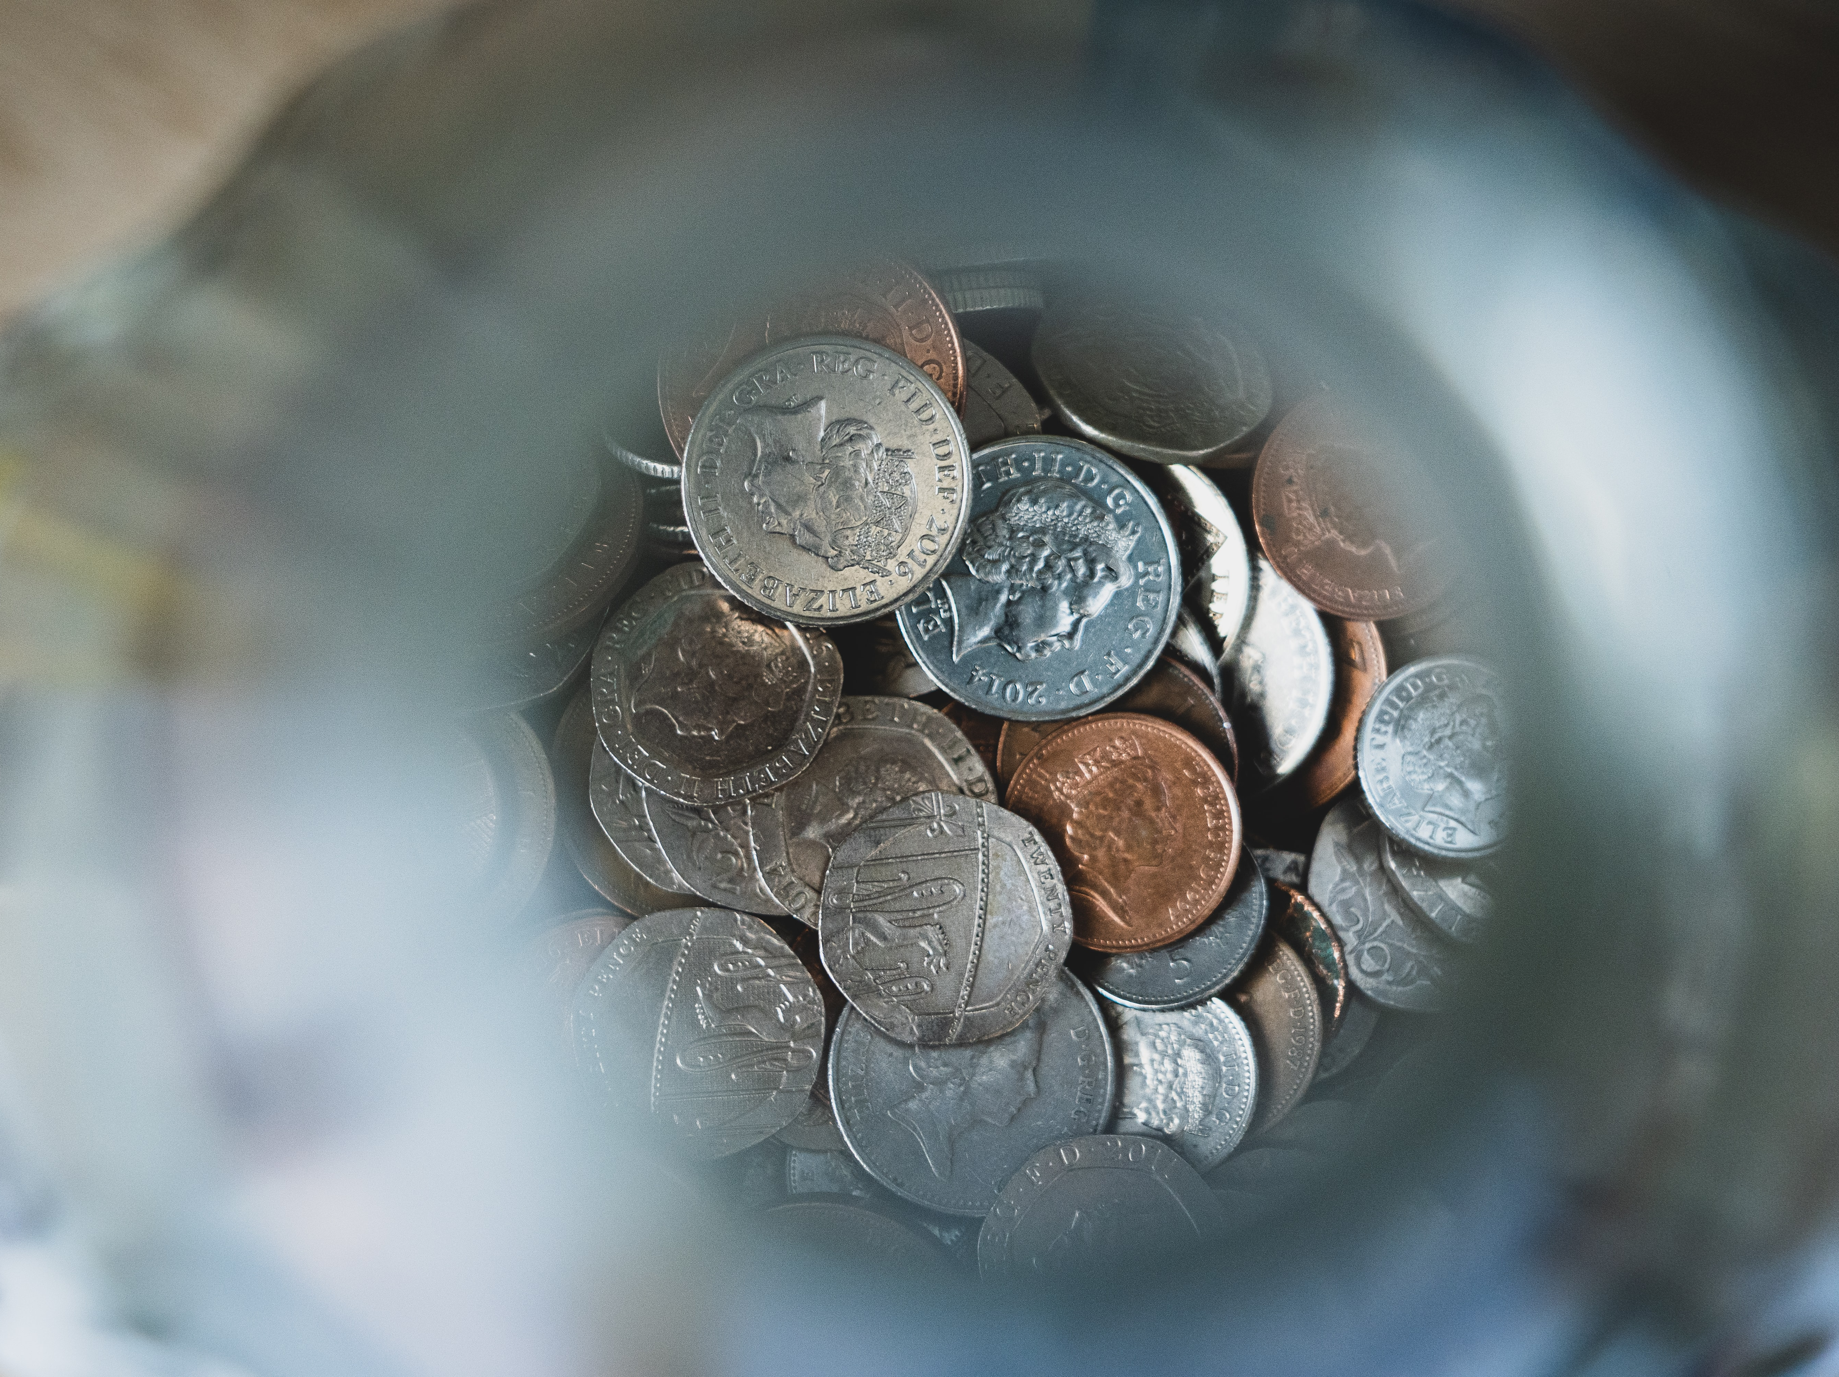

Slide 12
I bought it

Slide 13


Slide 14
I accepted it

Slide 15

The gift of God is eternal life through Jesus Christ our Lord.
Romans 6:23

