Slide 3
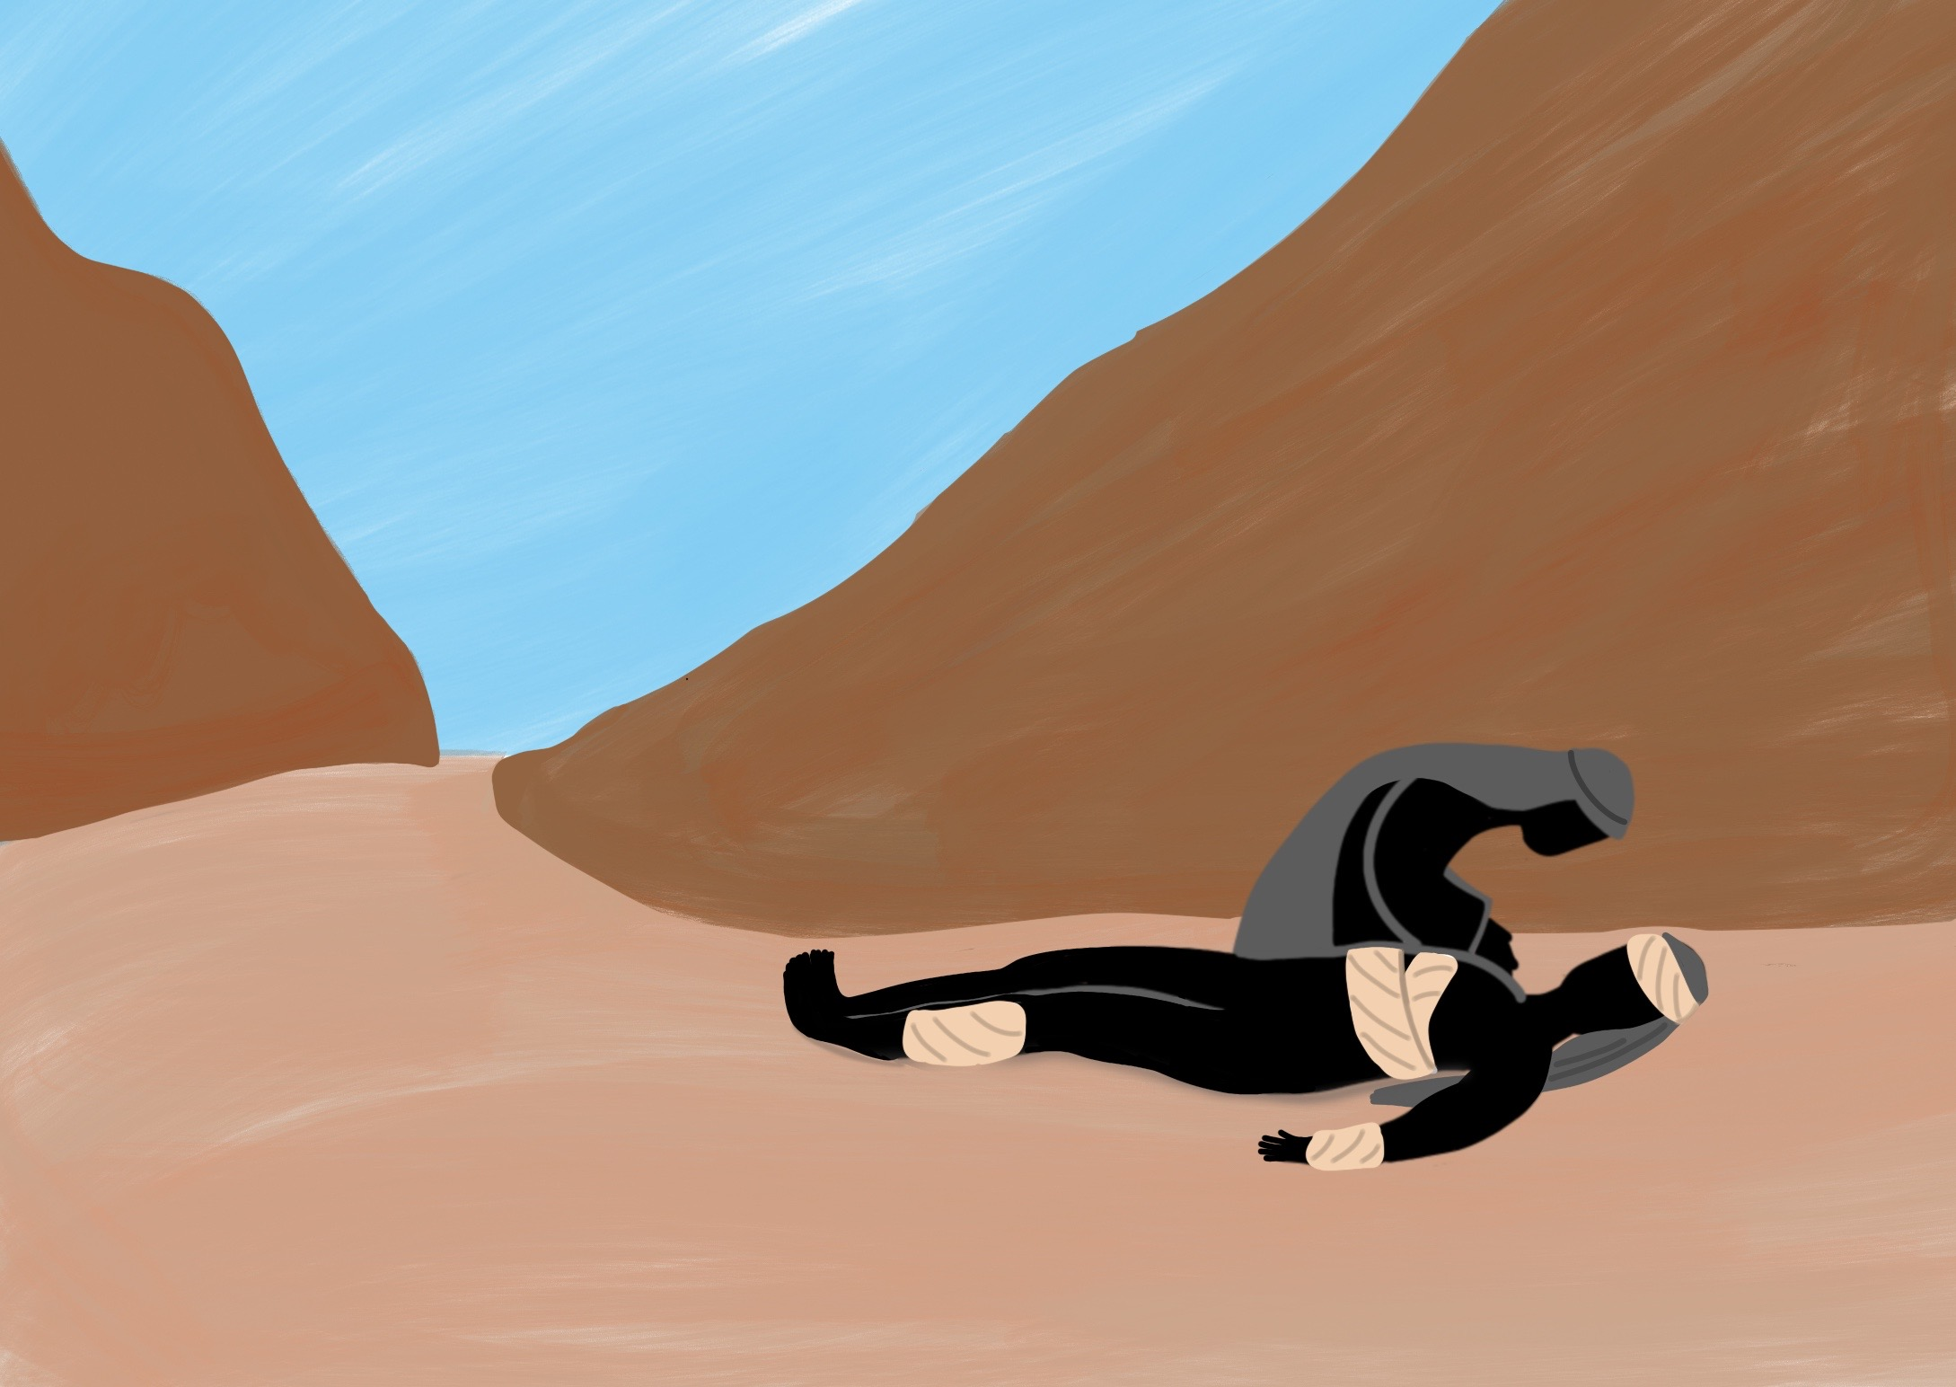

Slide 4
He taught us His way and He showed us His love.

Slide 5
Following Jesus means following His example

Slide 7
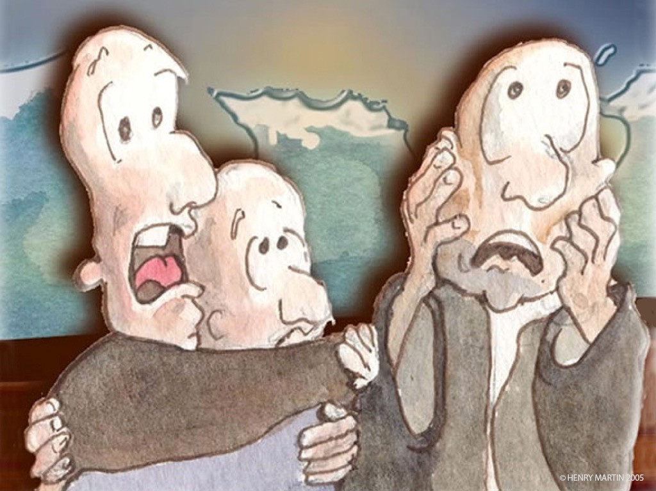

Slide 8
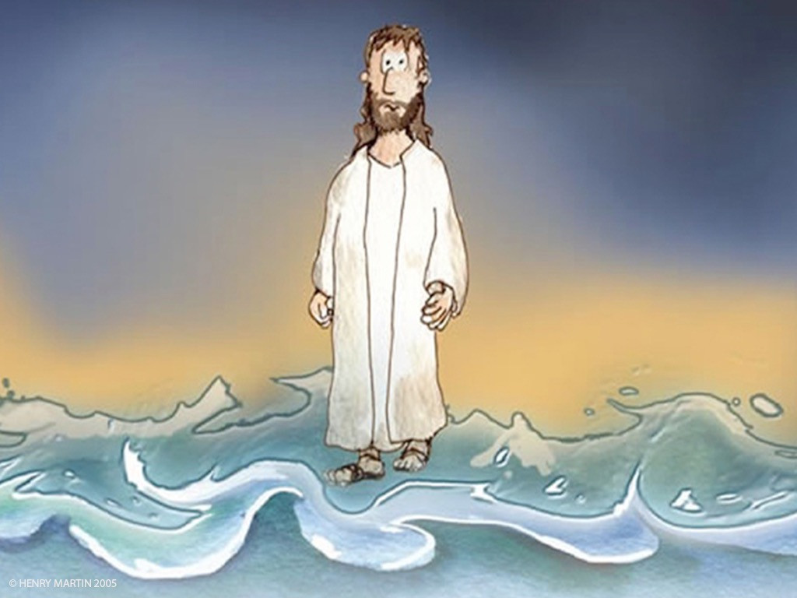

Slide 9
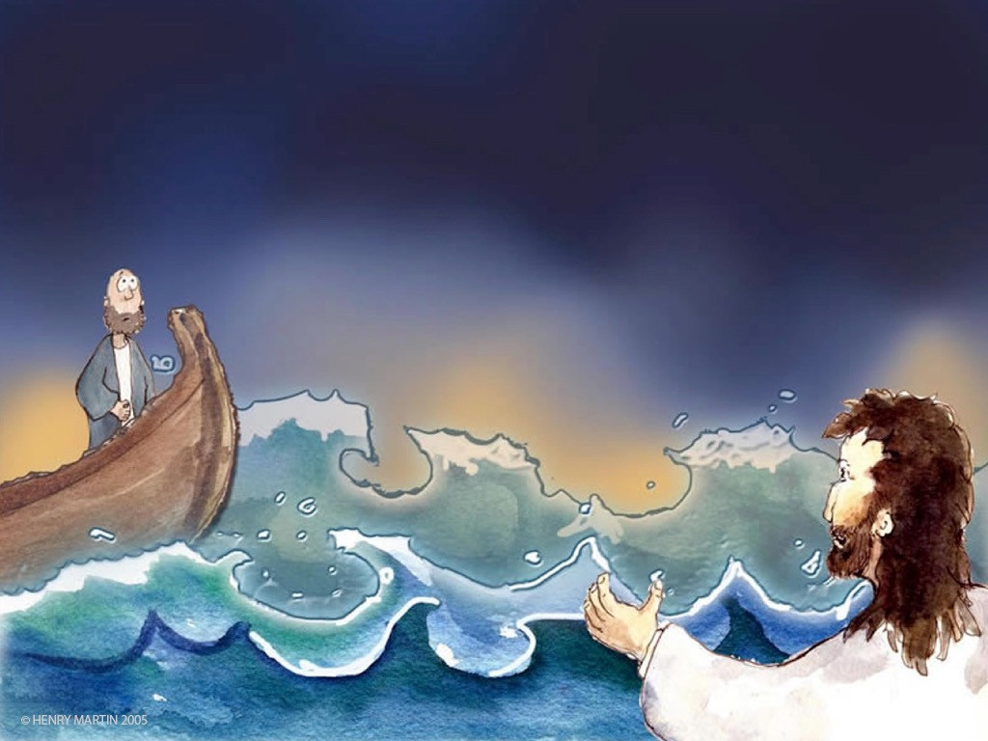

Slide 10
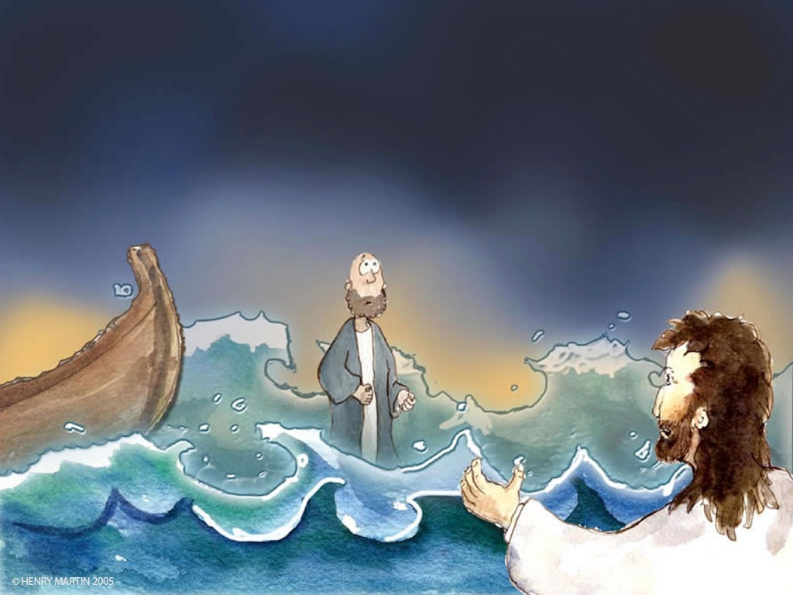

Slide 11
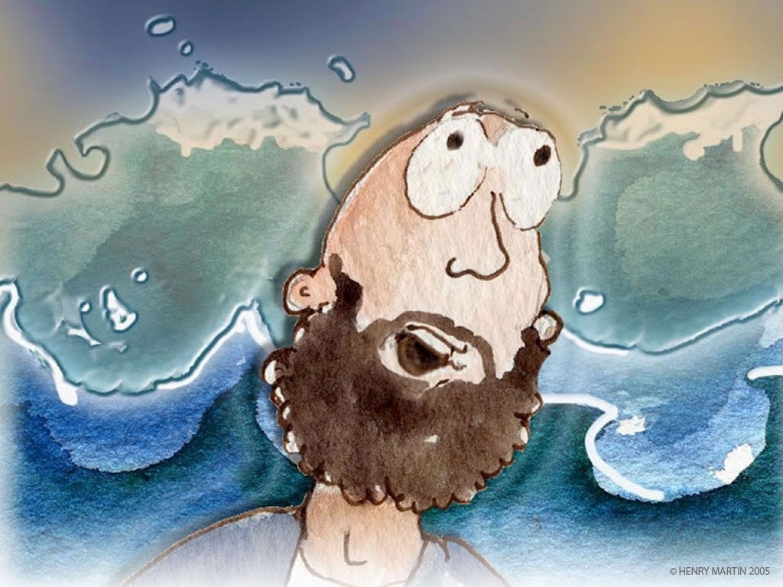

Slide 12
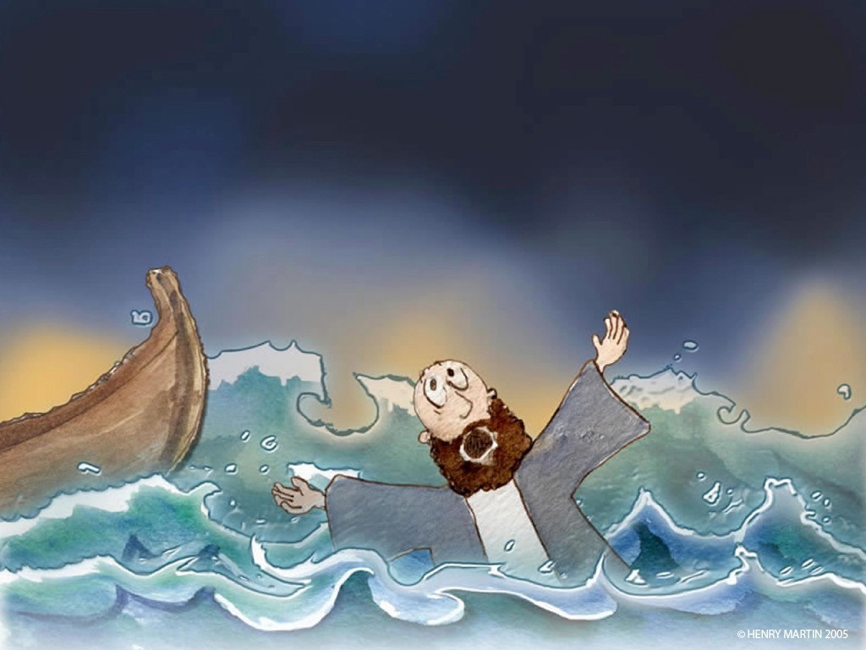

Slide 13
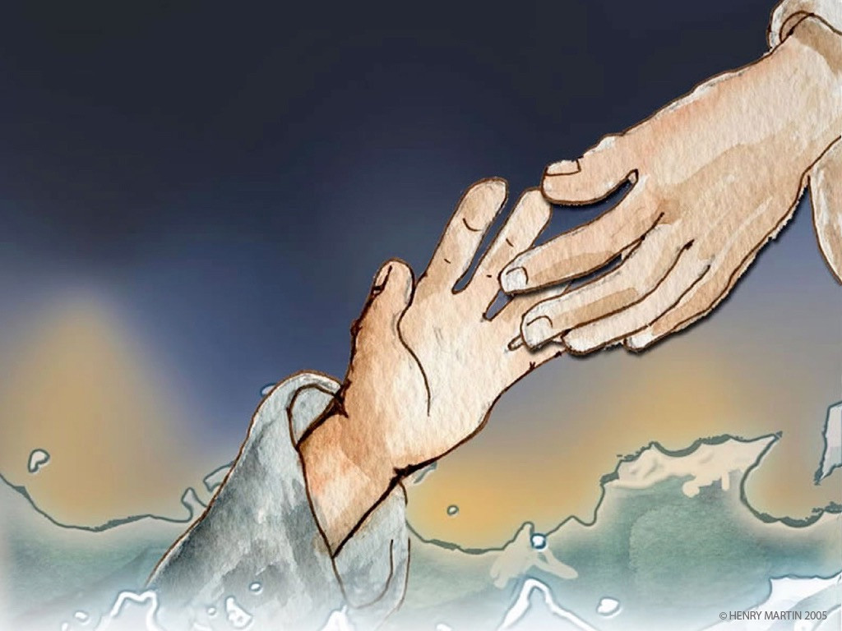

Slide 14
Nothing is impossible for Jesus
Jesus helps us to live God’s way

