Slide 1




Slide 3
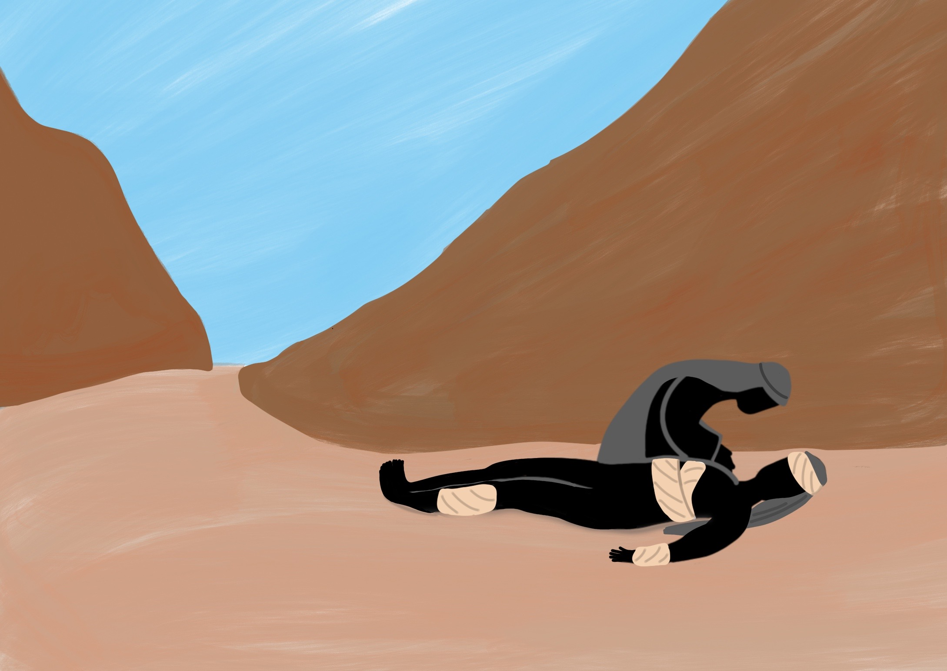

Slide 4
He taught us His way and He showed us His love.

Slide 5
Following Jesus means accepting His invitation

Slide 6


Slide 7




Slide 8
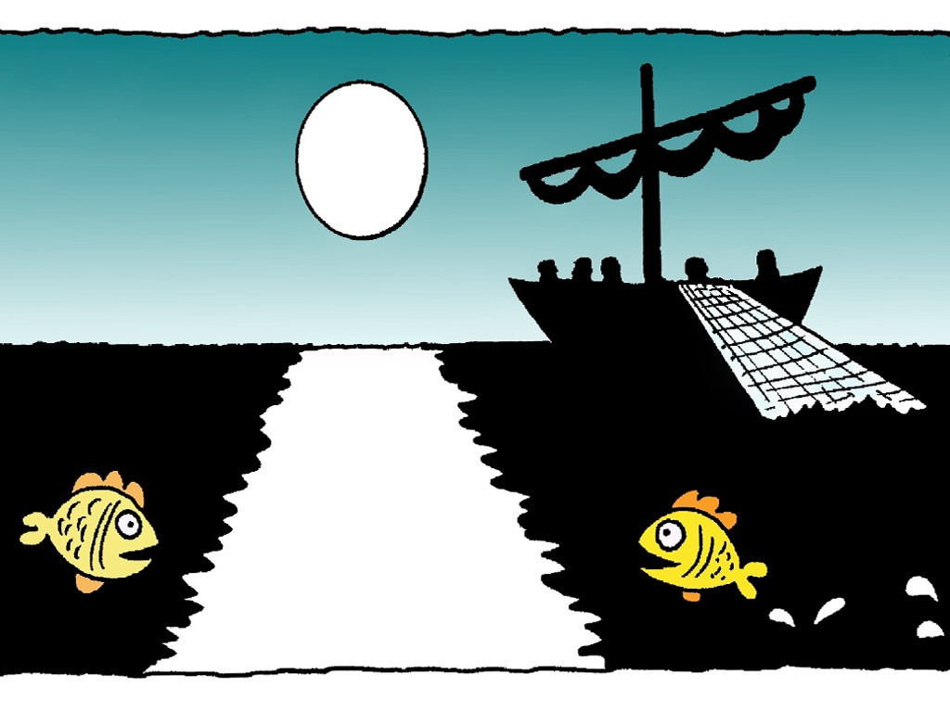

Slide 9


Slide 10
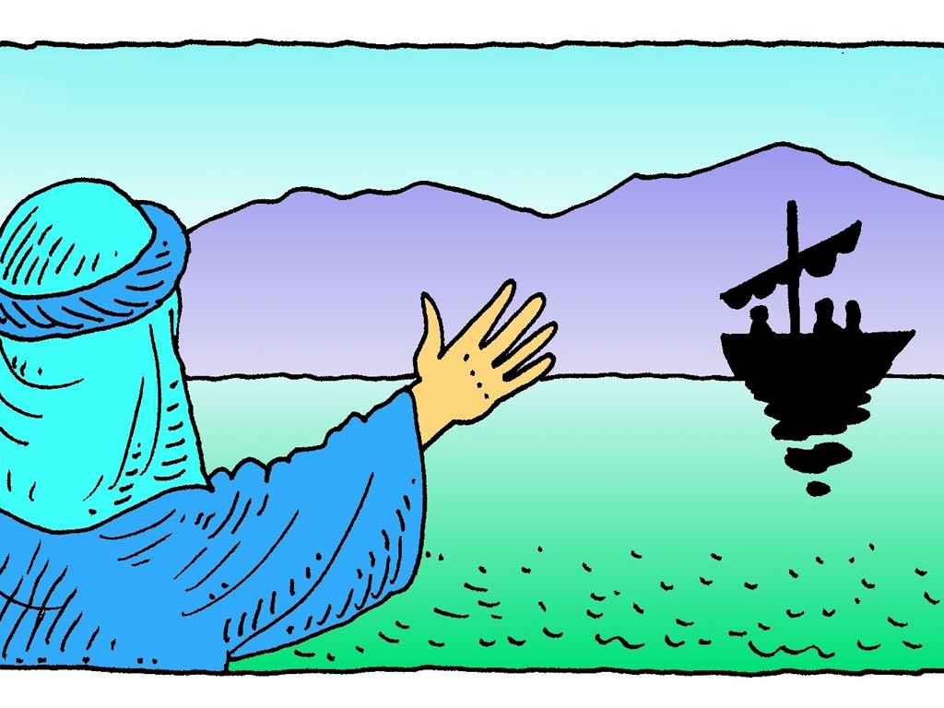

Slide 11
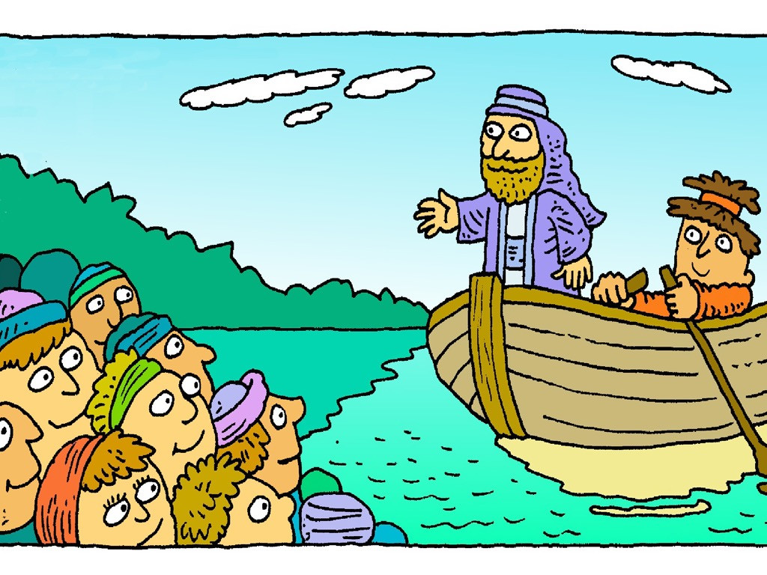

Slide 12
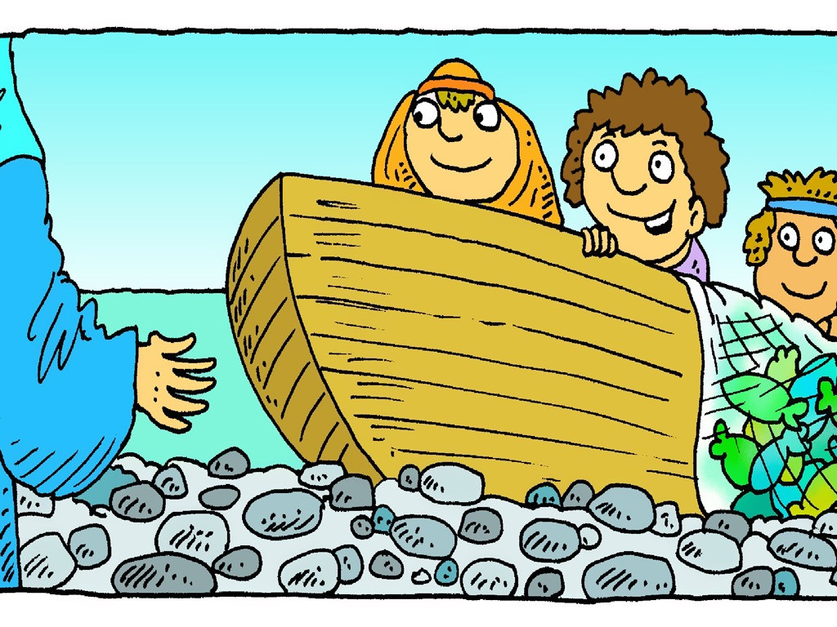

Slide 13
“Come and follow me, and I will show you how to fish for people.”
Matthew 4:20

