Slide 1
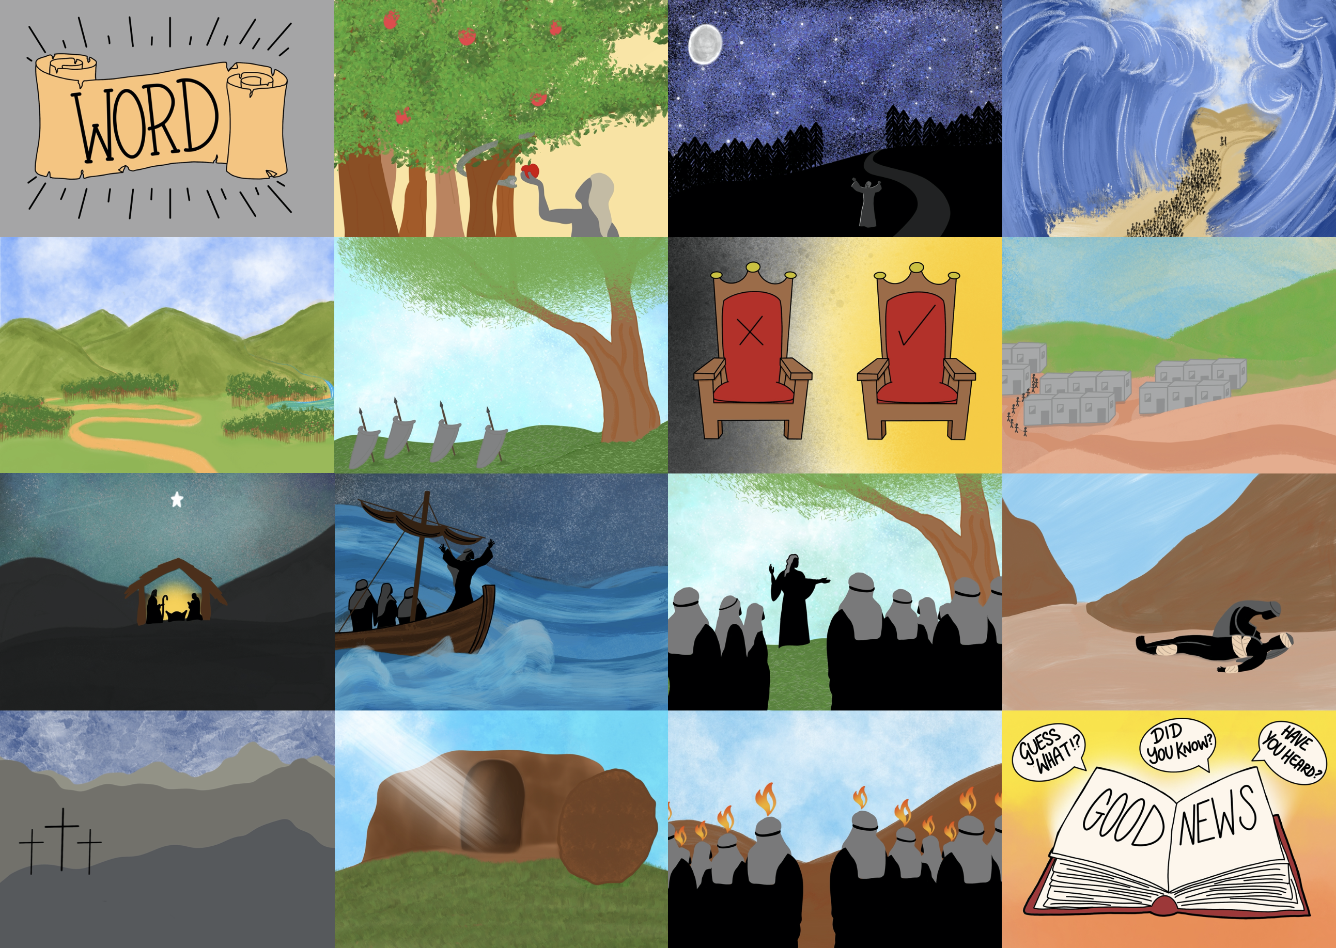



Slide 3


Slide 4
He brought us Good News from the Father above

Slide 5
Jesus came to give us a new start

Slide 6
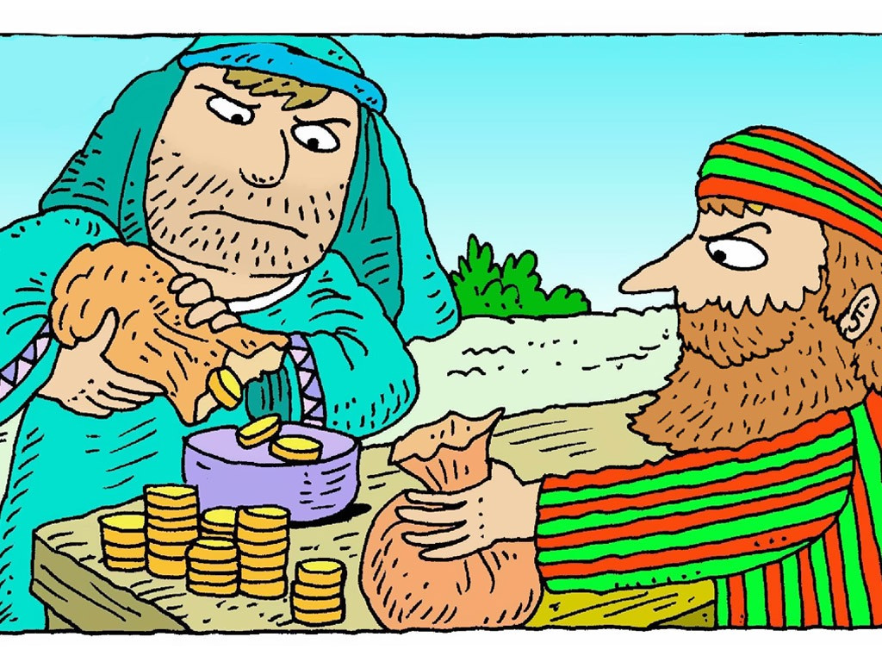

Slide 7
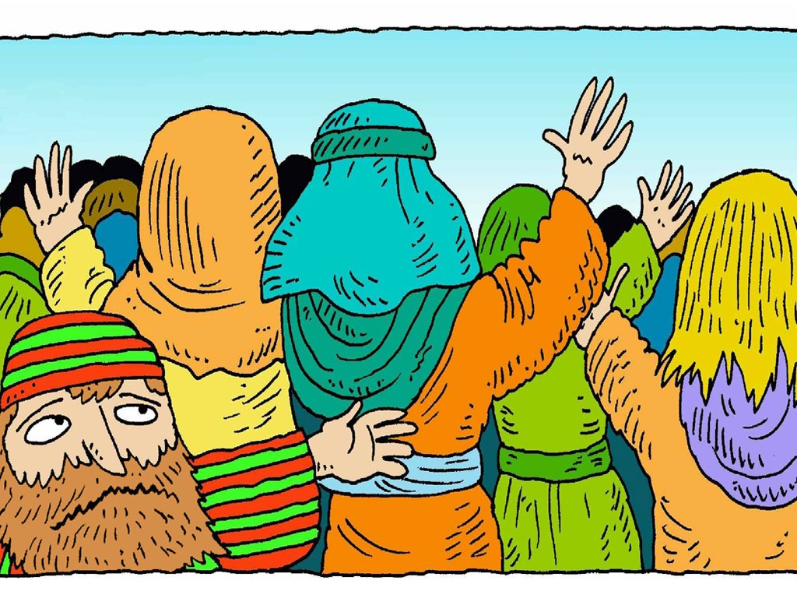

Slide 8
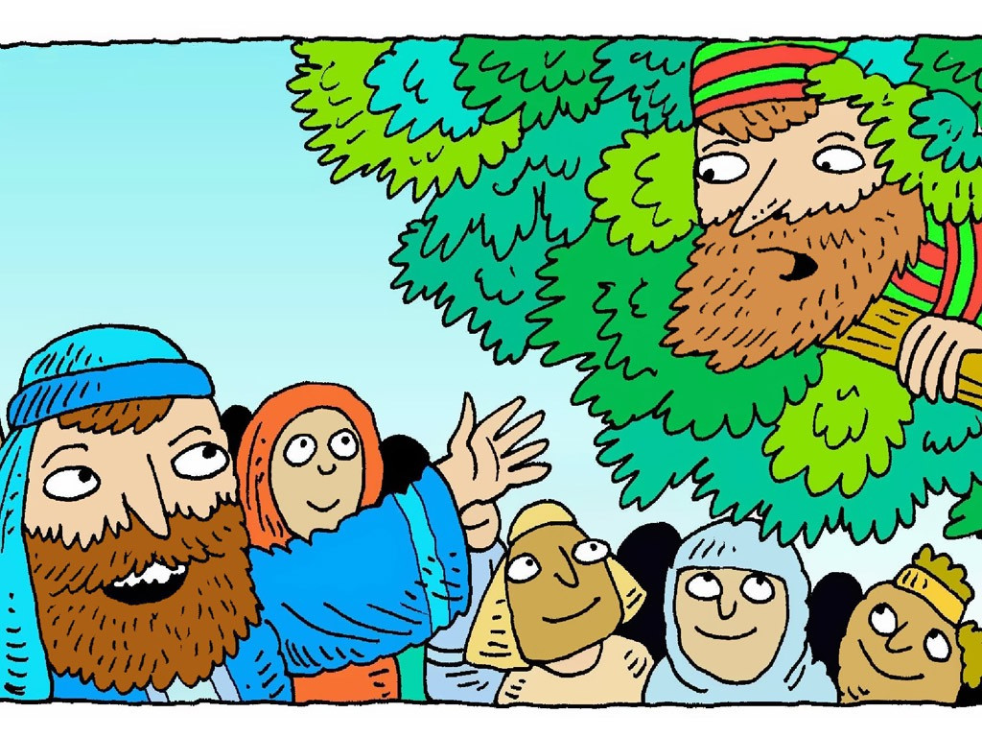

Slide 9
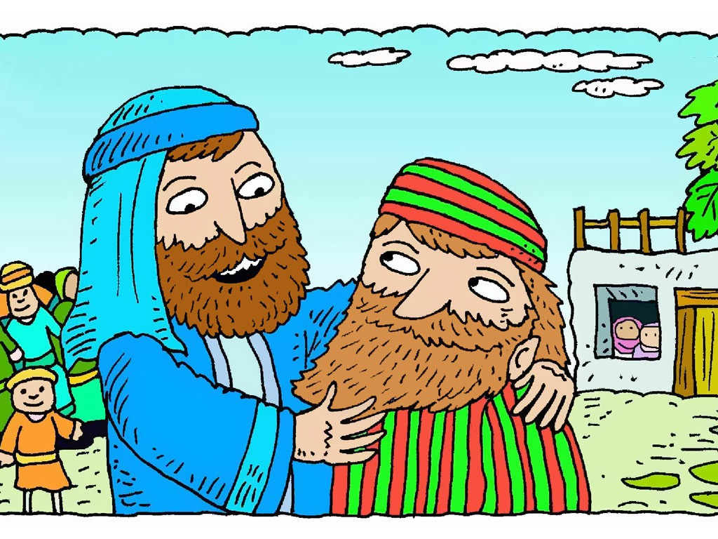

Slide 10
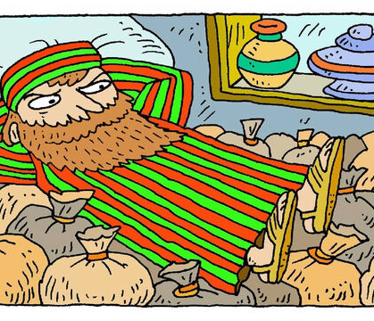
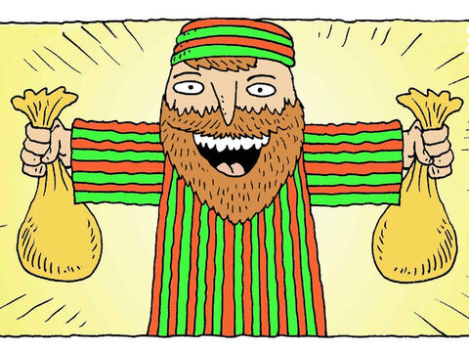
Anyone can be a friend of God
We can be forgiven and make a new start

Slide 11
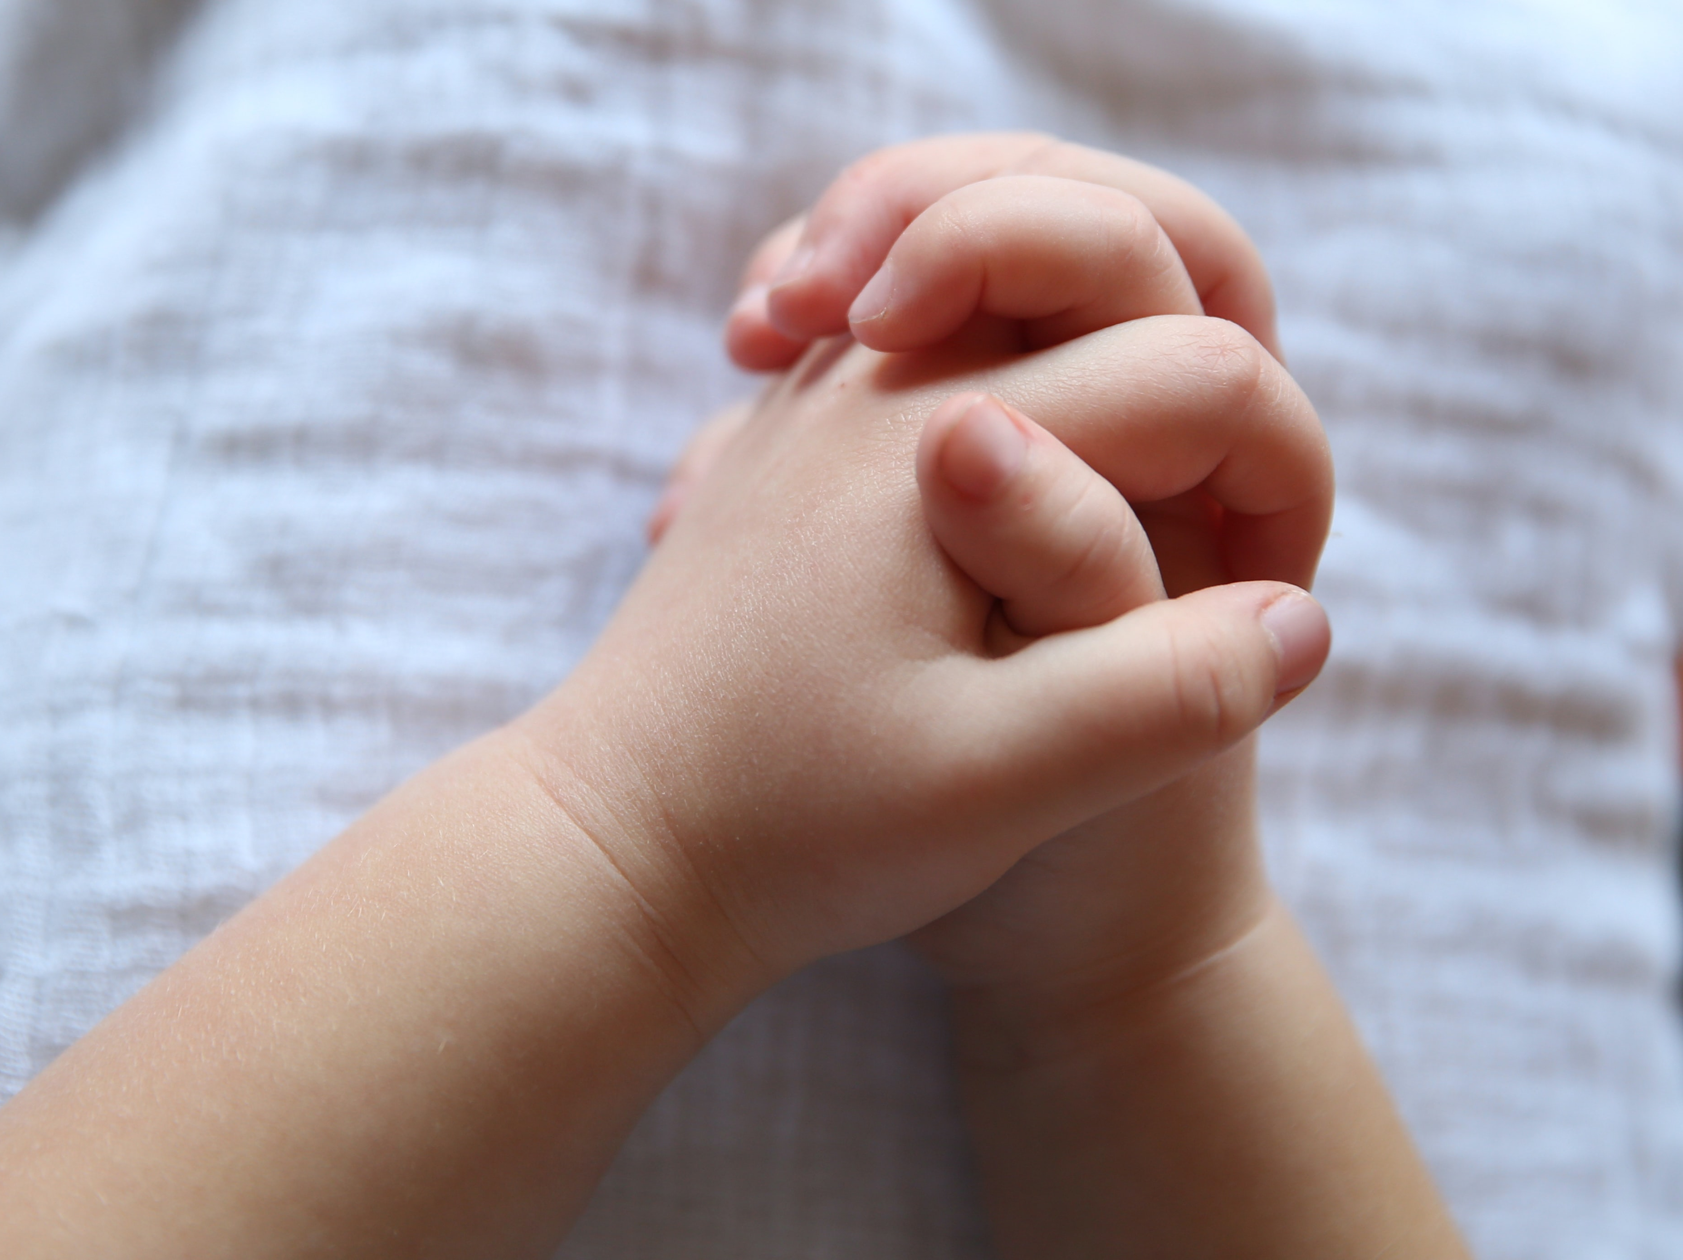
Please forgive us
and help us to change

