Slide 4
He brought us Good News from the Father above

Slide 5
Jesus came to bring us back to God

Slide 7
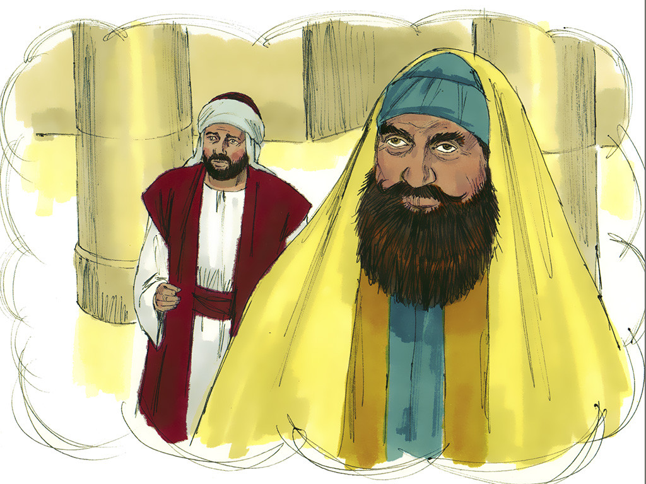

Slide 8
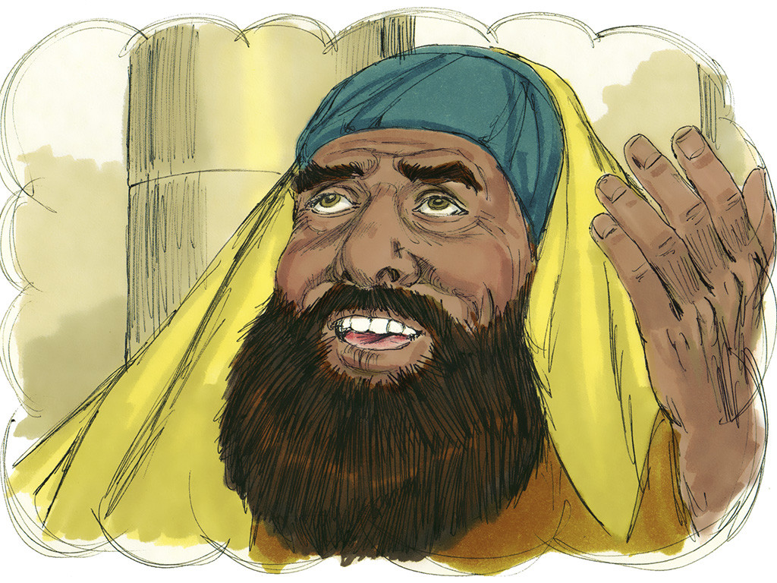

Slide 9
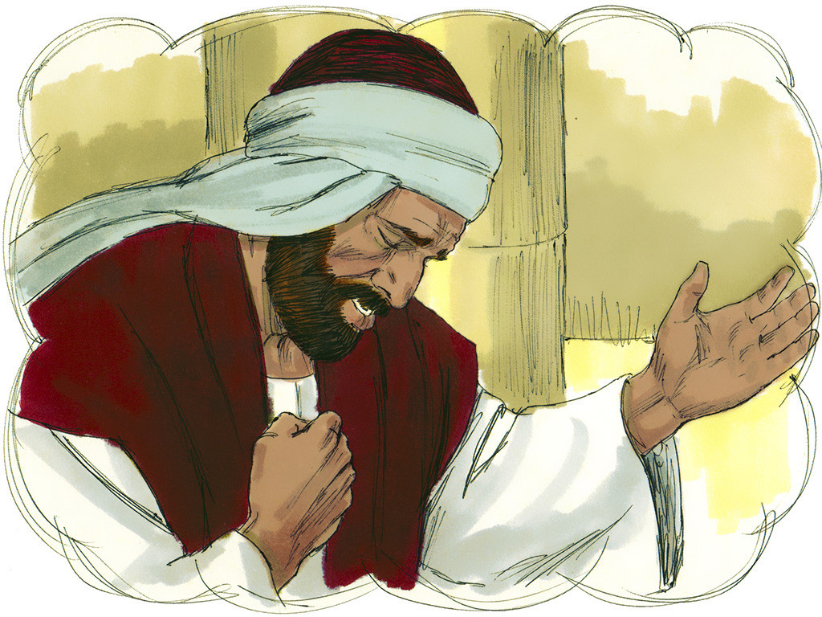

Slide 10
