Slide 1
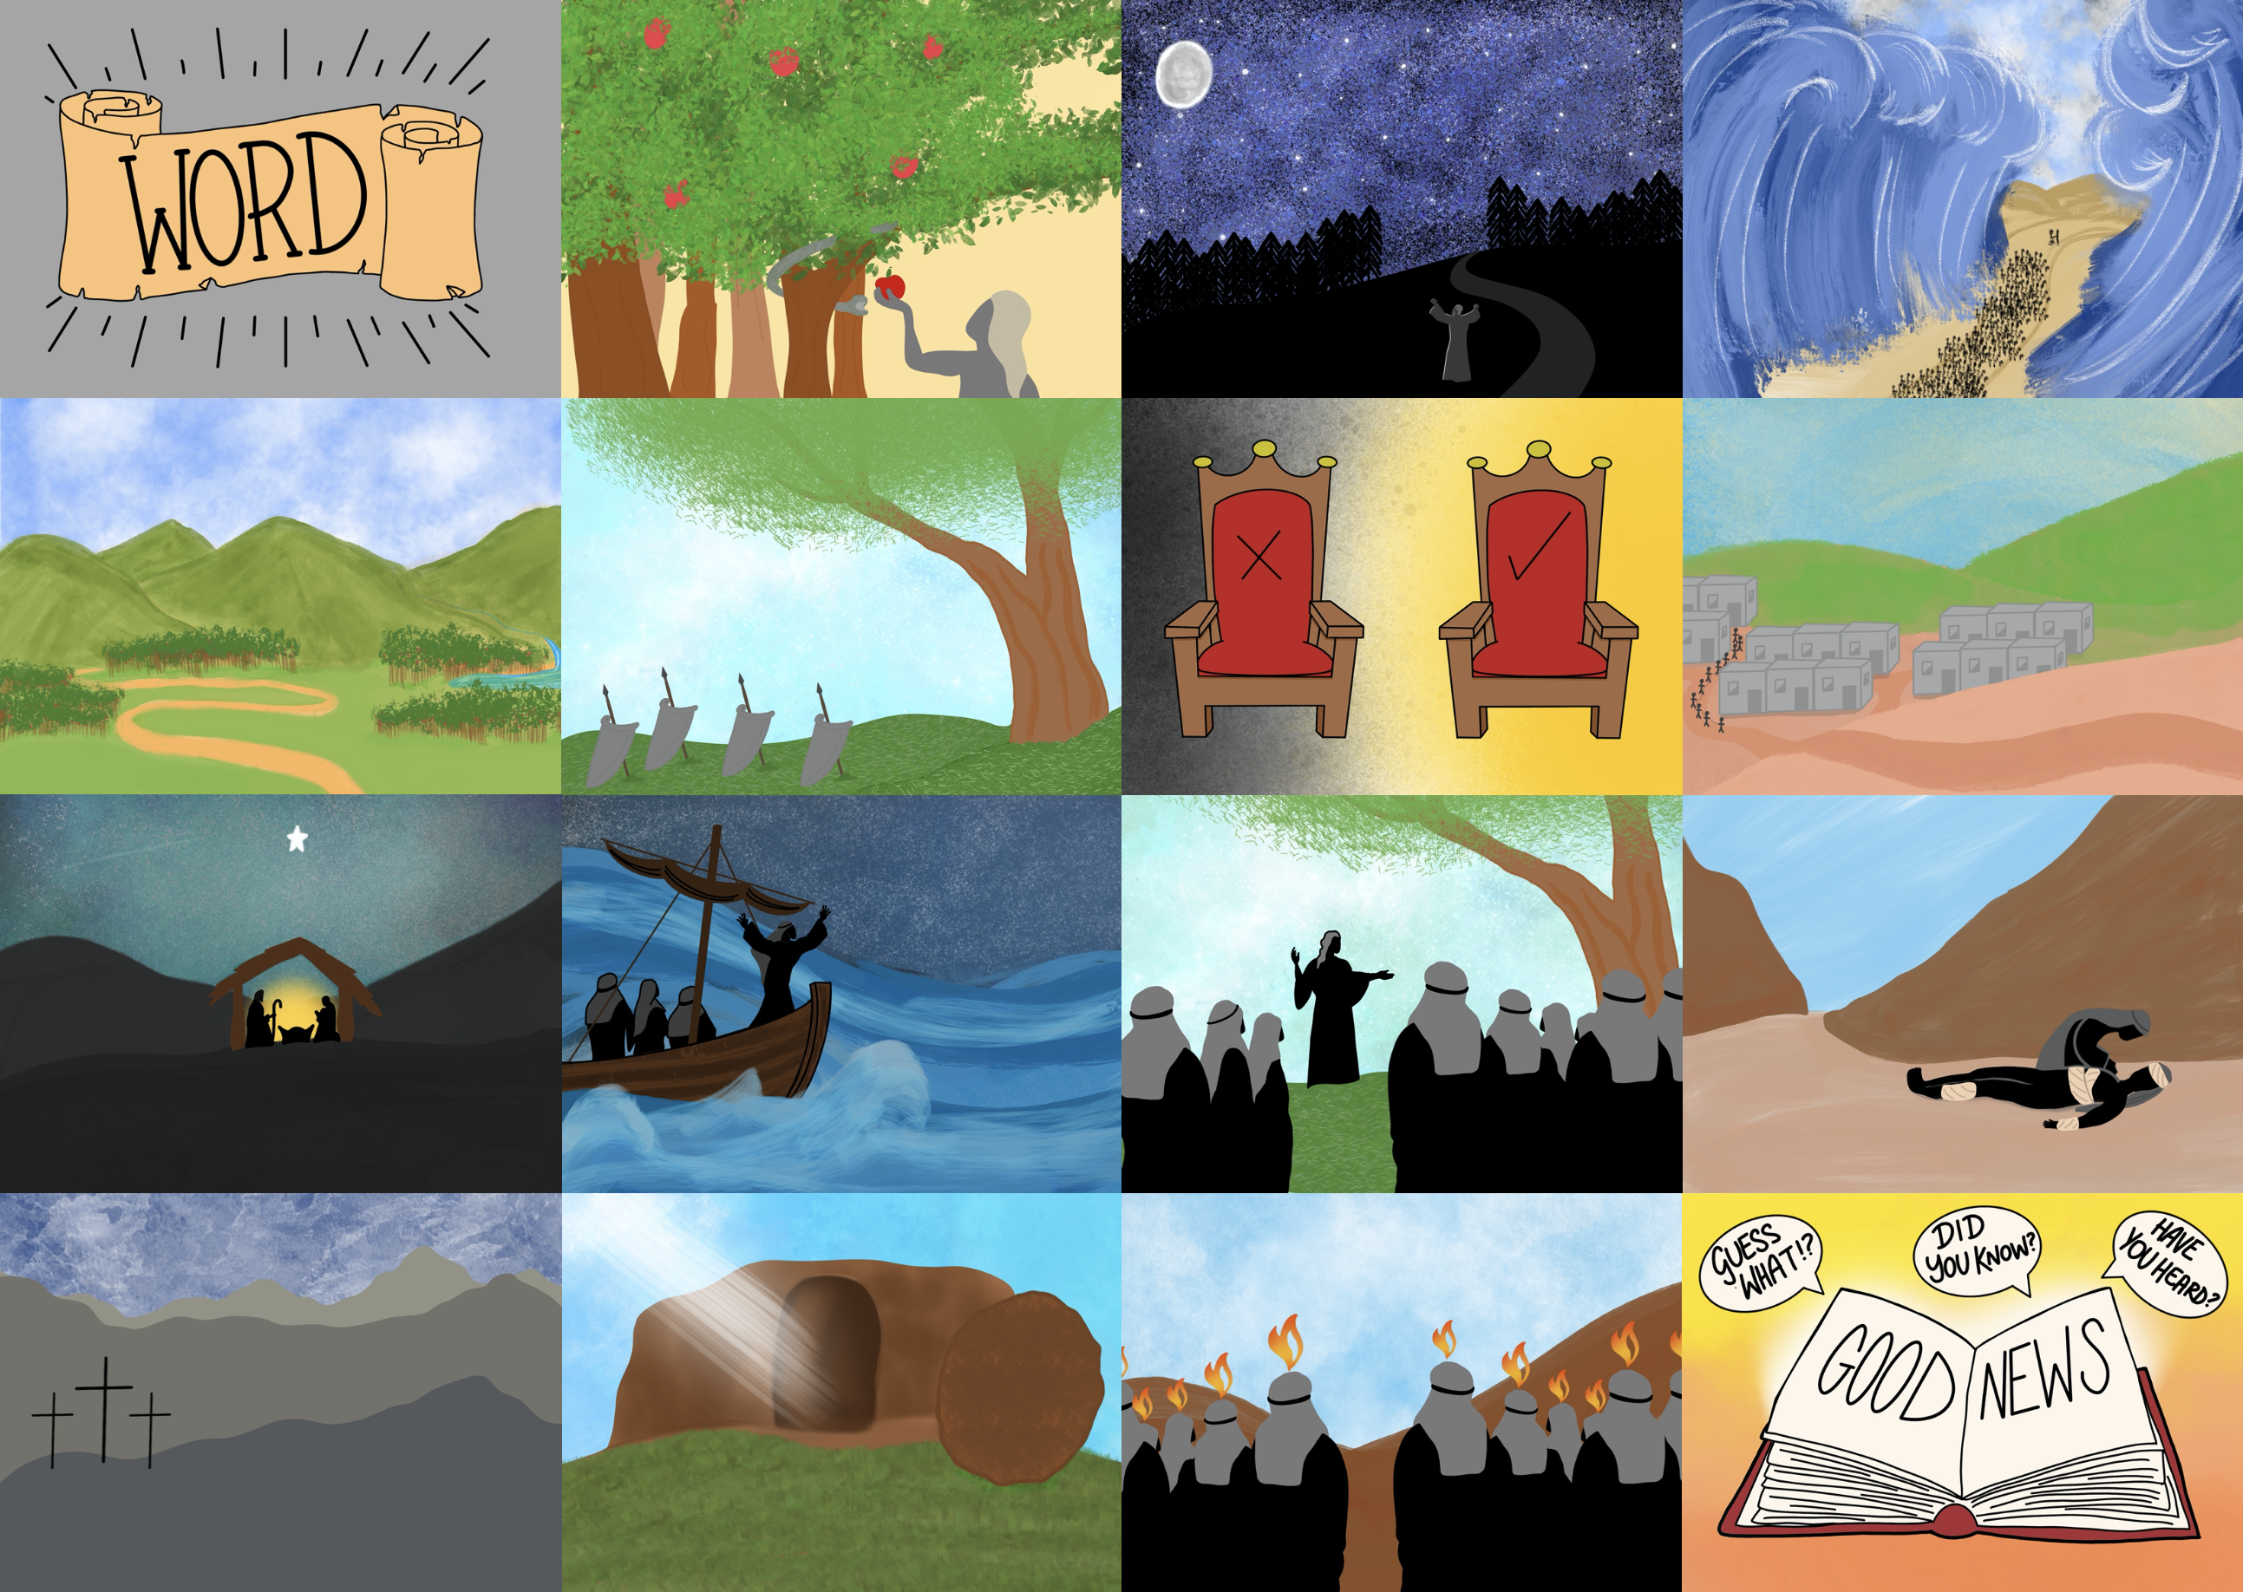

Slide 3
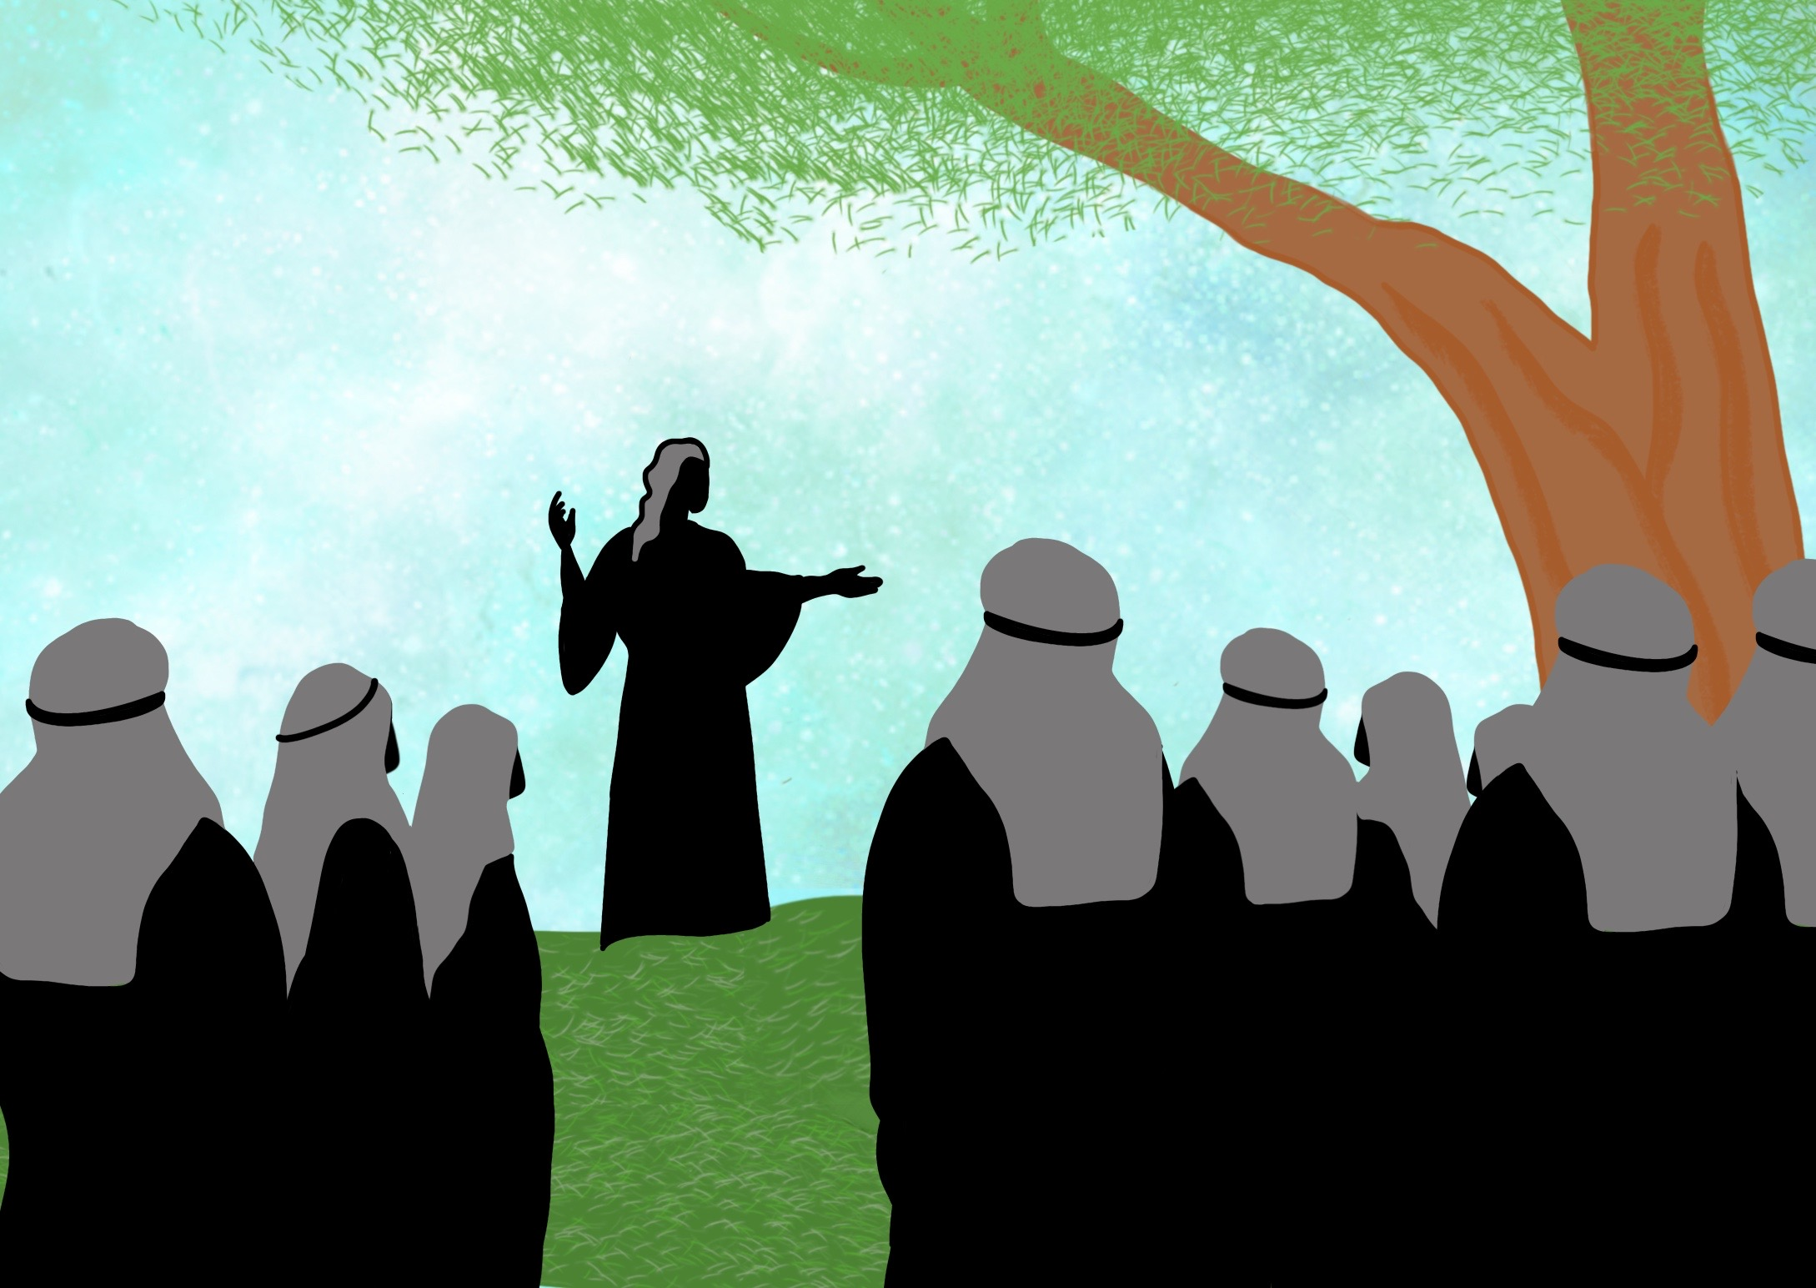

Slide 4
He brought us Good News from the Father above,

Slide 5
Jesus came to make us clean

Slide 7
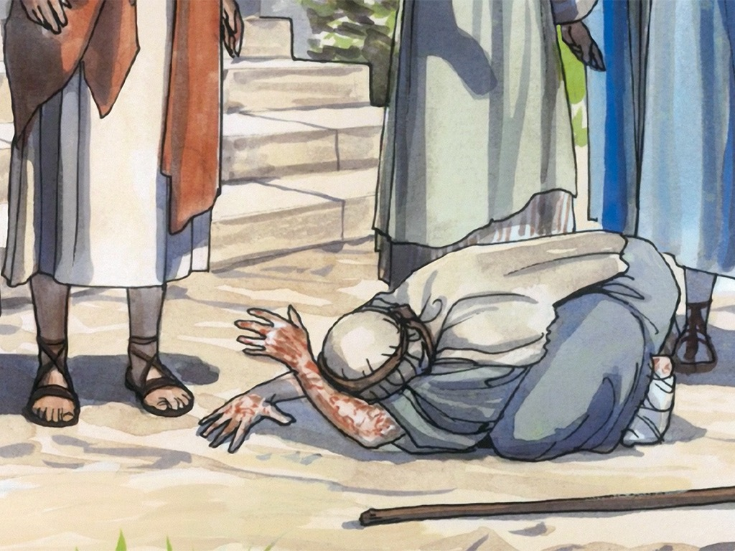

Slide 8
