Slide 3
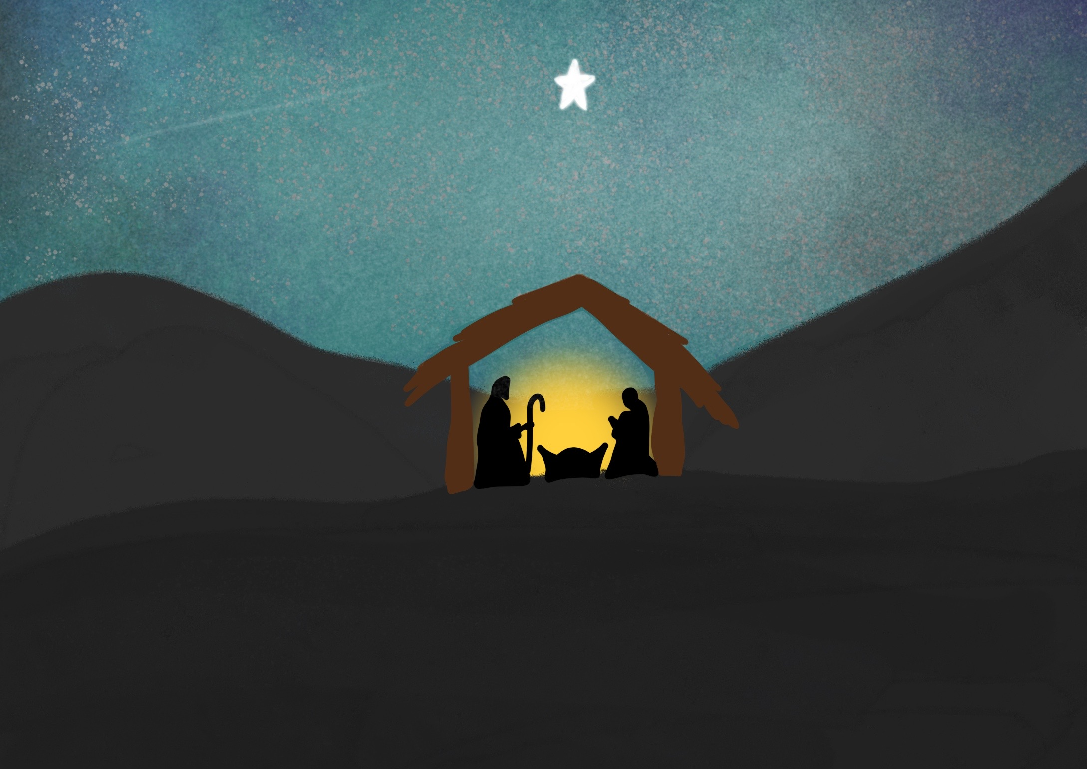

Slide 4
Angels announced the Good News of His birth,

Slide 5
Jesus is the perfect gift

Slide 7
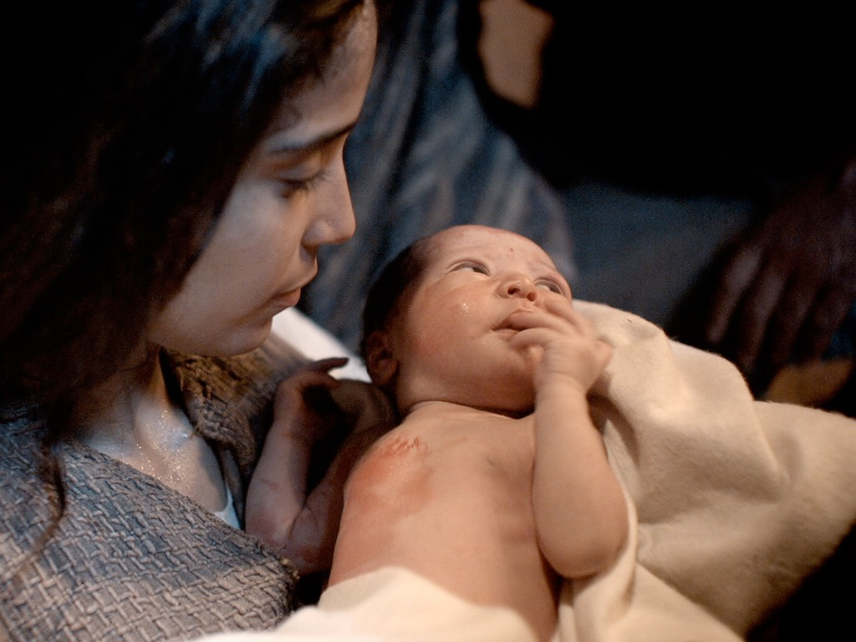

Slide 8
Something We All Need

Slide 9
Something No One Else Can Give

Slide 10
Something That Lasts

