Slide 1
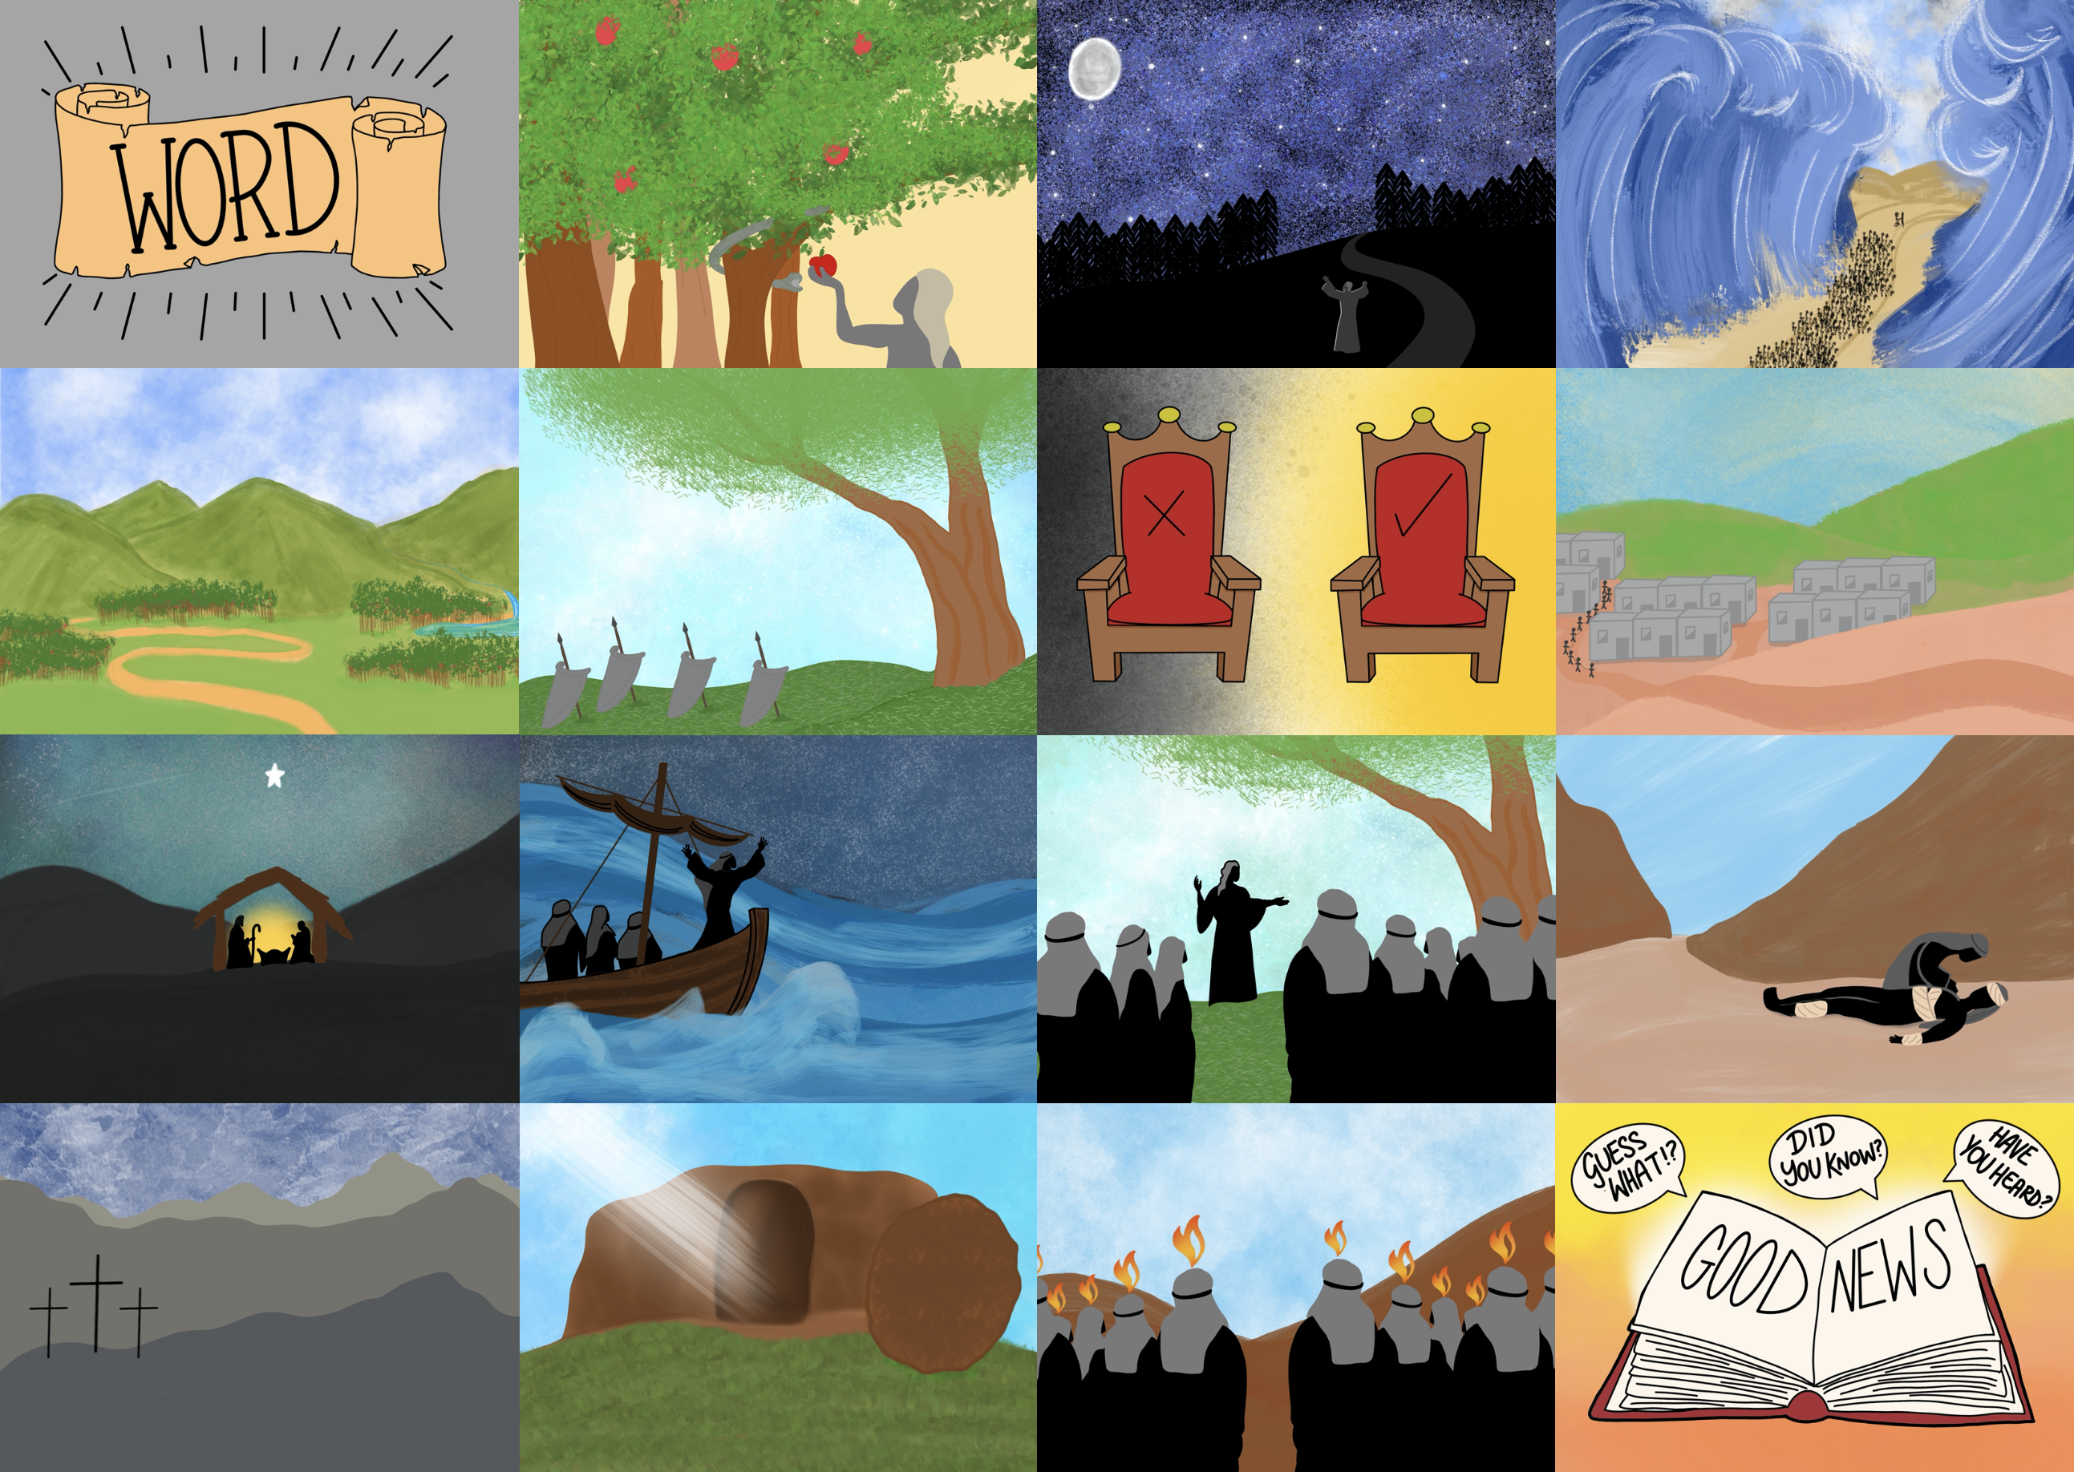

Slide 4
But God kept His word to restore them some day

Slide 5
In a hostile world, God wants us to do what we can for others

Slide 8
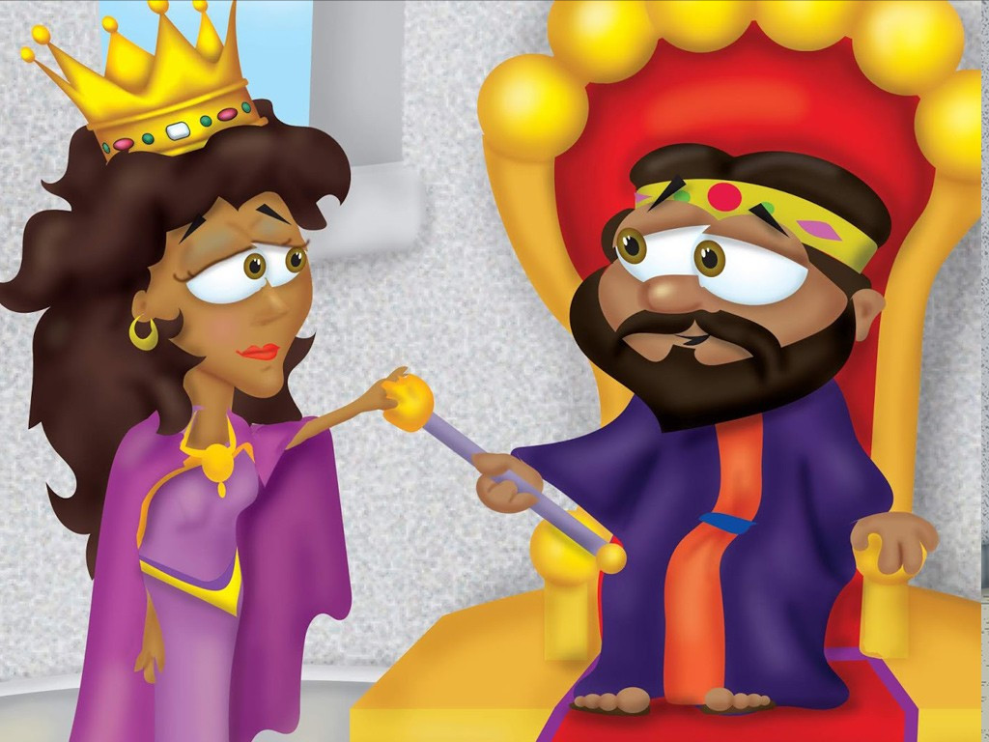
‘…For such a time as this…’
Esther 4:14

