Slide 3
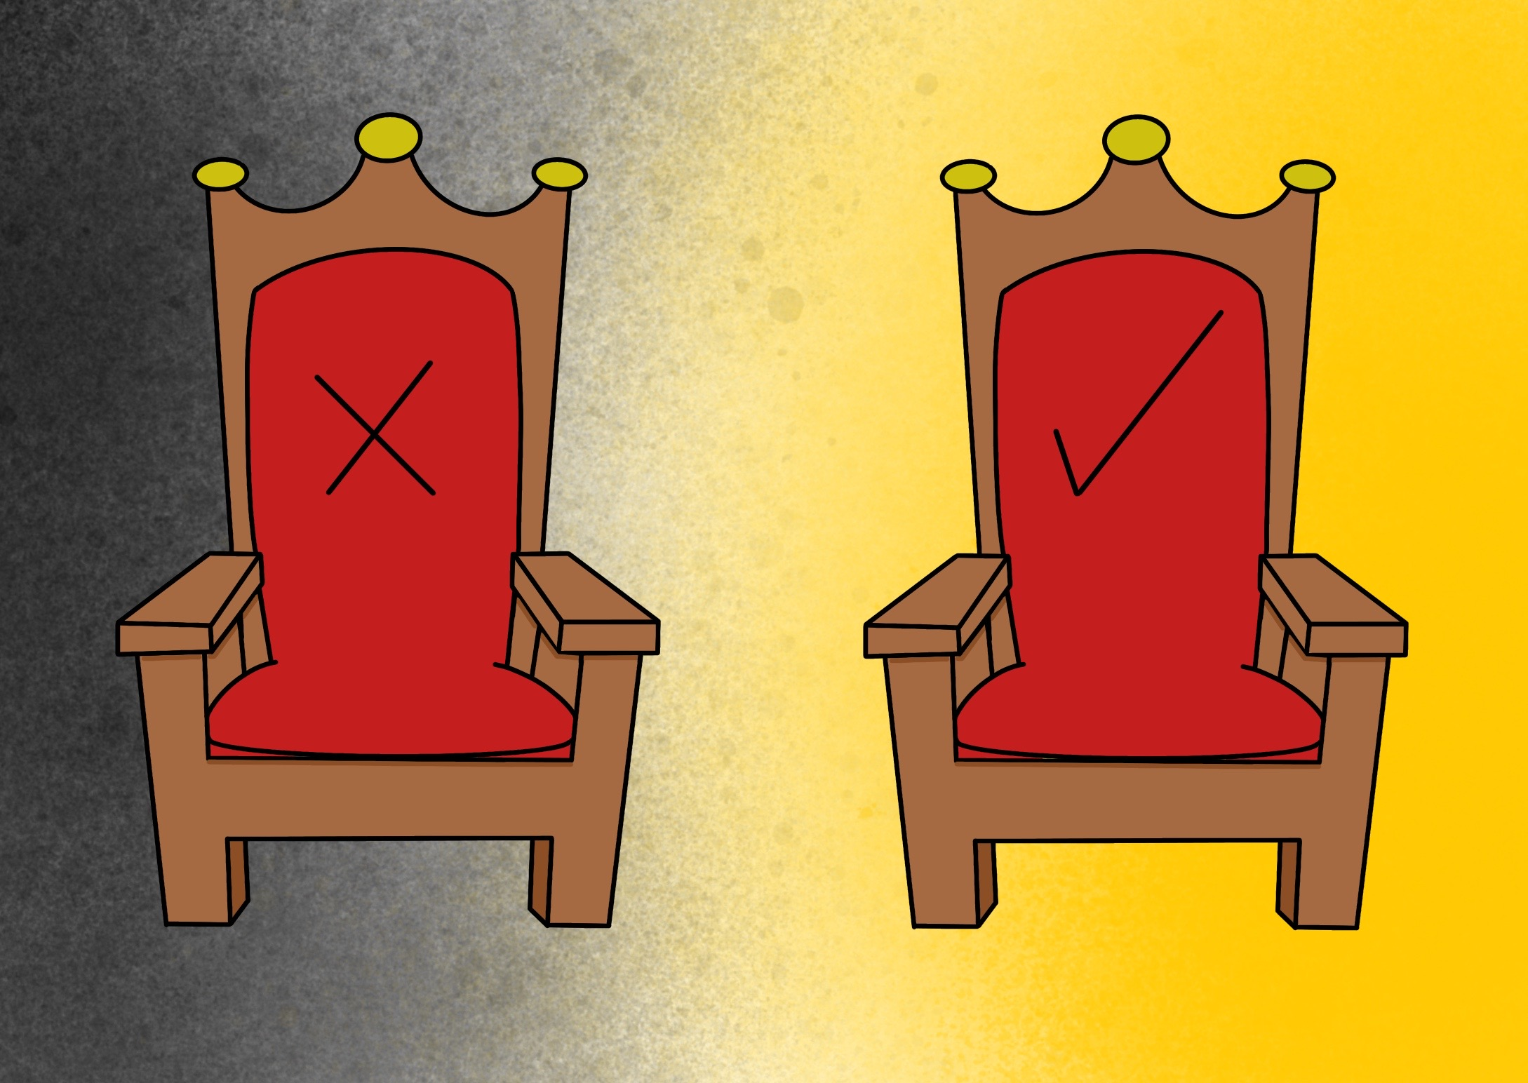

Slide 4
they were followed by Kings; some did wrong, some did right.

Slide 5
God chooses a king who keeps his promises

Slide 6
They are fun to be with
They can be trusted
What makes a
They like doing the same things as you
They set a good example
They stick with you
They share what they have
They encourage you
good friend ?
They are kind and helpful
They put you first

Slide 8
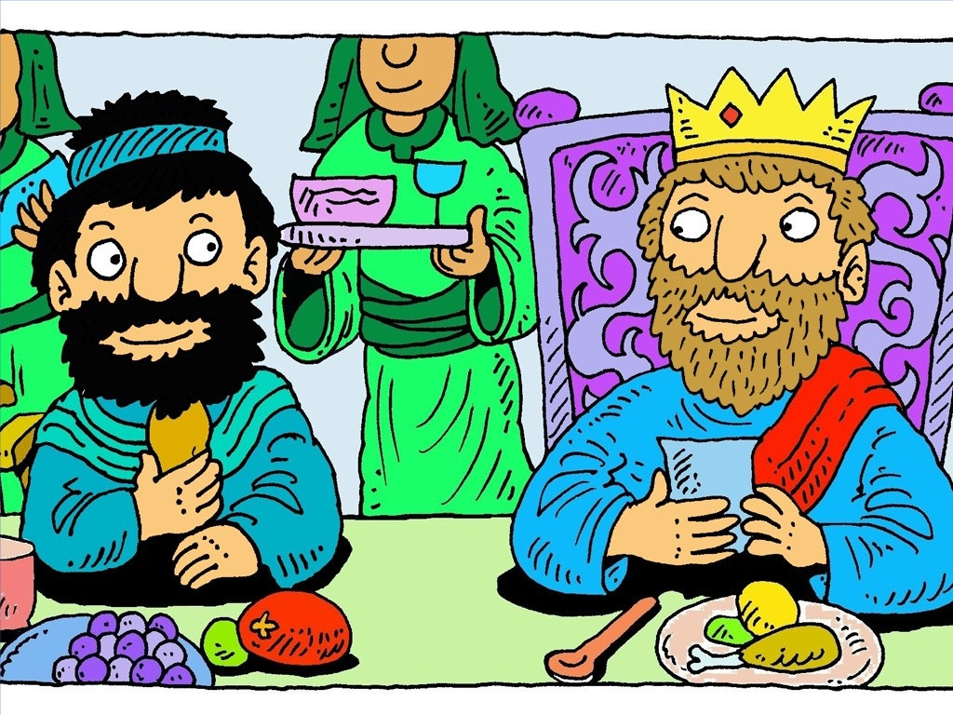

Slide 9
Jesus keeps his promises
Jesus wants to be our friend

