Slide 3
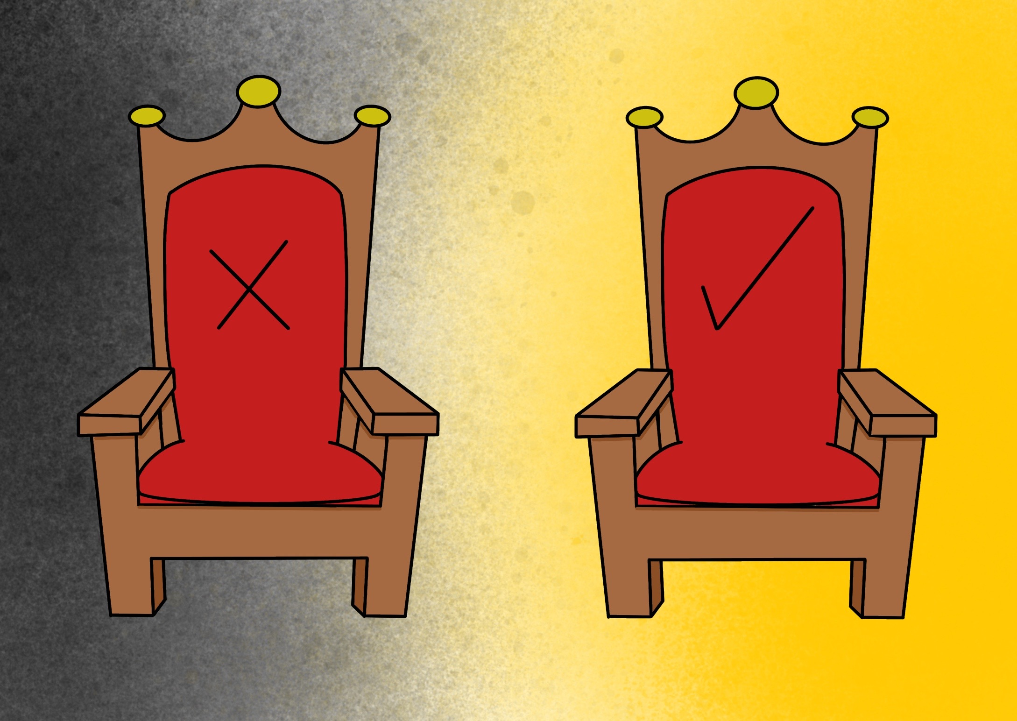

Slide 4
they were followed by Kings; some did wrong, some did right.

Slide 5
God chooses a king who fights for His people

Slide 7
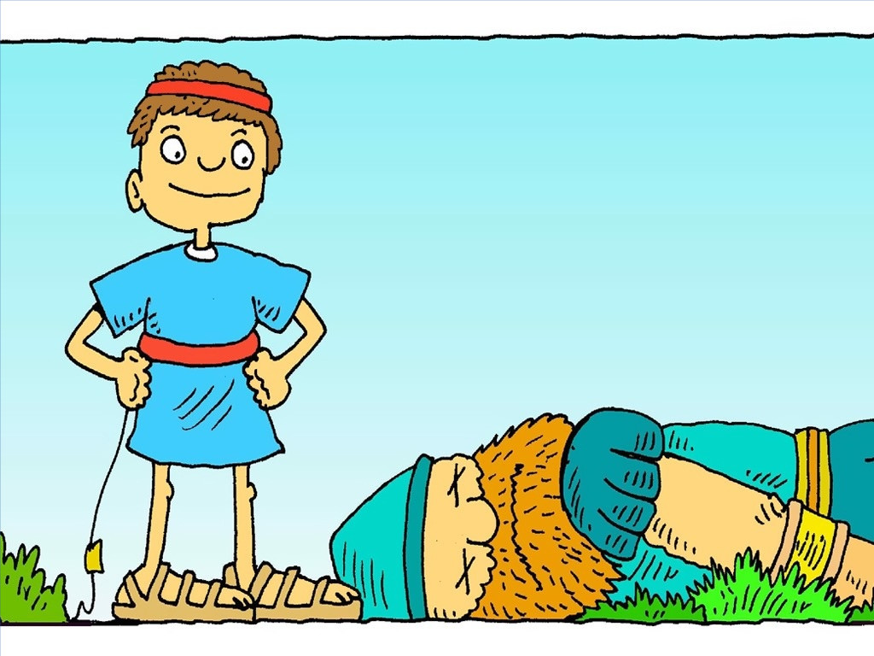

Slide 10
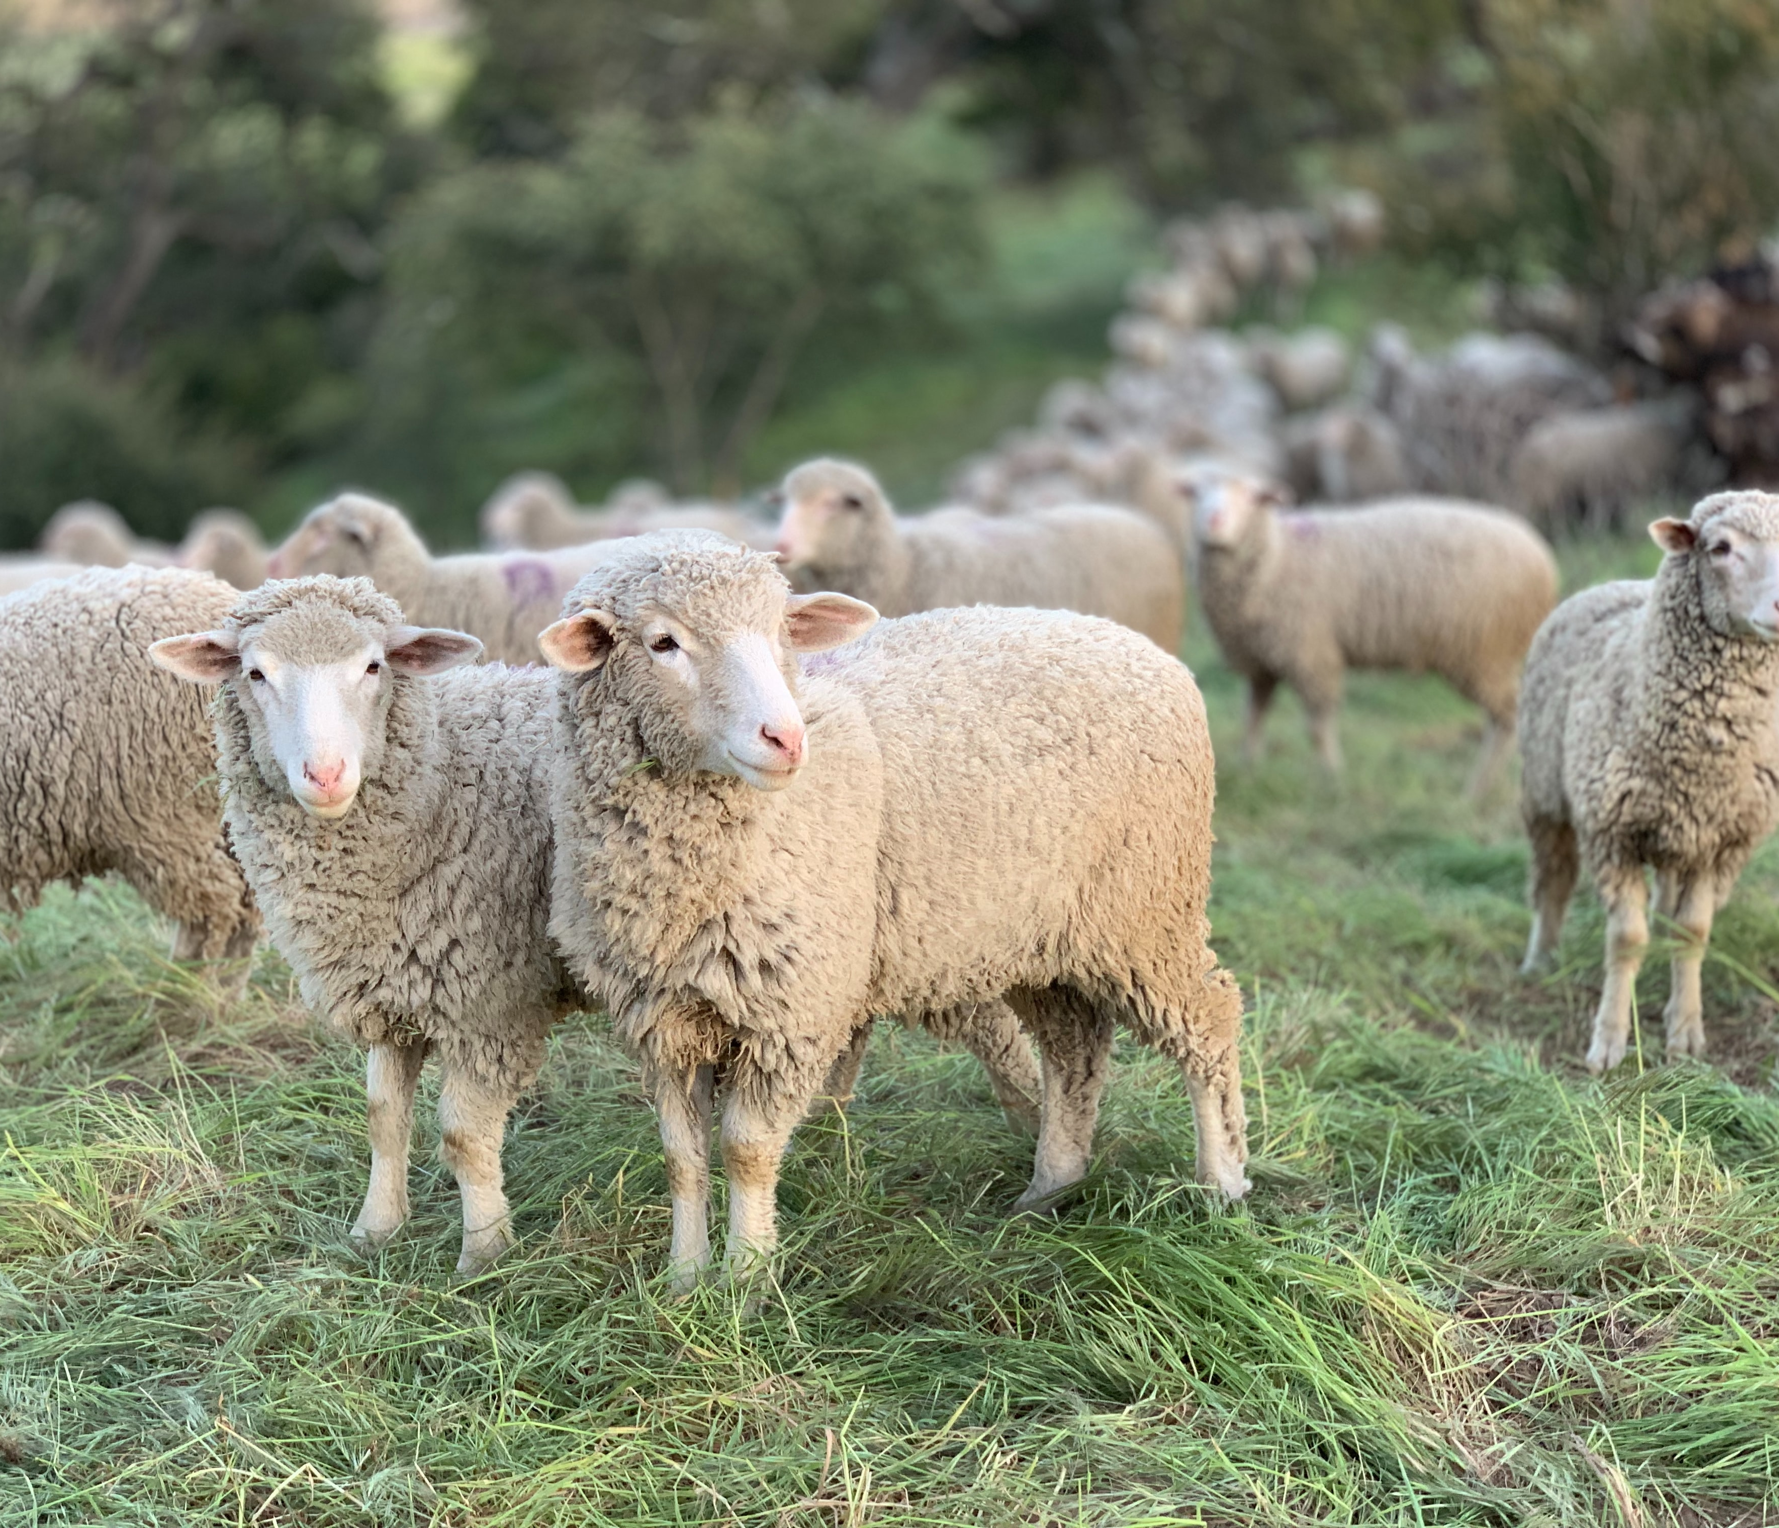
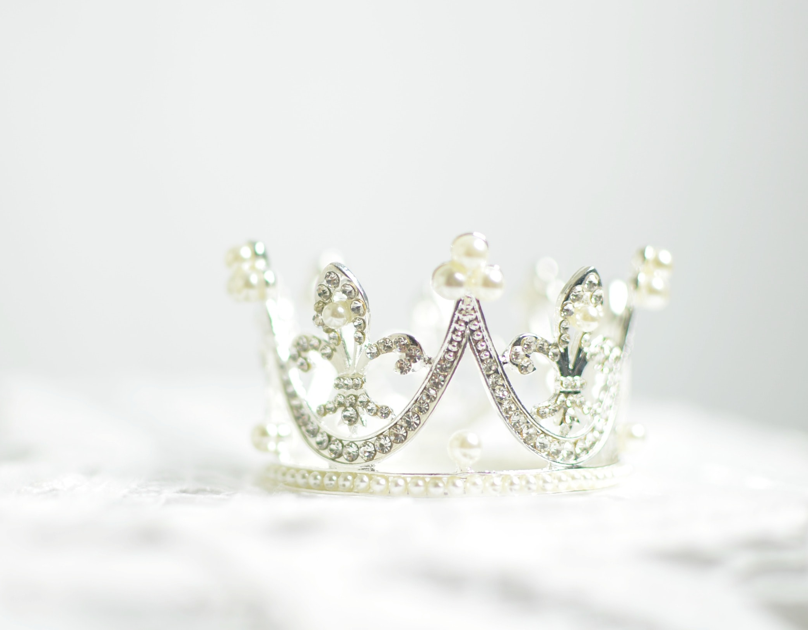
From Shepherd…
To King…

Slide 11
Jesus is the
perfect
king

