Slide 1
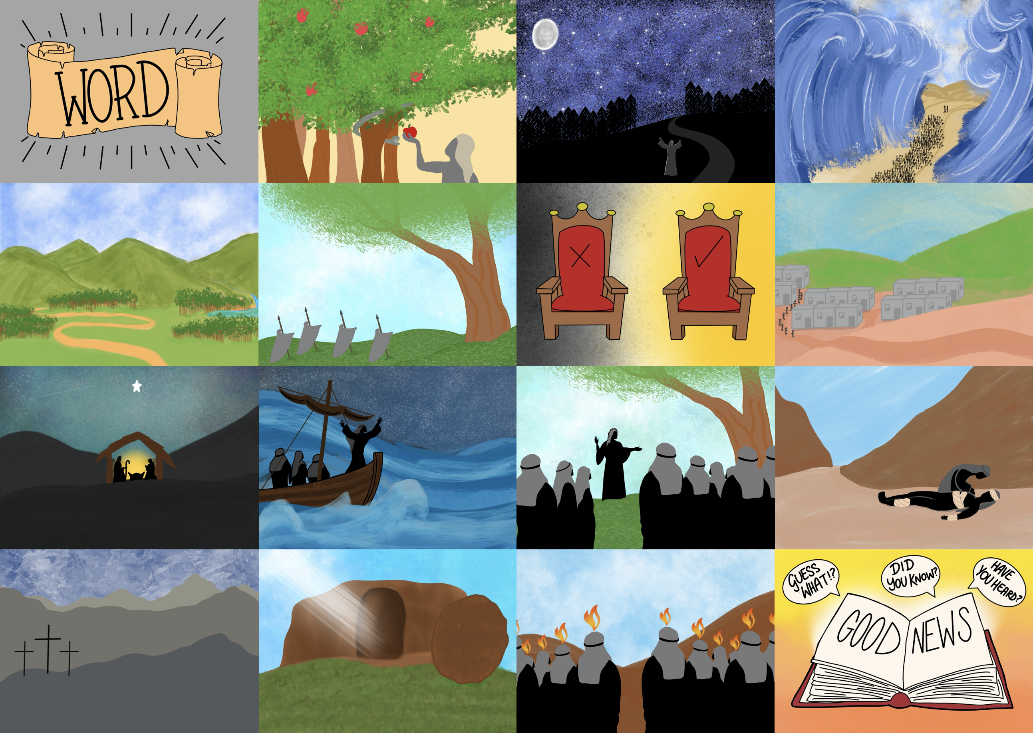

Slide 4
to spread the Good News until He comes again!

Slide 5
The first Christians told others about Jesus

Slide 7
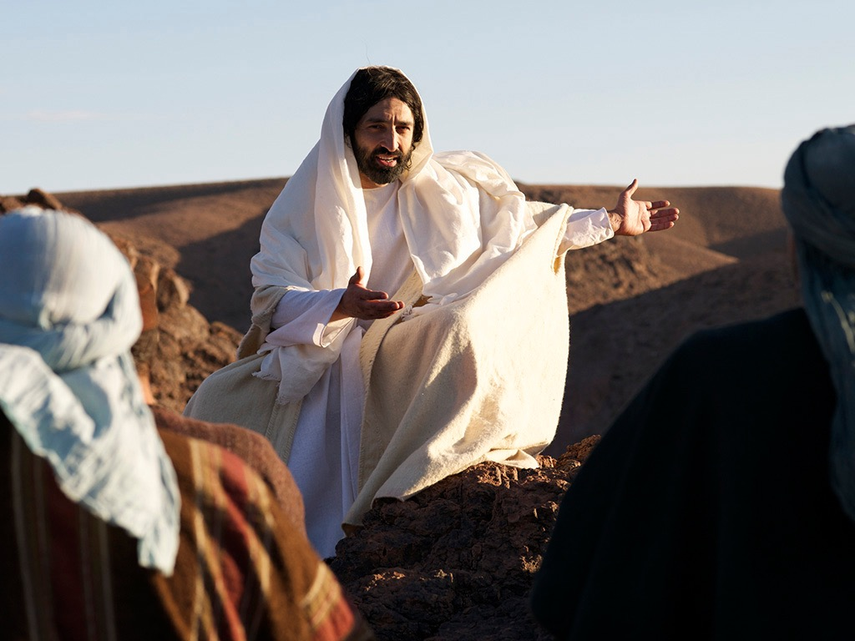
“But the Holy Spirit will come upon you and give you power.
Then you will tell everyone about me in Jerusalem, in all Judea, in Samaria, and everywhere in the world.”
Acts 1:8

Slide 9
Insert pictures of ways your church helps to share the Good News about Jesus with others here

