Slide 4
He died on a cross so our sins can be forgiven,

Slide 5
Jesus came to show His love, not His power

Slide 8
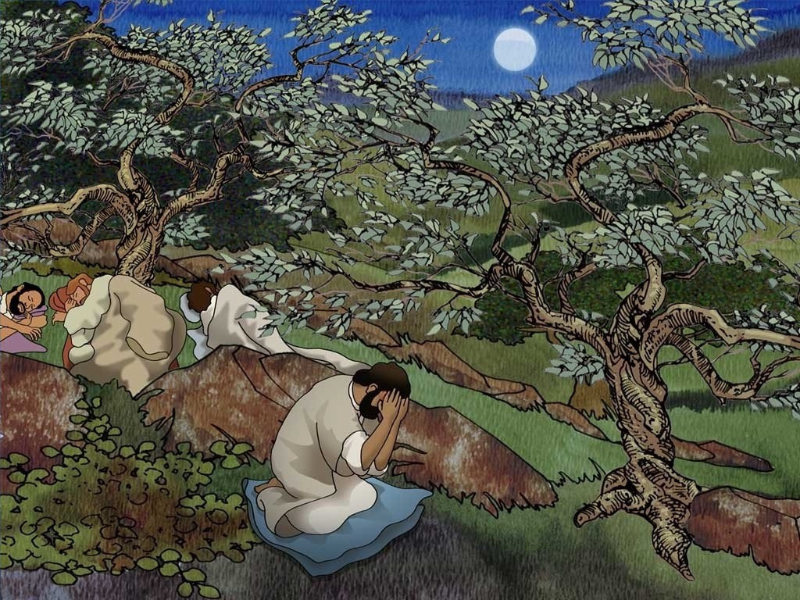

Slide 9
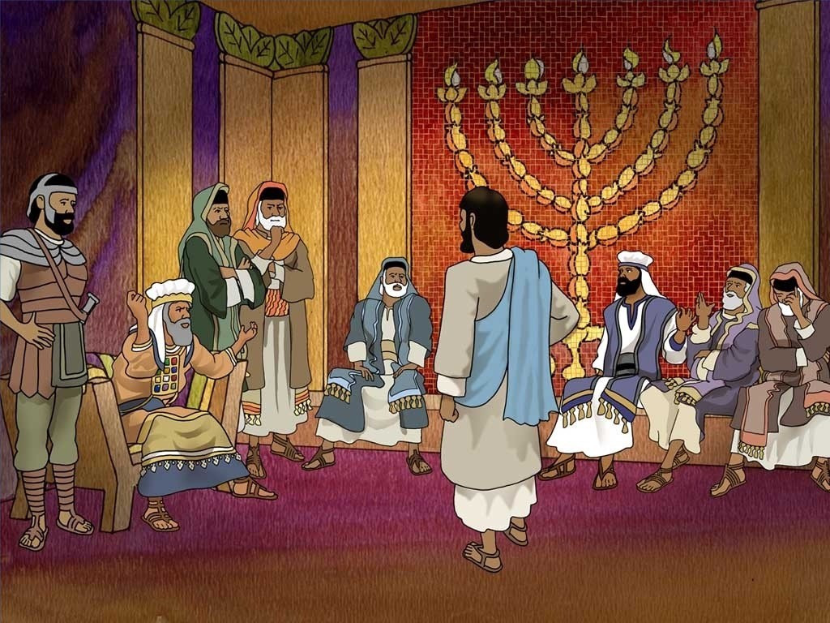

Slide 10
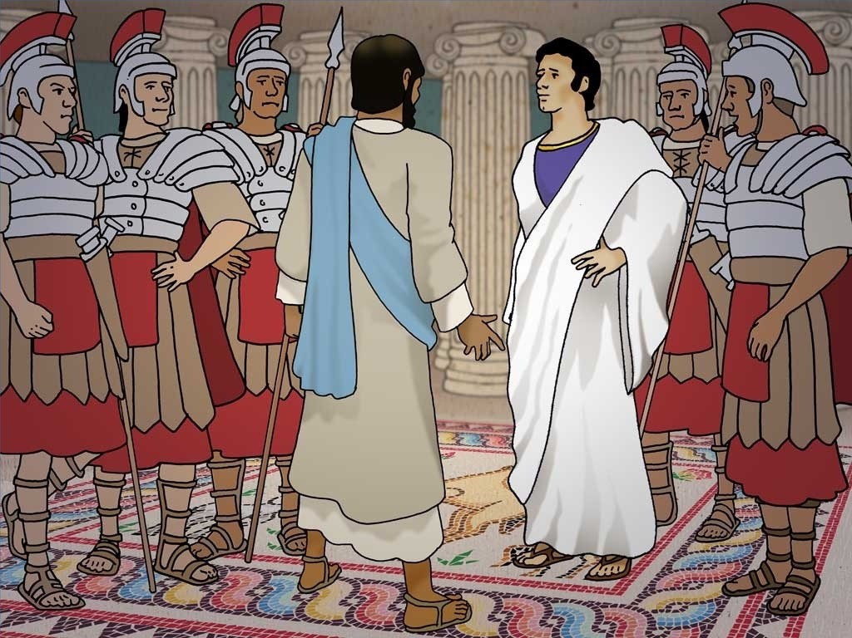

Slide 11
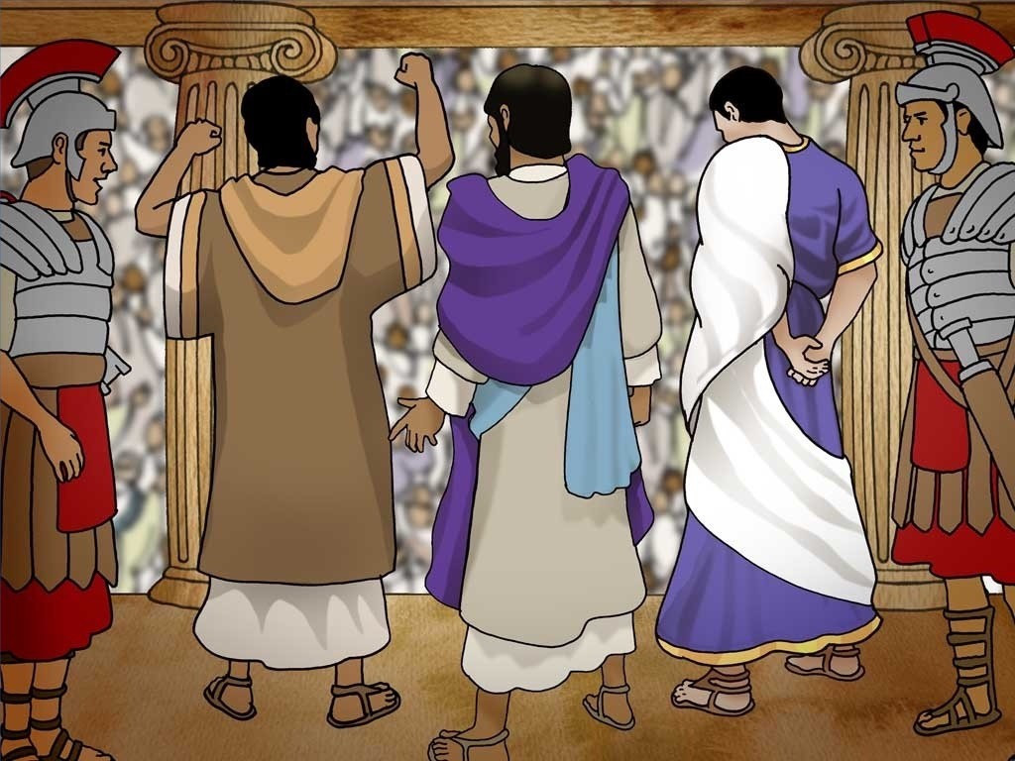

Slide 12
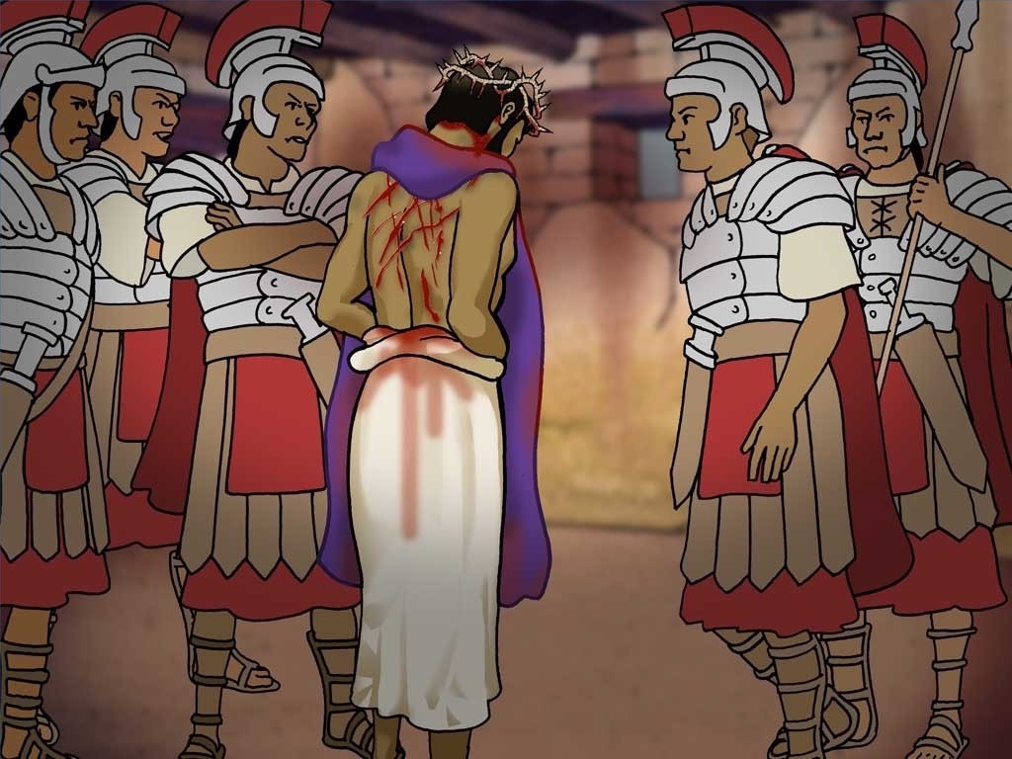

Slide 13
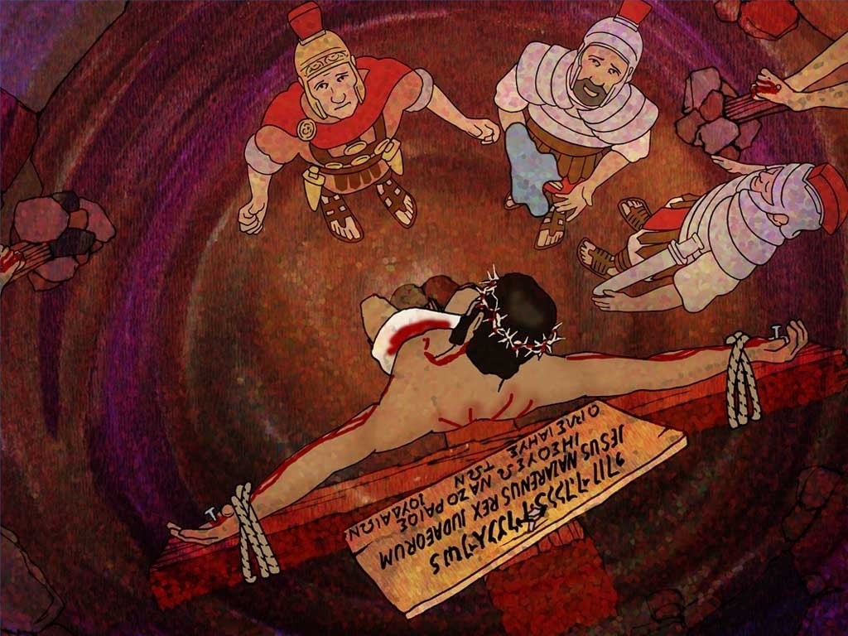

Slide 14
God loved the people of this world so much that he gave his only Son,
so that everyone who has faith in him will have eternal life…
John 3:16

