Slide 1
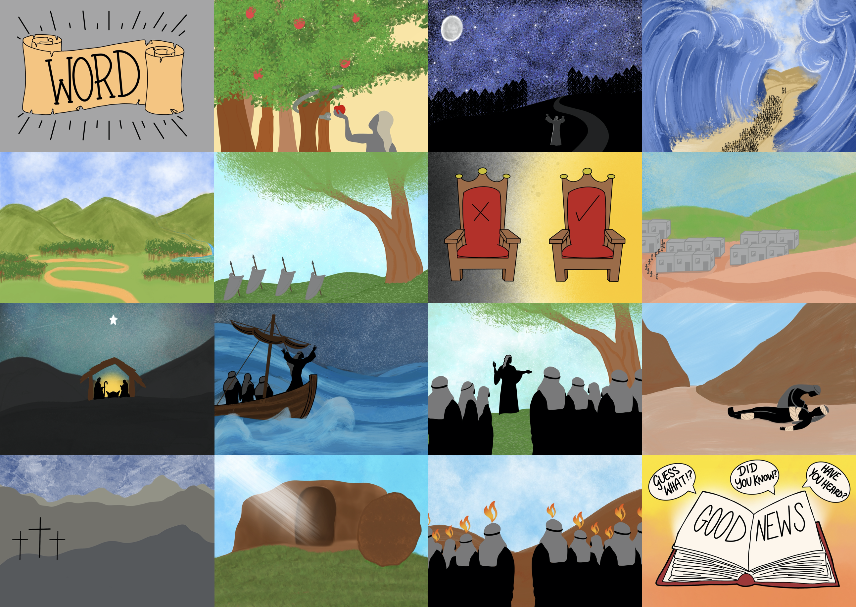



Slide 3


Slide 4
He died on a cross so our sins can be forgiven,

Slide 5
Jesus came to serve, not to be served

Slide 7
UGH!!

Slide 8
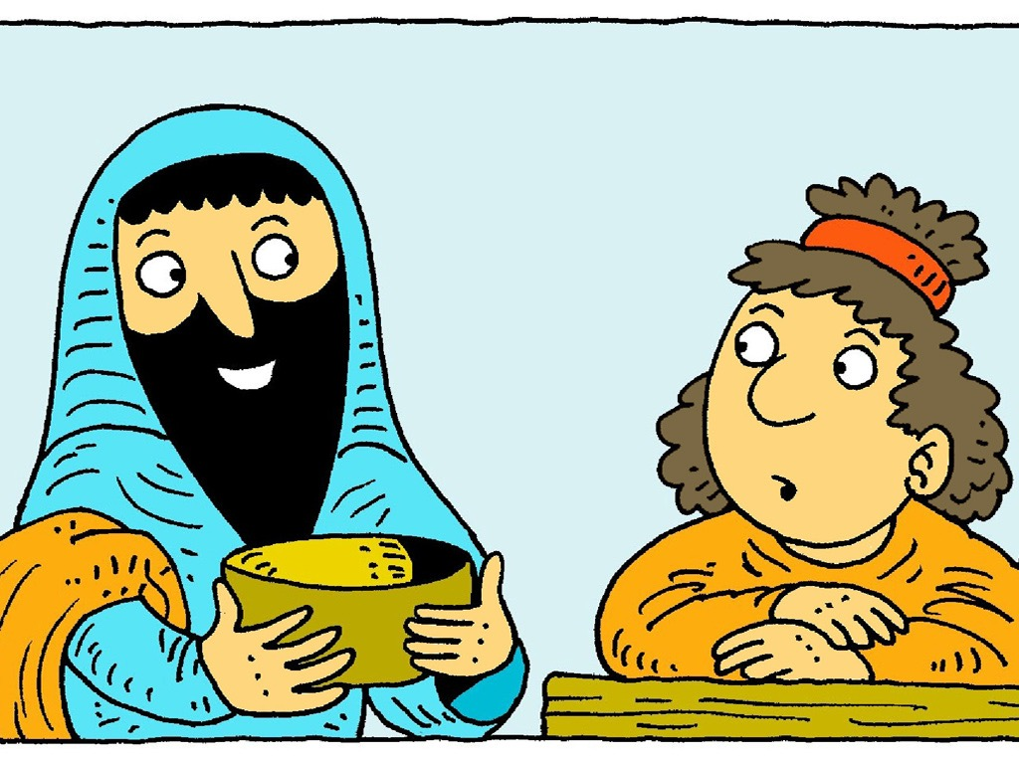

Slide 9
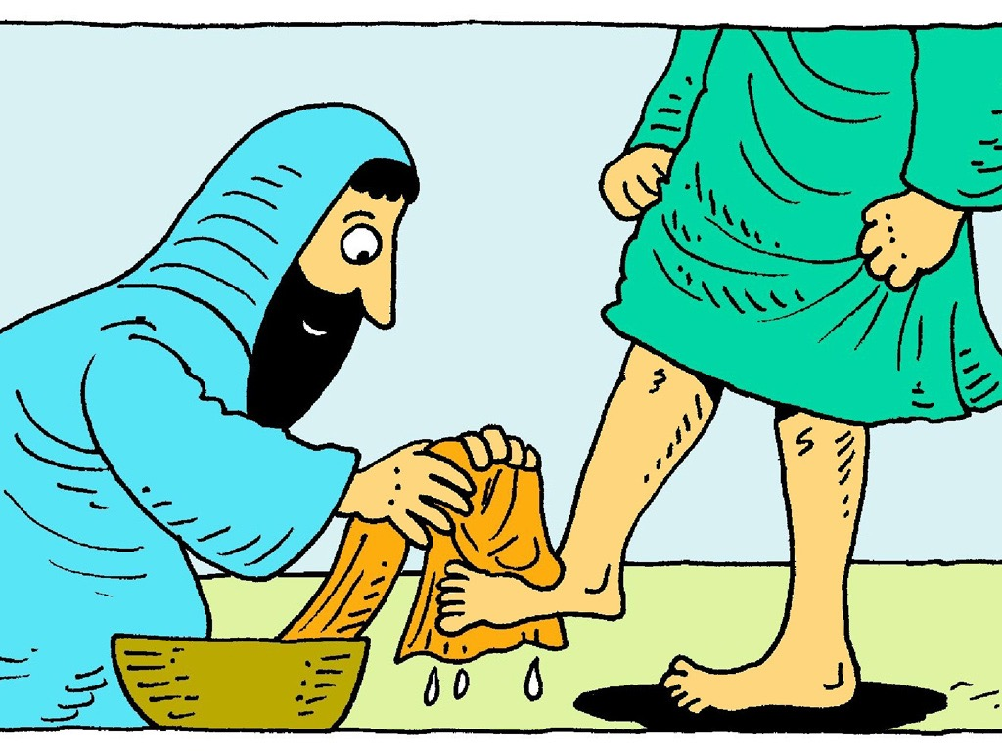

Slide 10

I have set you an example that you should do as I have done for you.
John 13:15

