Slide 1
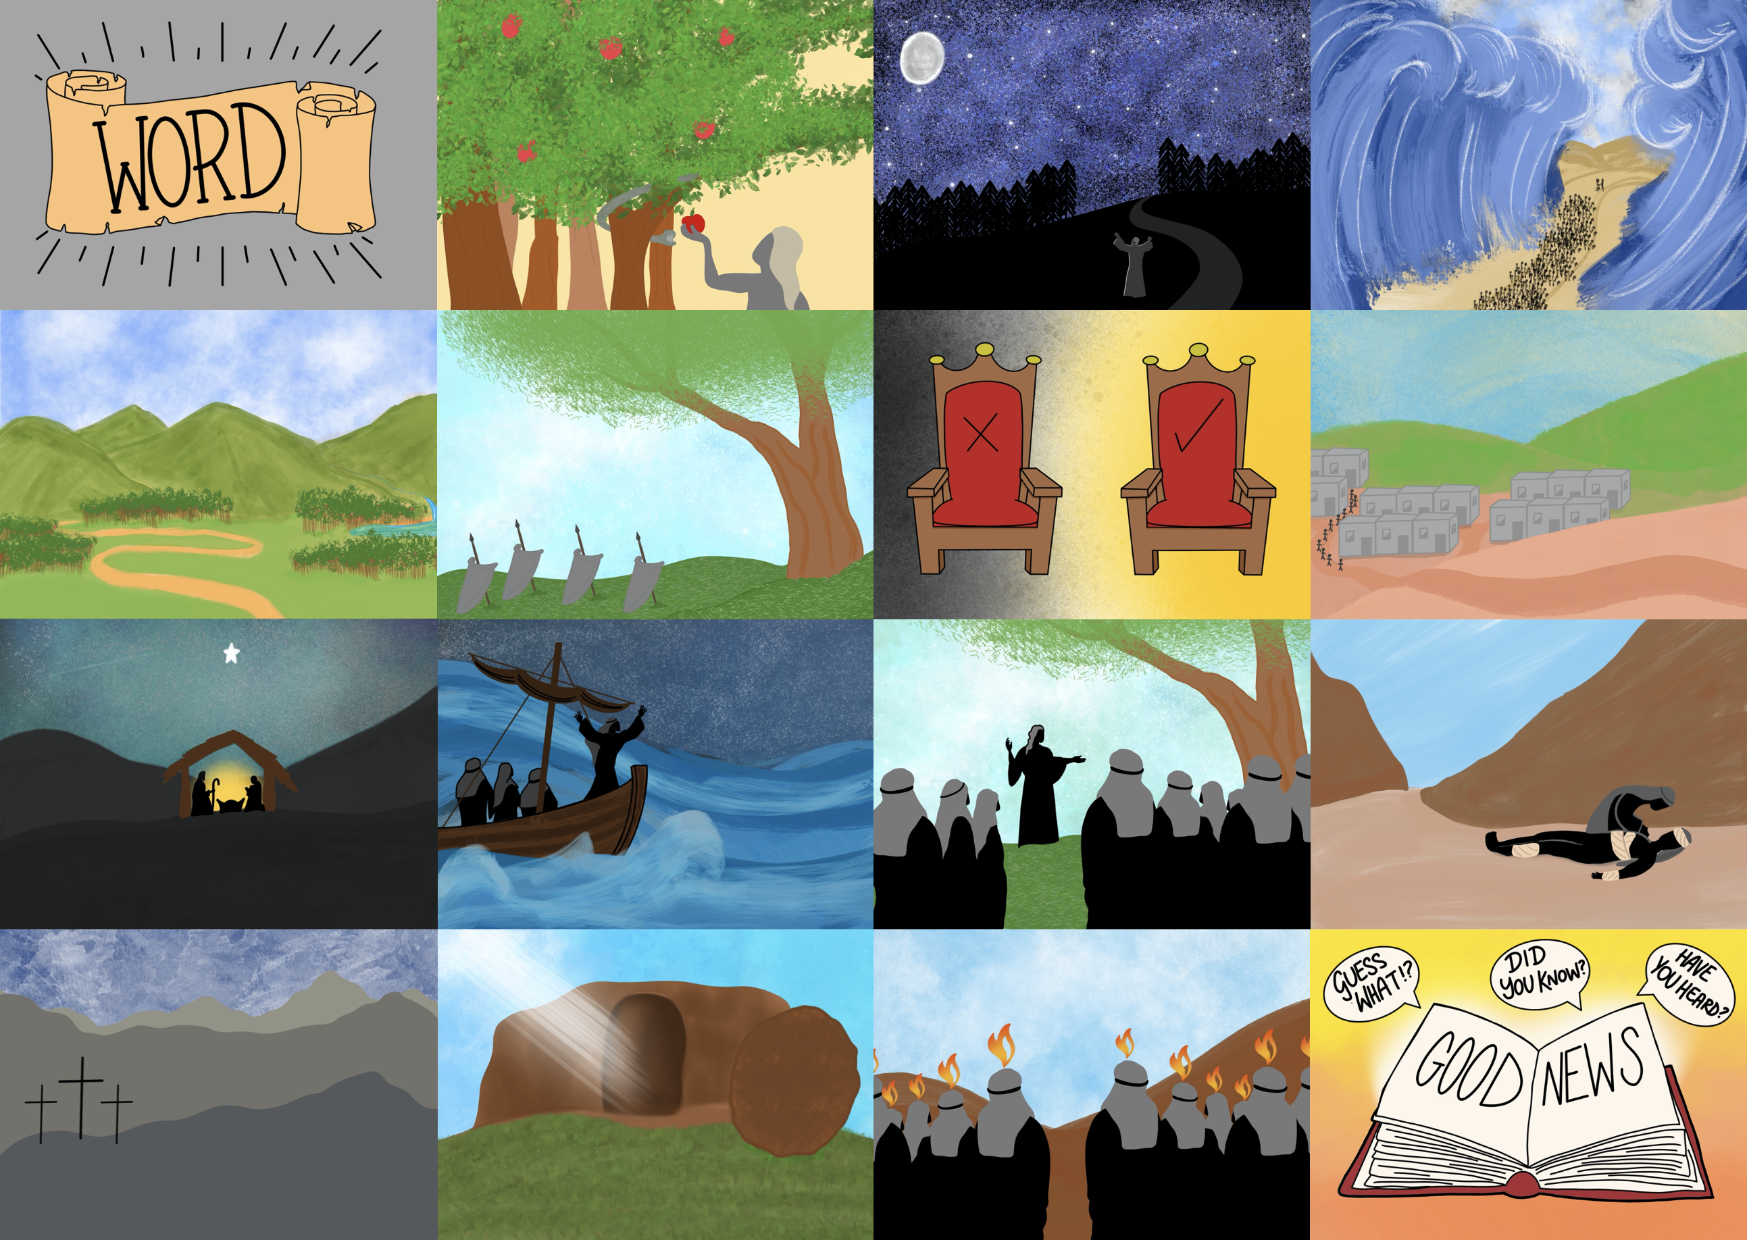

Slide 3
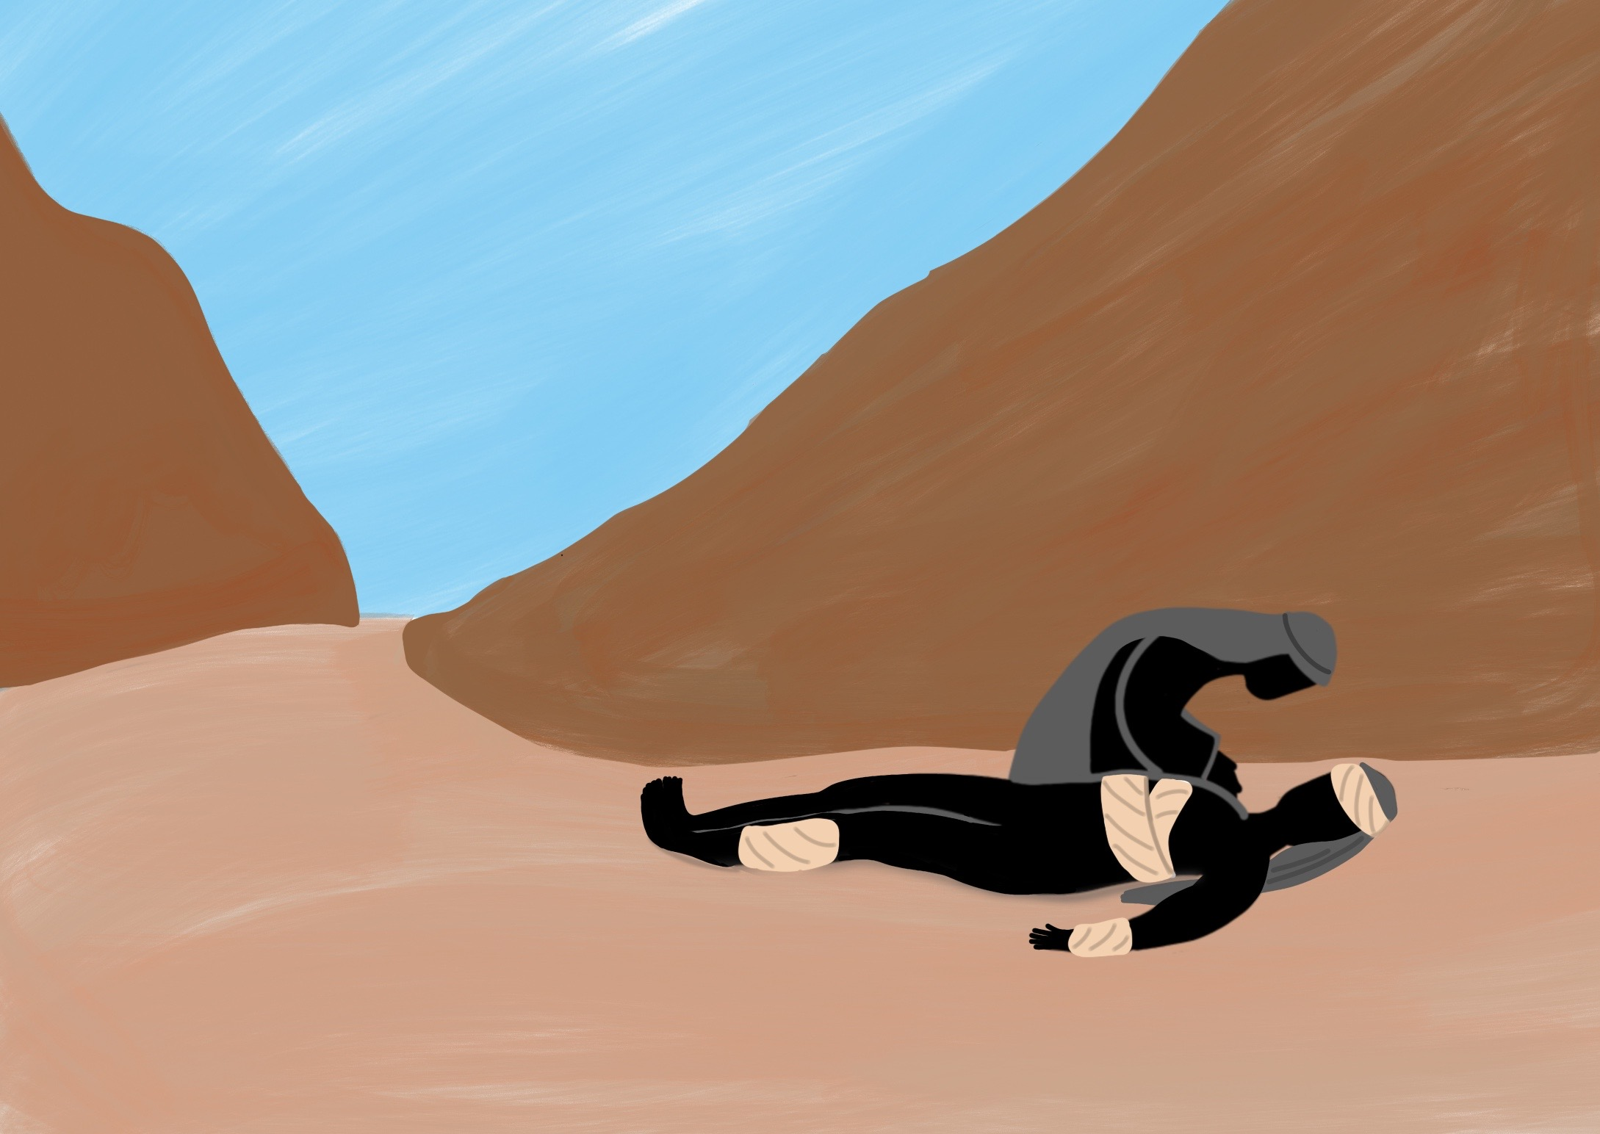

Slide 4
He taught us His way and He showed us His love.

Slide 5
Jesus taught us to live God’s way

Slide 10
Everyone who hears my words and obeys them is like a wise man who built his house on rock.
Matthew 7: 24

