Slide 3
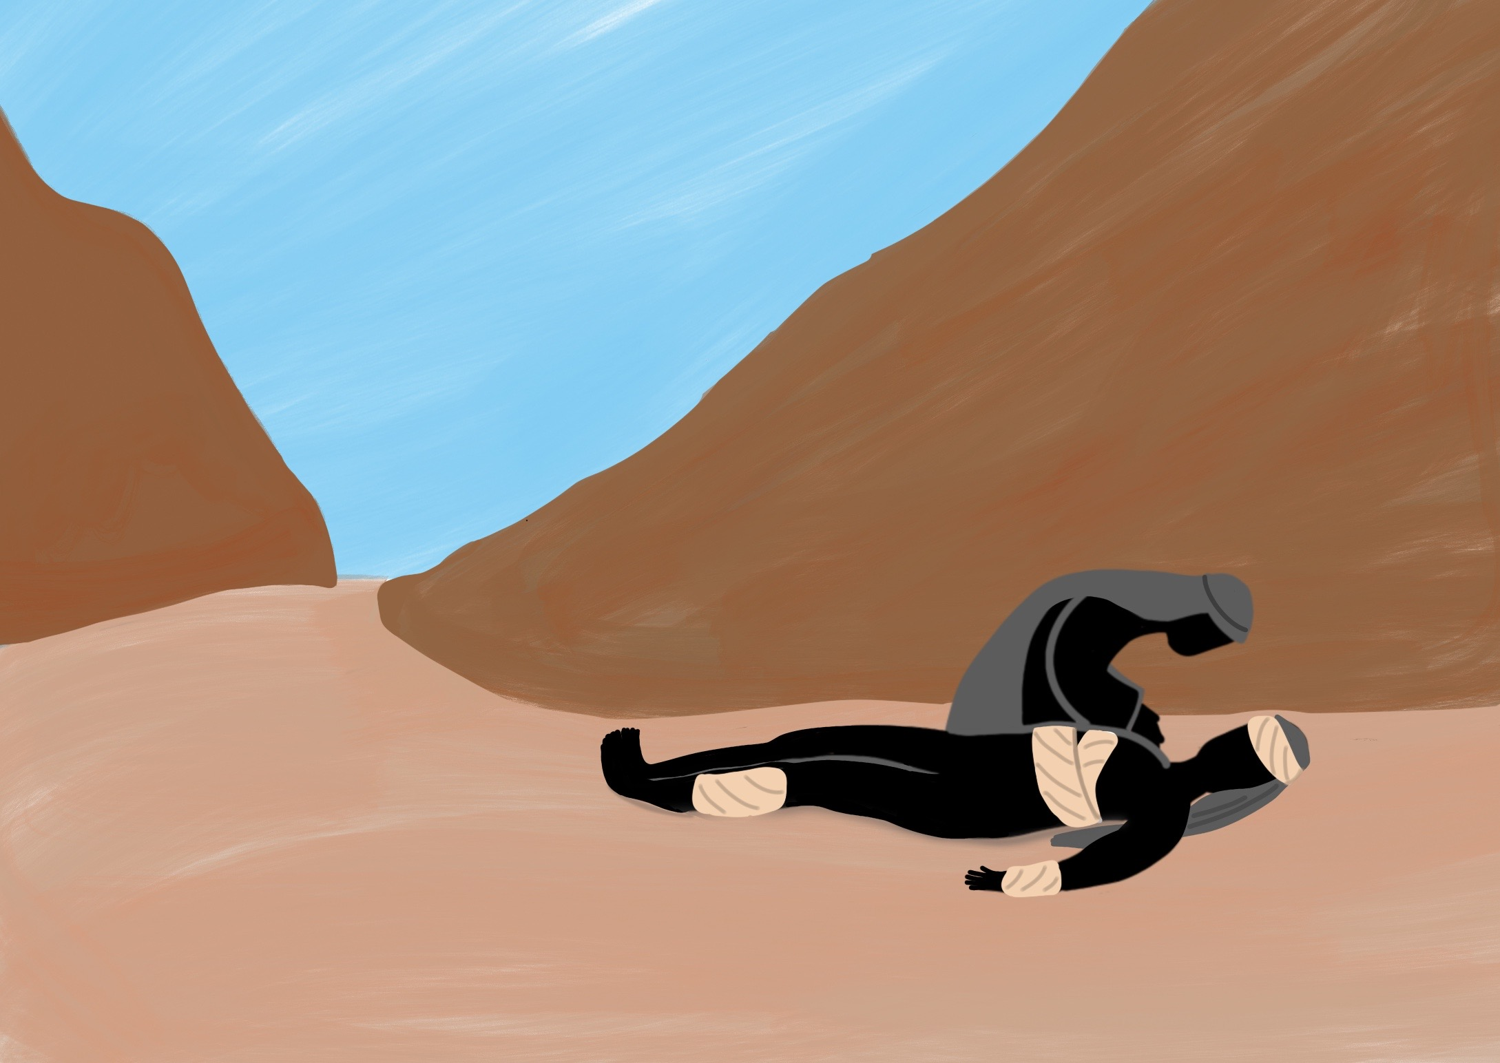

Slide 4
He taught us His way and He showed us His love.

Slide 5
Jesus taught us to forgive those who hurt us

Slide 8
How many times….
…. should I forgive someone?

Slide 9
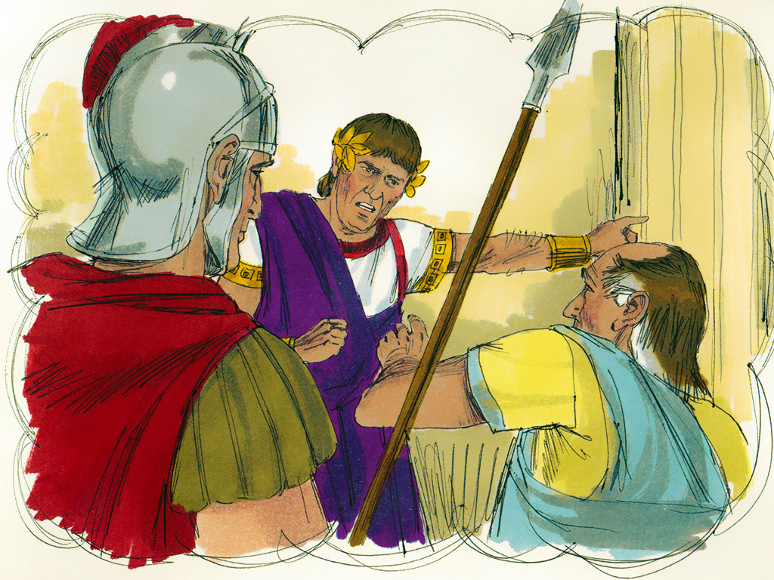

Slide 10
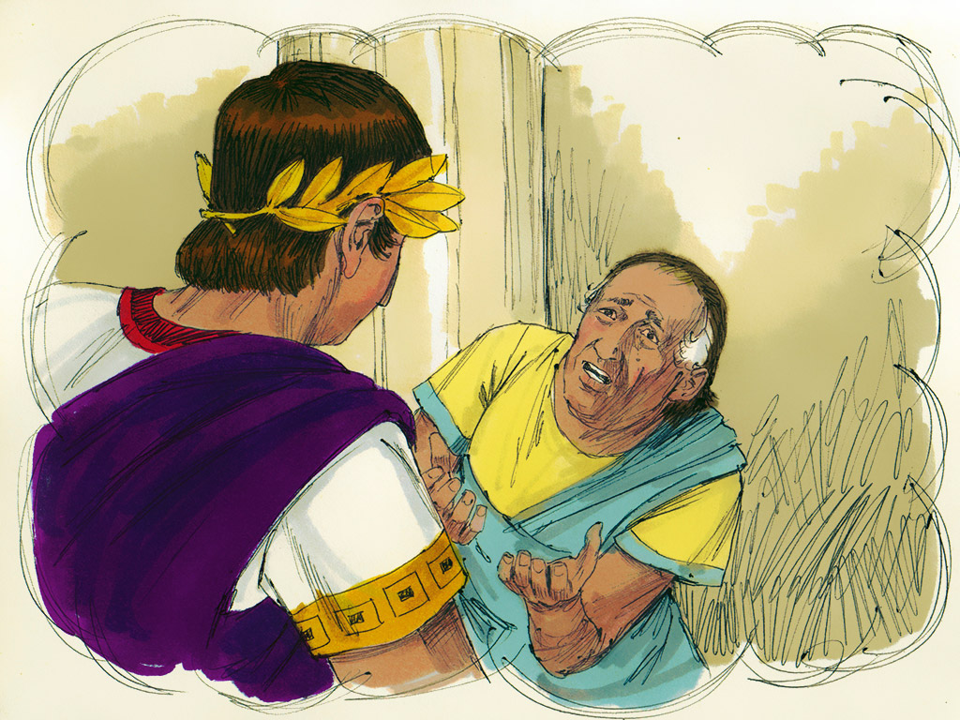

Slide 11
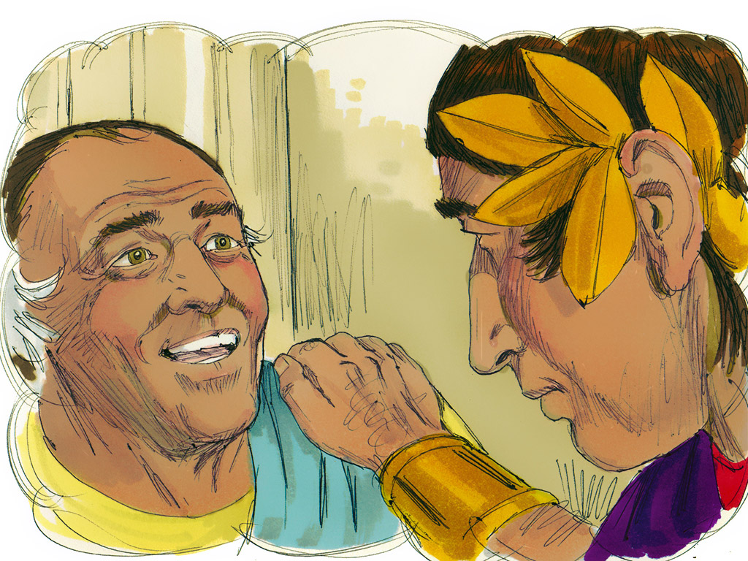

Slide 12
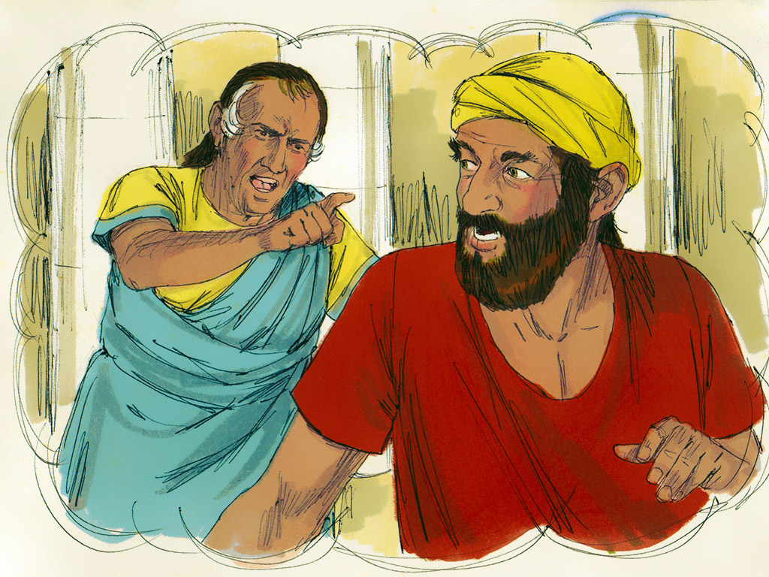

Slide 13
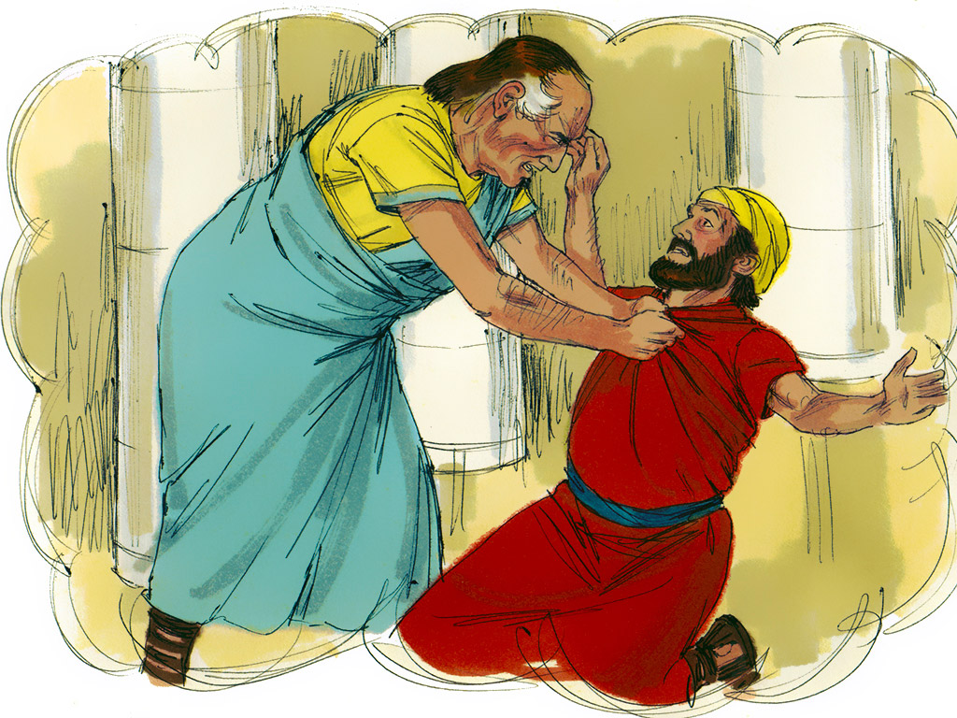

Slide 14
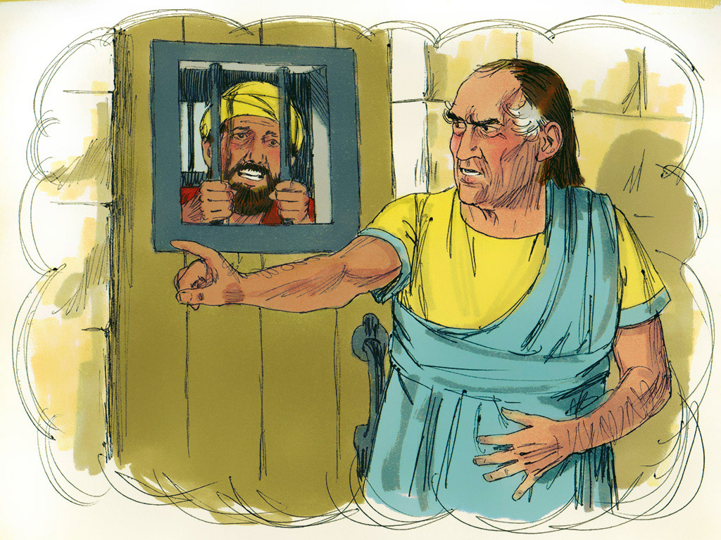

Slide 15
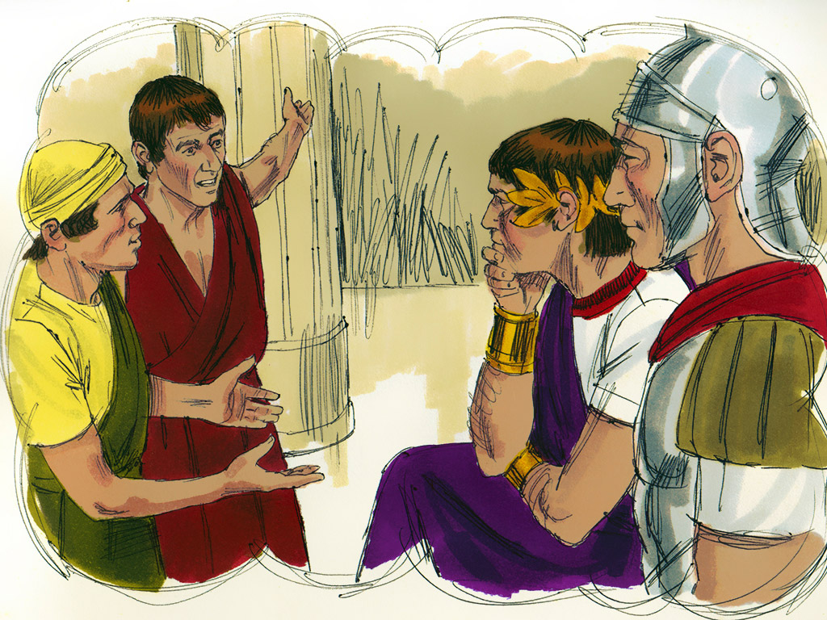

Slide 16
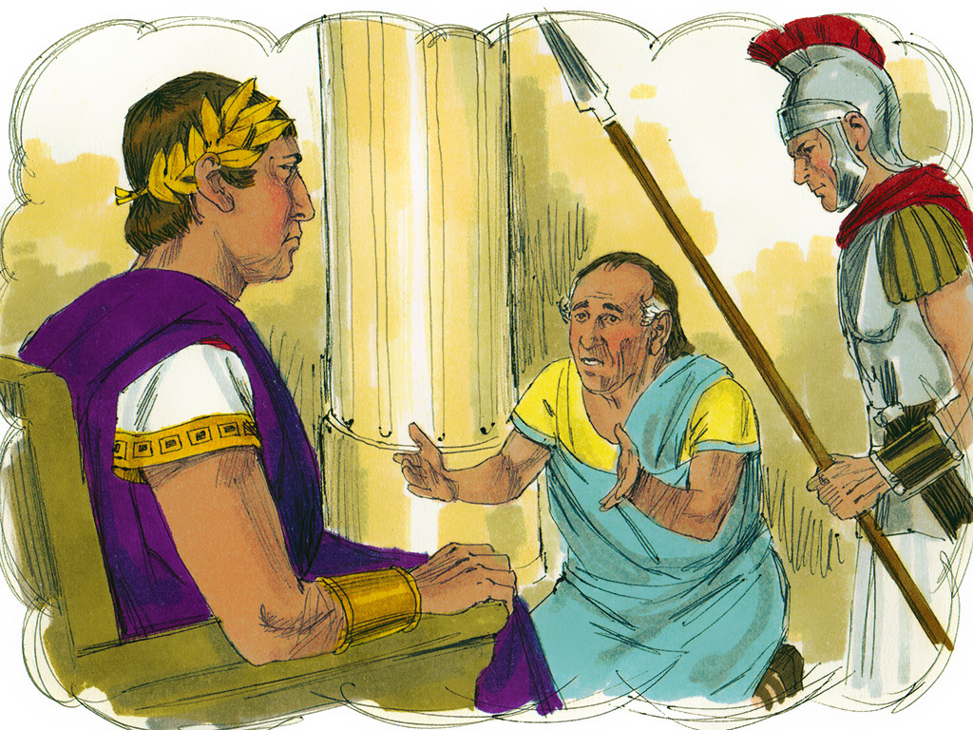

Slide 17
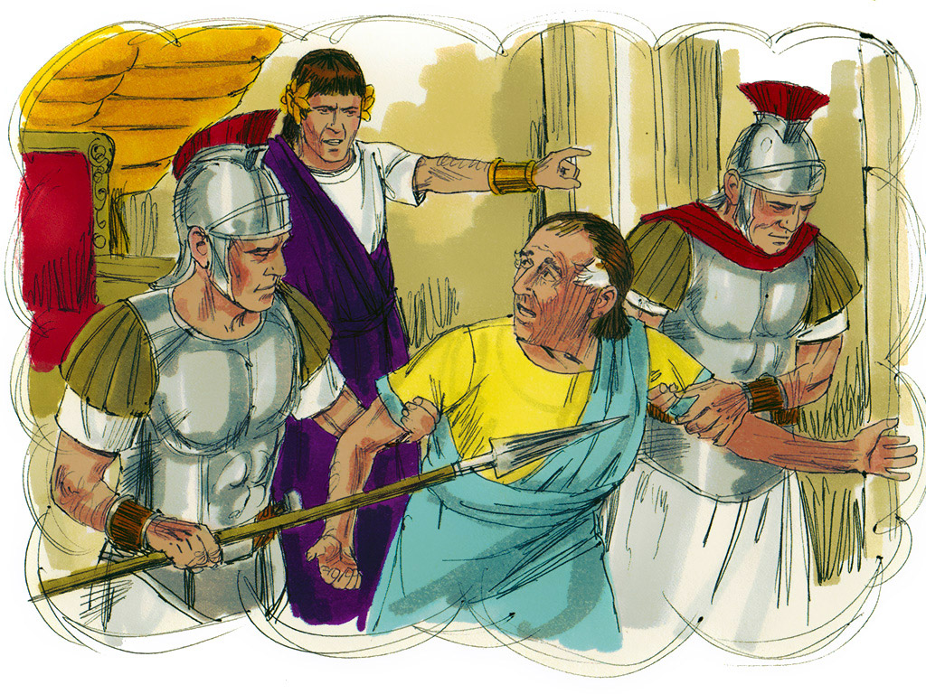

Slide 18
“Father forgive them…” Luke 23:34

Slide 19
Our angry feelings

Slide 20
Can we be friends again?

Slide 21
Jesus wants us to be forgiven

