Slide 1
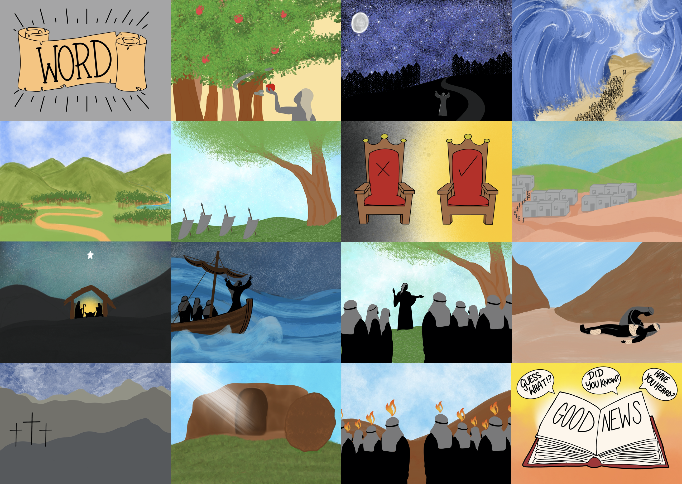



Slide 3
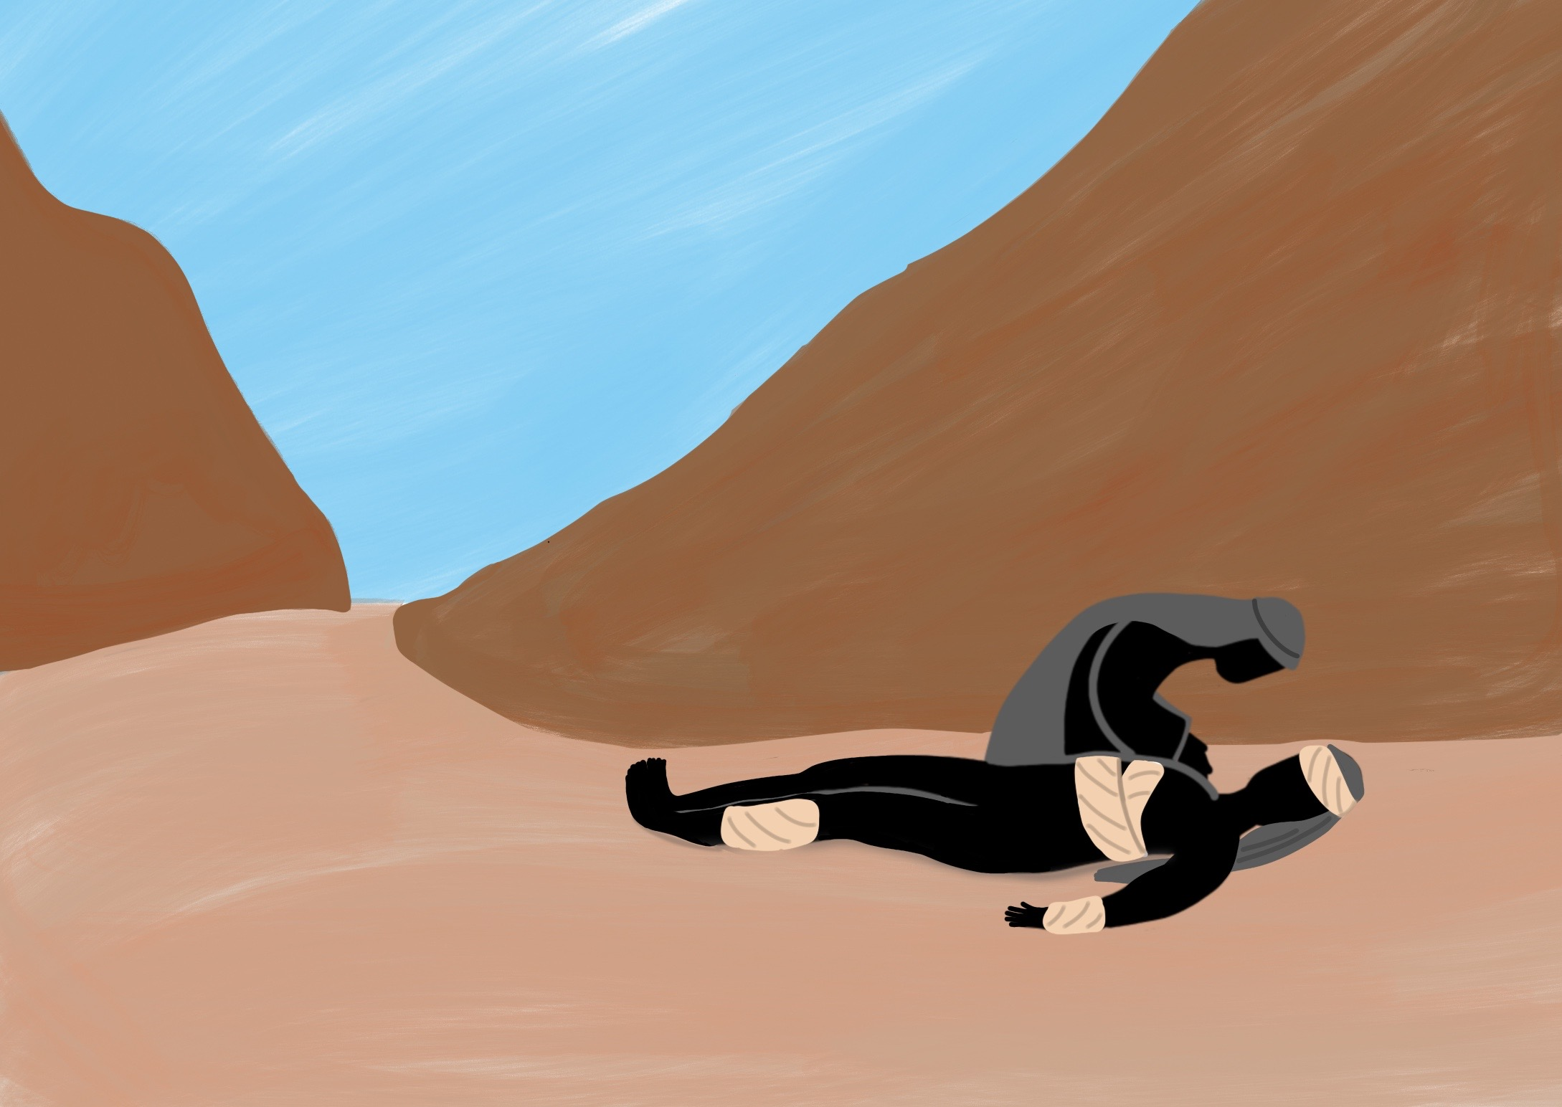

Slide 4
He taught us His way and He showed us His love.

Slide 5
Jesus taught us to love our neighbours

Slide 6
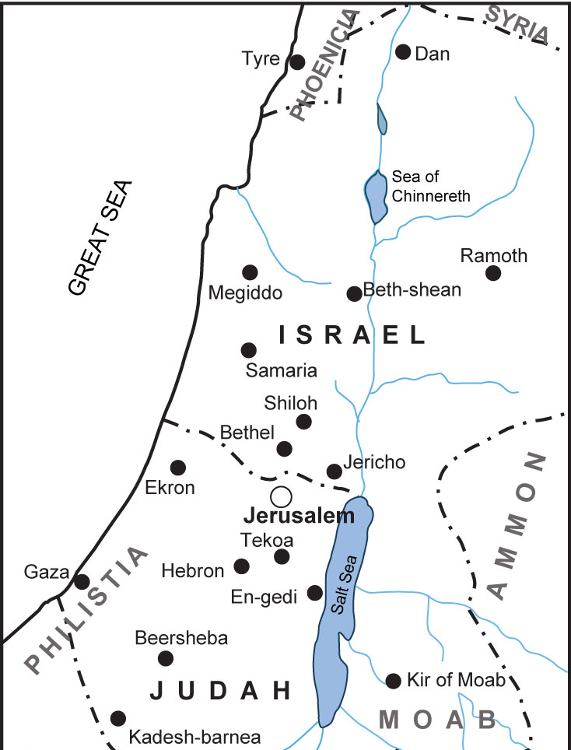
Samaritans
Oh yes
we are!
N O R T H
Jews
Oh no
you’re not!
S O U T H

Slide 7
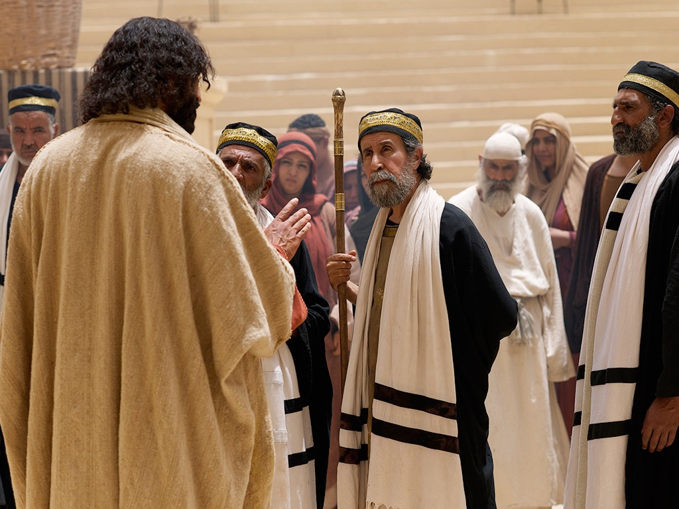

Slide 8

Love the Lord your God with all your heart,
with all your soul,
with all your mind
and with all your strength and love your neighbour
as you love yourself.
Luke 10: 27

Slide 9
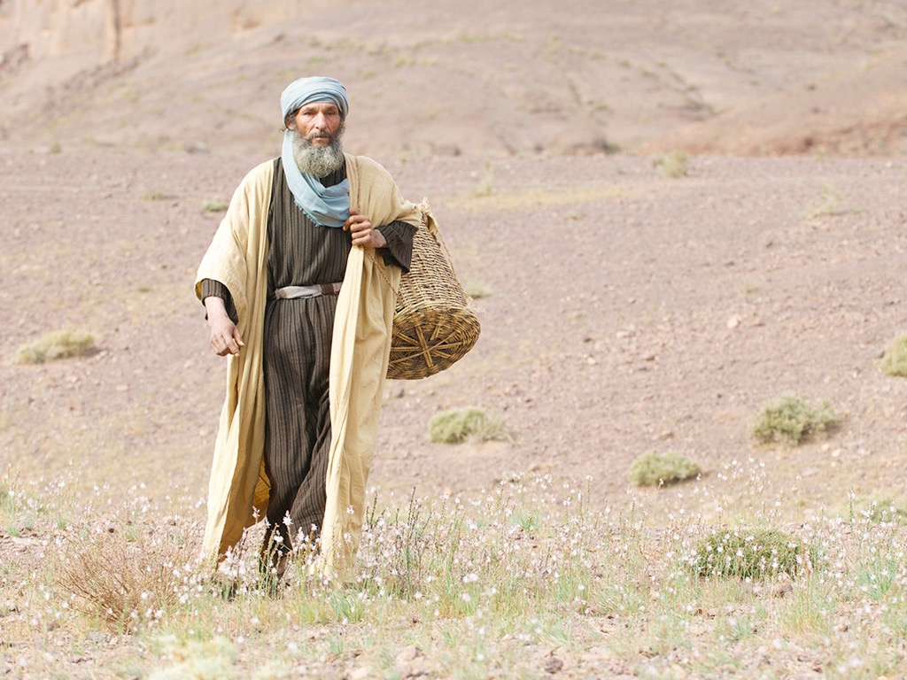

Slide 10
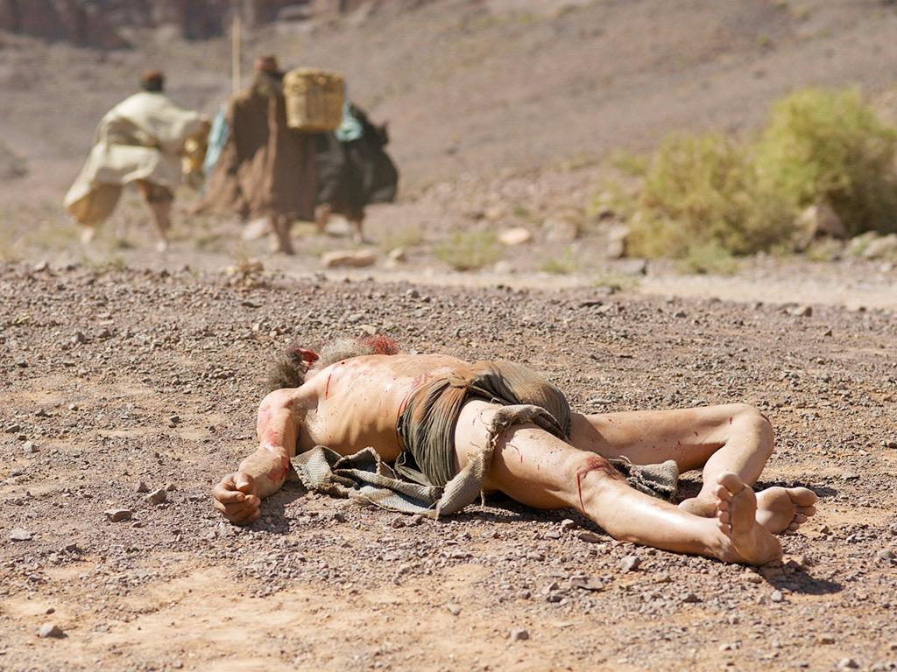

Slide 11
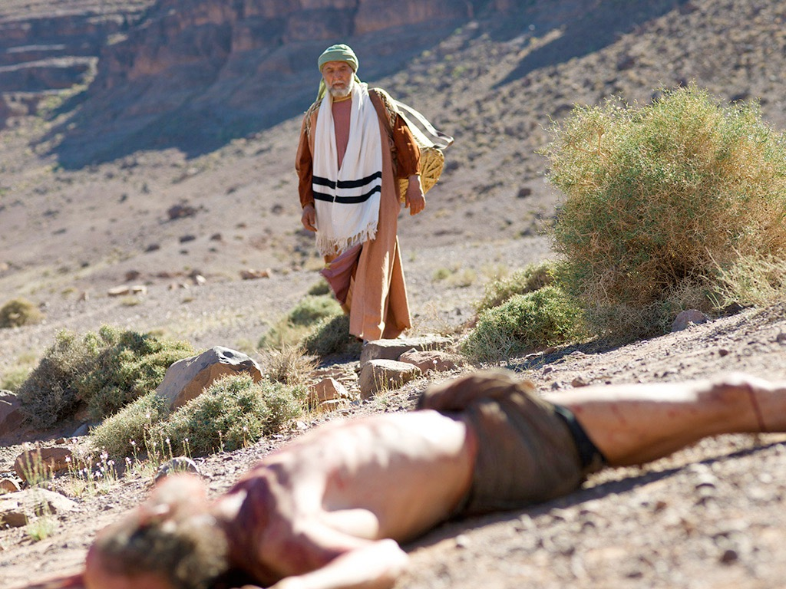

Slide 12
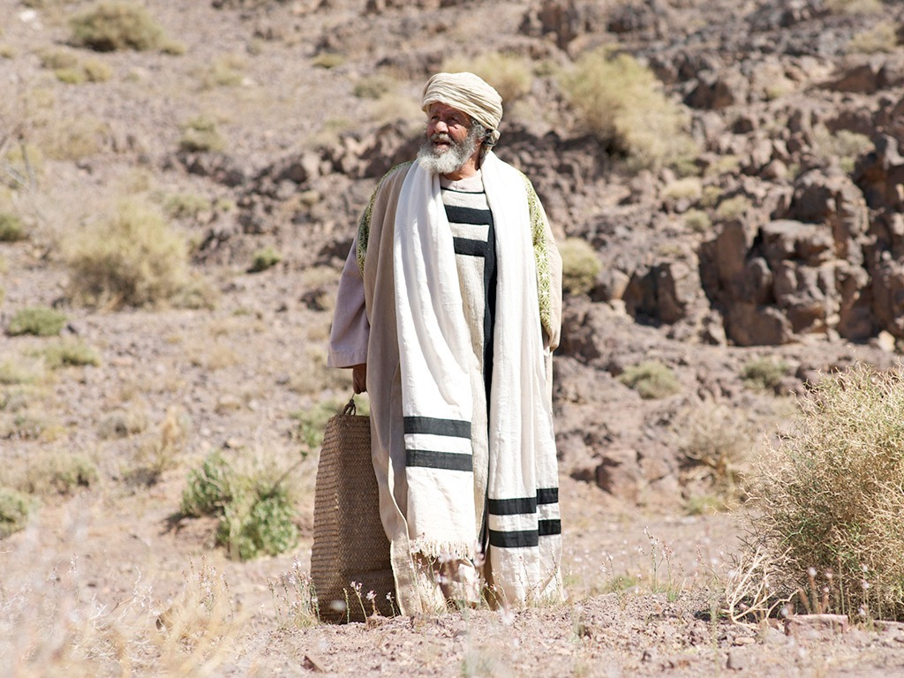

Slide 13
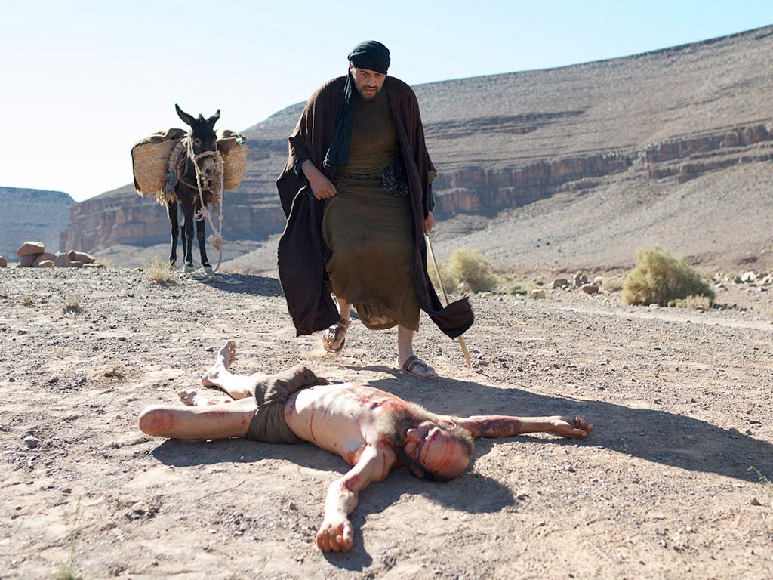

Slide 14
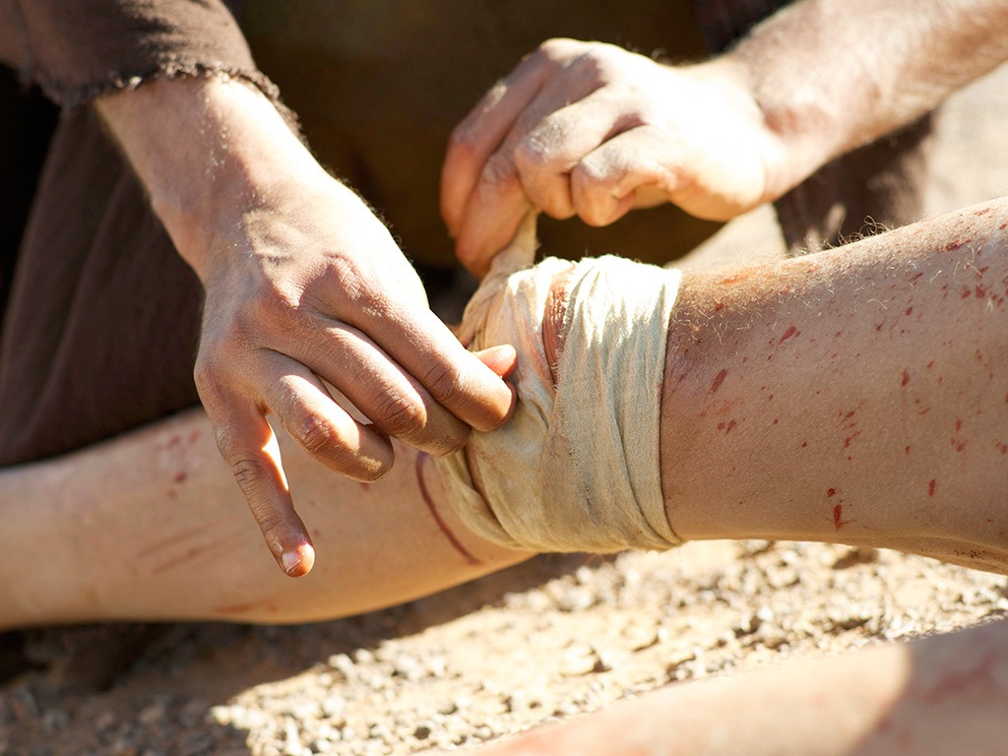

Slide 15
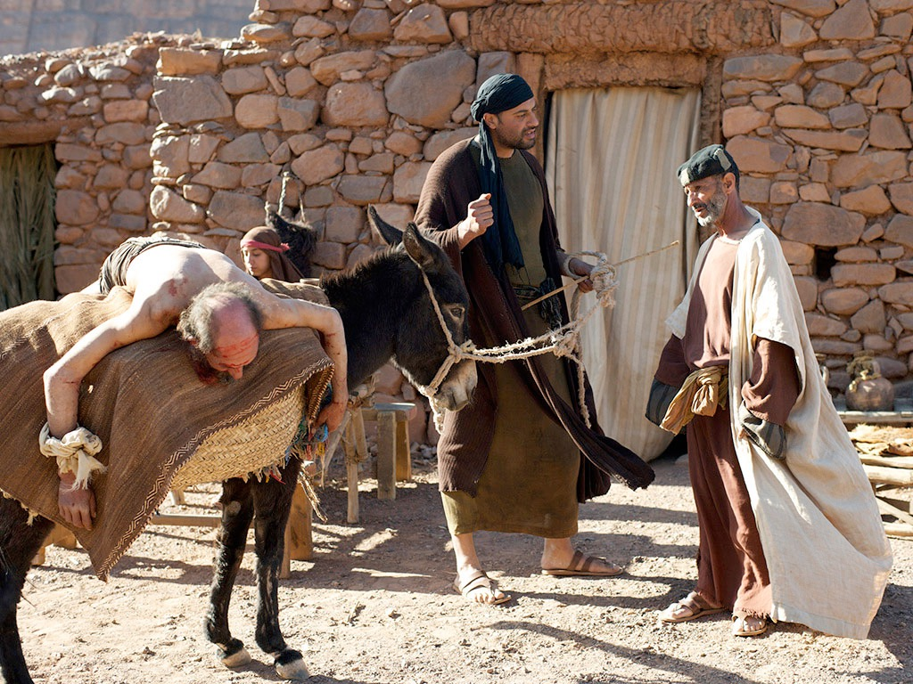

Slide 16
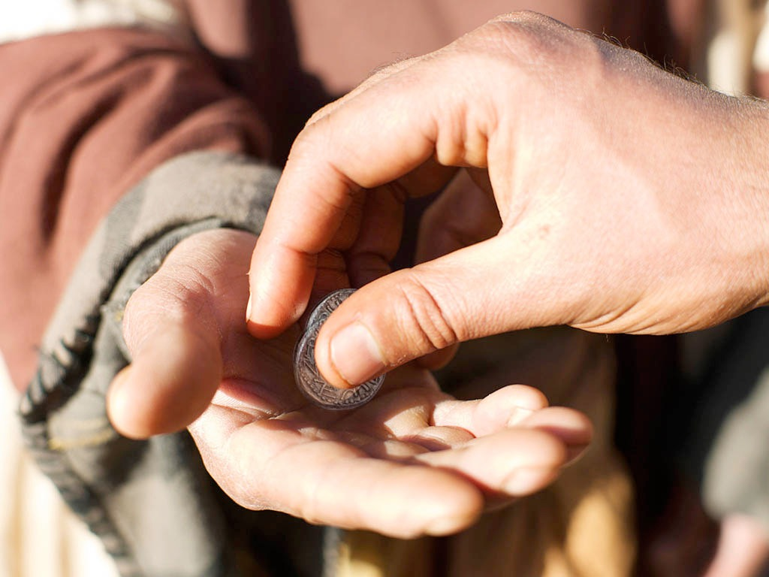

Slide 17
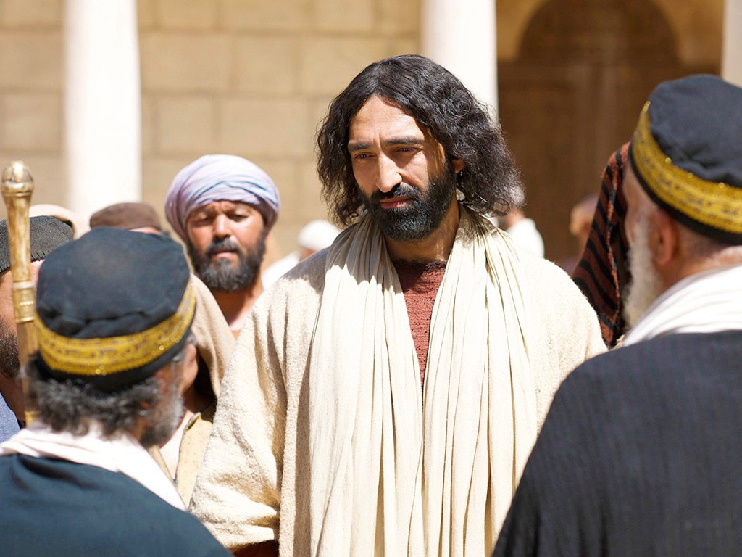

Slide 18
Love the Lord your God with all your heart,
with all your soul,
with all your mind
and with all your strength and love your neighbour
as you love yourself.
Luke 10: 27

