Slide 1
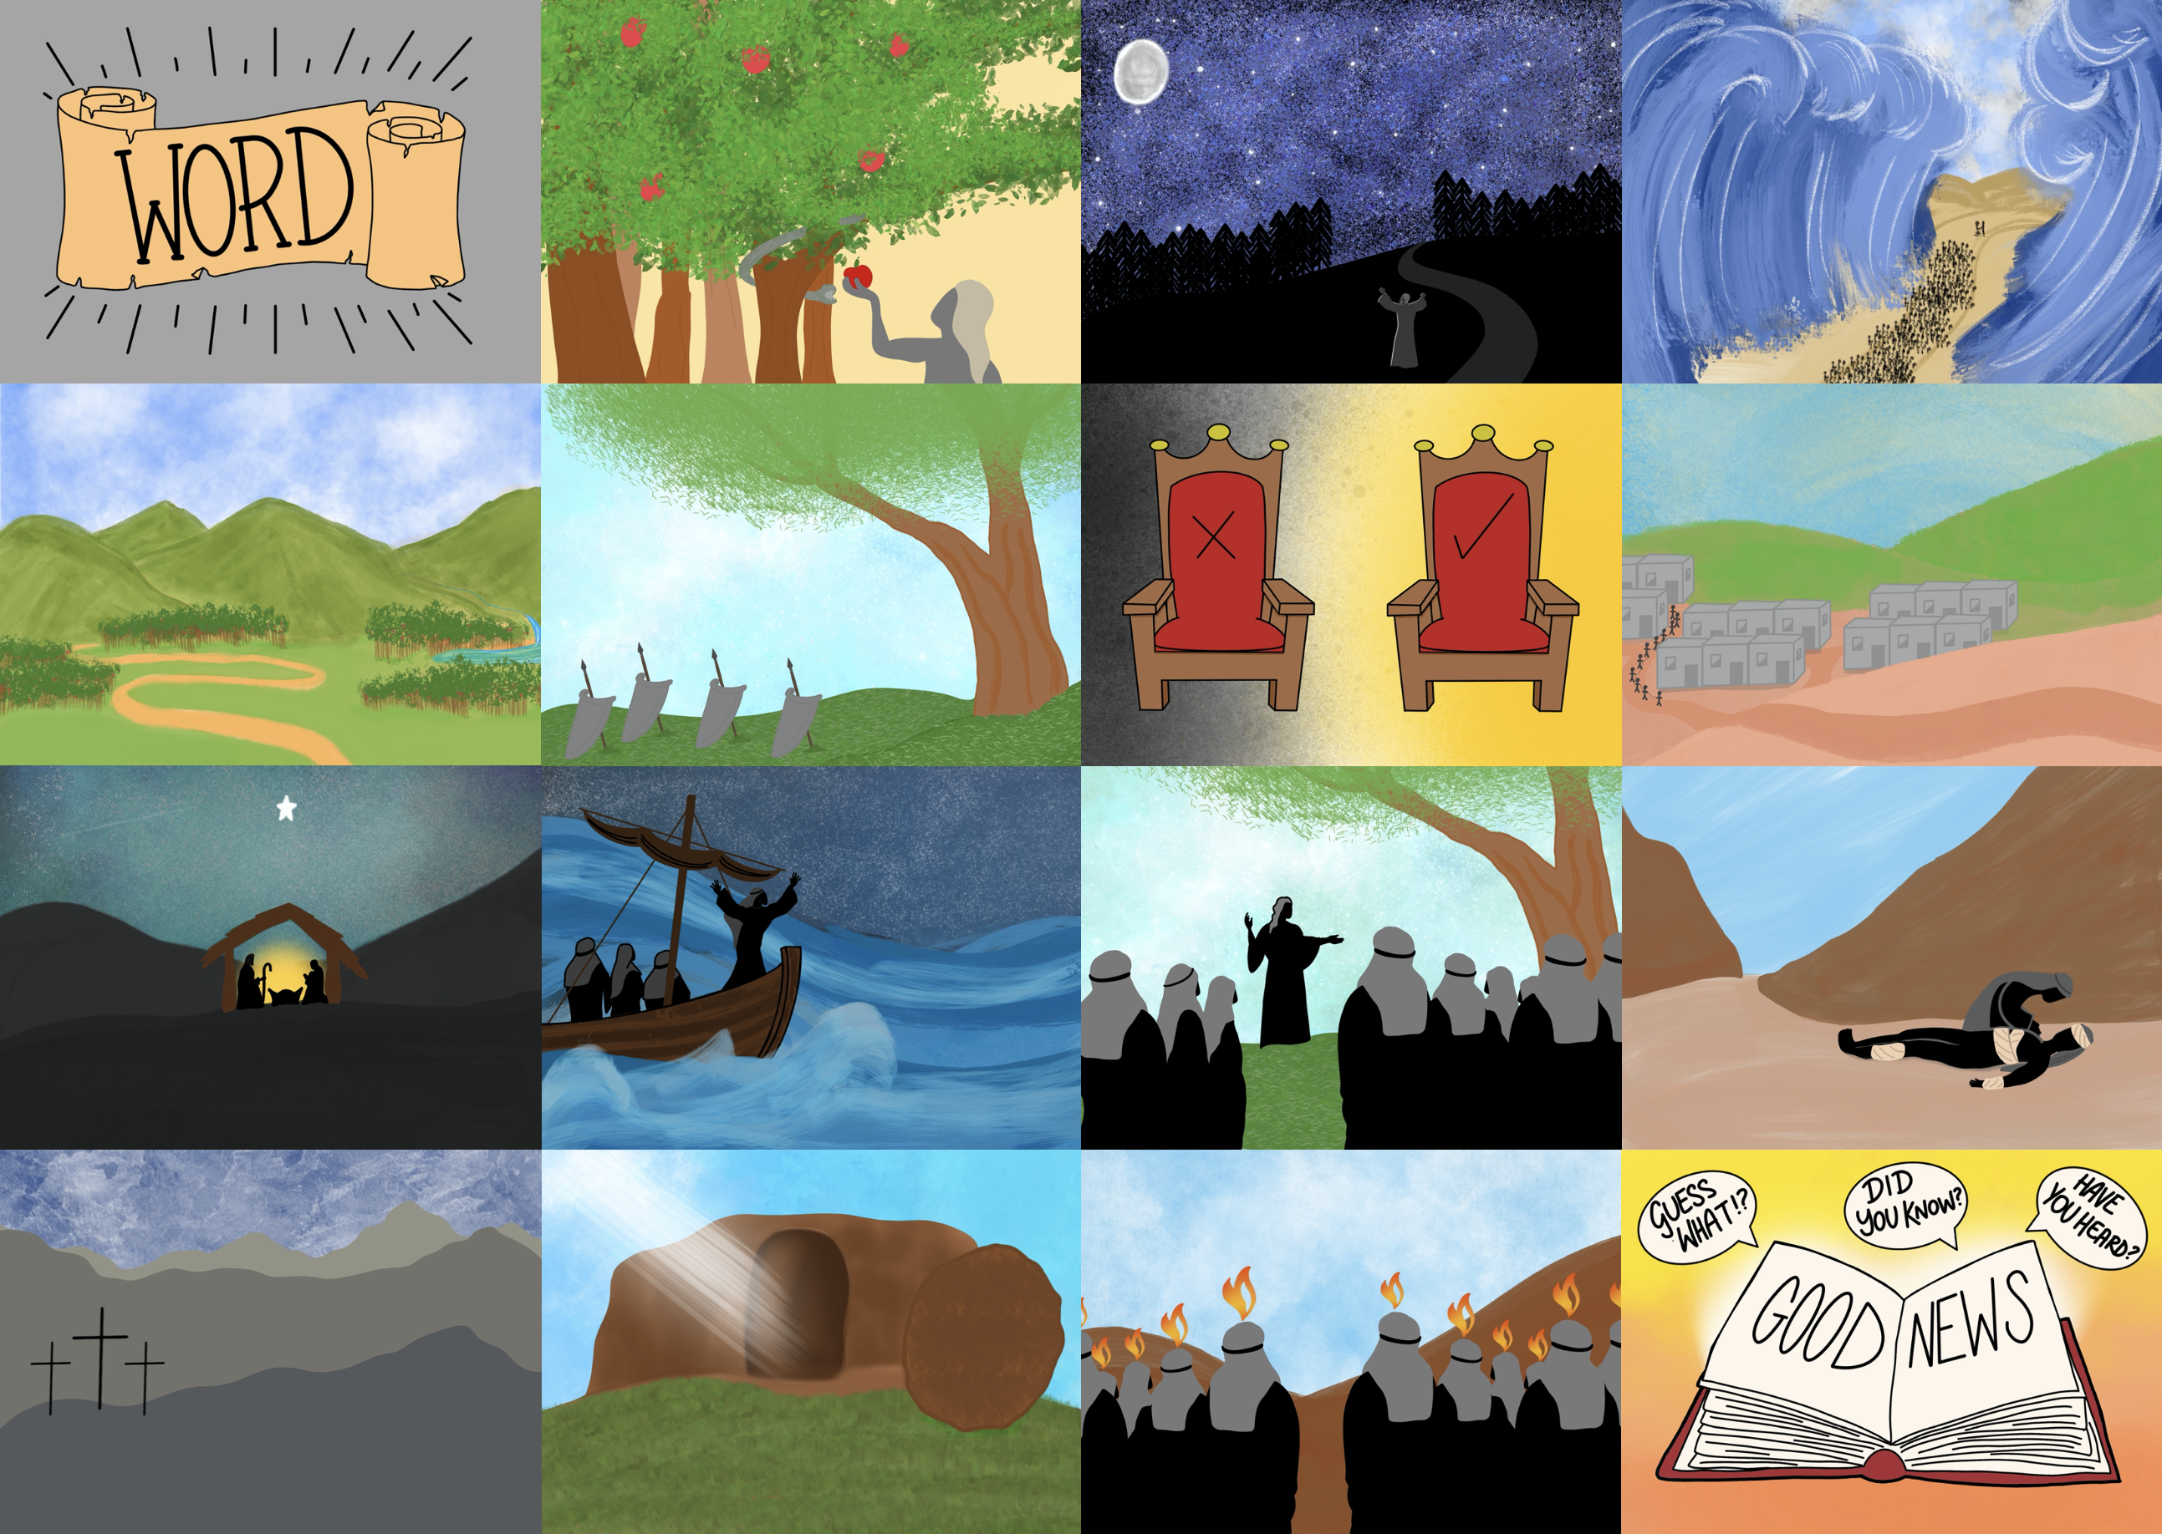

Slide 3
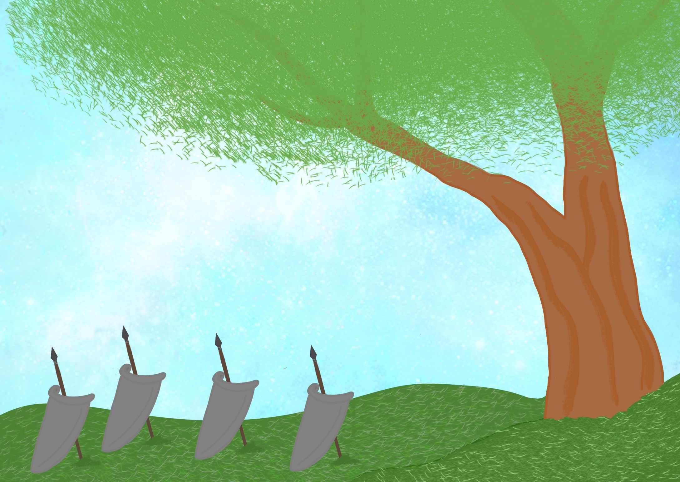

Slide 4
Their leaders were Judges who helped them to fight;

Slide 5
God wants His people to love one another

Slide 6
Insert personal photos here

Slide 7
Insert personal photos here

Slide 8
My Family Tree
Me

Slide 9
Obed’s Family Tree
x
Elimilech
Naomi
x
x
x
Ruth
Mahlon
Chilion
Orpah
Boaz
Obed
Jesse
King David

Slide 10
