Slide 3
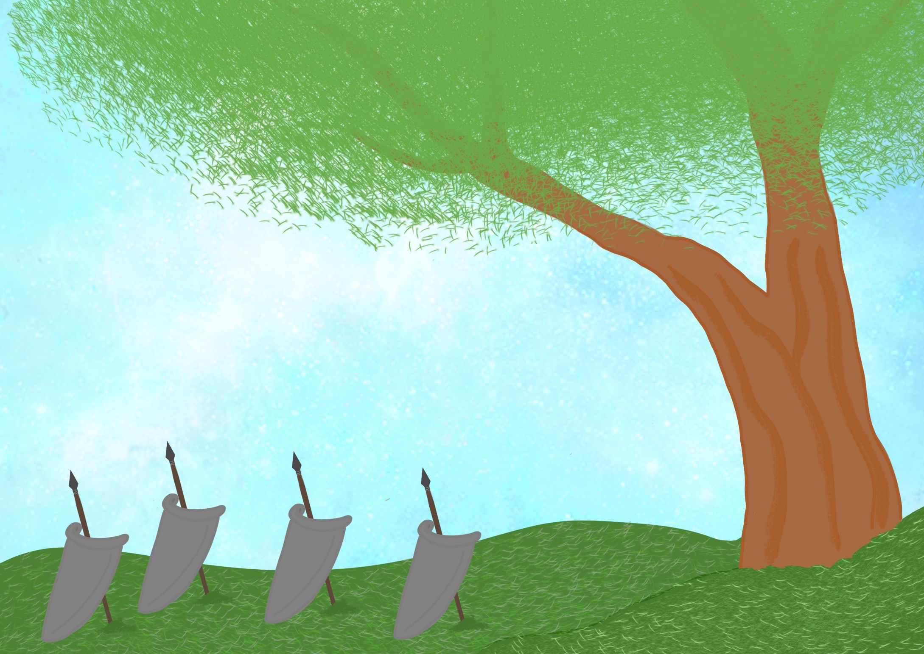

Slide 4
Their leaders were Judges who helped them to fight;

Slide 5
God wants His people to fight against wrong things

Slide 12
32,000

Slide 13
10,000

Slide 14
300

Slide 15
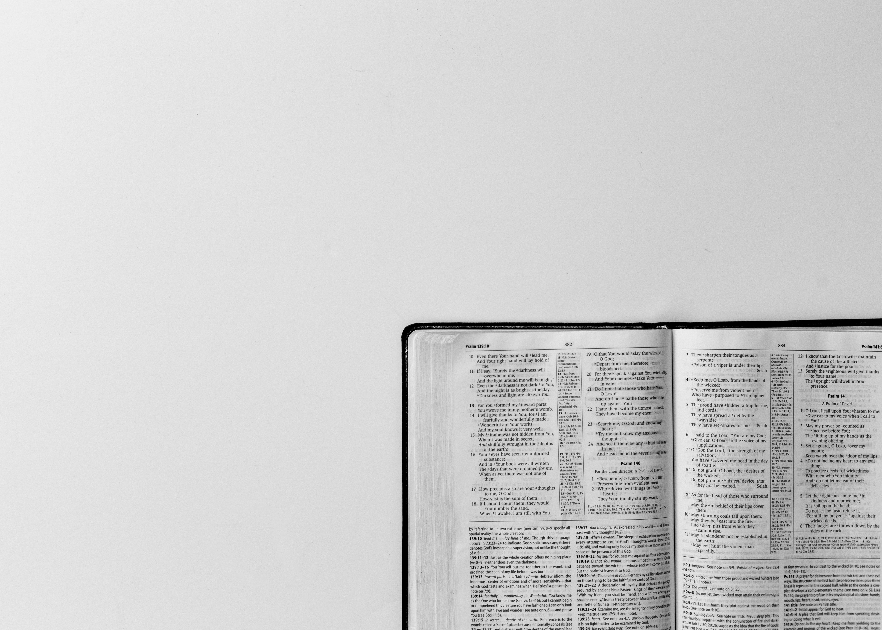
Finally, let the mighty strength of the Lord make you strong.
Ephesians 6:10

