Slide 1
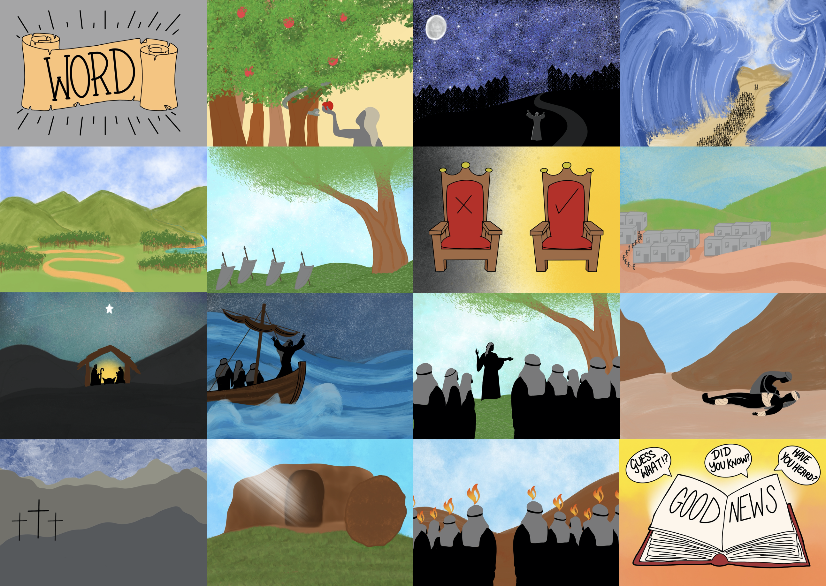



Slide 3
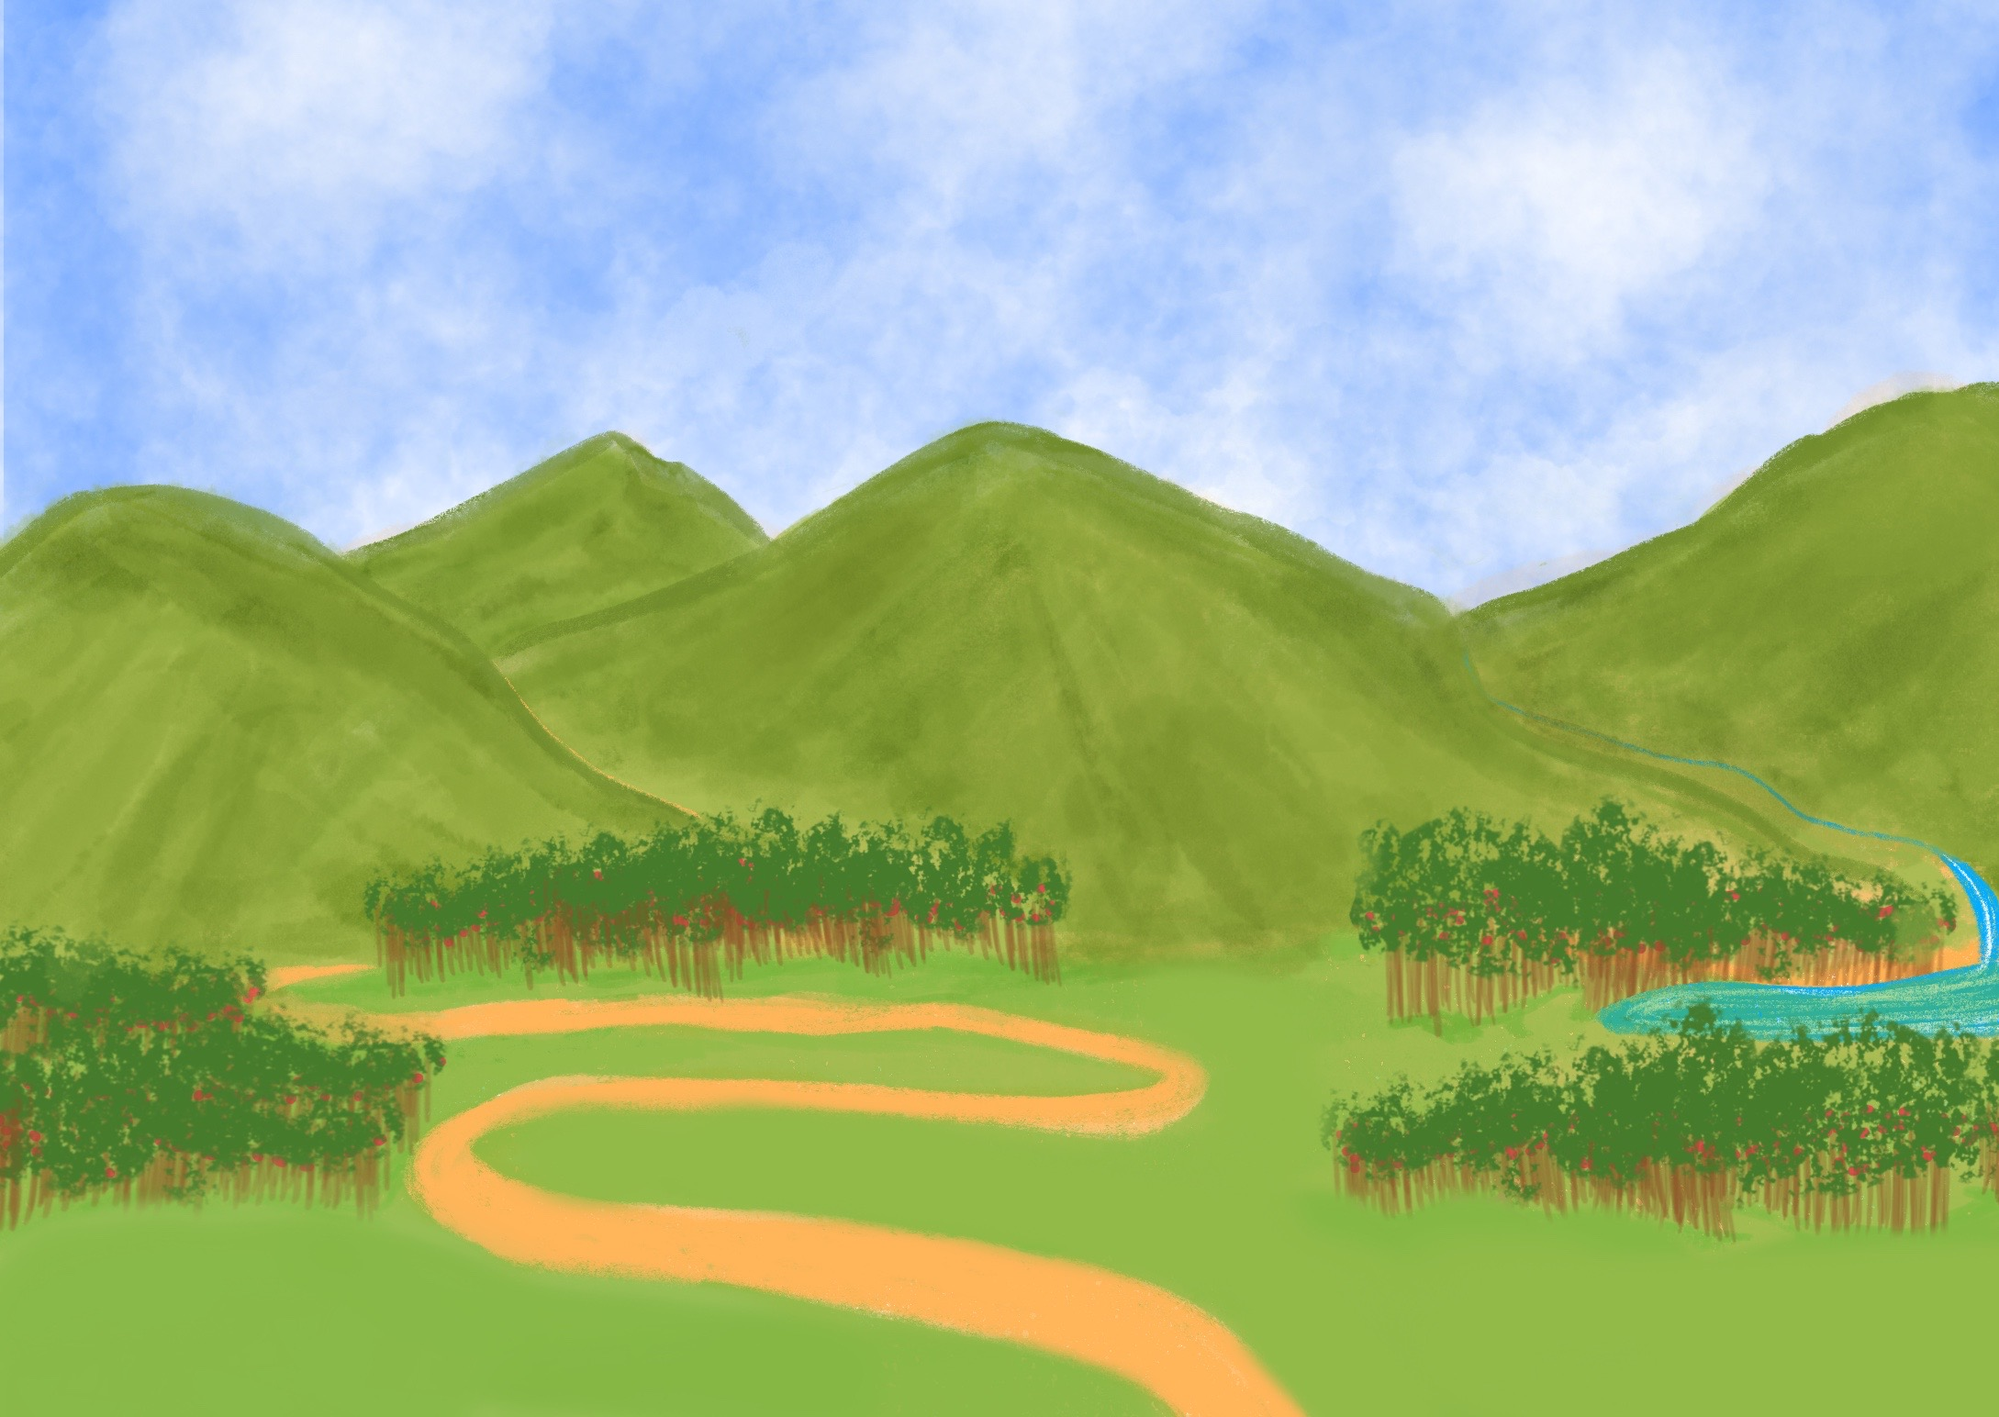

Slide 4
and took them to live in their own promised land.

Slide 5
God wants his people to obey him

Slide 6
School
Rules

Slide 10
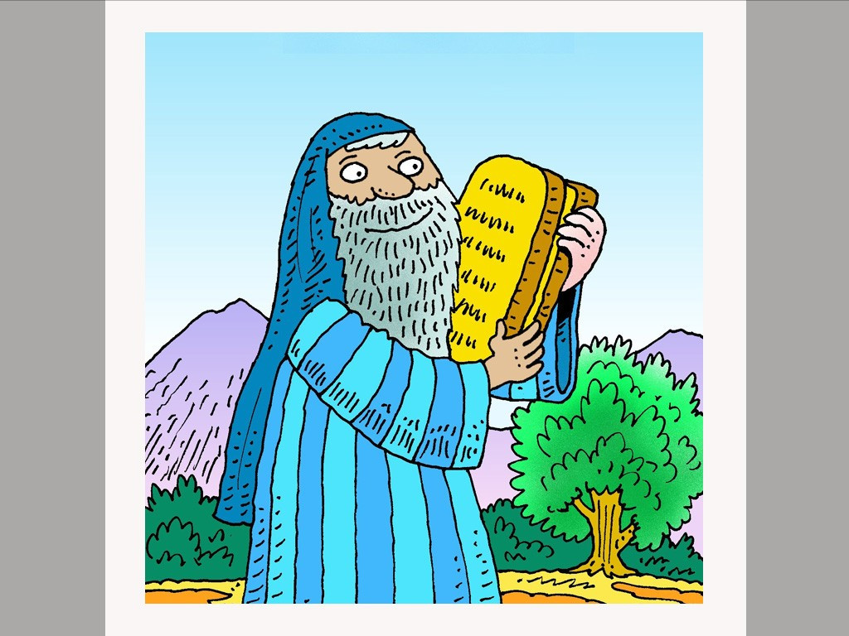

Slide 11
Learn to be content.
Don’t tell lies.
Don’t steal from others.
Don’t break a promise.
Don’t get mad.
Obey mum and dad.
Make time for me.
Show me respect.
Don’t worship things- And
Have no other God’s but me.

Slide 12
Song Lyrics (optional)
Sung to the tune of ‘The 12 Days of Christmas’.

Slide 13
Learn to be content.
Don’t tell lies.
Don’t steal from others.
Don’t break a promise.
Don’t get mad.
Obey mum and dad.
Make time for me.
Show me respect.
Don’t worship things- And
Have no other God’s but me.
From the top of Mount Sinai, God gave his people rules:

Slide 14

Love the Lord your God
with all your heart…
Love your neighbour
as yourself.
Mark 12 : 30 - 31

