Slide 1
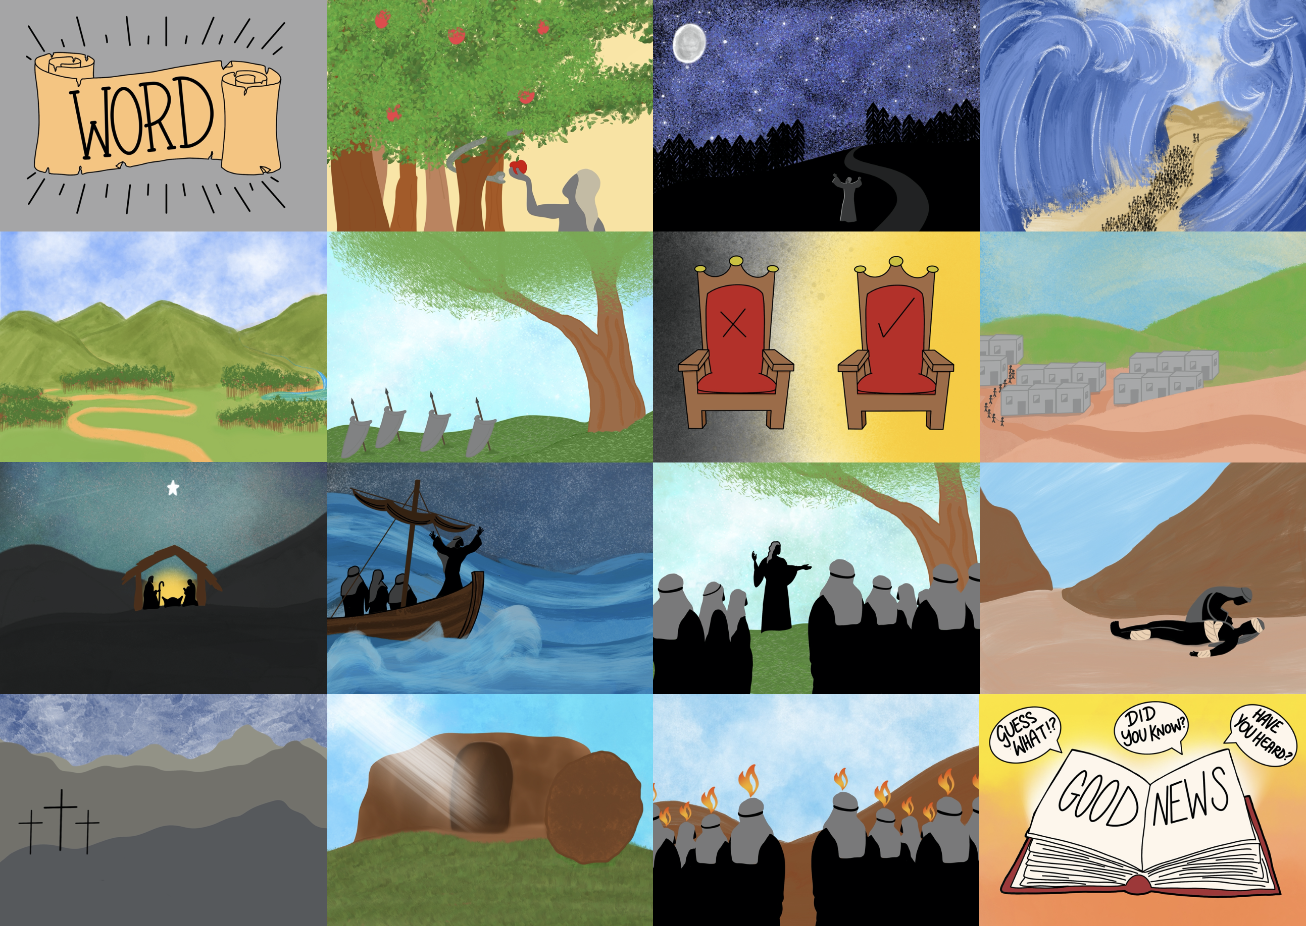



Slide 3
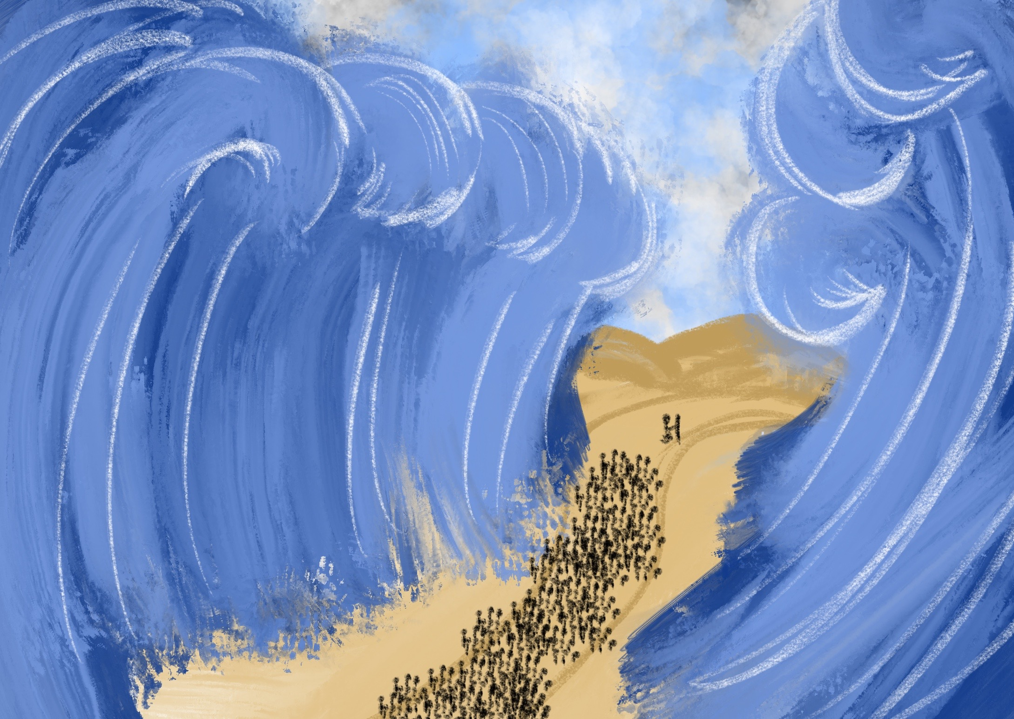

Slide 4
From Egypt He rescued them by His mighty hand

Slide 5
In a broken world, God hears our prayers

Slide 6
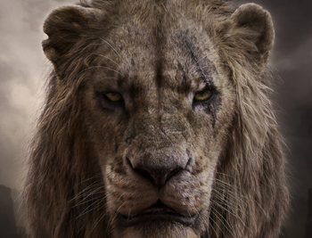
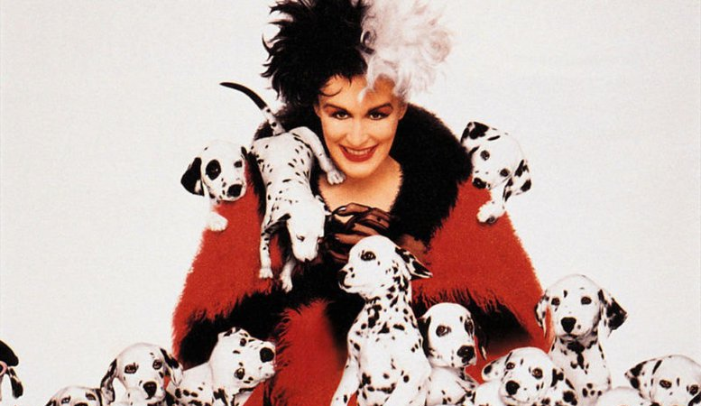
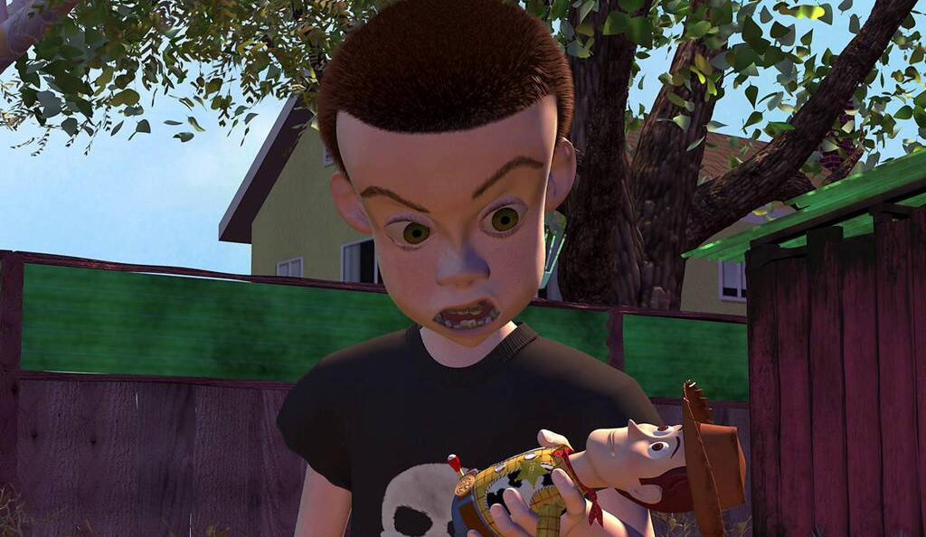


Slide 7
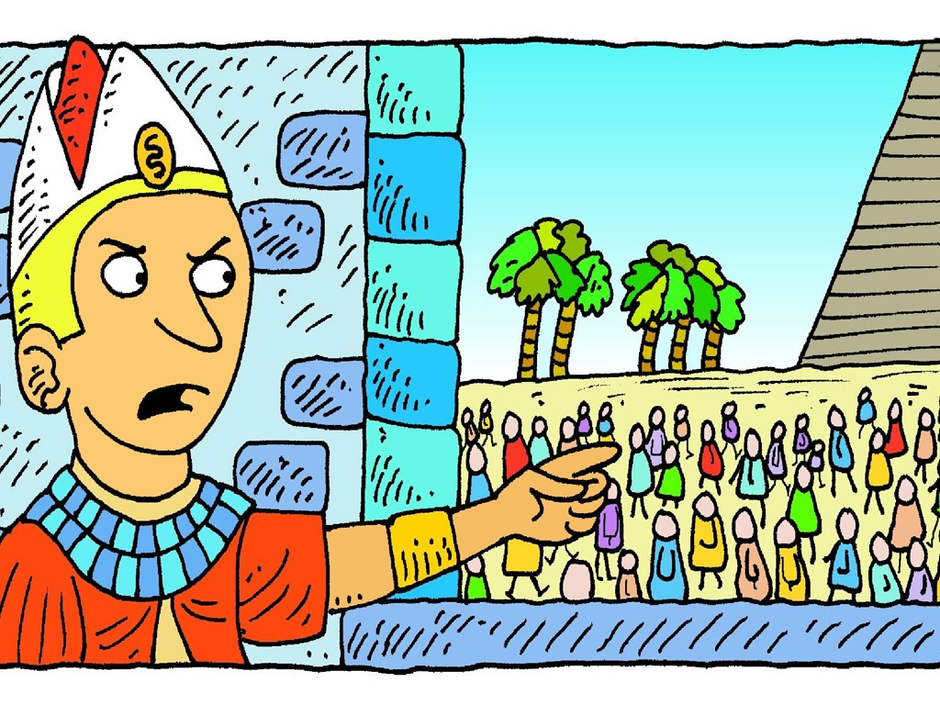

Slide 8
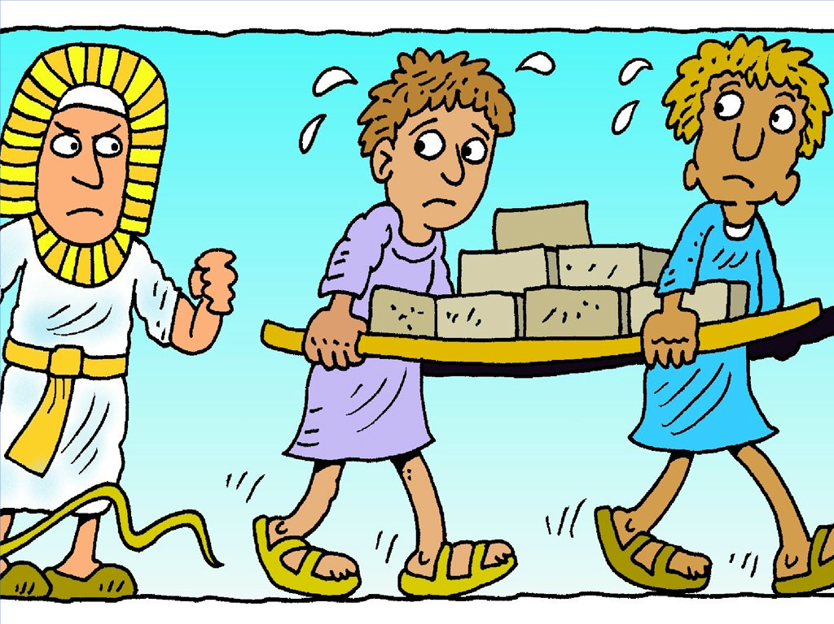

Slide 10
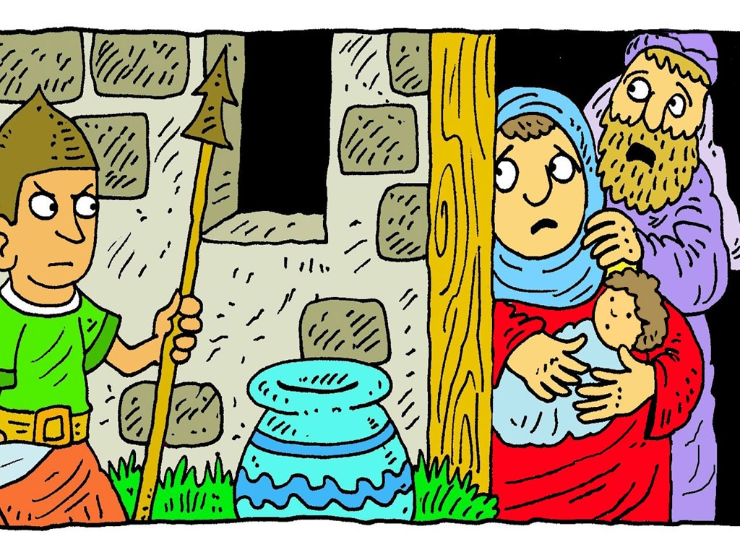

Slide 11
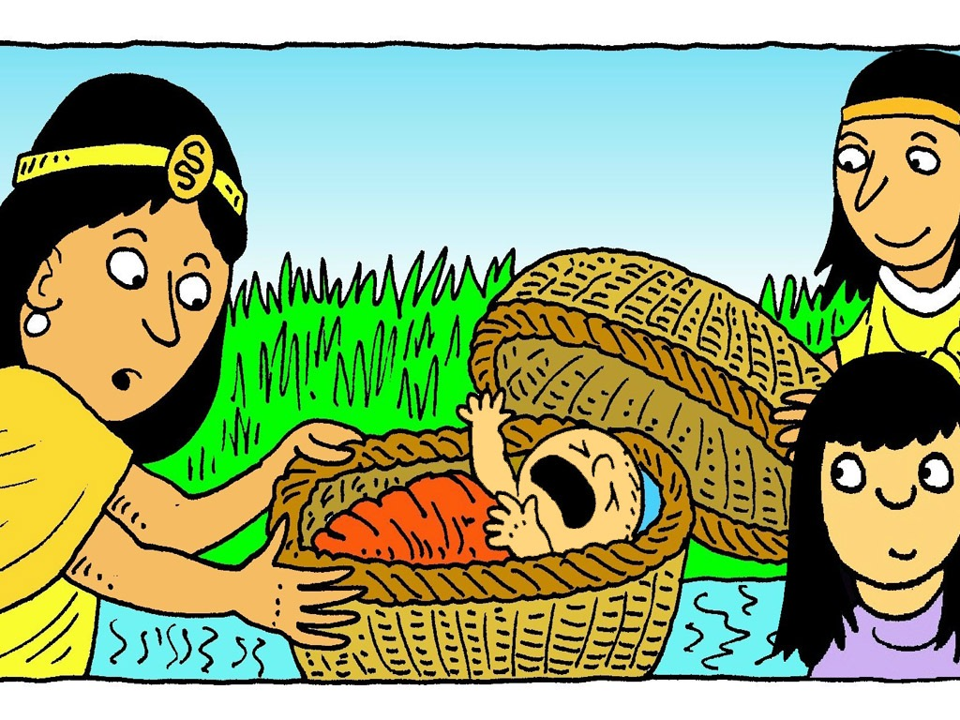

Slide 12
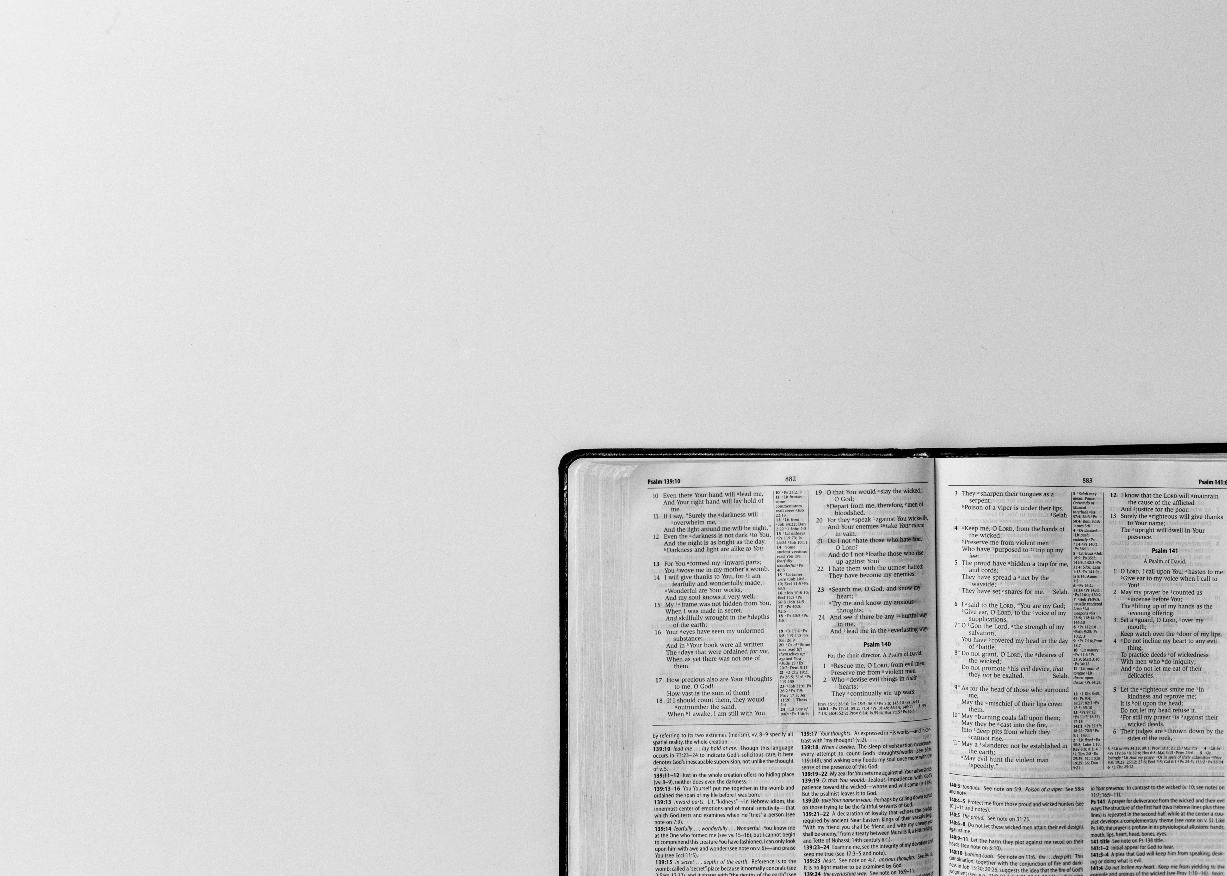
A long time passed
and that king of Egypt died.
But the Israelites were
still forced to work very hard.
They cried out for help,
and God heard them.
Exodus 2:23-24

Slide 13
?
To be
continued….

Slide 14

