Slide 2
The
Story
Of
God’s
Rescue
Plan
“In the beginning God created the heavens and the earth.”
Genesis 1 verse 1

Slide 3
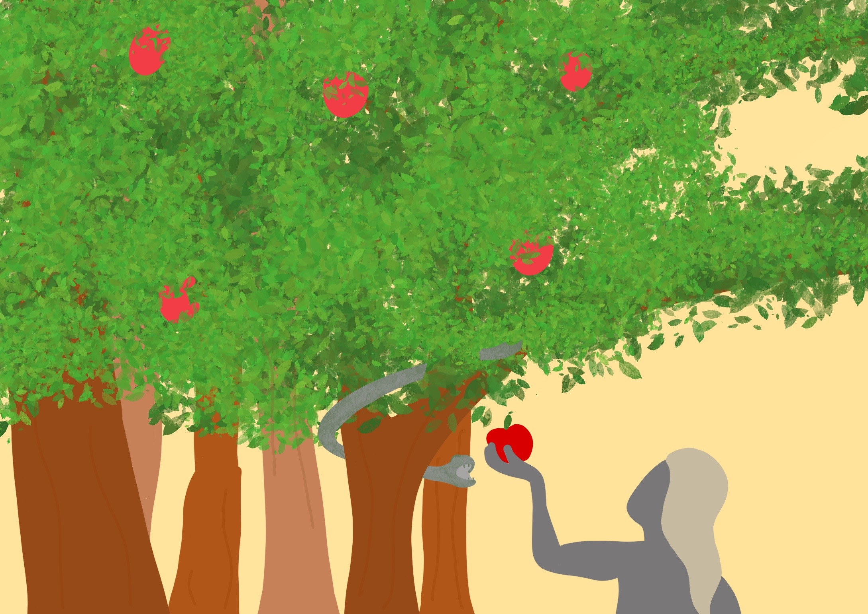
In God’s perfect world when wrong things began,

Slide 4
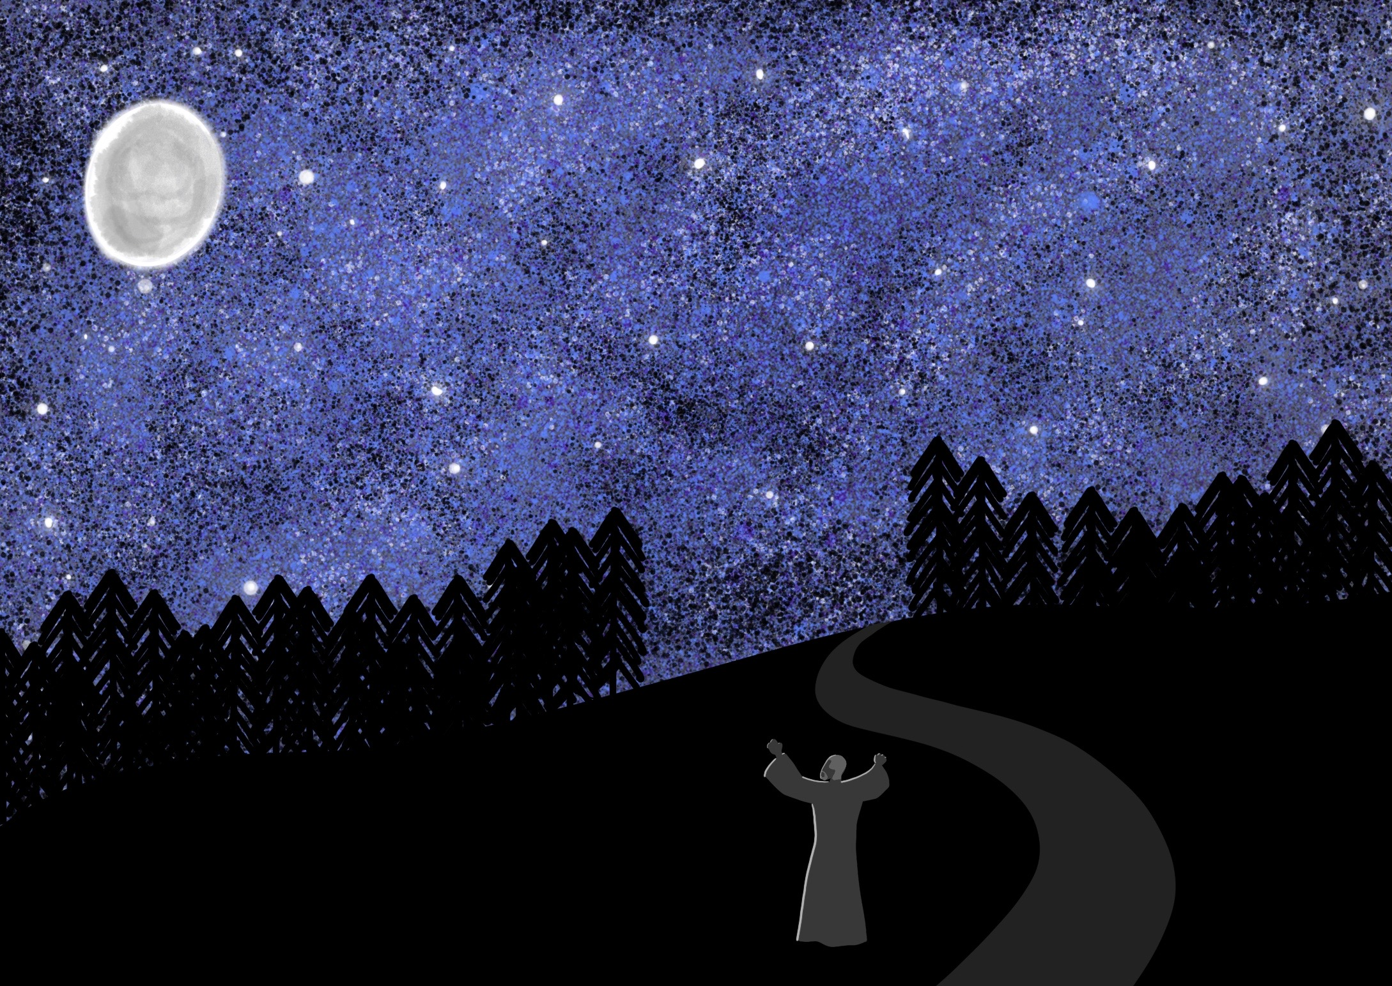
God gave Abraham and his family a part in His plan.

Slide 5
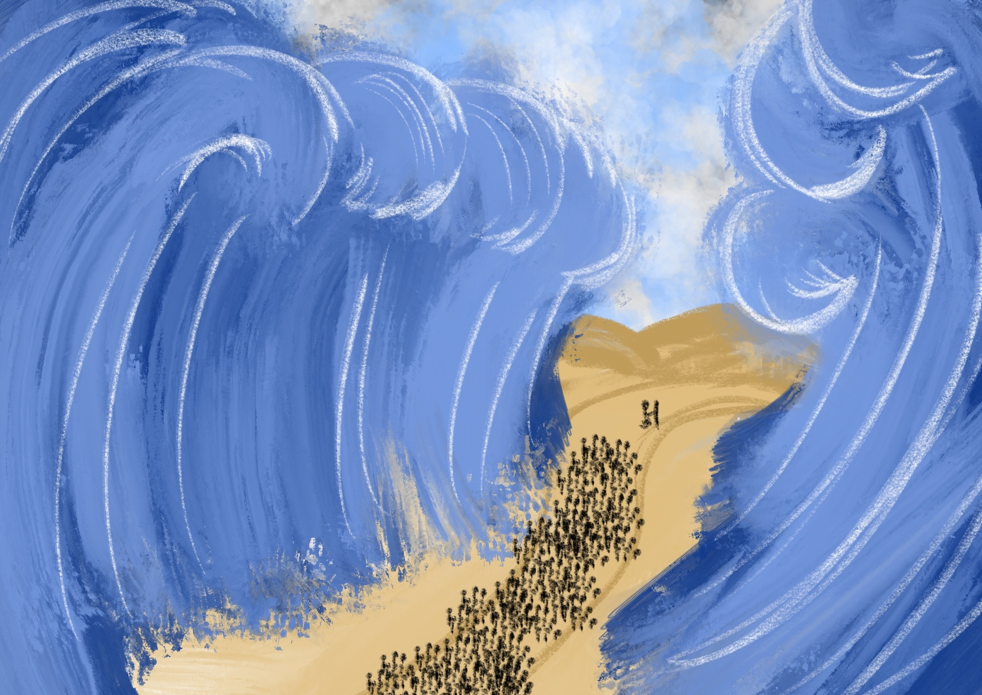
From Egypt He rescued them by His mighty hand,

Slide 6
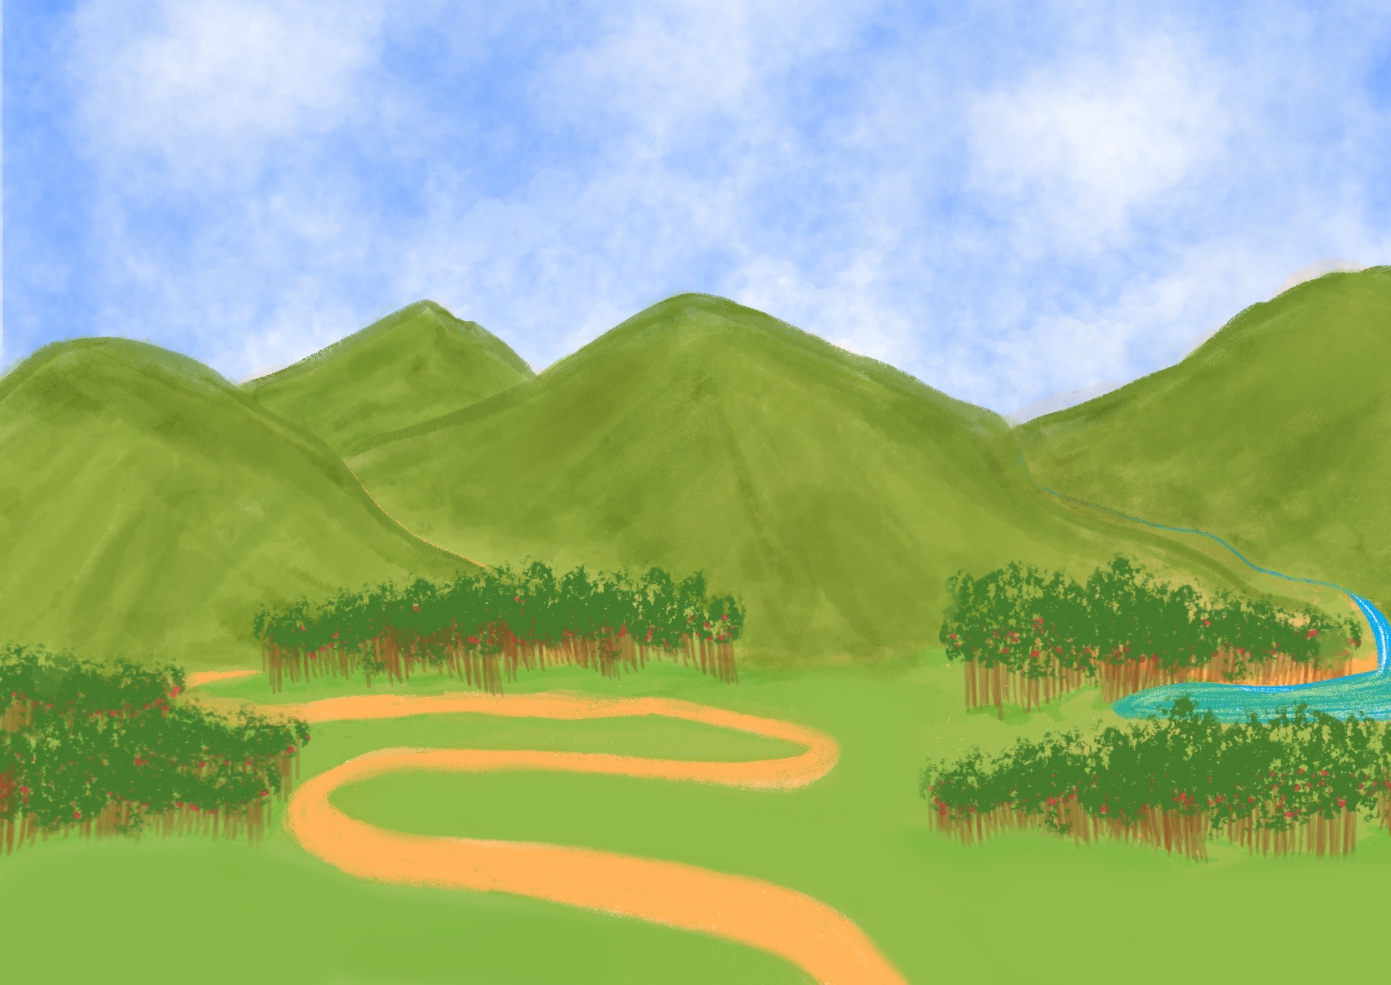
and took them to live in their own promised land.

Slide 7
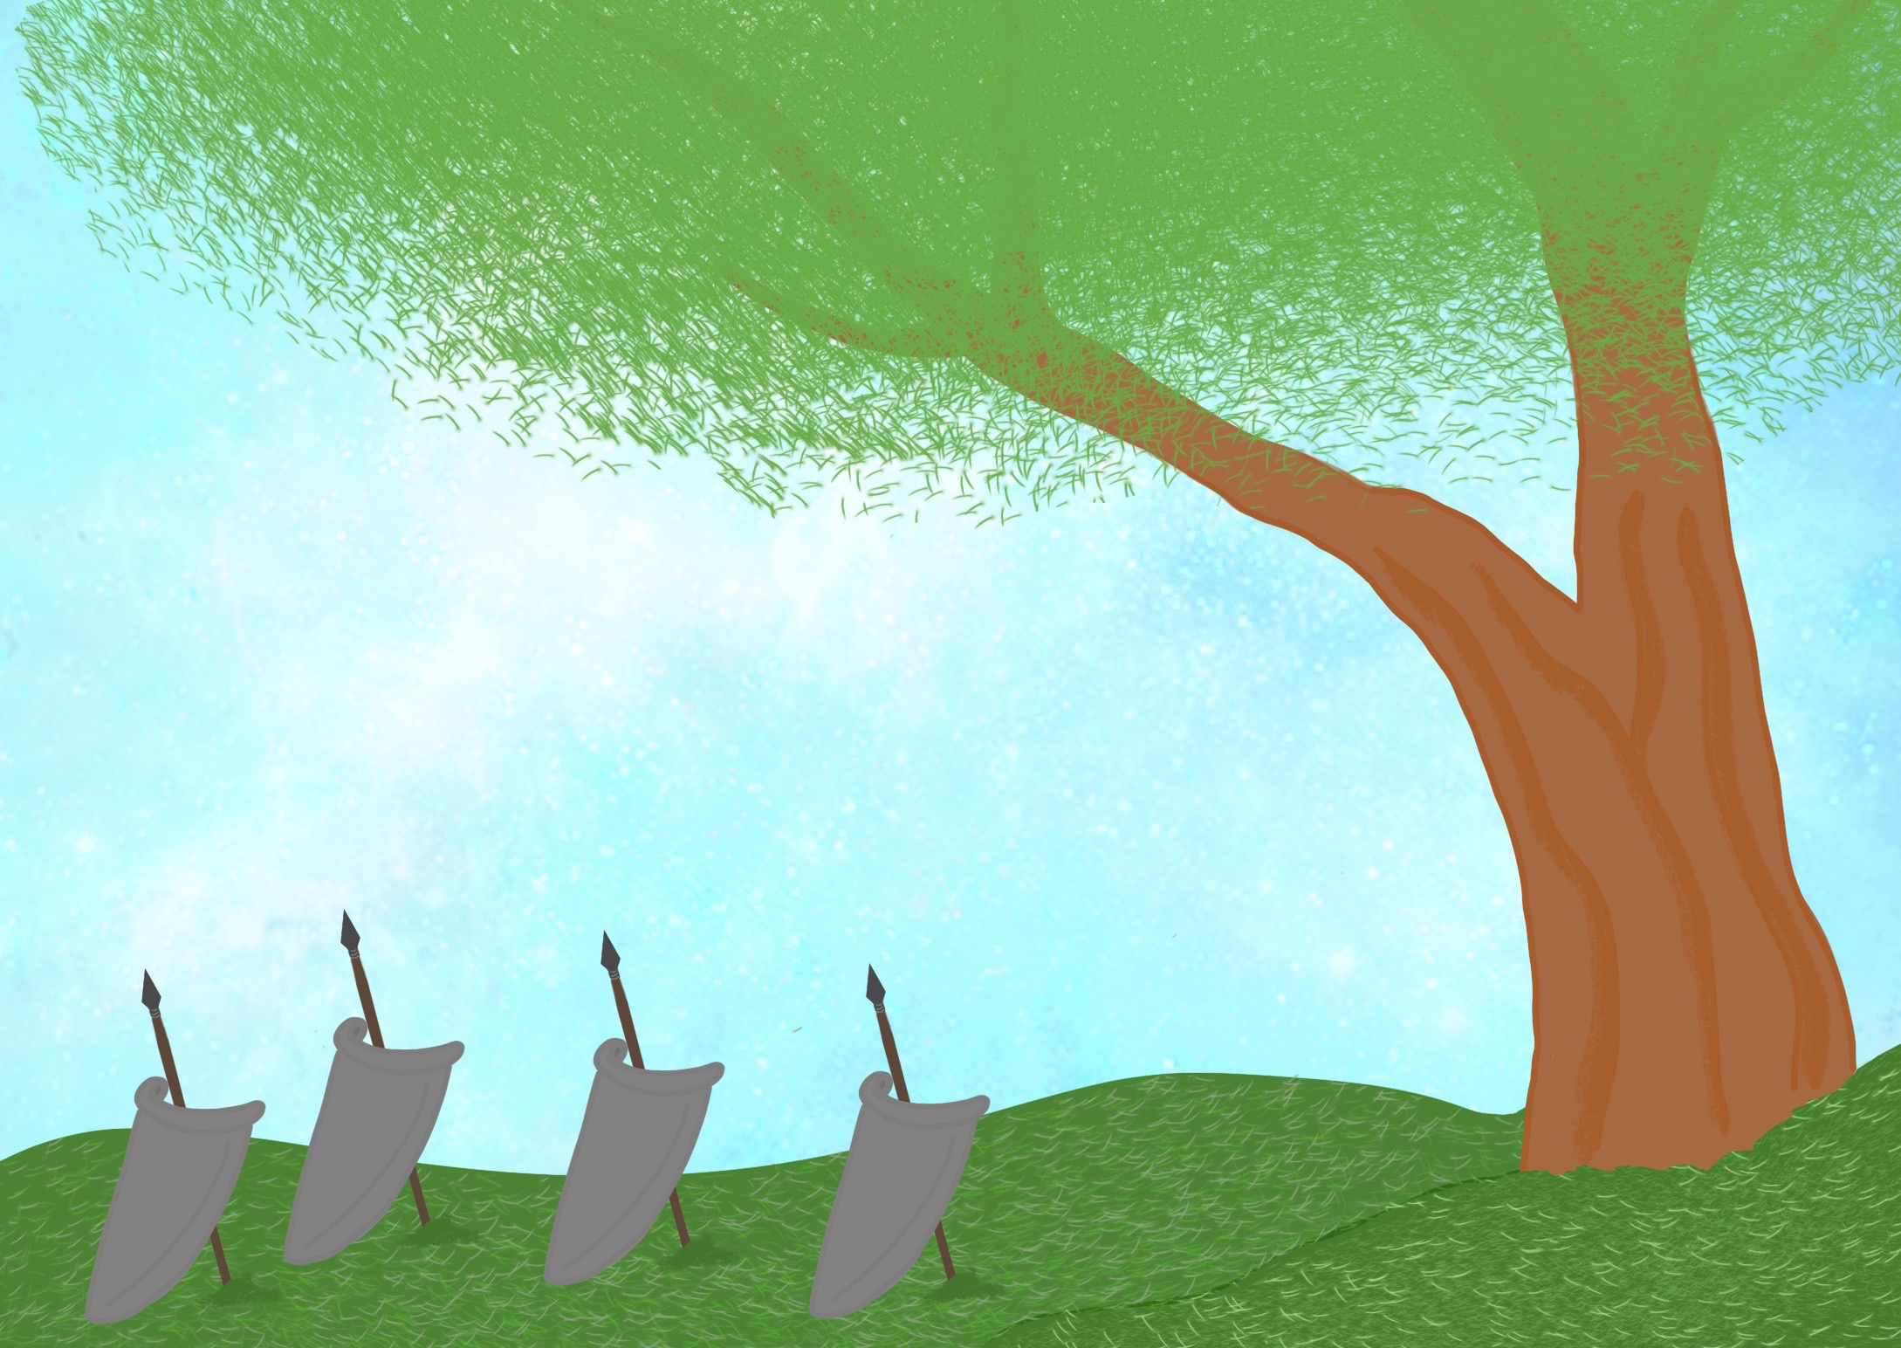
Their leaders were Judges who helped them to fight;

Slide 8
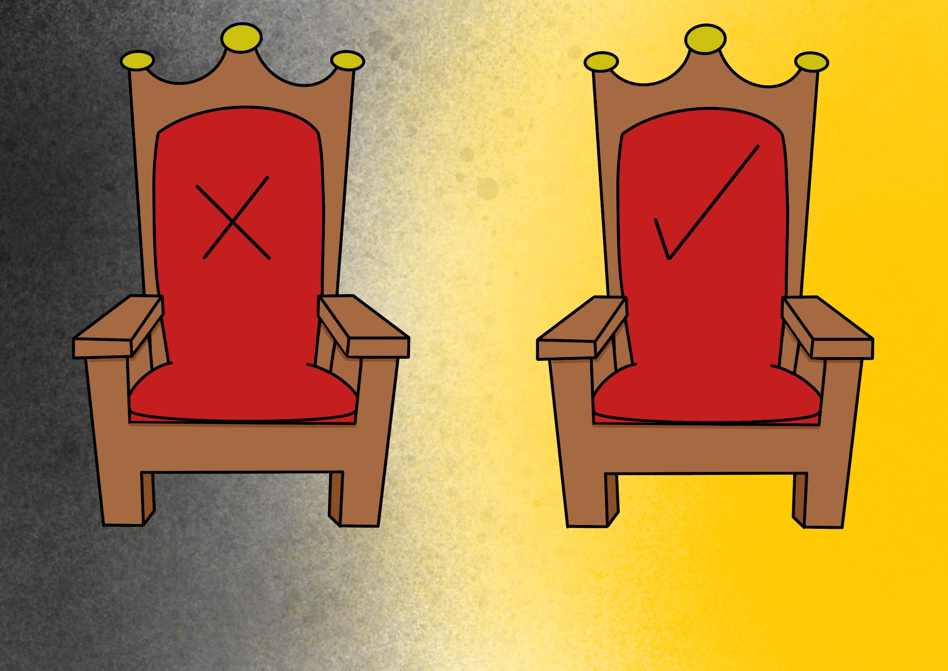
they were followed by Kings; some did wrong, some did right.

Slide 9
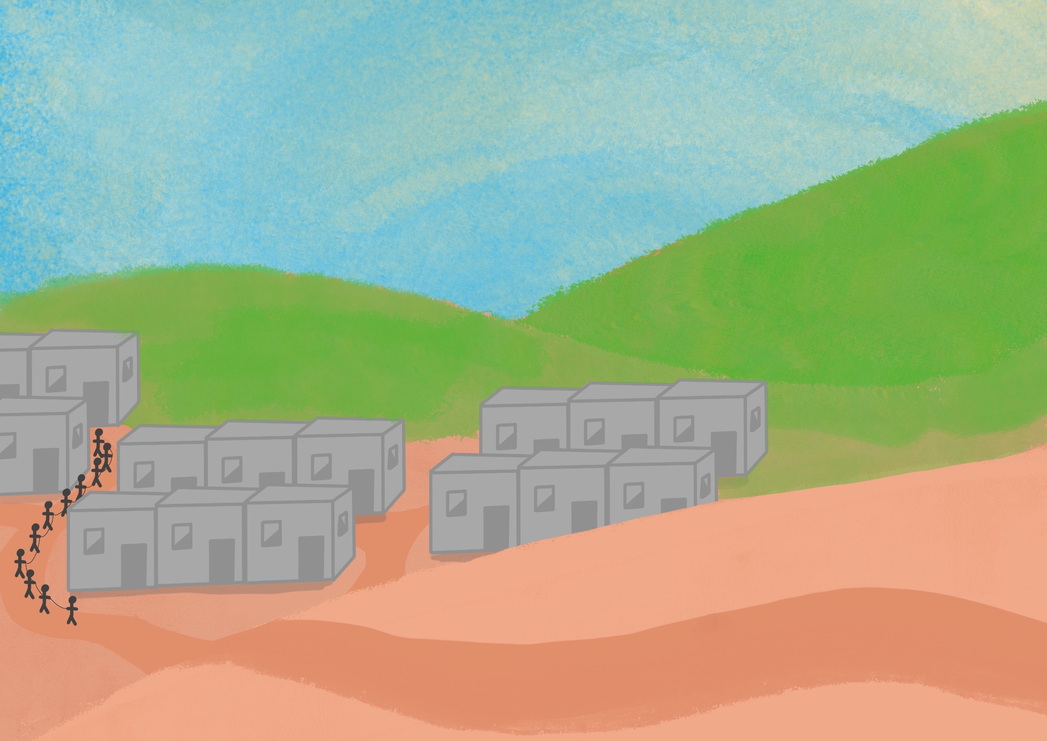
Their enemies came, took God’s people away,

Slide 10
but God kept His Word to restore them someday.

Slide 11
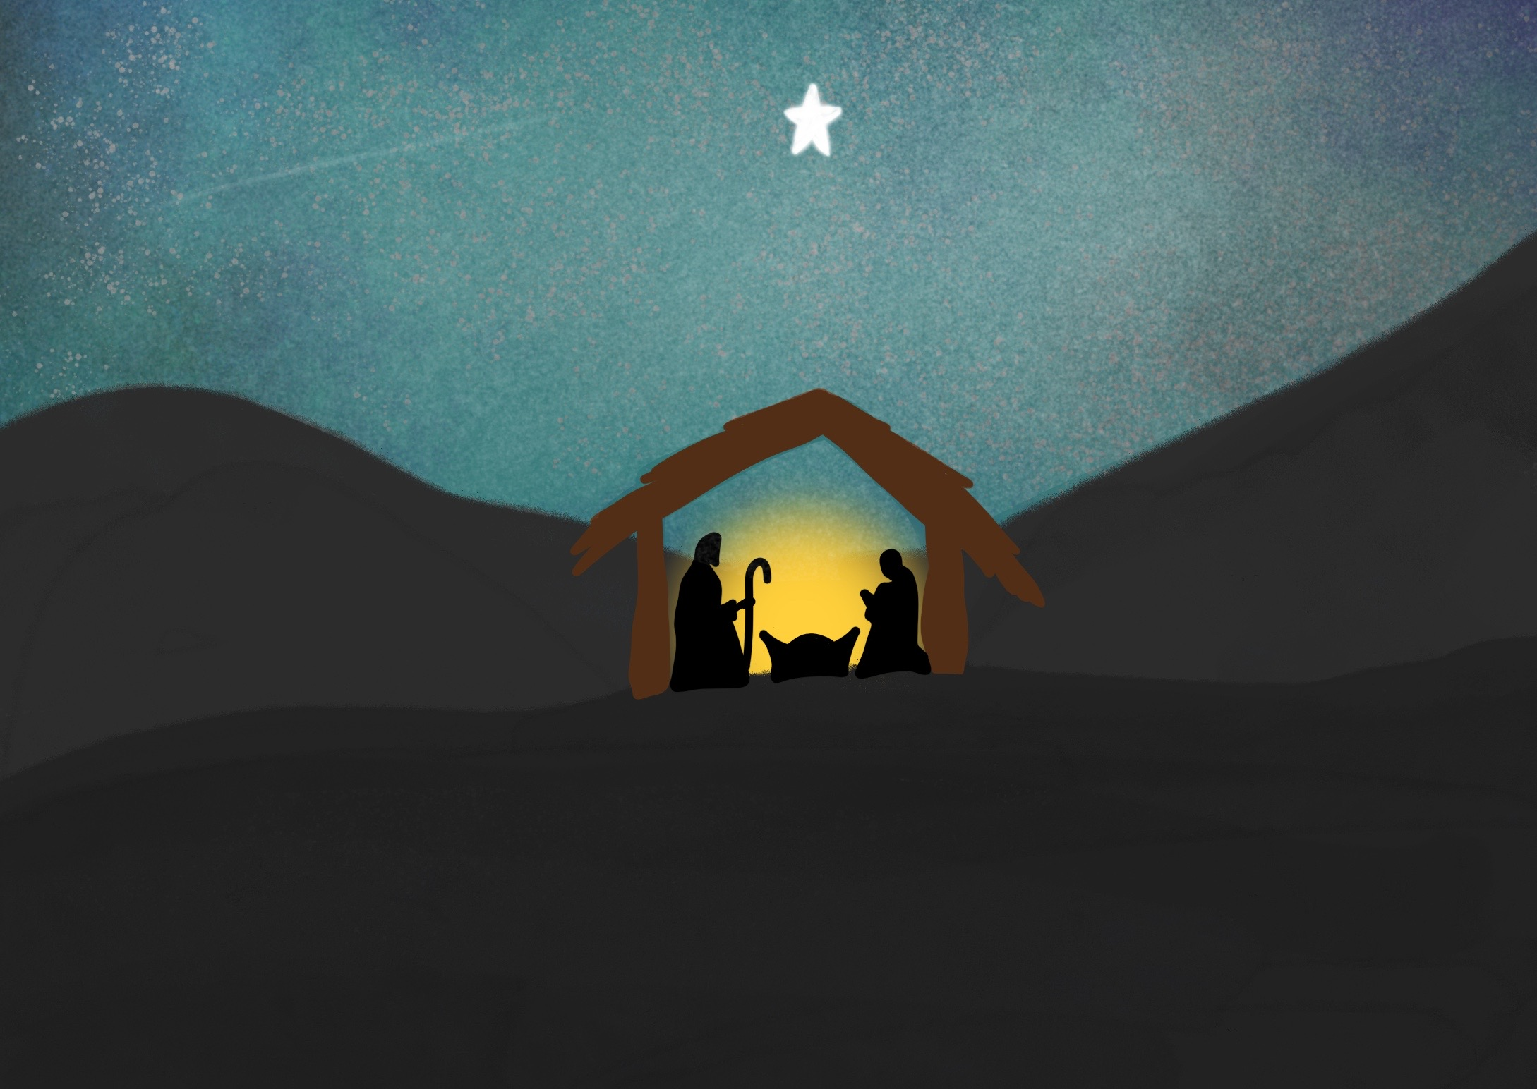
Angels announced the Good News of His birth,

Slide 12
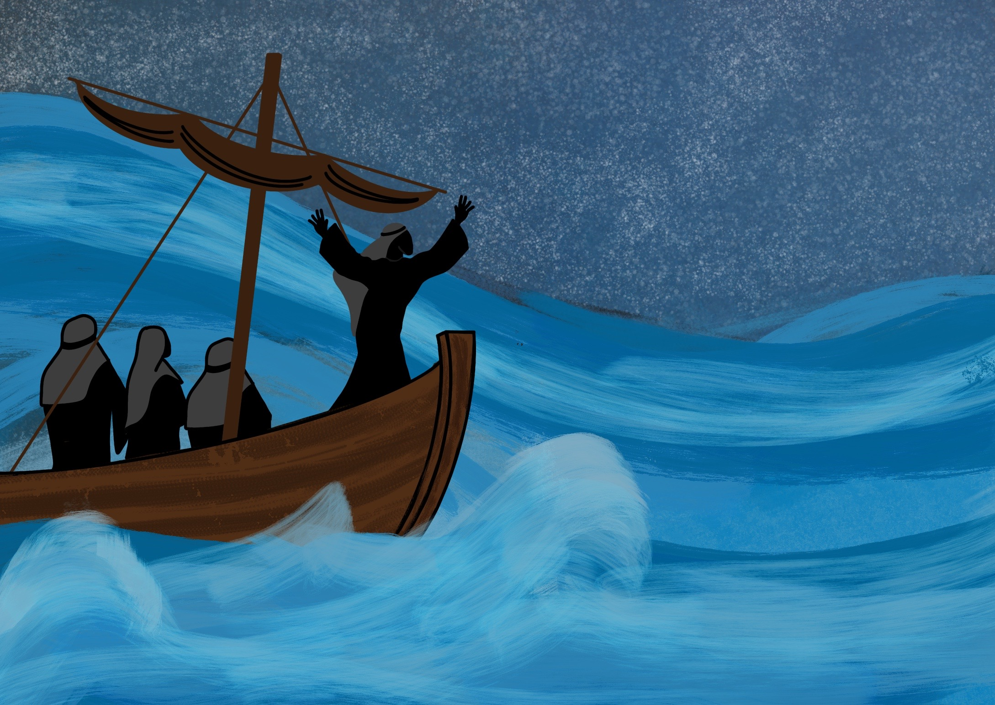
as Jesus, God’s Son, came to live on the Earth.

Slide 13
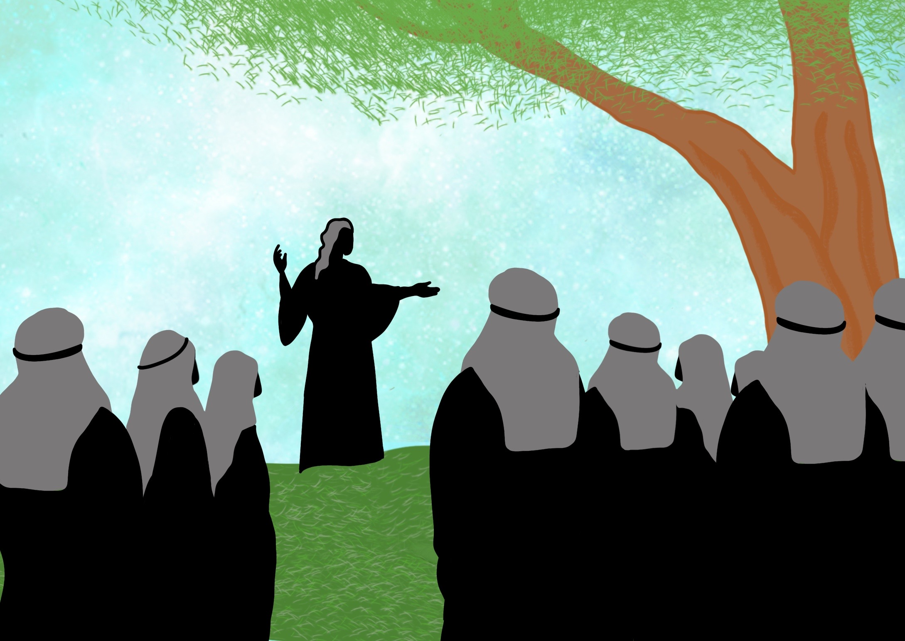
He brought us Good News from the Father above,

Slide 14
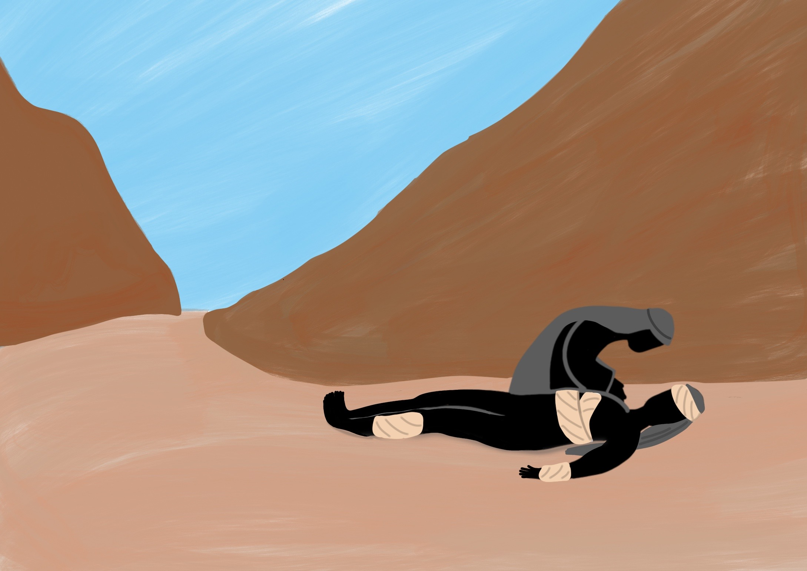
He taught us His way and He showed us His love.

Slide 15
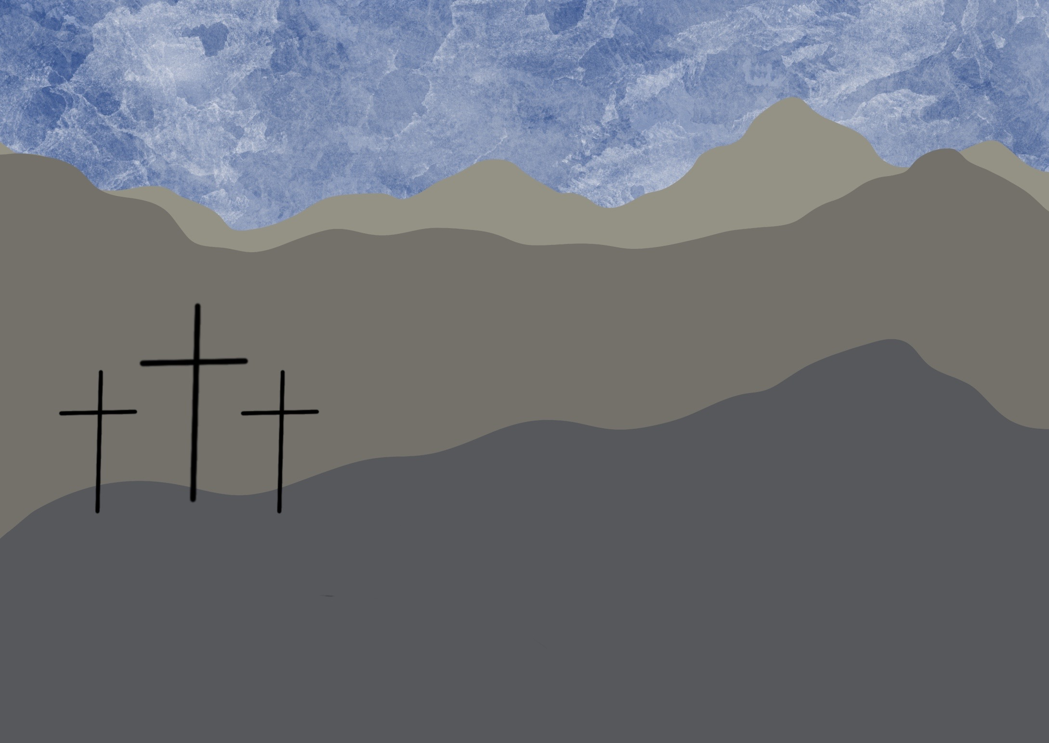
He died on a cross so our sins can be forgiven,

Slide 16
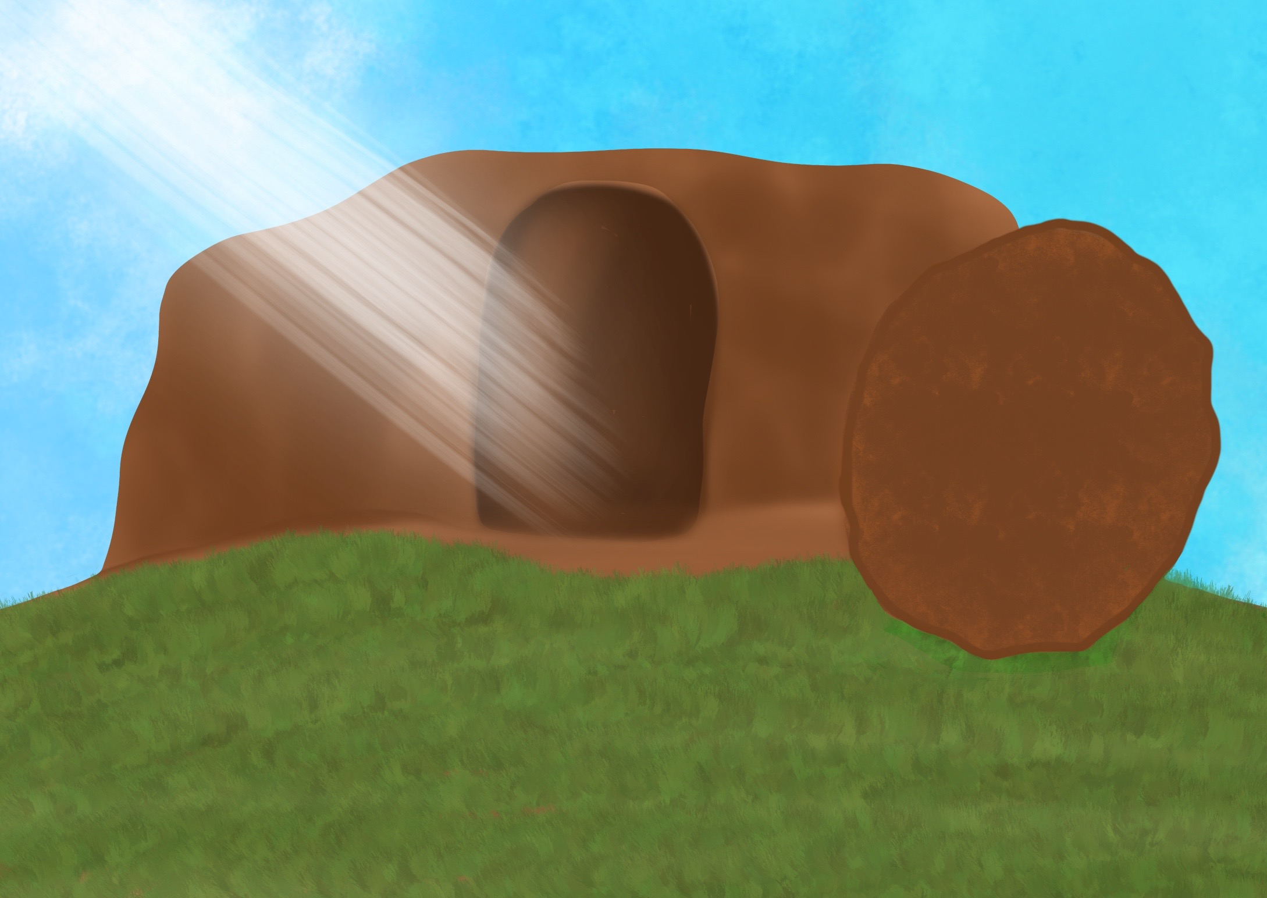
then He rose from the dead and ascended to heaven.

Slide 17
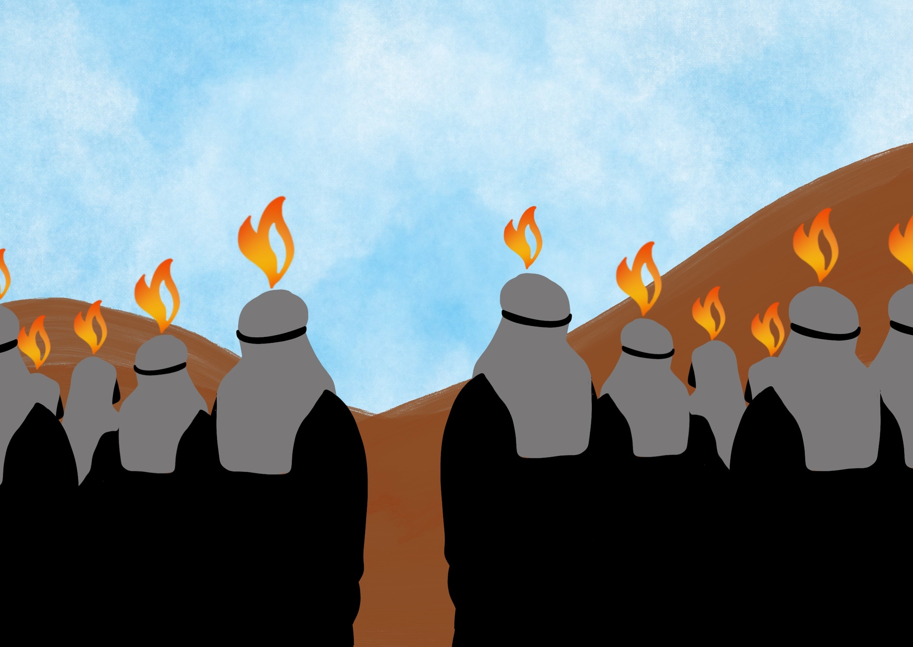
He has given us His Spirit to help us since then,

Slide 18
to spread the Good News until He comes again!

Slide 19
“Behold, I am making all things new.”
Revelation 21 verse 5

