Slide 4
...God gave Abraham's family a part in His plan.

Slide 5
God has a plan for our lives

Slide 7
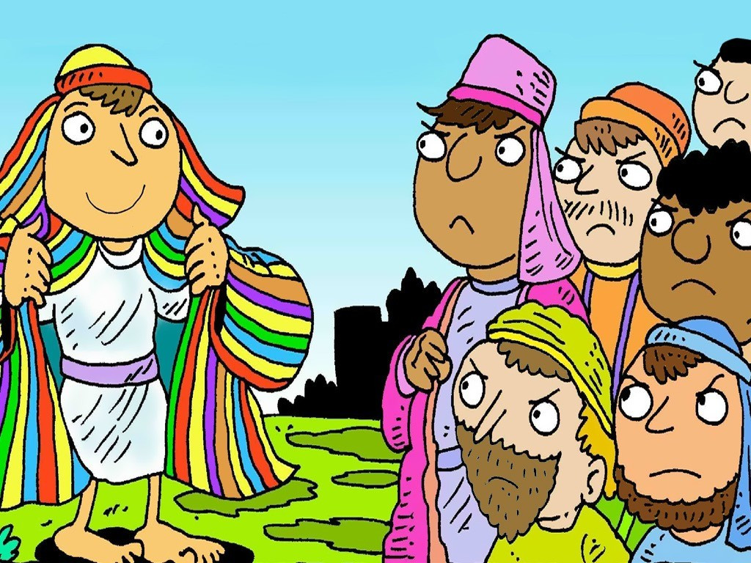

Slide 8
We know that God is always at work for the good of everyone who loves him.
Romans 8:28

