Slide 1
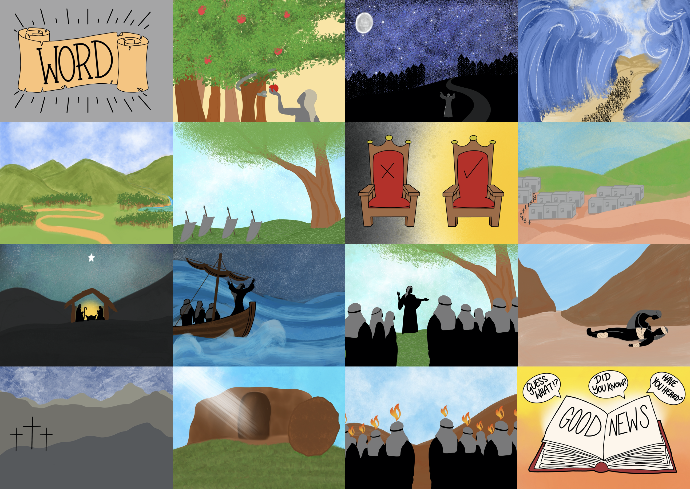



Slide 3


Slide 4
...God gave Abraham's family a part in His plan.

Slide 5
God has a plan for people everywhere

Slide 6

What
makes you laugh?

Slide 8


Slide 11
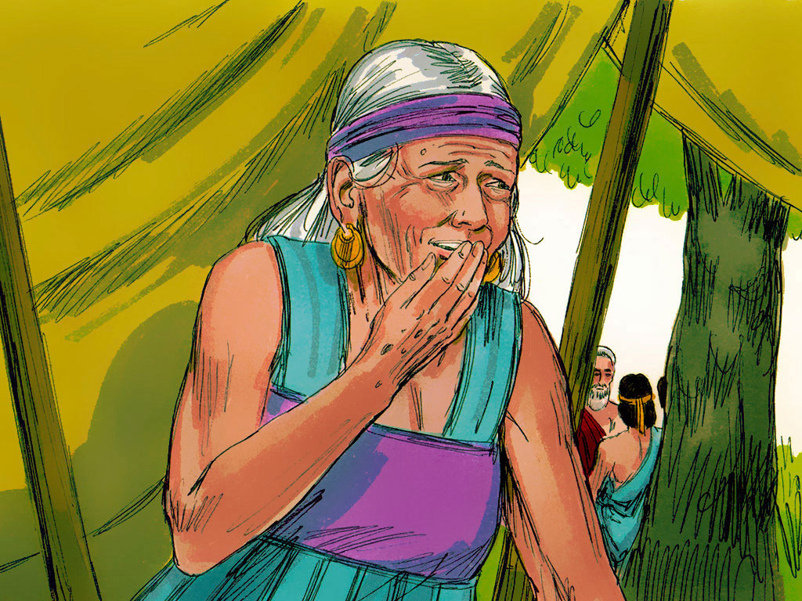

Slide 12
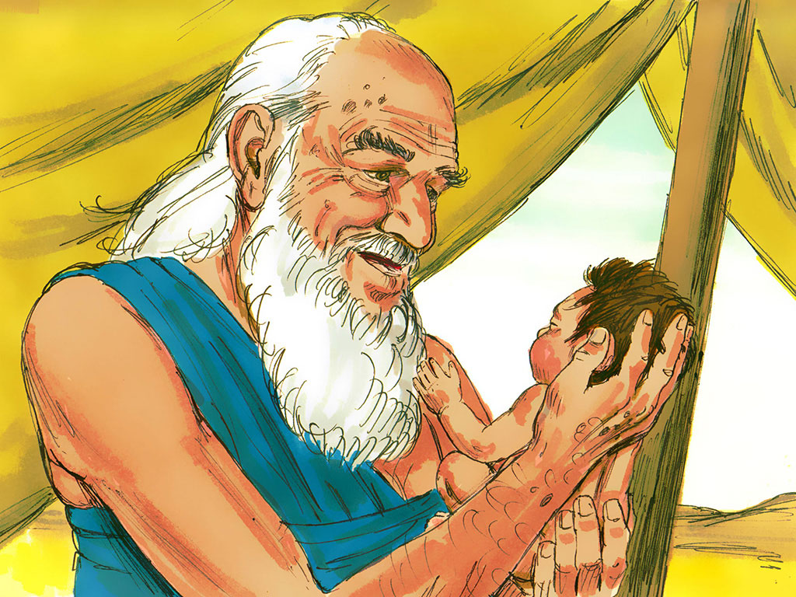

Slide 13
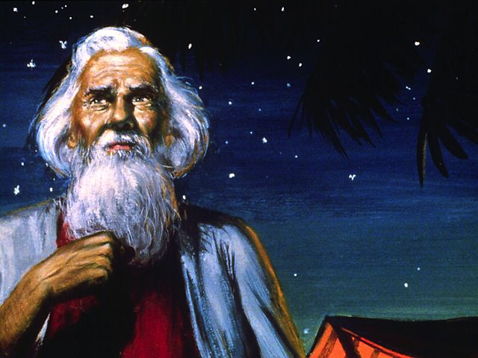

Slide 14
