Slide 3
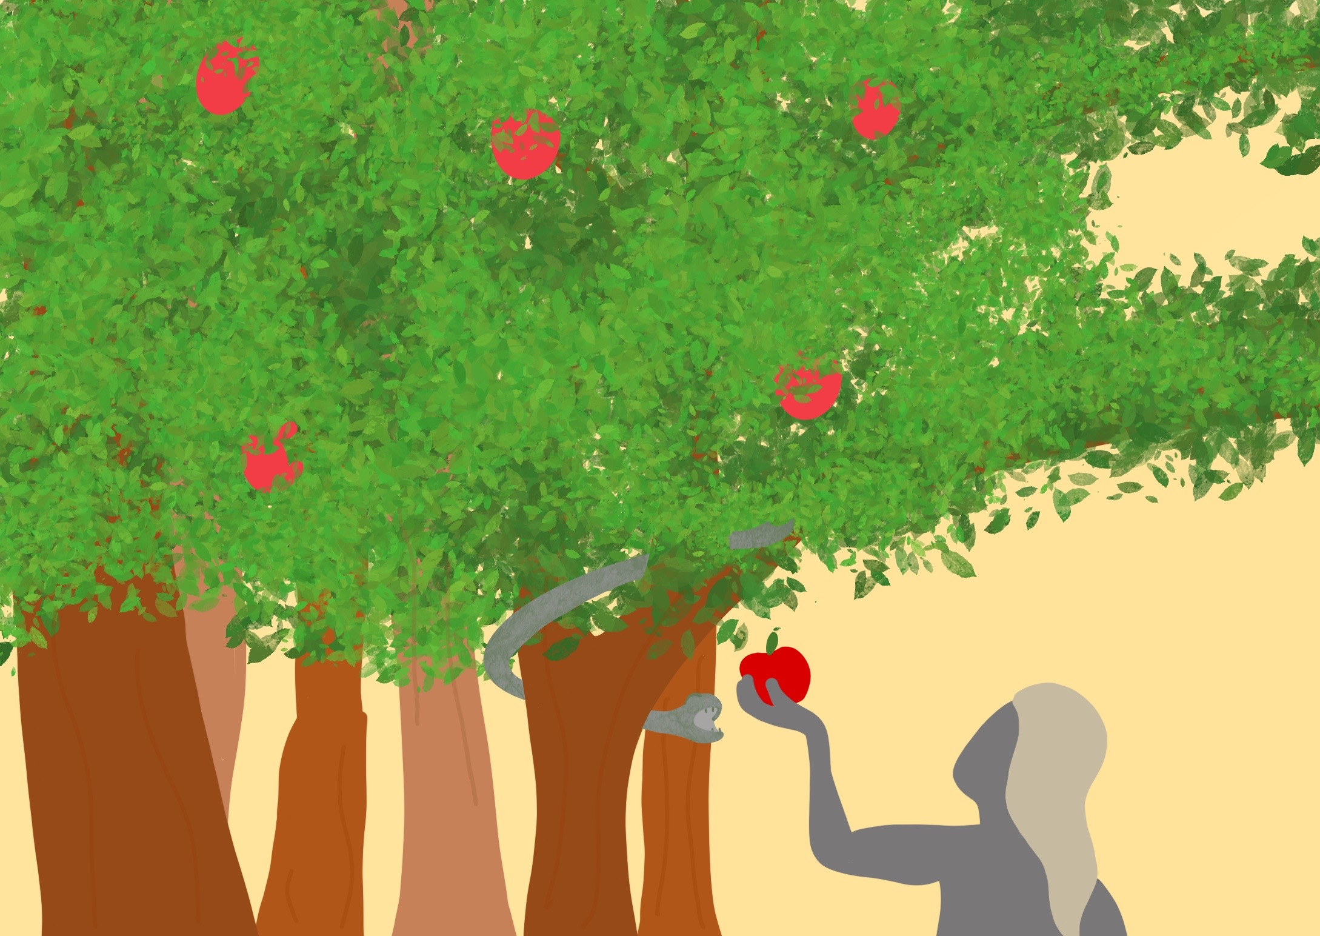

Slide 4
In God’s perfect world when wrong things began…

Slide 5
In the beginning God had a rescue plan

