Slide 3
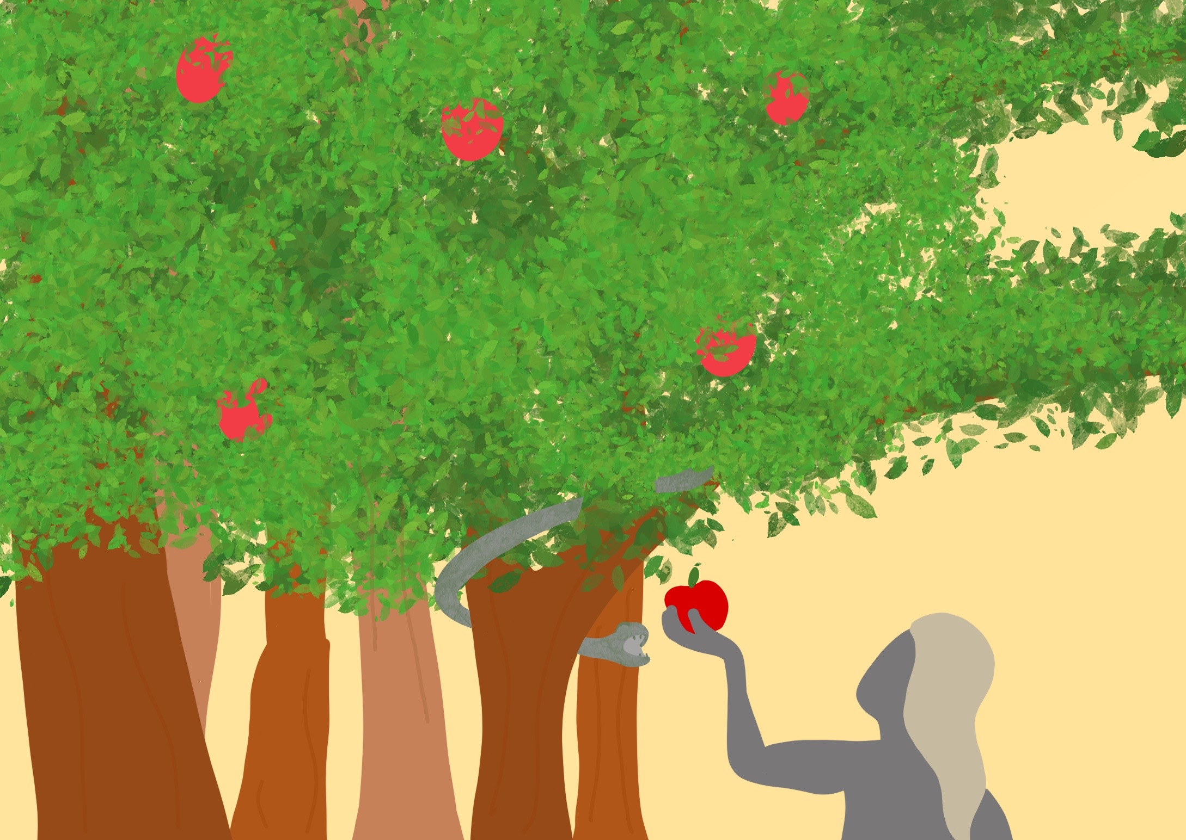

Slide 4
In God’s perfect world when wrong things began…

Slide 5
In the beginning when God made the world

Slide 6
Notes:
Imagine you are surrounded by nothing.
No one is anywhere near you.
Close your eyes and imagine what this would be like.
It’s dark and gloomy.
But in the middle of this nothing is God. He just is.
And as God moved around, he began to create. Out of nothing he made something.
Out of the darkness he created light.
In the beginning, there was nothing. Nothing except God.

Slide 7
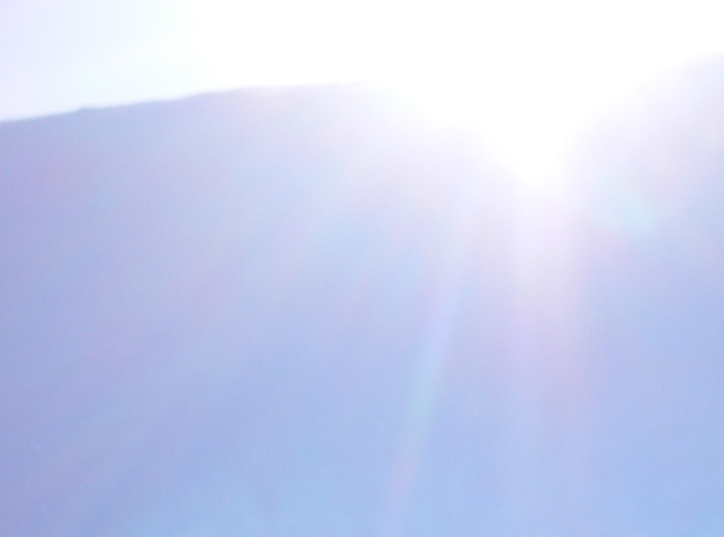
Notes:
God saw the light was good.

Slide 8
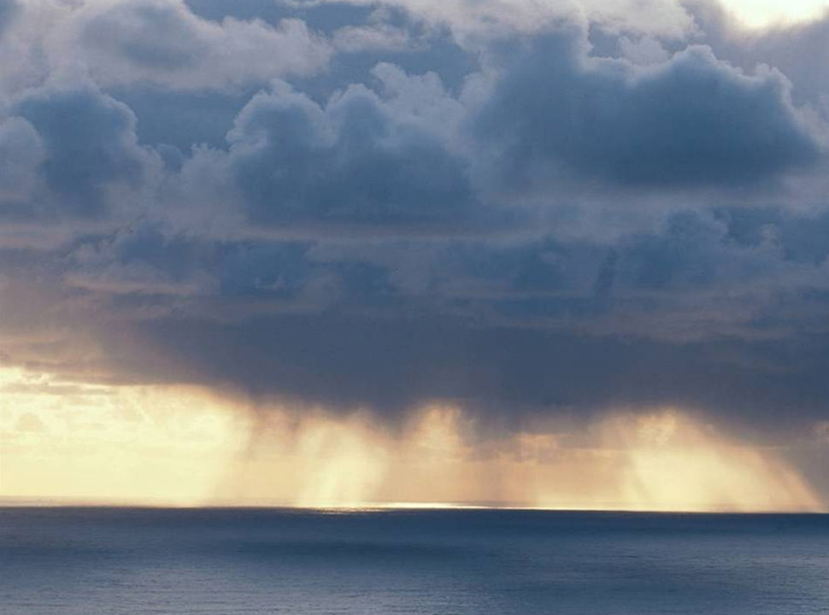
Notes:
Then God made the sea and the sky.

Slide 9
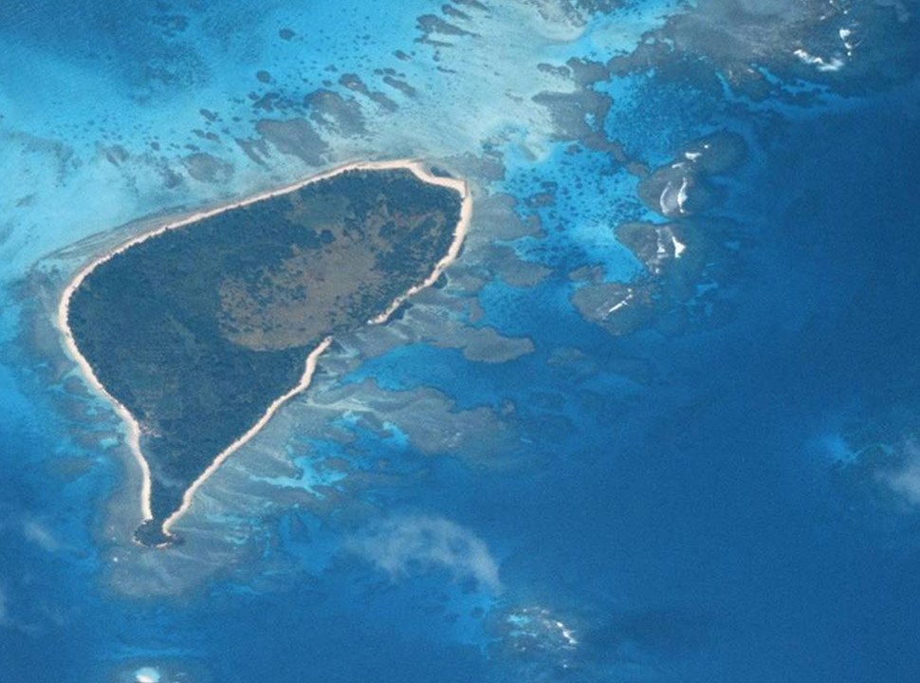
Notes:
From the sea, he made the dry land. He made islands and beaches.

Slide 10
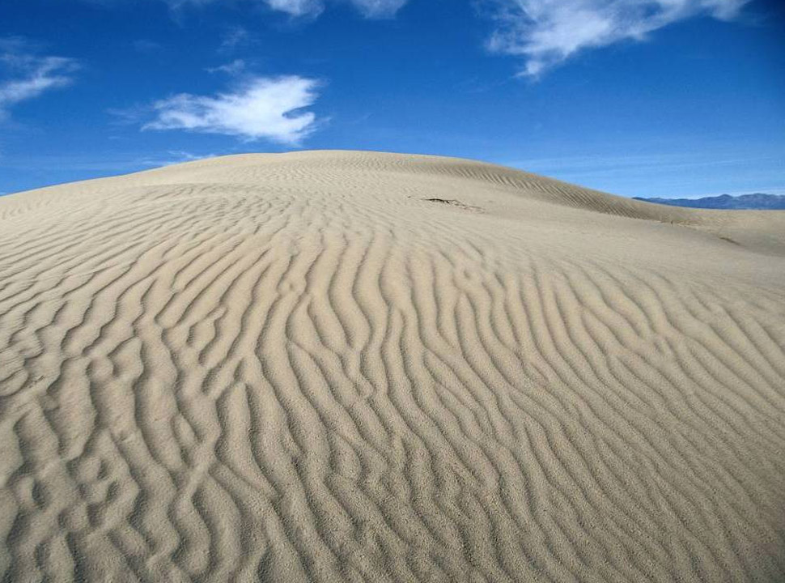
Notes:
He made deserts and valleys

Slide 11
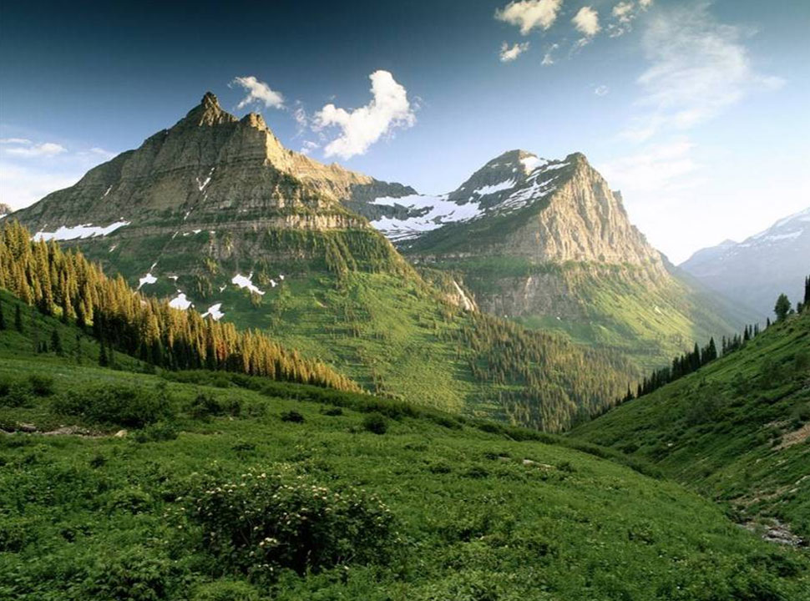
Notes:
He made mountains and hills
And God said: That’s good.

Slide 12
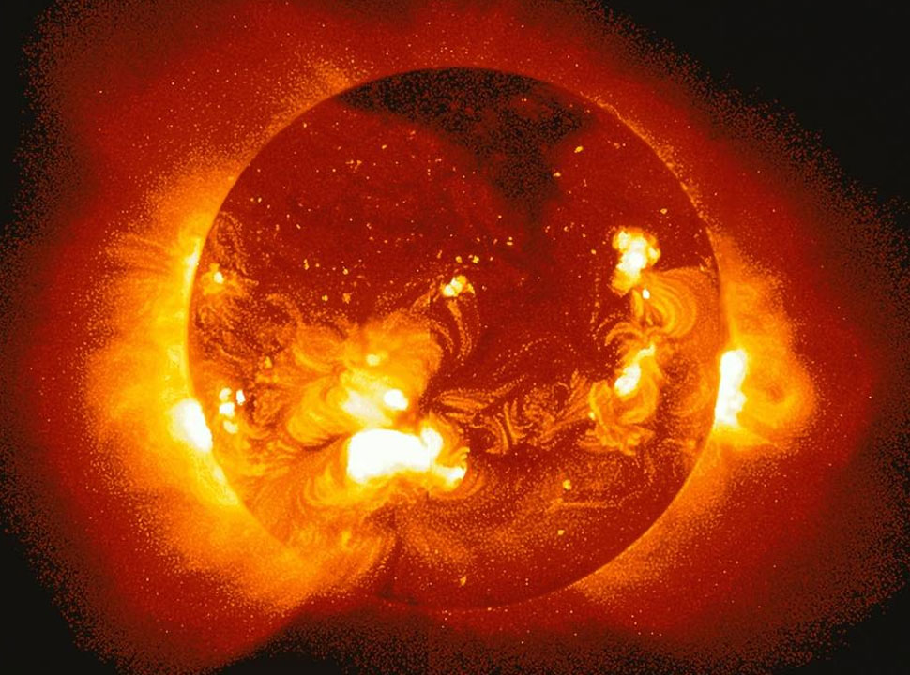
Notes:
God made the sun – bright and glowing

Slide 13
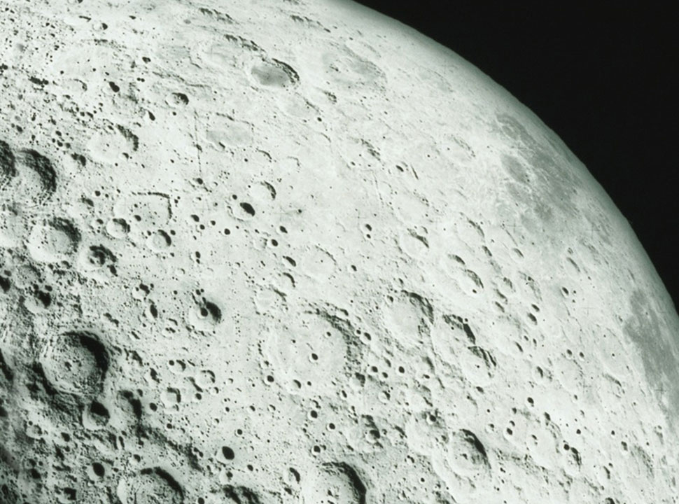
Notes:
He made the moon, pale and silvery

Slide 14
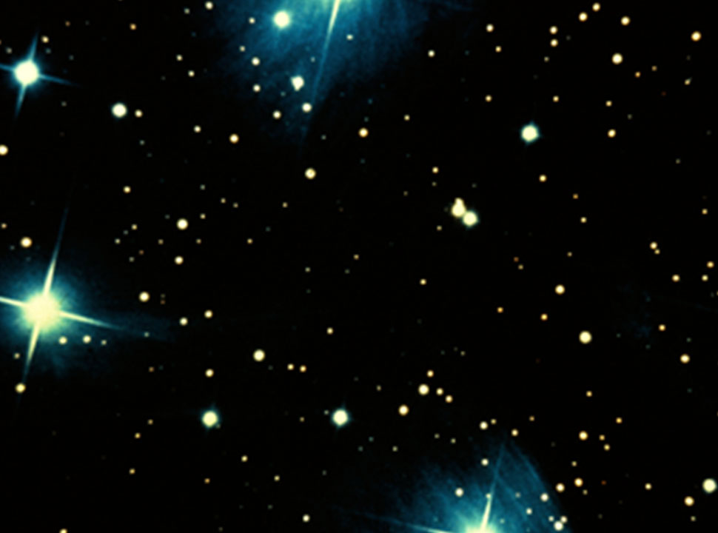
Notes:
He made the stars, far away and mysterious
And God saw what he’d made and was pleased. ‘This is very good’, he said.

Slide 15
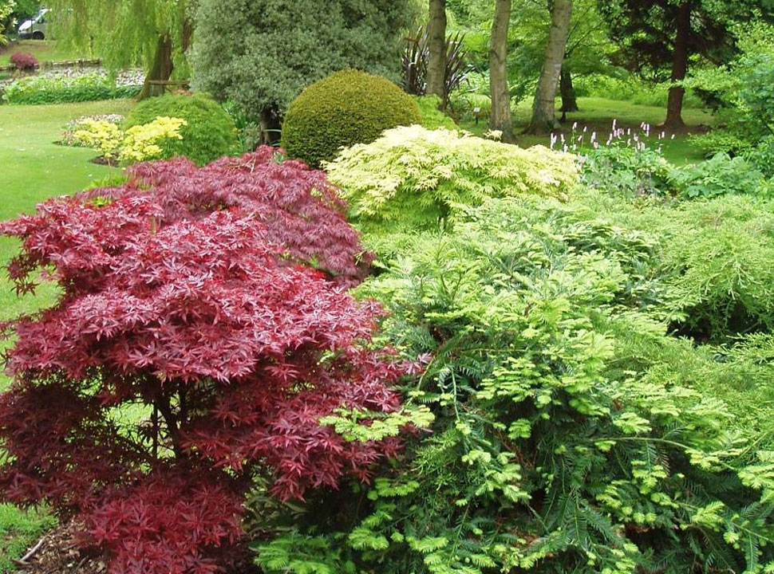
Notes:
God made plants; trees and flowers to grow on the land.

Slide 16
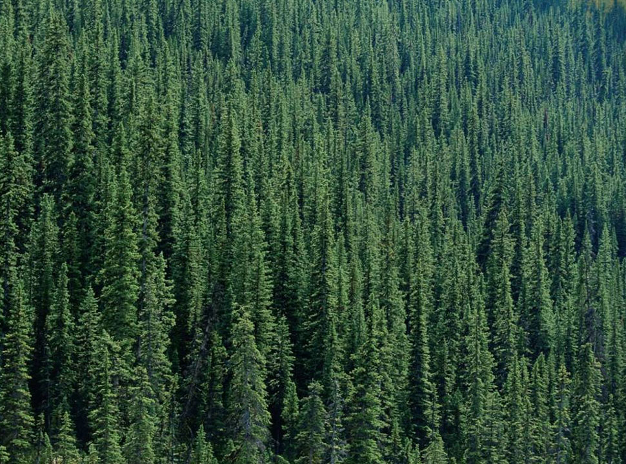
Notes:
He made forests and woods

Slide 17
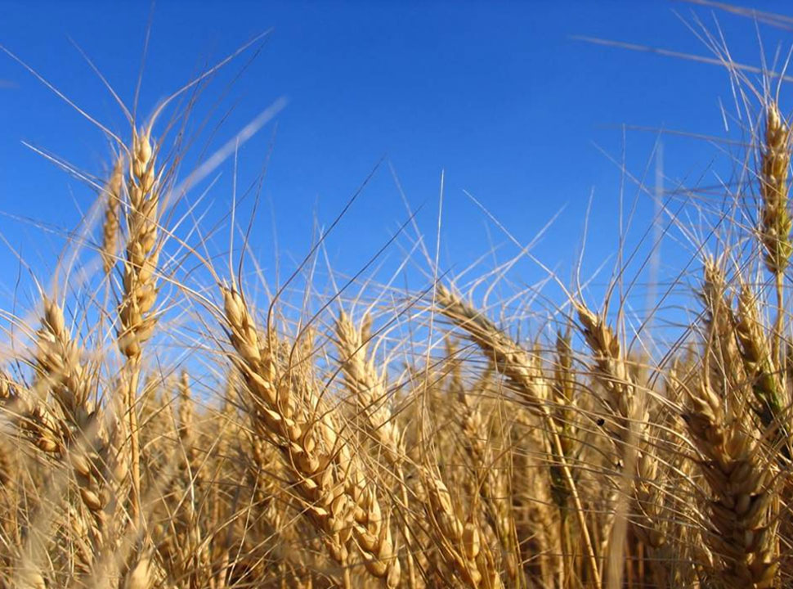
Notes:
He made grain, wheat, barley, and maize

Slide 18
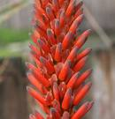
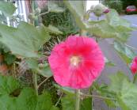
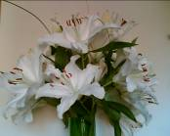
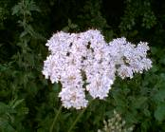
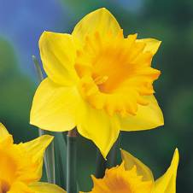
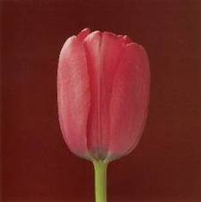
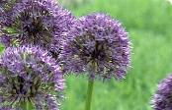
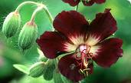
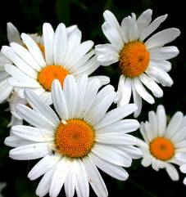
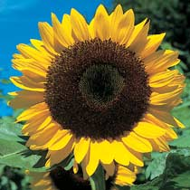
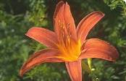
Notes:
He made flowers: daffodils, tulips, sunflowers and daisies
loads and loads of different flowers
hundreds and thousands and millions of them!

Slide 19
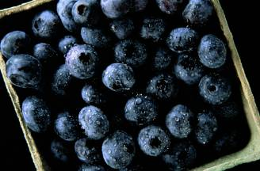
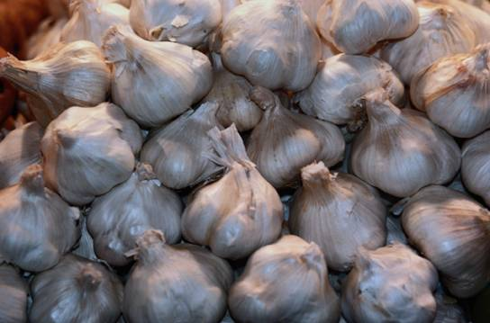
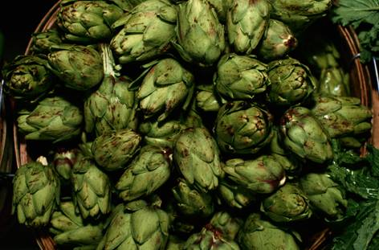
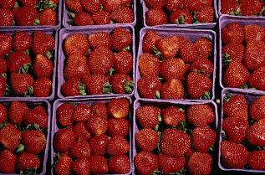
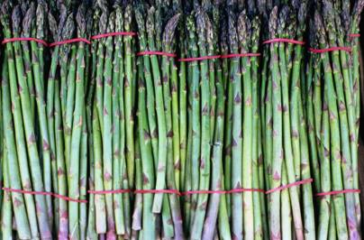
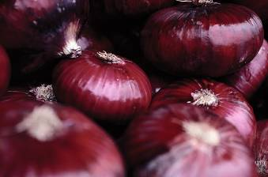
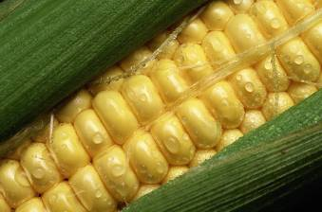
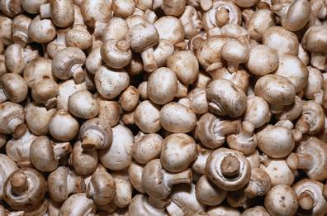
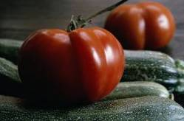
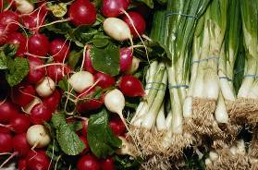
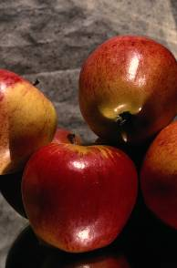
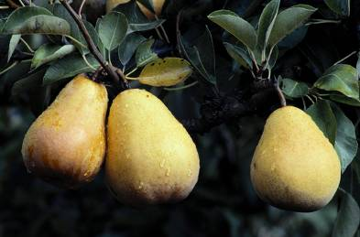
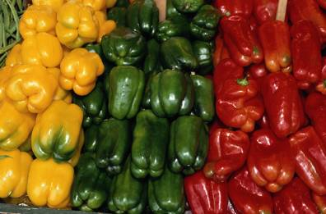
Notes:
He made plants which can be eaten – fruit and vegetables, growing on trees and bushes, growing under the ground and over it.
And God saw it was very good.

Slide 20
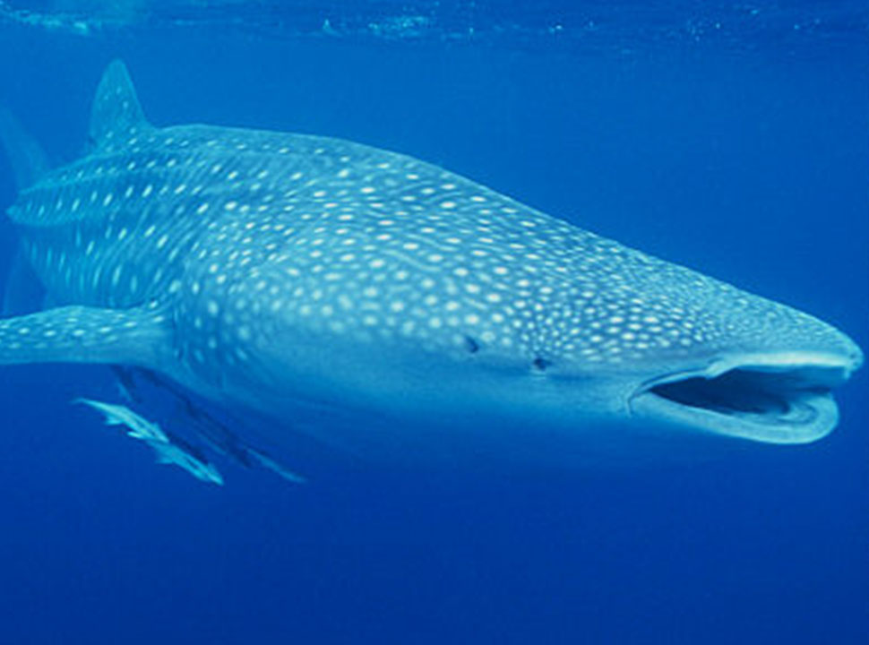
Notes:
God created all sorts of animals in the sea – massive ones

Slide 21
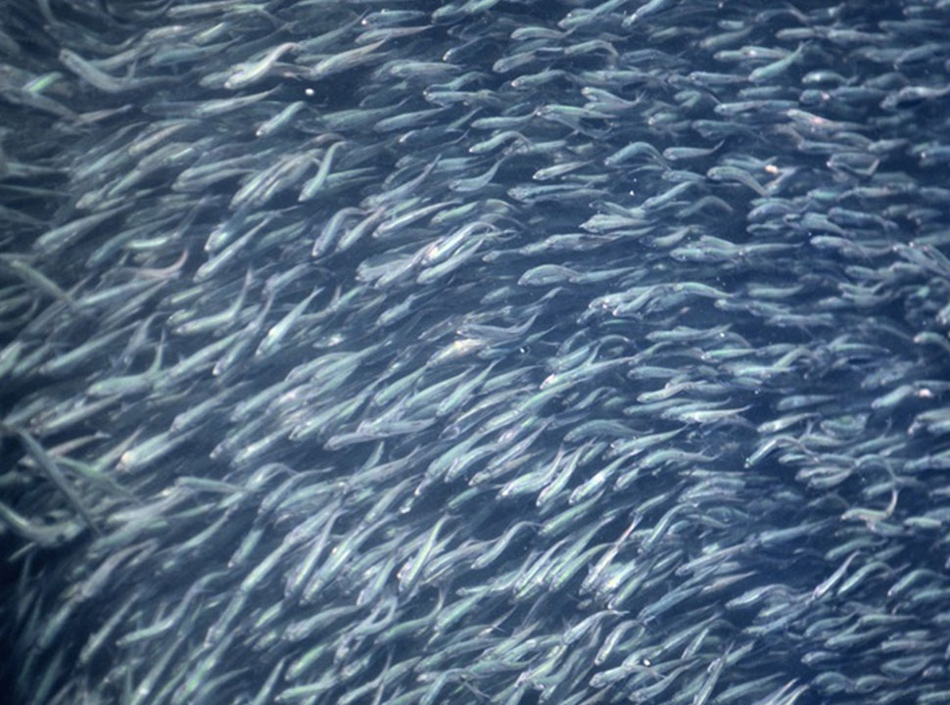
Notes:
Small ones

Slide 22
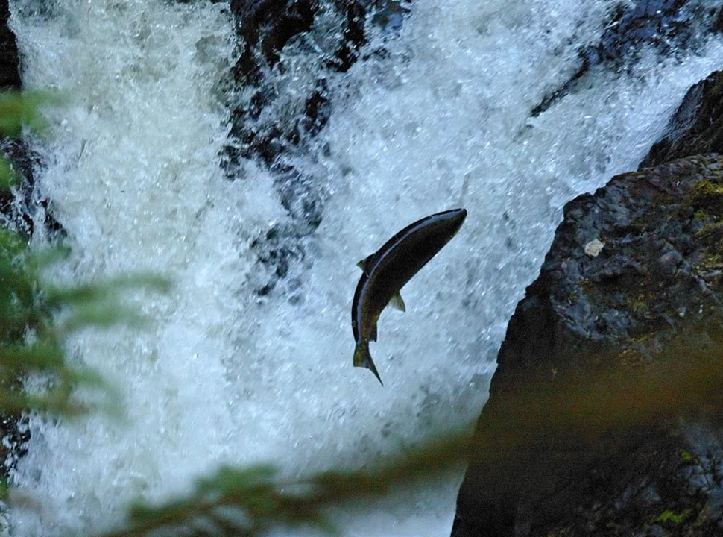
Notes:
Jumping ones

Slide 23
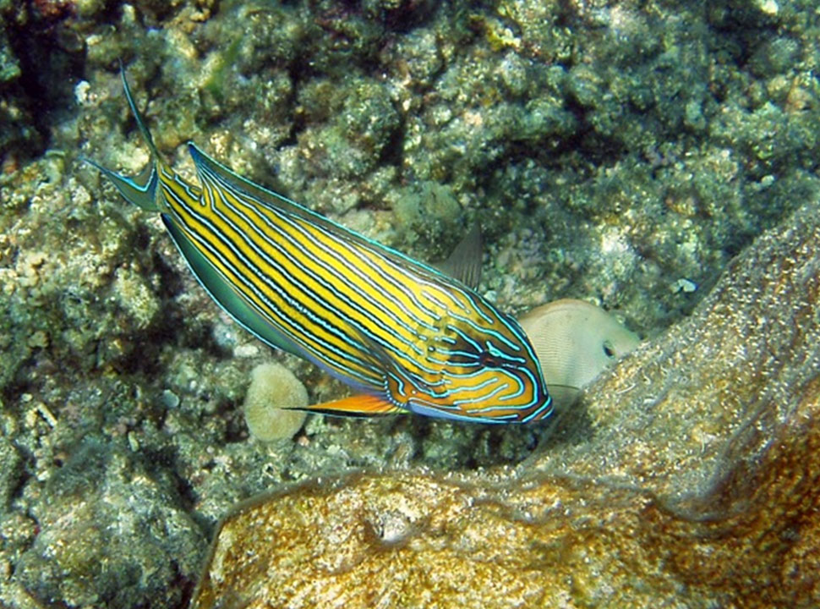
Notes:
Nibbling ones

Slide 24
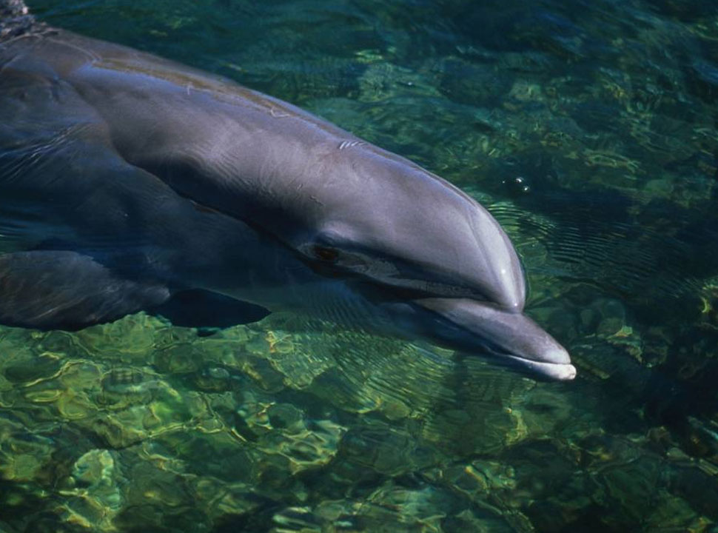
Notes:
Warm water ones

Slide 25
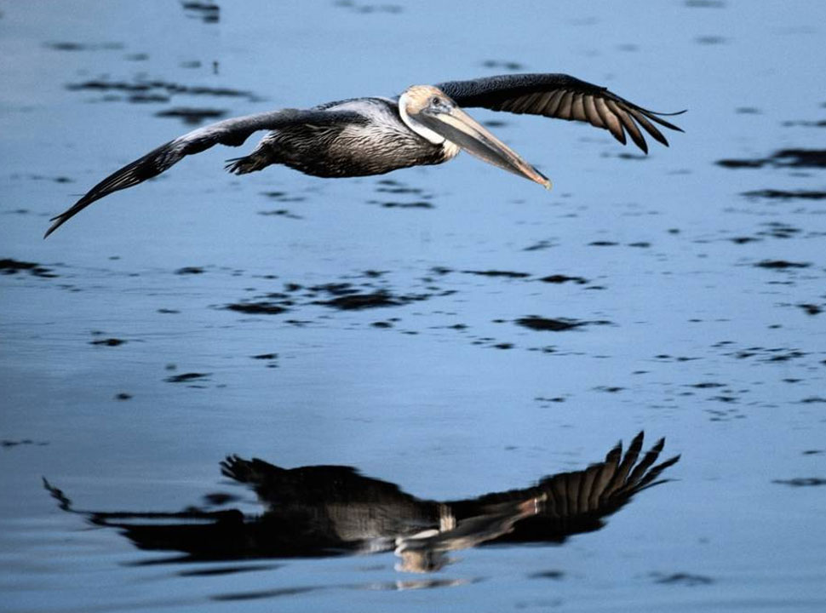
Notes:
And he made the birds

Slide 26
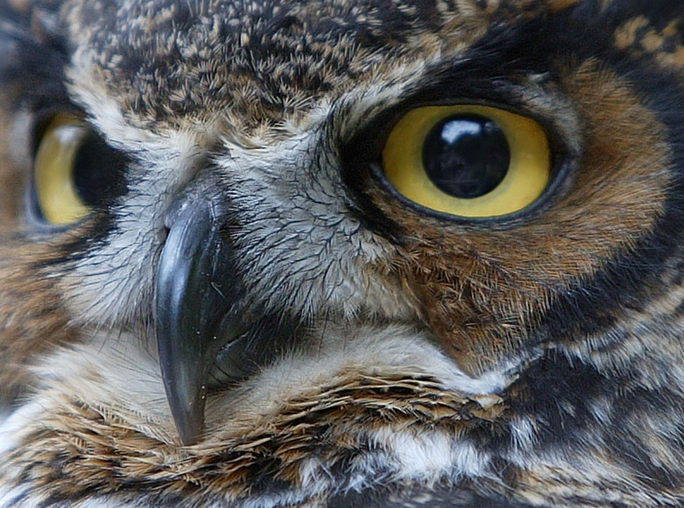
Notes:
Night time birds

Slide 27
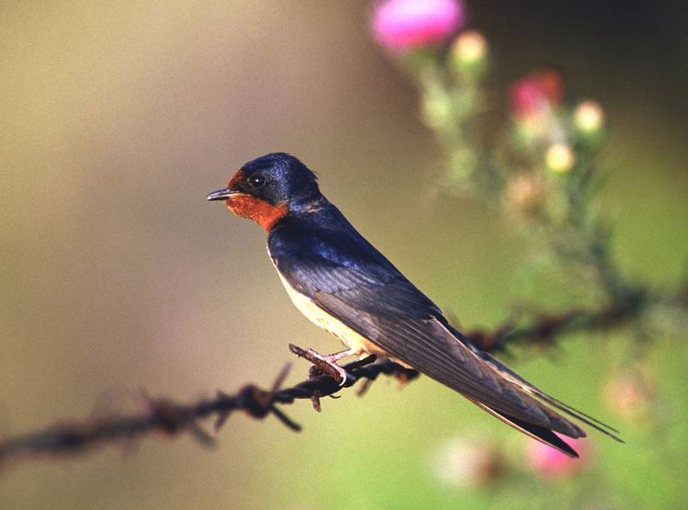
Notes:
Day time birds

Slide 28
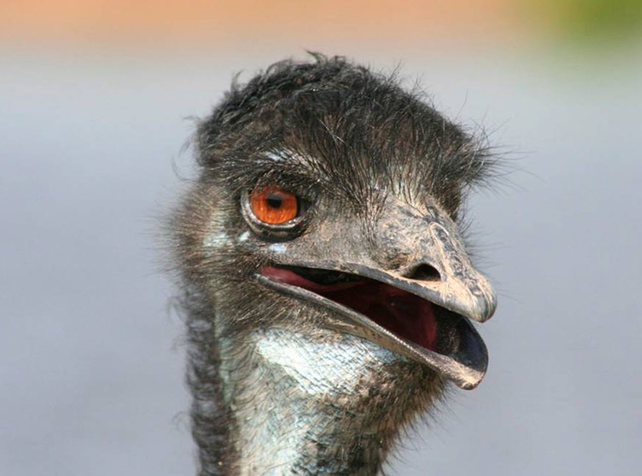
Notes:
Birds with different beaks

Slide 29
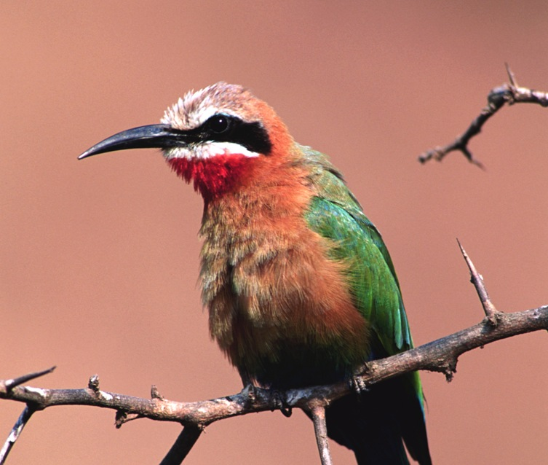
Notes:
And different feathers

Slide 30
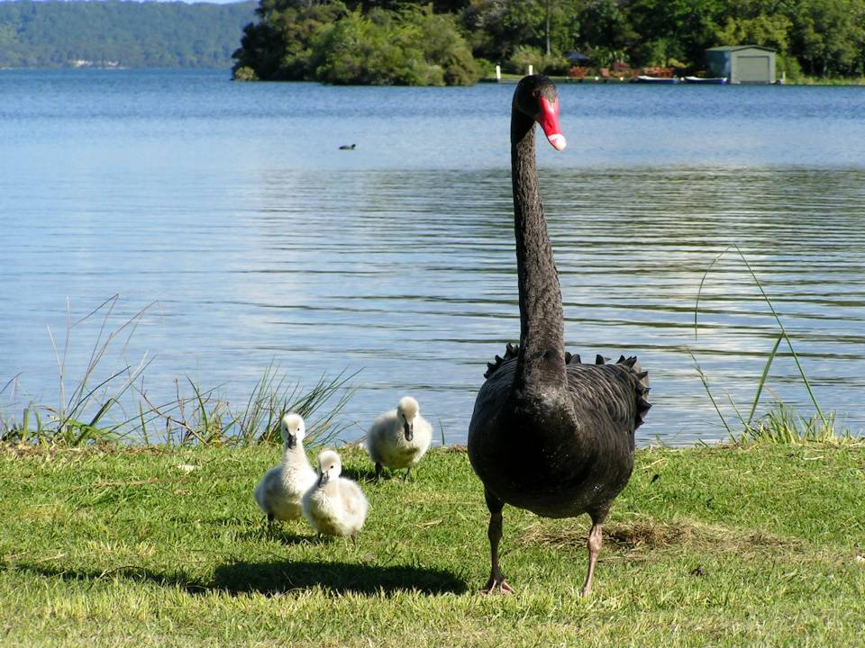
Notes:
Even baby birds

Slide 31
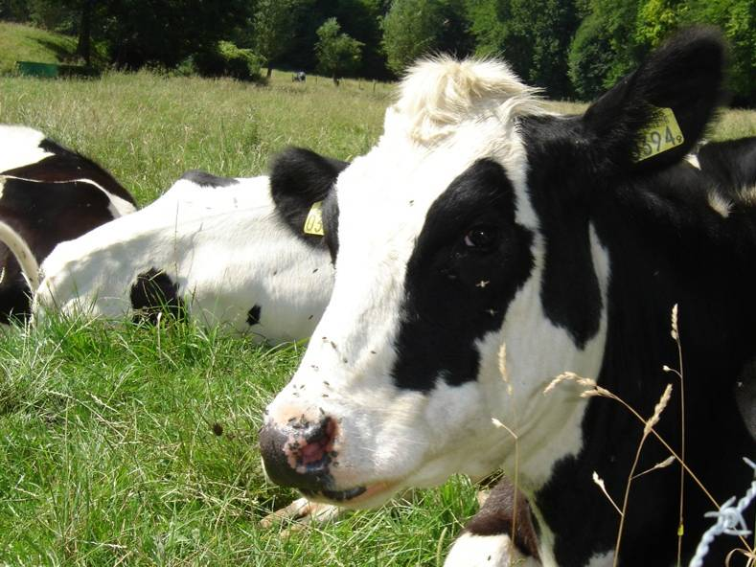
Notes:
And he made animals on the land – cows

Slide 32
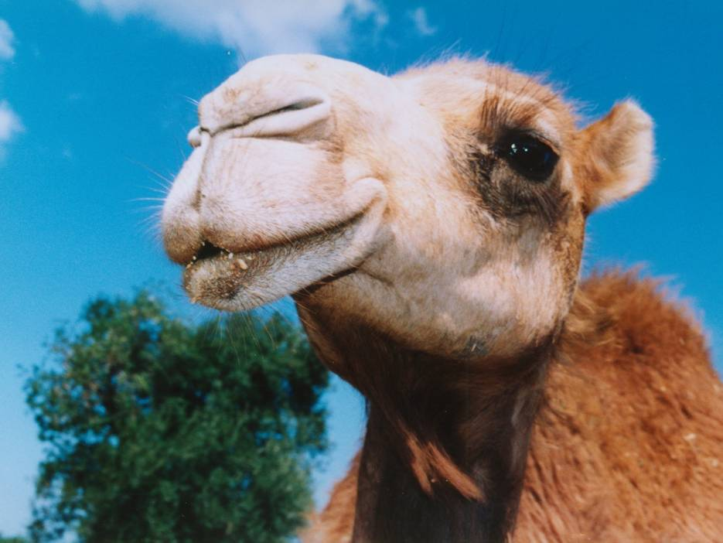
Notes:
Camels

Slide 33
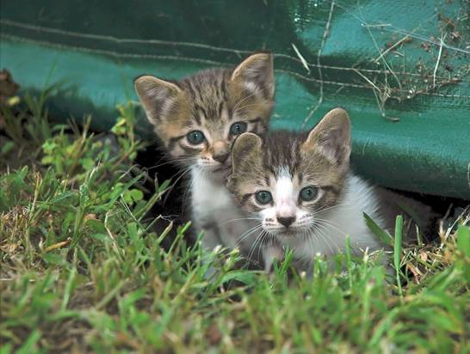
Notes:
And kittens

Slide 34
Notes:
lions

Slide 35
Notes:
Lemurs and

Slide 36
Notes:
lizards

Slide 37
Notes:
pythons

Slide 38
Notes:
And polar bears

Slide 39
Notes:
Scary animals

Slide 40
Notes:
Cute animals

Slide 41
Notes:
Wild animals

Slide 42
Notes:
Tame animals

Slide 43
Notes:
Large animals

Slide 44
Notes:
Amphibians

Slide 45
Notes:
Insects

Slide 46
Notes:
And Mammals

Slide 47
It’s good!
Notes:
And God looked at everything he had made and he said,
“It’s good!”

Slide 48
Notes:
Finally, God made human beings. They were different from the animals because they were able to be friends with God.
And God gave them a special job to do.
He asked them to give names to all the animals. He also told them they had to look after everything in the world. They had to make sure that the plants grew properly, and that the birds, animals, and fish were well cared for. This was a big job, but God knew humans beings could do this properly.

Slide 49
It’s good!
Notes:
And God looked at everything he had made and he said,
“It’s good!”

