Slide 4
The Bible is the word of God

Slide 5
The Bible helps us find our way

Slide 6
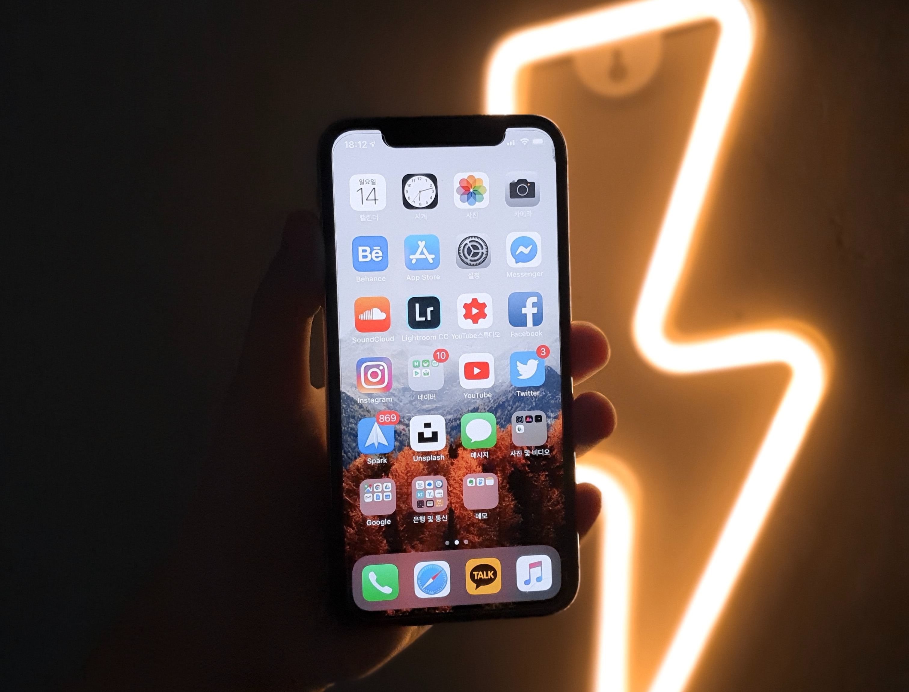
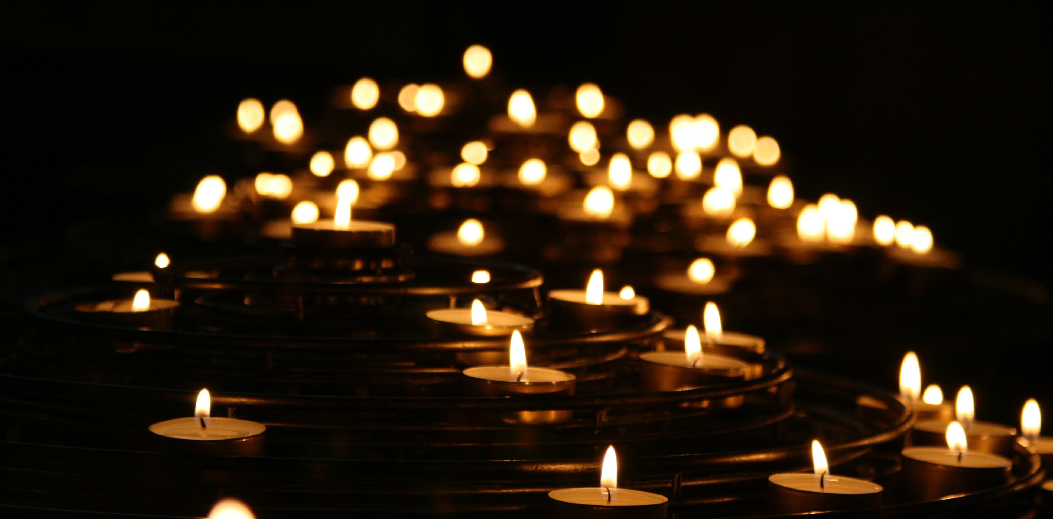

Slide 7
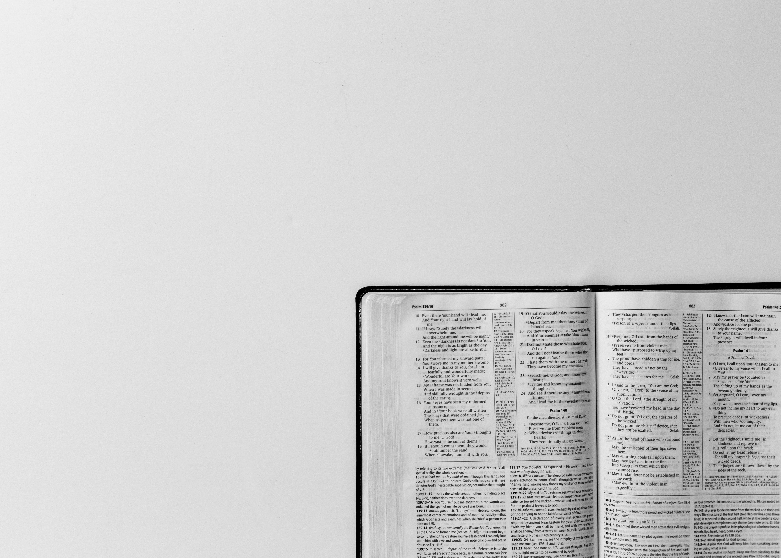
Your word is a lamp for my feet
and a light to my path.
Psalm 119:105

