Slide 3
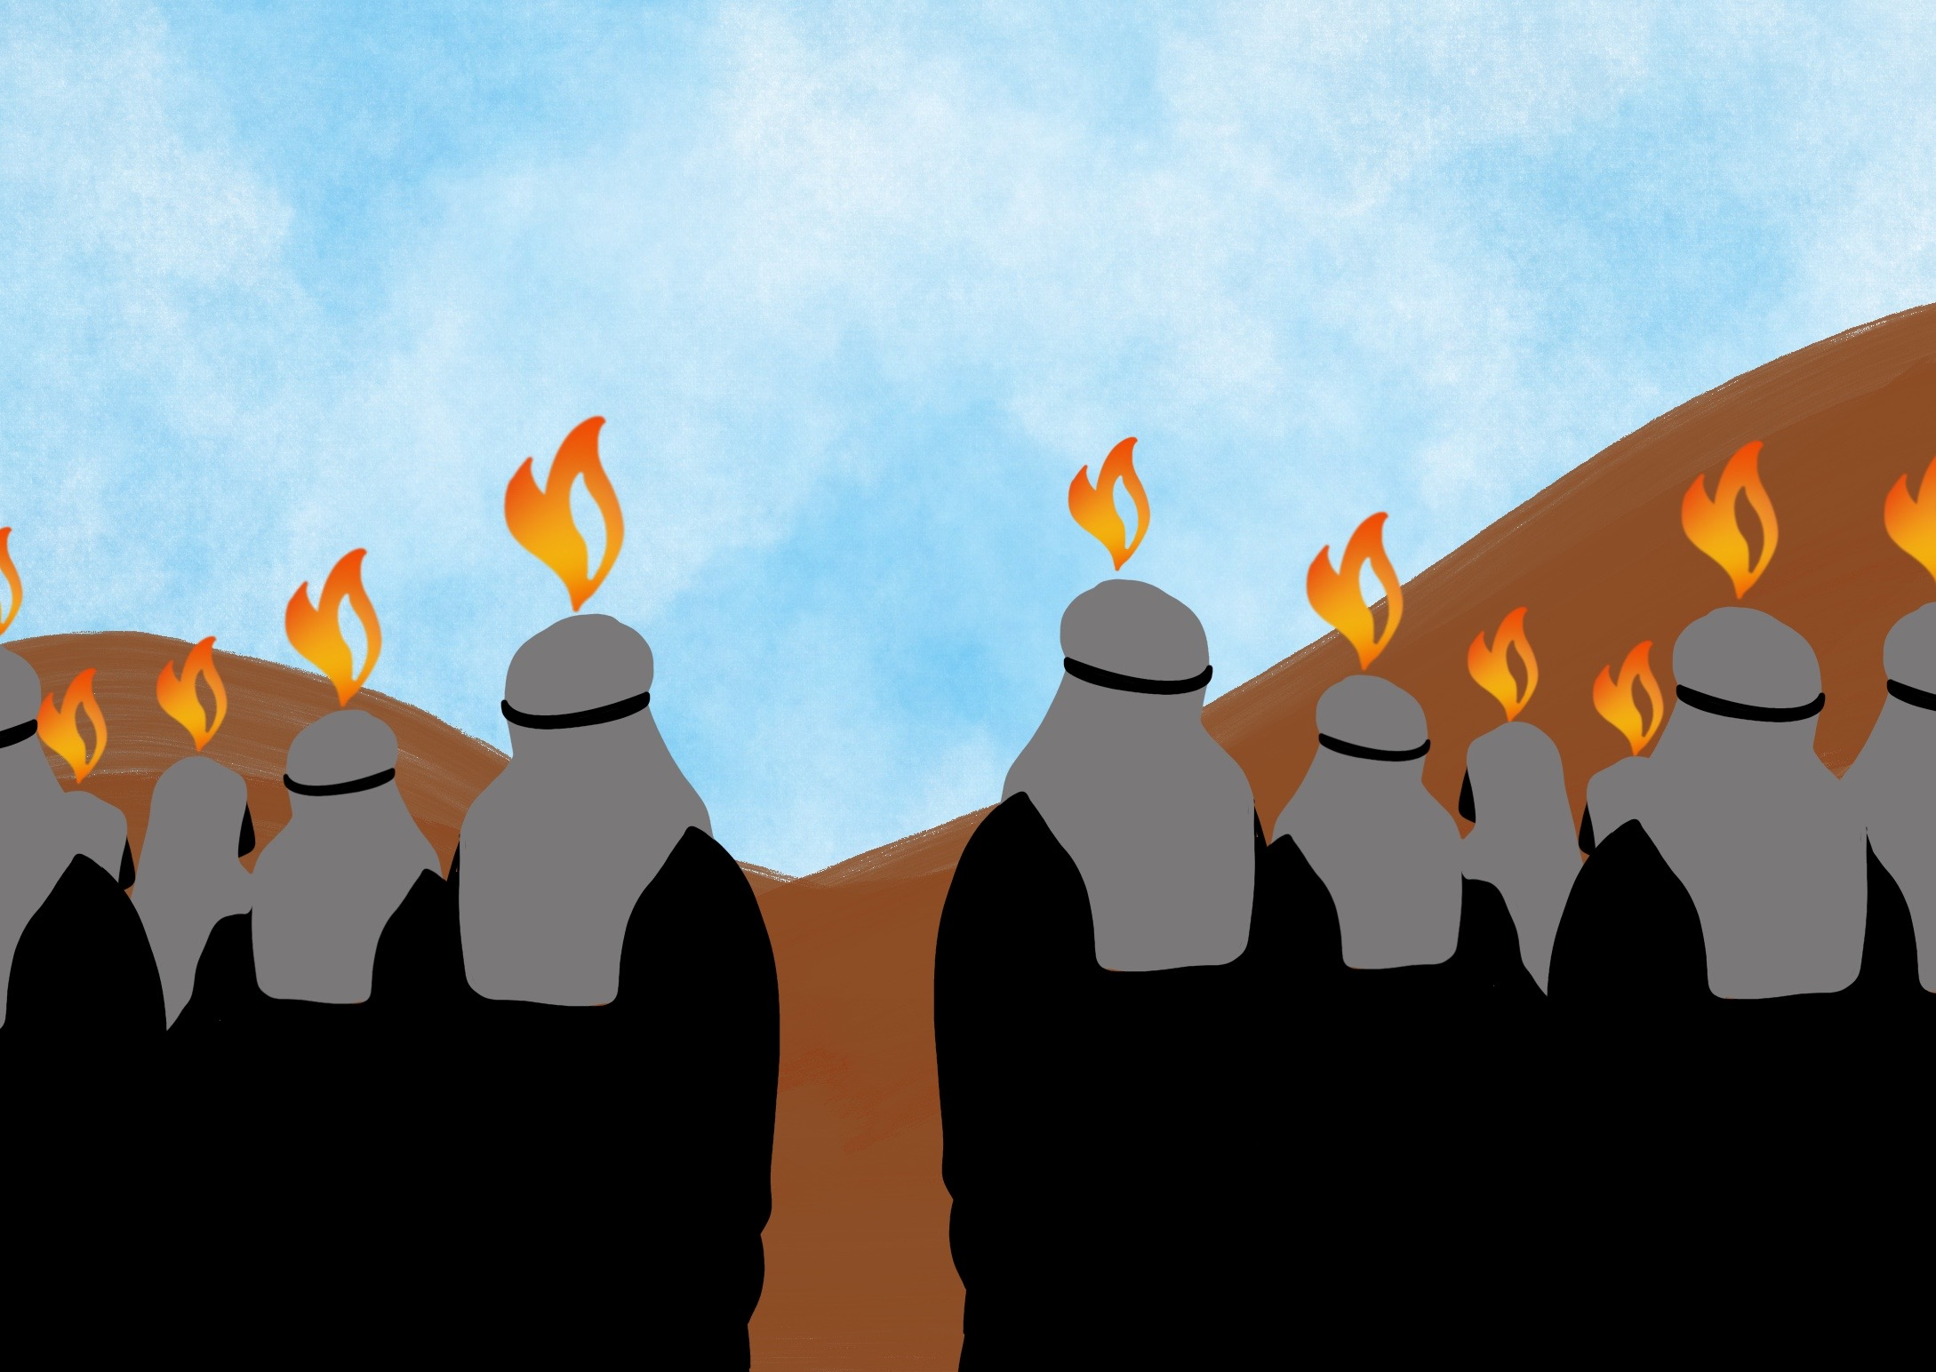

Slide 4
He has given us His Spirit to help us since then,

Slide 5
The Holy Spirit helps us to live God’s way

Slide 6
