Slide 1
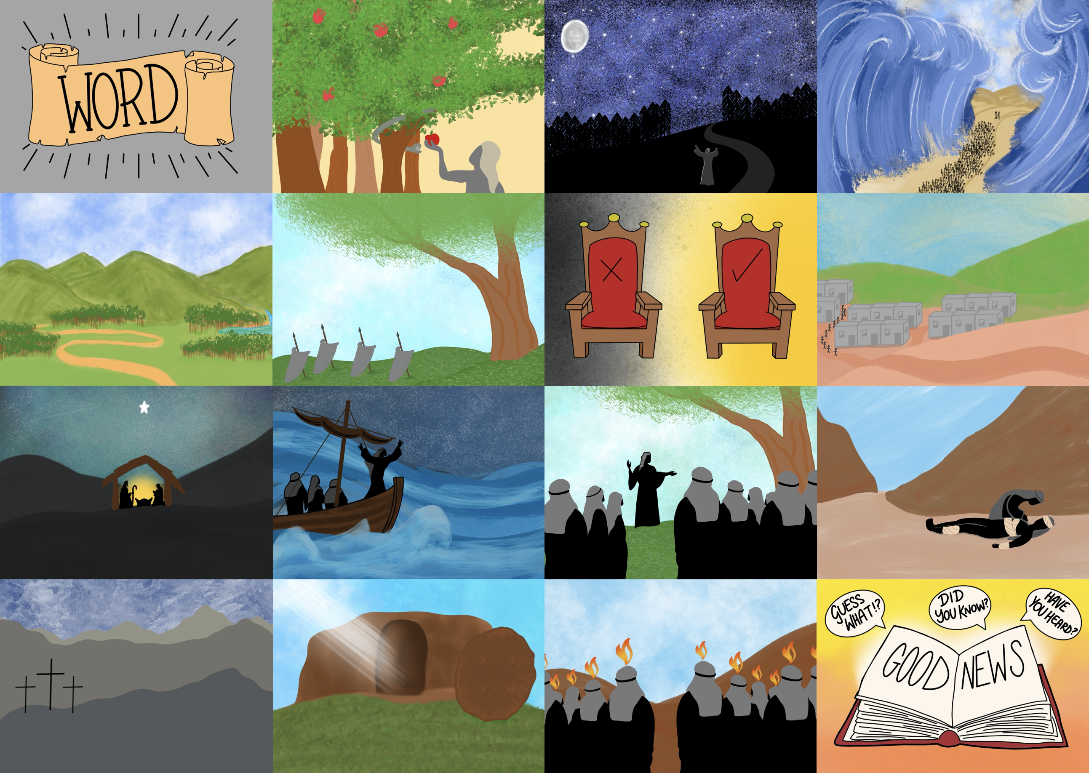

Slide 3
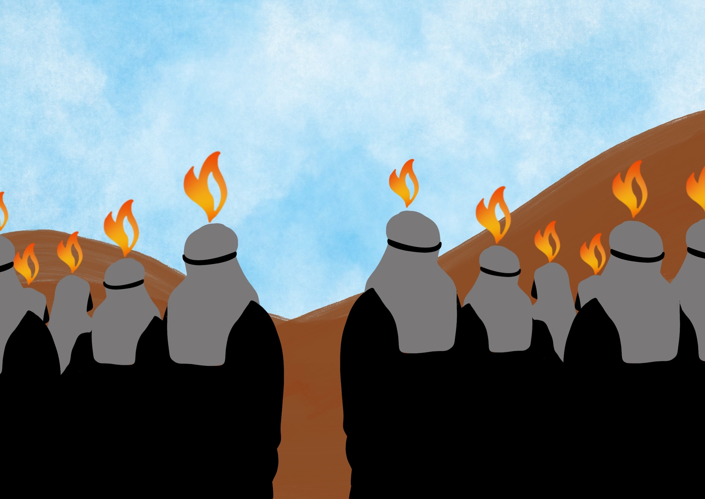

Slide 4
He has given us His Spirit to help us since then,

Slide 5
The Holy Spirit helps us to care for others

Slide 6
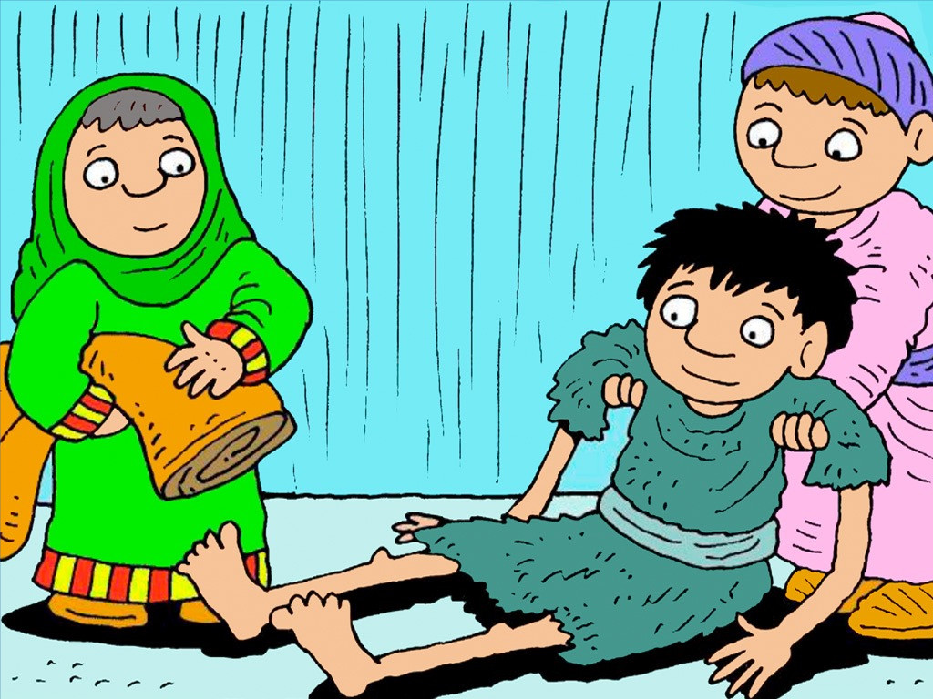

Slide 7
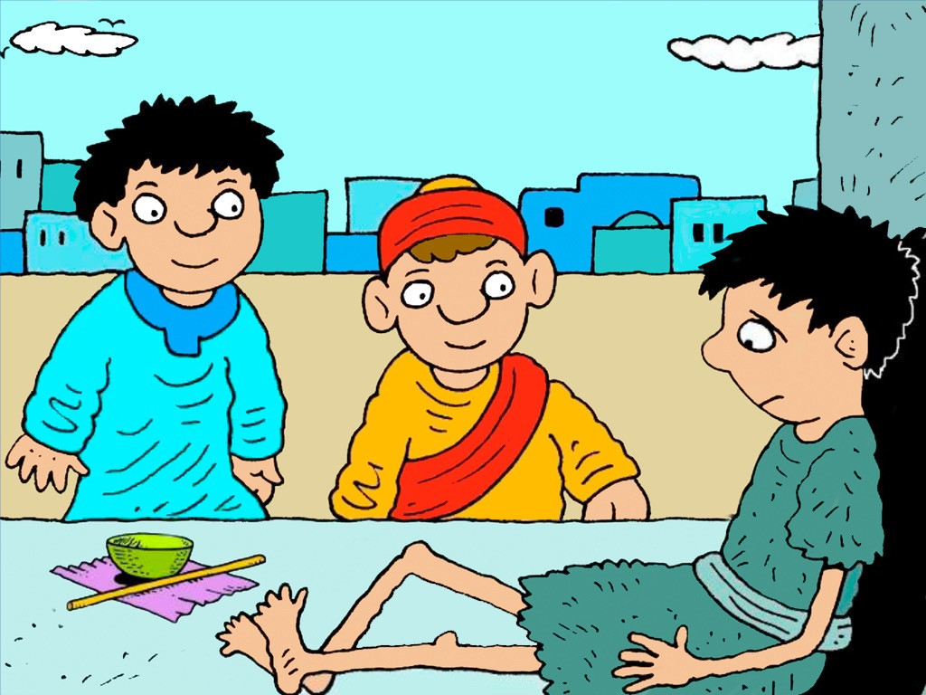

Slide 8
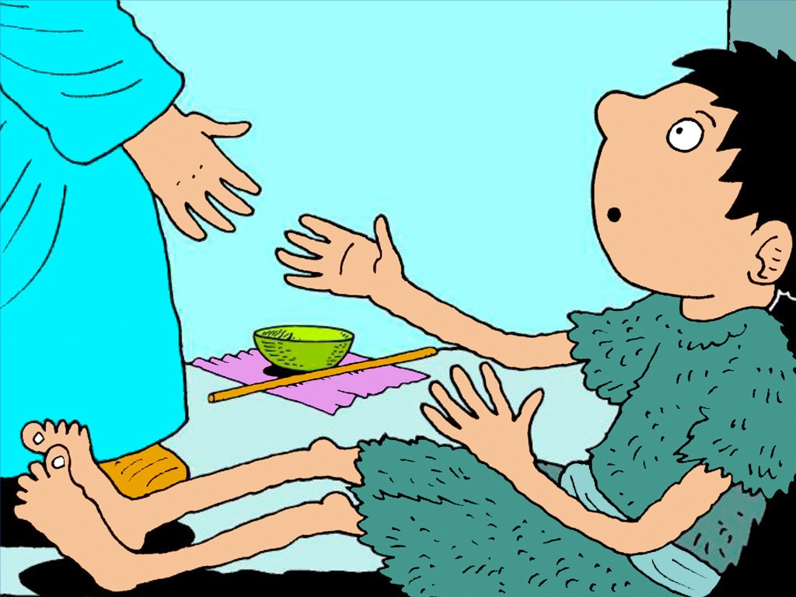

Slide 9
