Slide 1
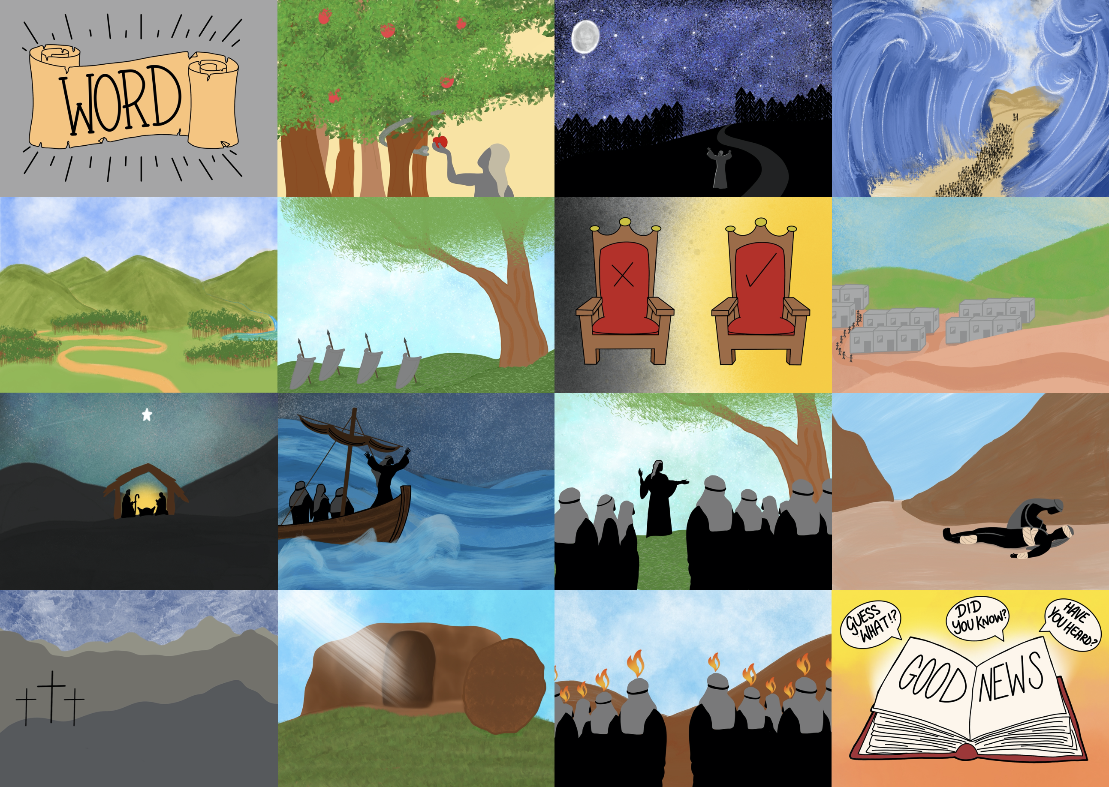



Slide 3
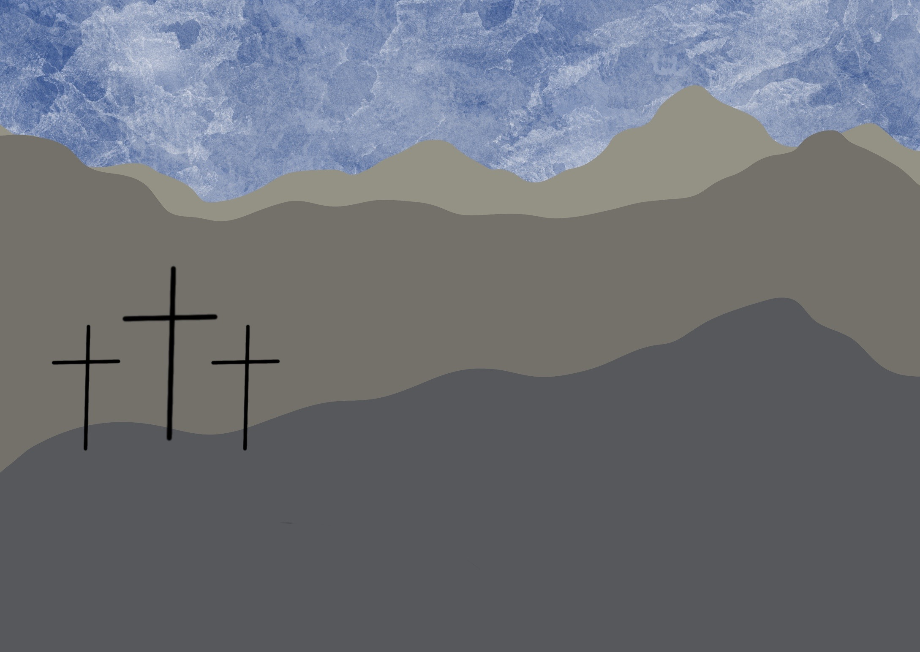

Slide 4
He died on a cross so our sins can be forgiven,

Slide 5
Jesus died for our sins

Slide 6
x
2 + 2 = 5
There is something wrong

Slide 7
I have come to rescue you

Slide 8
I love you

Slide 9

There is treasure for you to find

Slide 10
You have a choice to make

Slide 11
Christ died for our sins. 1 Corinthians 15:3

Slide 12
