Slide 4
The Bible comes from God

Slide 5
The Bible is the word of God

Slide 7
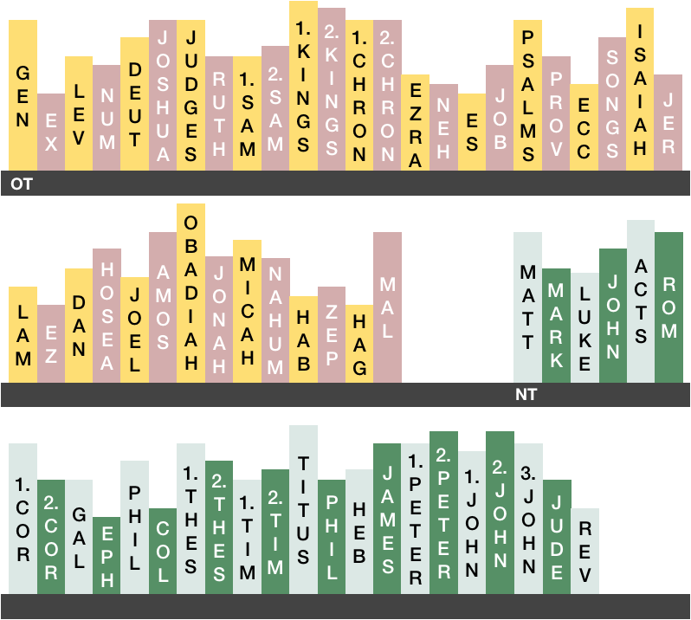

Slide 8
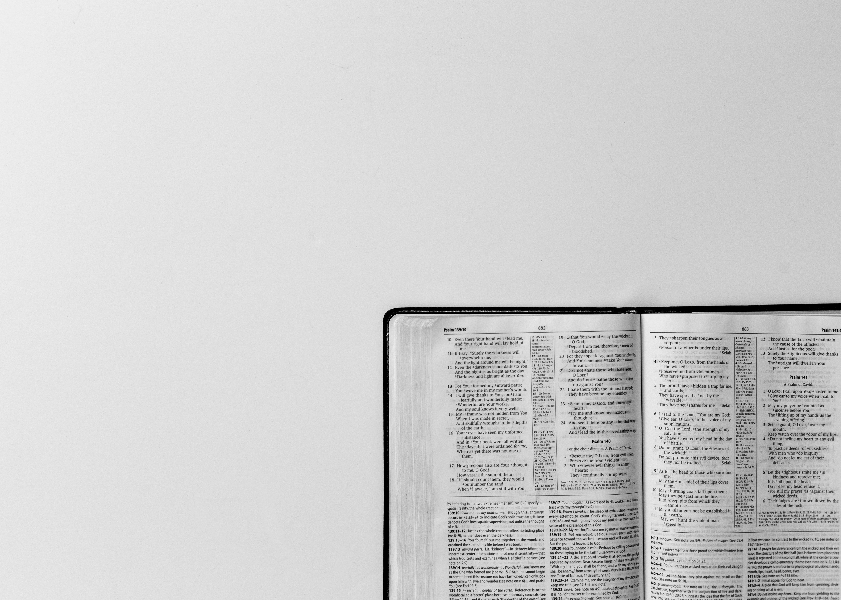
Everything in the Scriptures
is God’s word.
2 Timothy 3:16

Slide 10
Obey the Maker’s Instructions
(Optional song lyrics)

Slide 11
Obey the Maker’s instructions all the time
Obey the Maker’s instructions and you will find:
Obey the Maker’s instructions – it will help you see
That things fit together much more easily.

Slide 12
Say you buy a model of your
favourite classic car.
Without checking instructions you put it together so far;
But when you think you’ve finished you find a little extra bit;
It’s the driver of the car but now he just won’t fit!

Slide 13
Obey the Maker’s instructions all the time
Obey the Maker’s instructions and you will find:
Obey the Maker’s instructions – it will help you see
That things fit together much more easily.

Slide 14
Say you read the Bible to see
what God has said
And you find instructions and store them all in your head;
But when you find you’re tempted to do things the wrong way,
Instructions mean nothing unless you do what they say!

Slide 15
Obey the Maker’s instructions all the time
Obey the Maker’s instructions and you will find:
Obey the Maker’s instructions – it will help you see
That things fit together much more easily.

