Slide 1
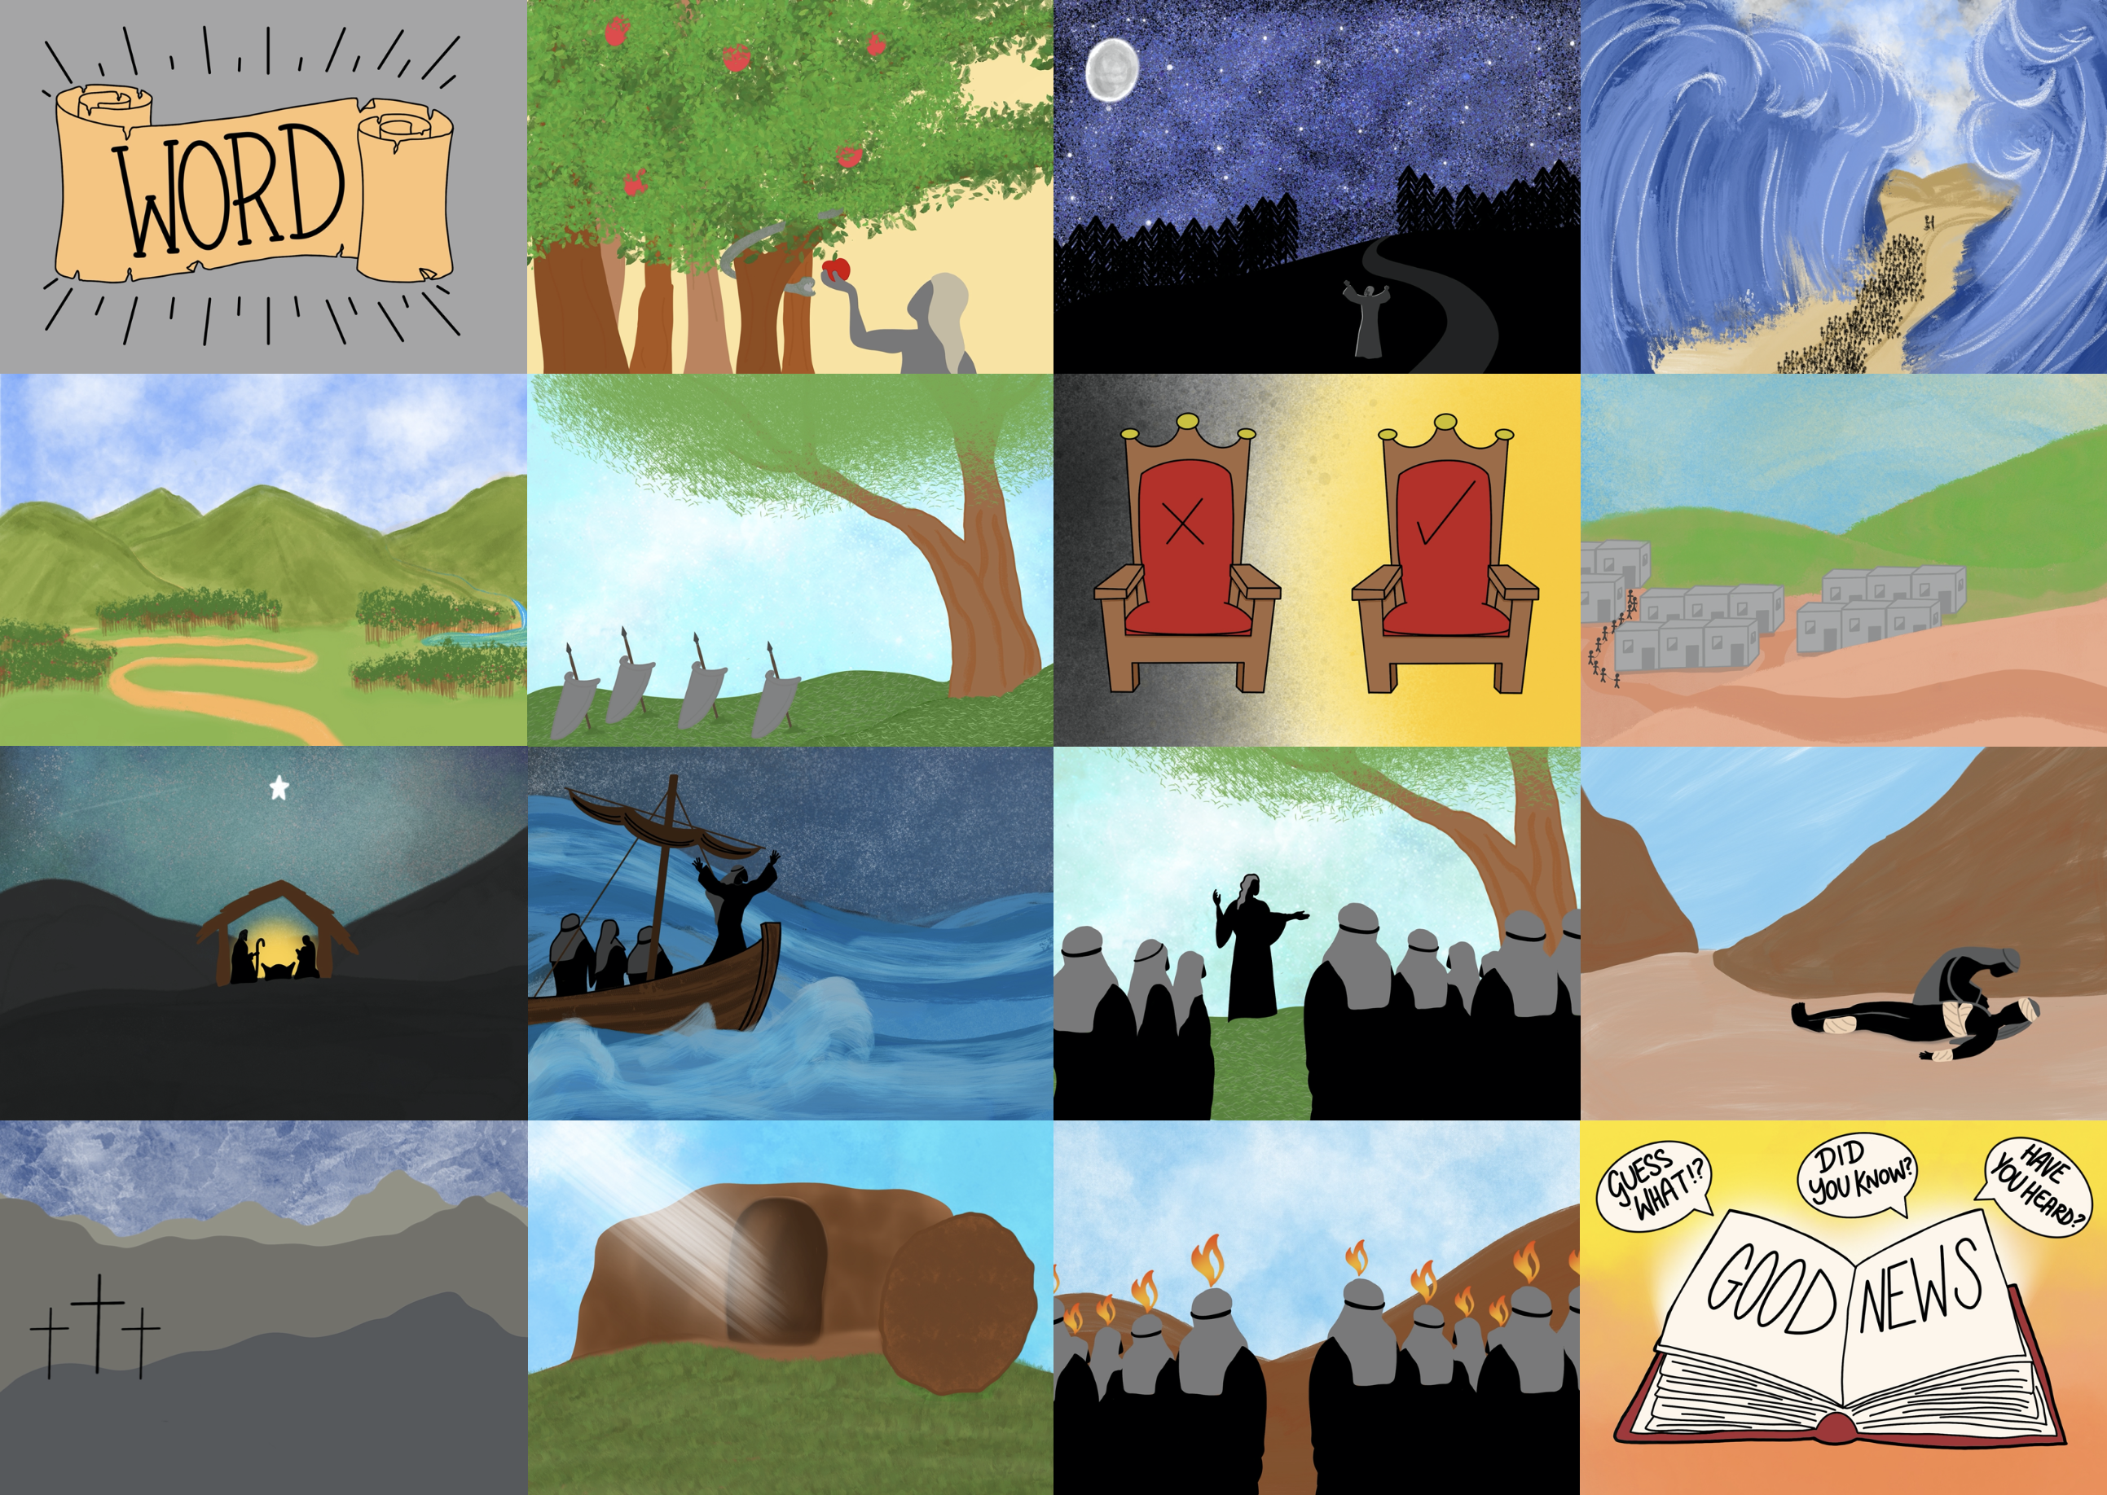



Slide 3
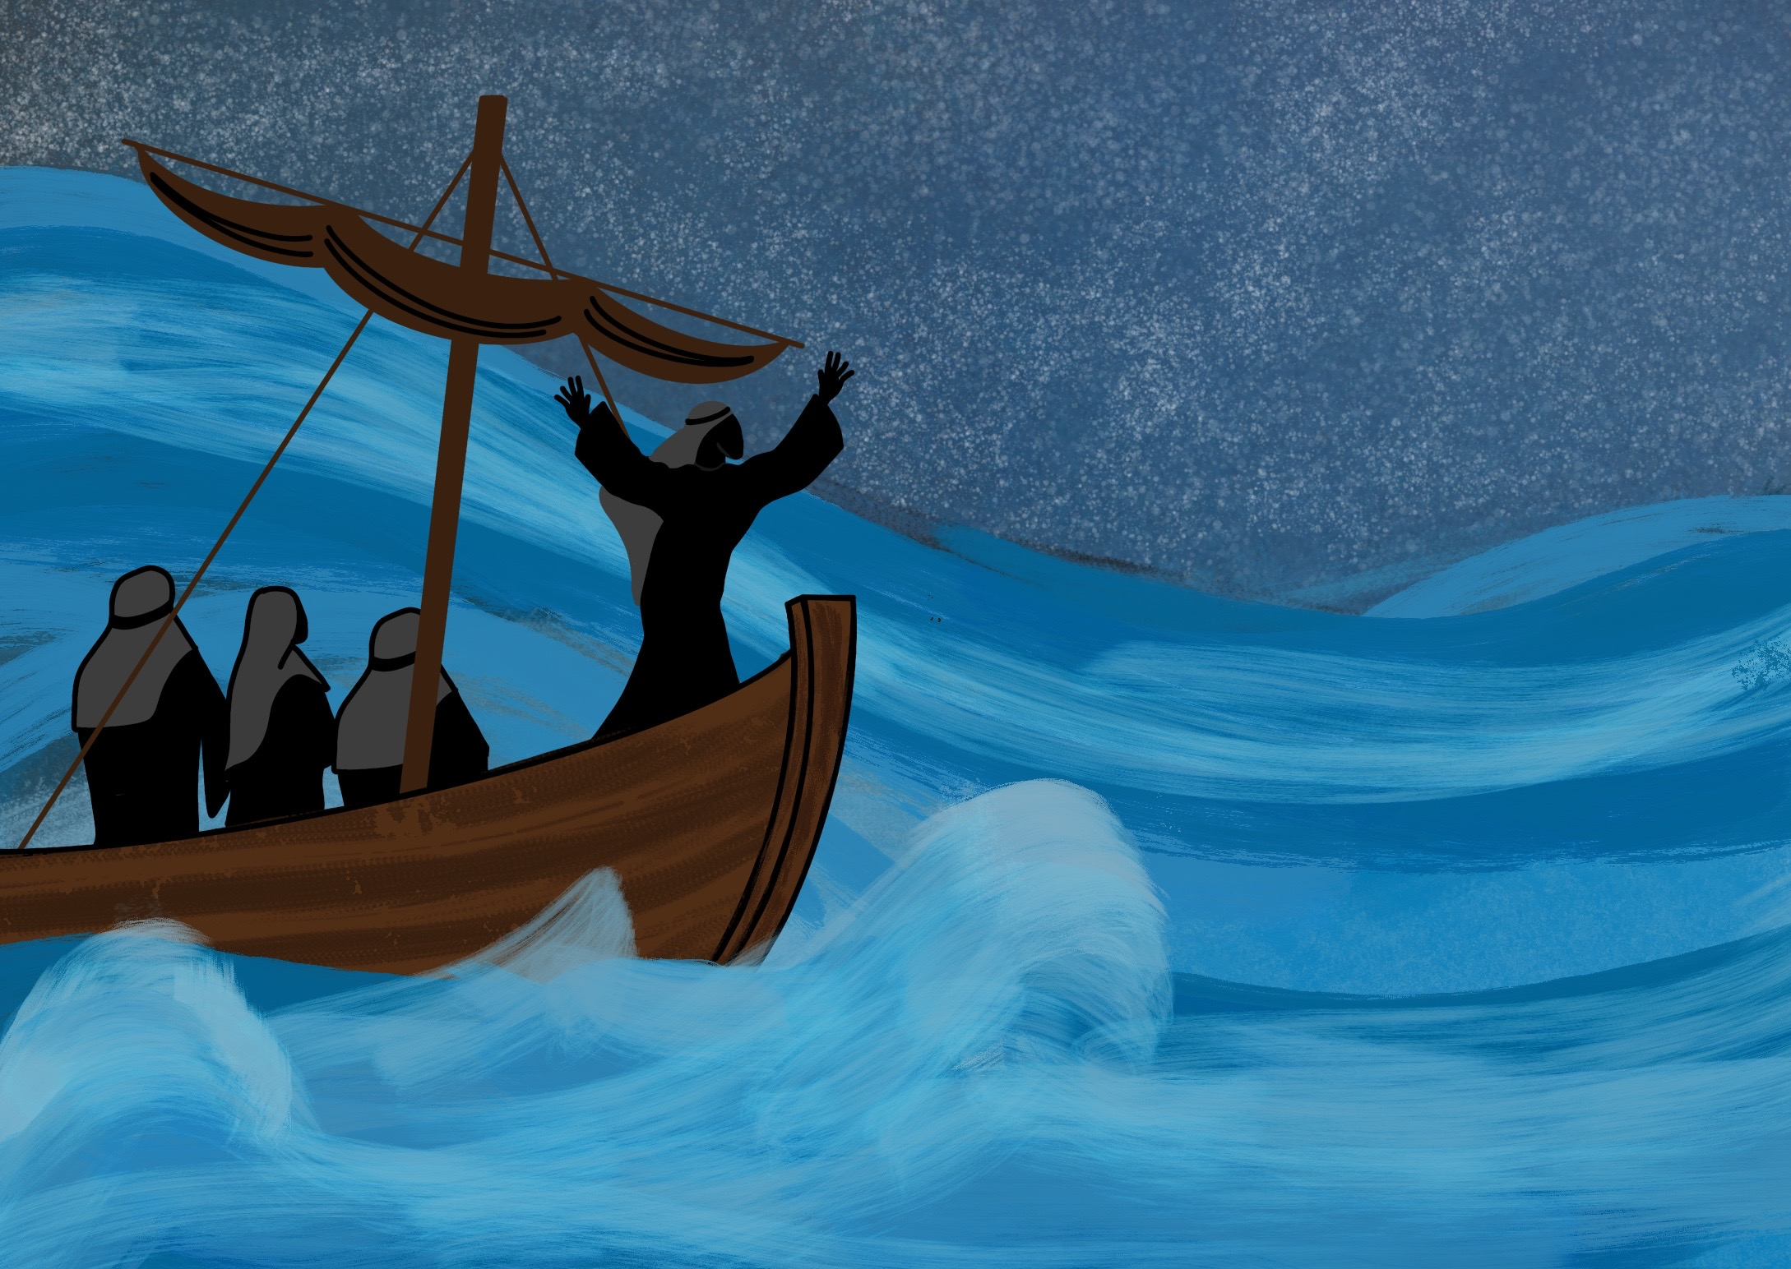

Slide 4
As Jesus, God’s Son, came to live on the Earth.

Slide 5
Our Father God knows what we need

Slide 6
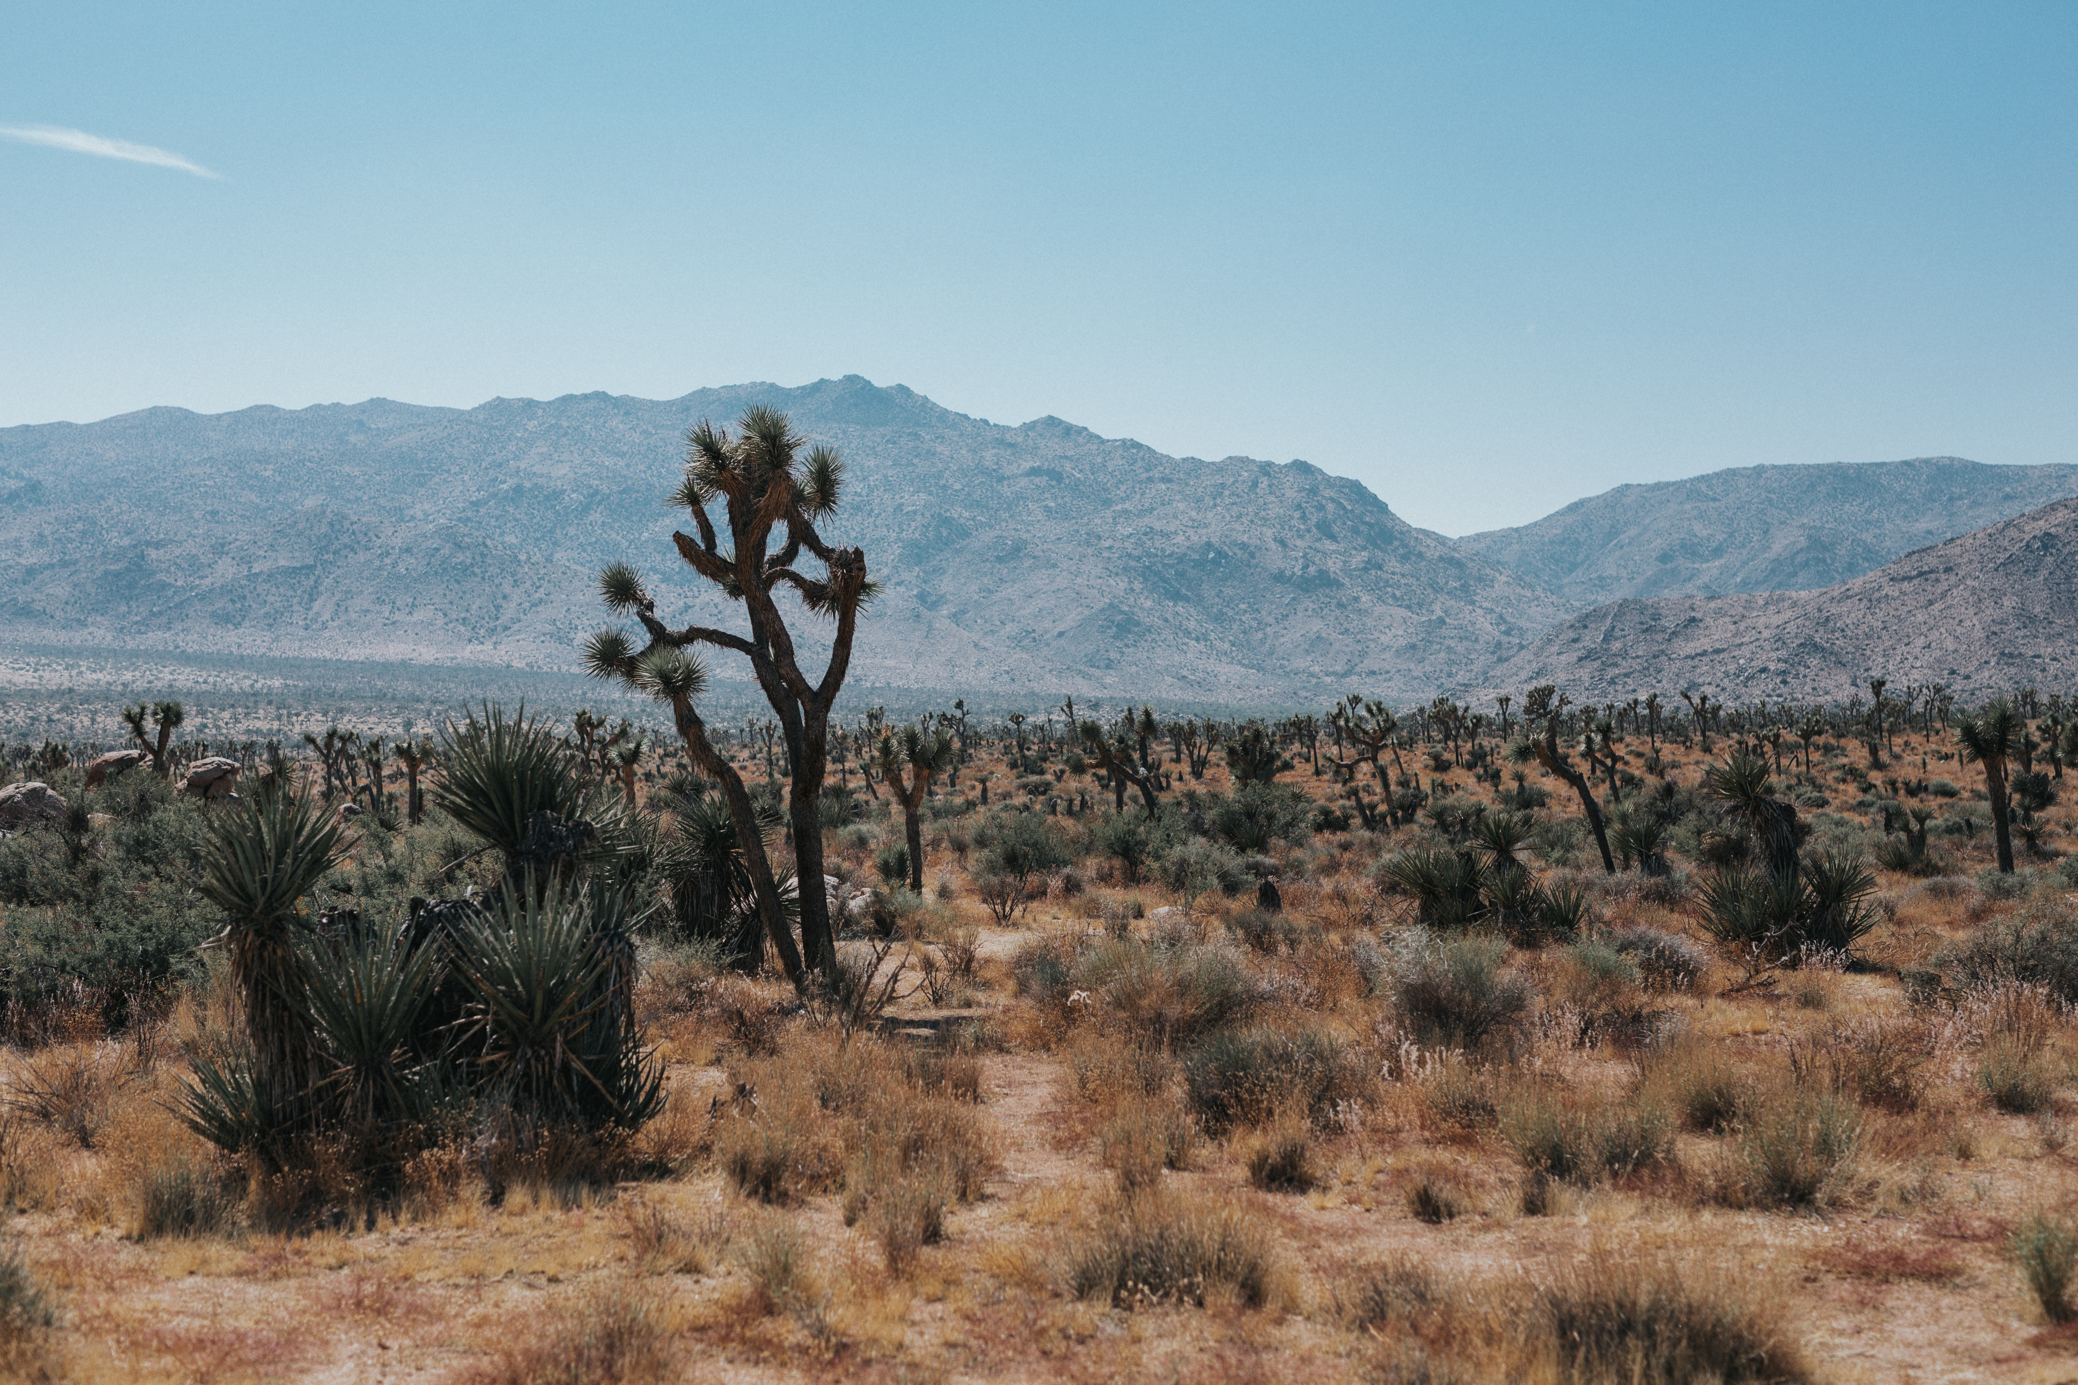
How to
survive in the
wilderness

Slide 7
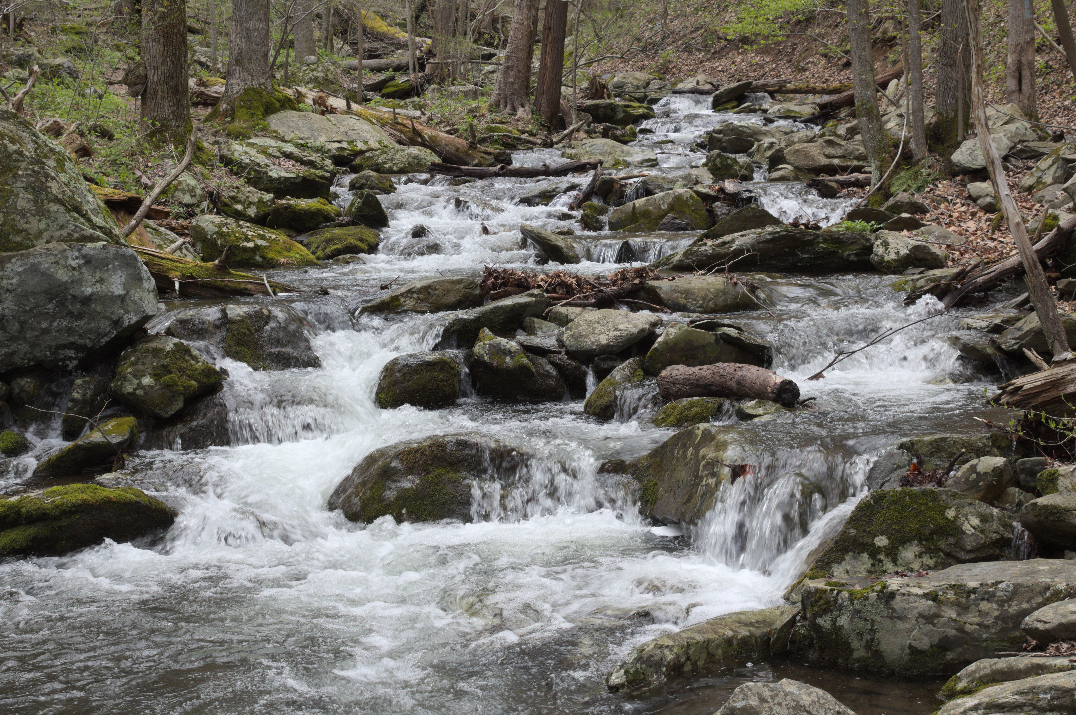
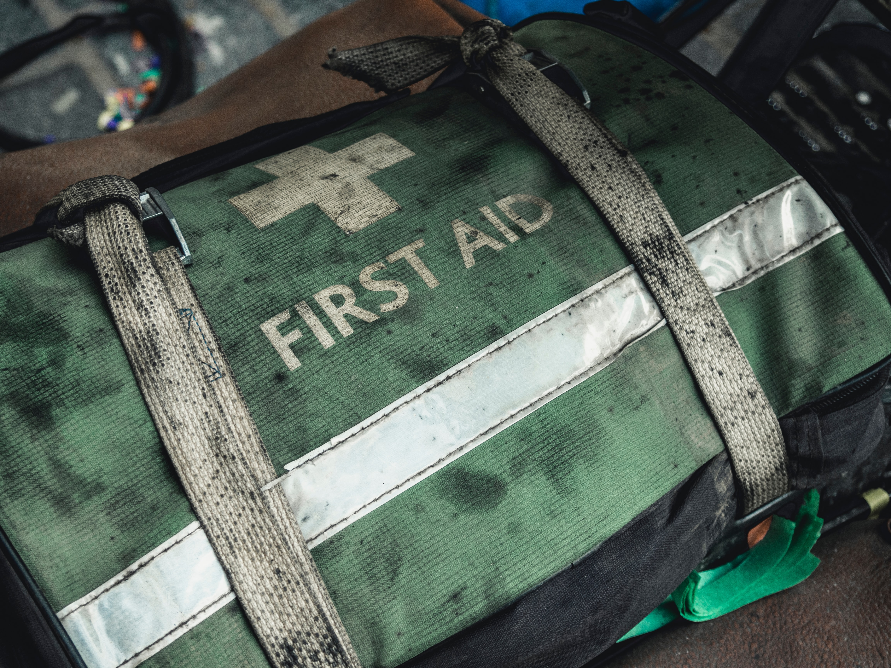
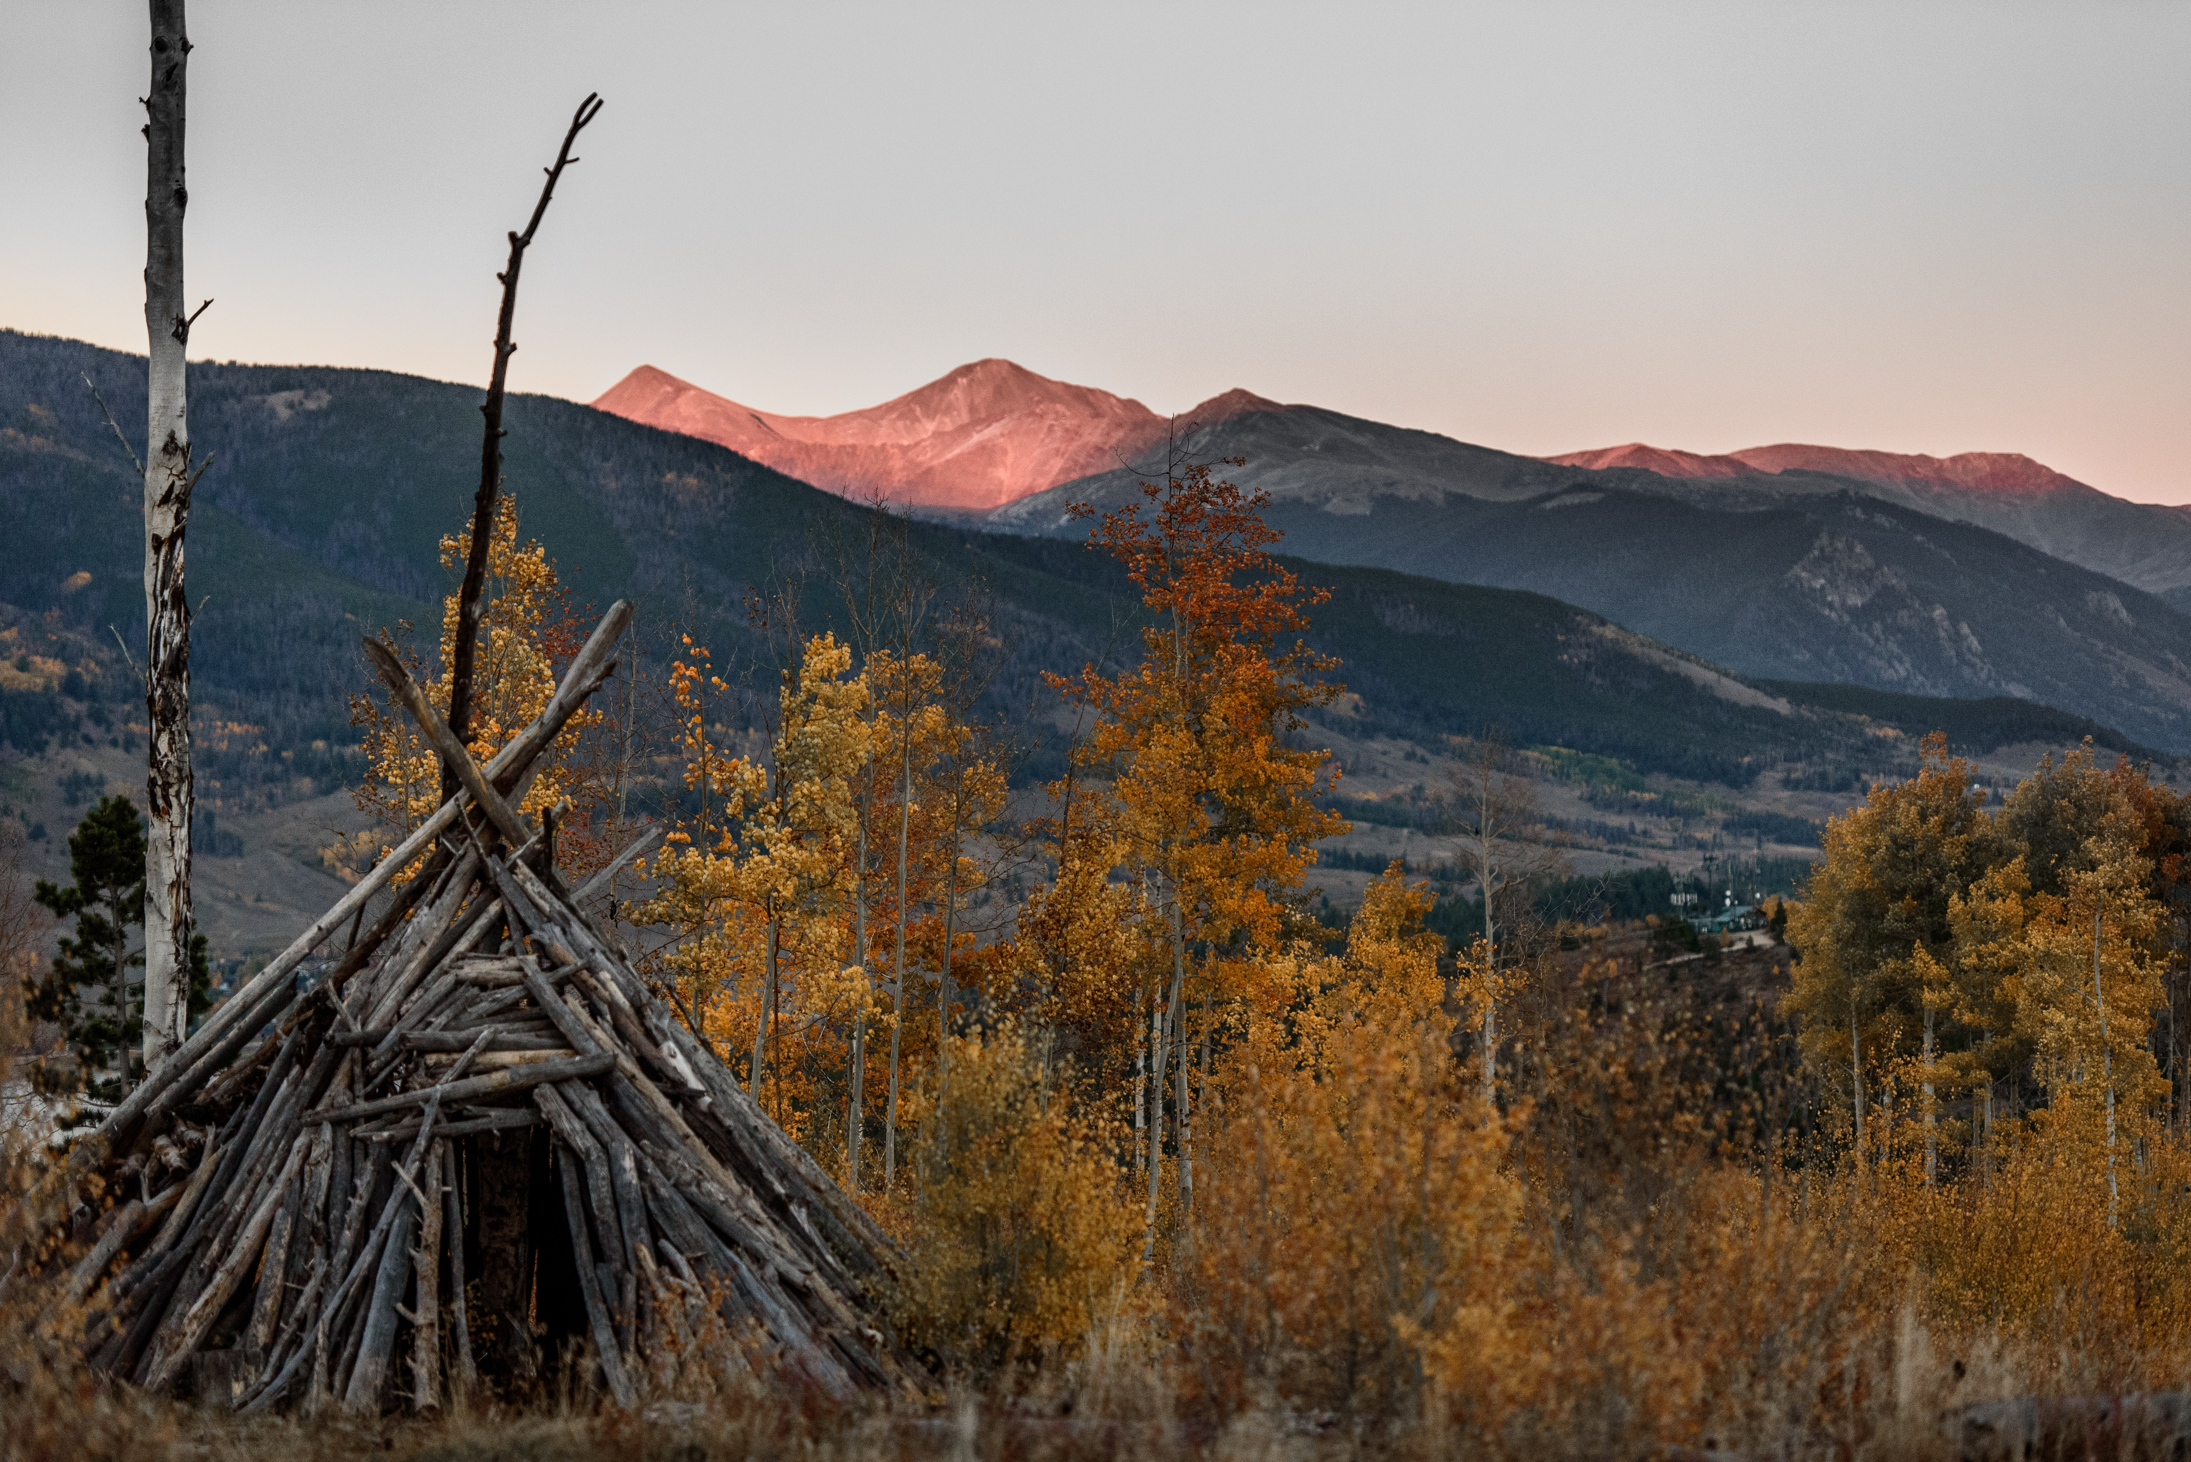
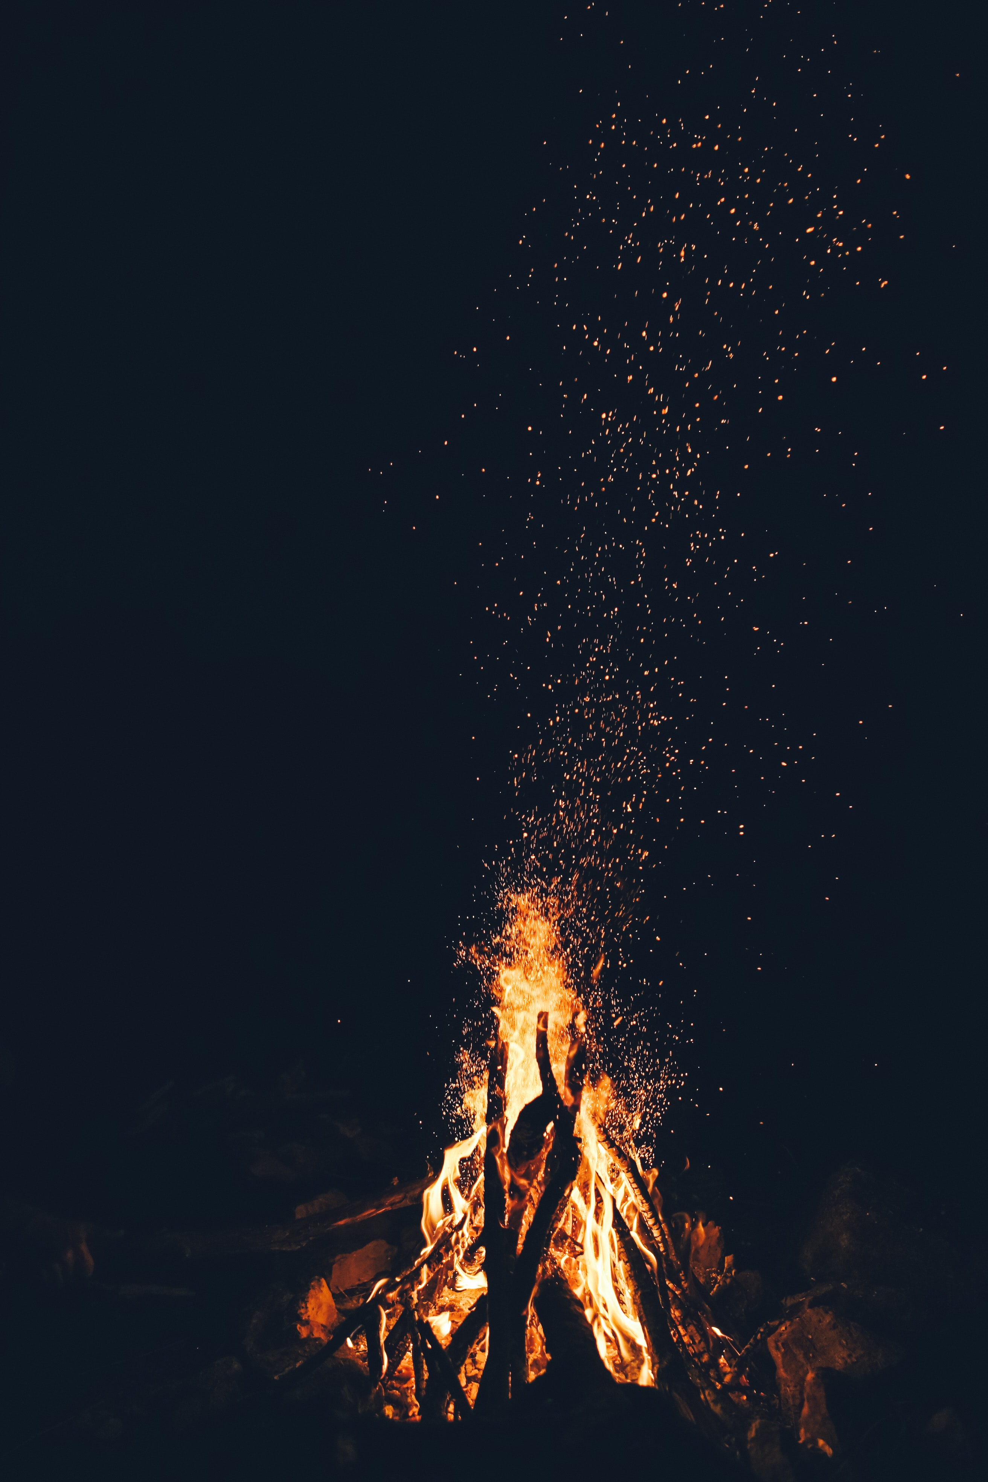
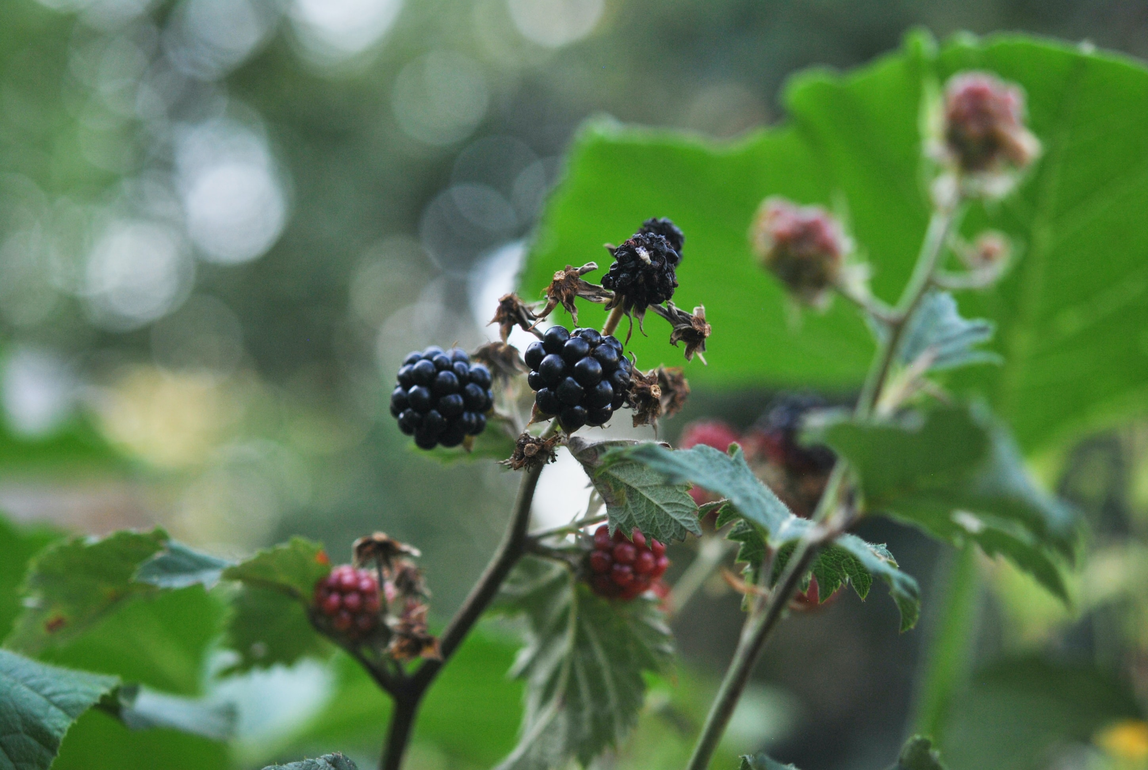
Look for water
Take care of injuries
Build shelter
Build a fire
Look for food

Slide 8
3 Build a fire
1 Take care of injuries
4 Look for water
2 Build shelter
5 Look for food

Slide 9
What did people worry about in Jesus’ day?

Slide 13
friends
family
school
work
looks
latest
thing
health

Slide 14
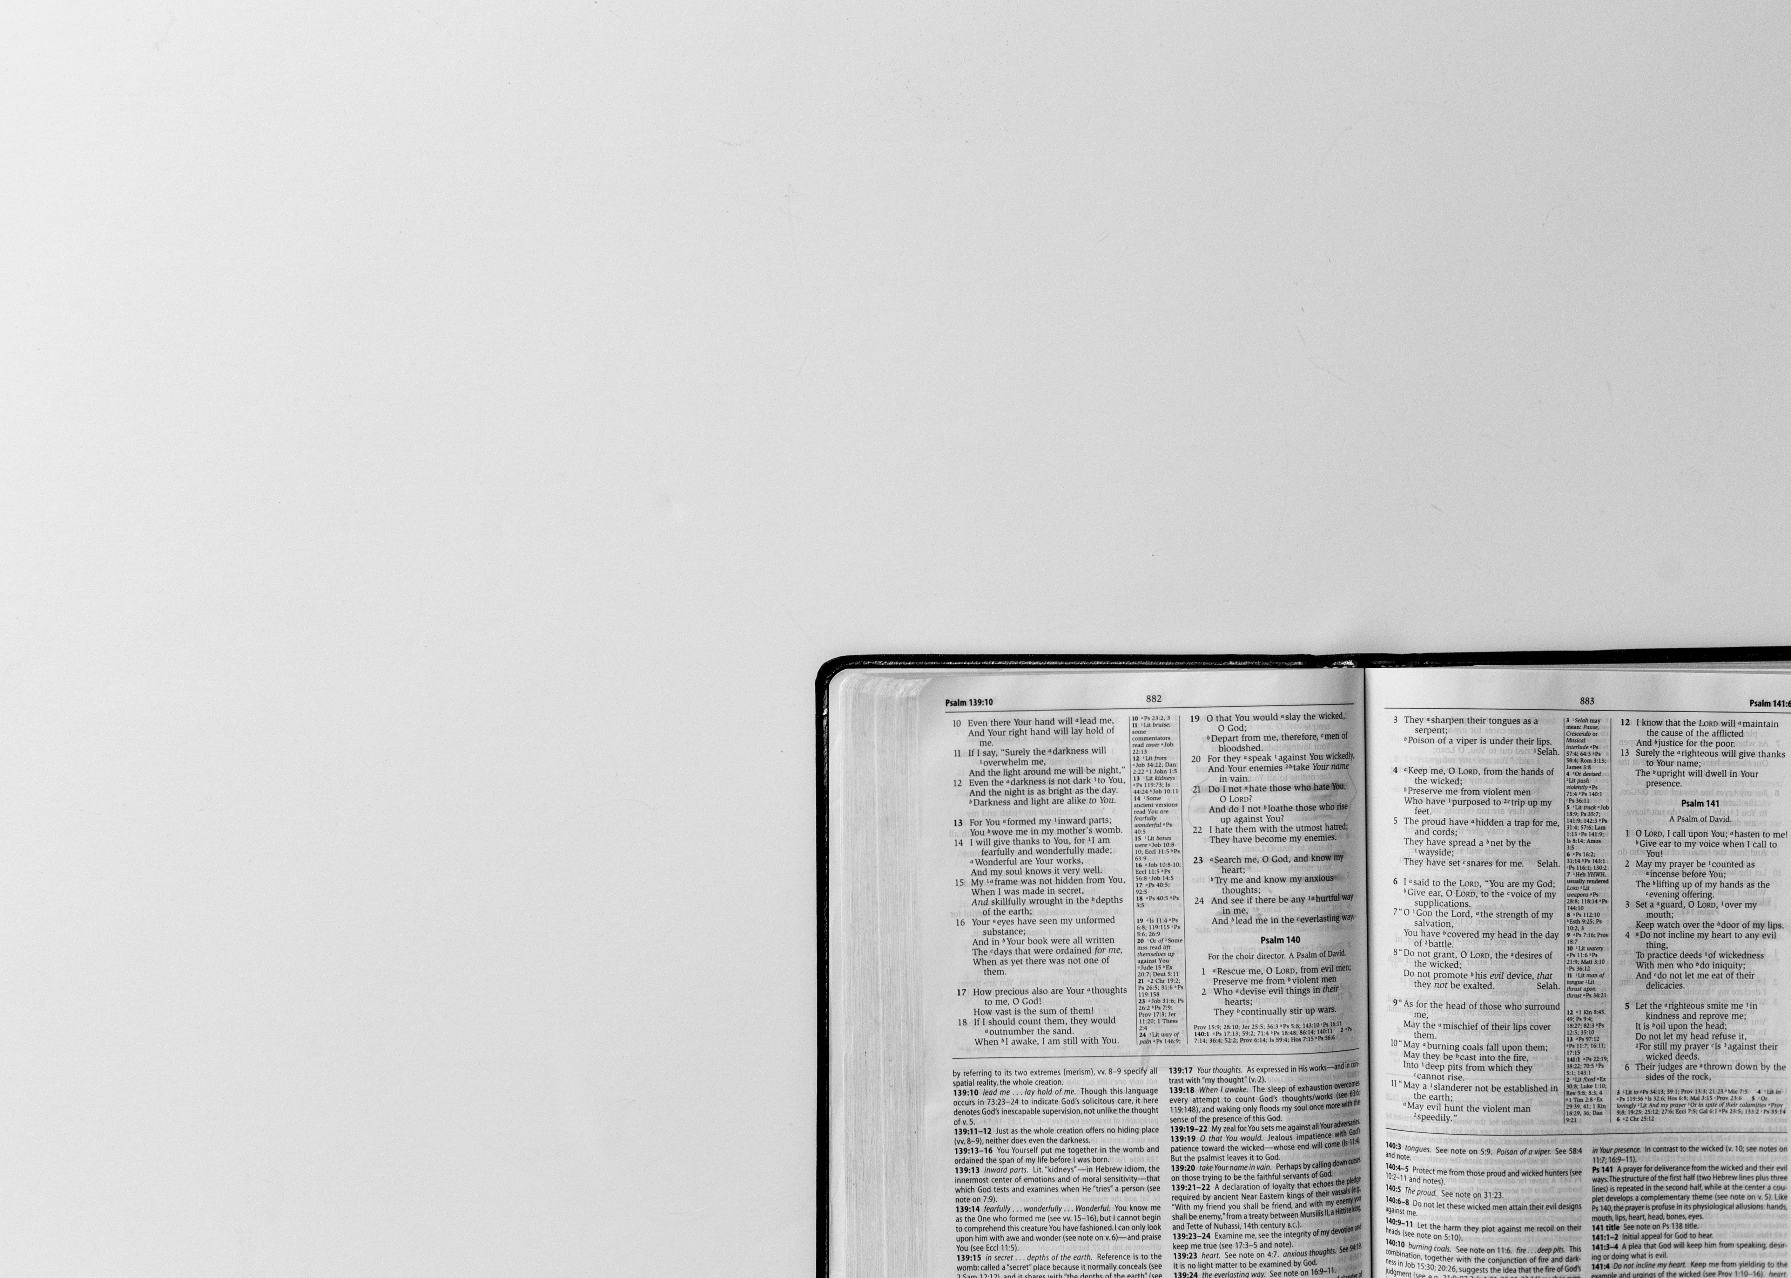
Put God’s kingdom first.
Do what he wants you to do.
Then all those things will also be given to you.
Matthew 6:33

