Slide 3
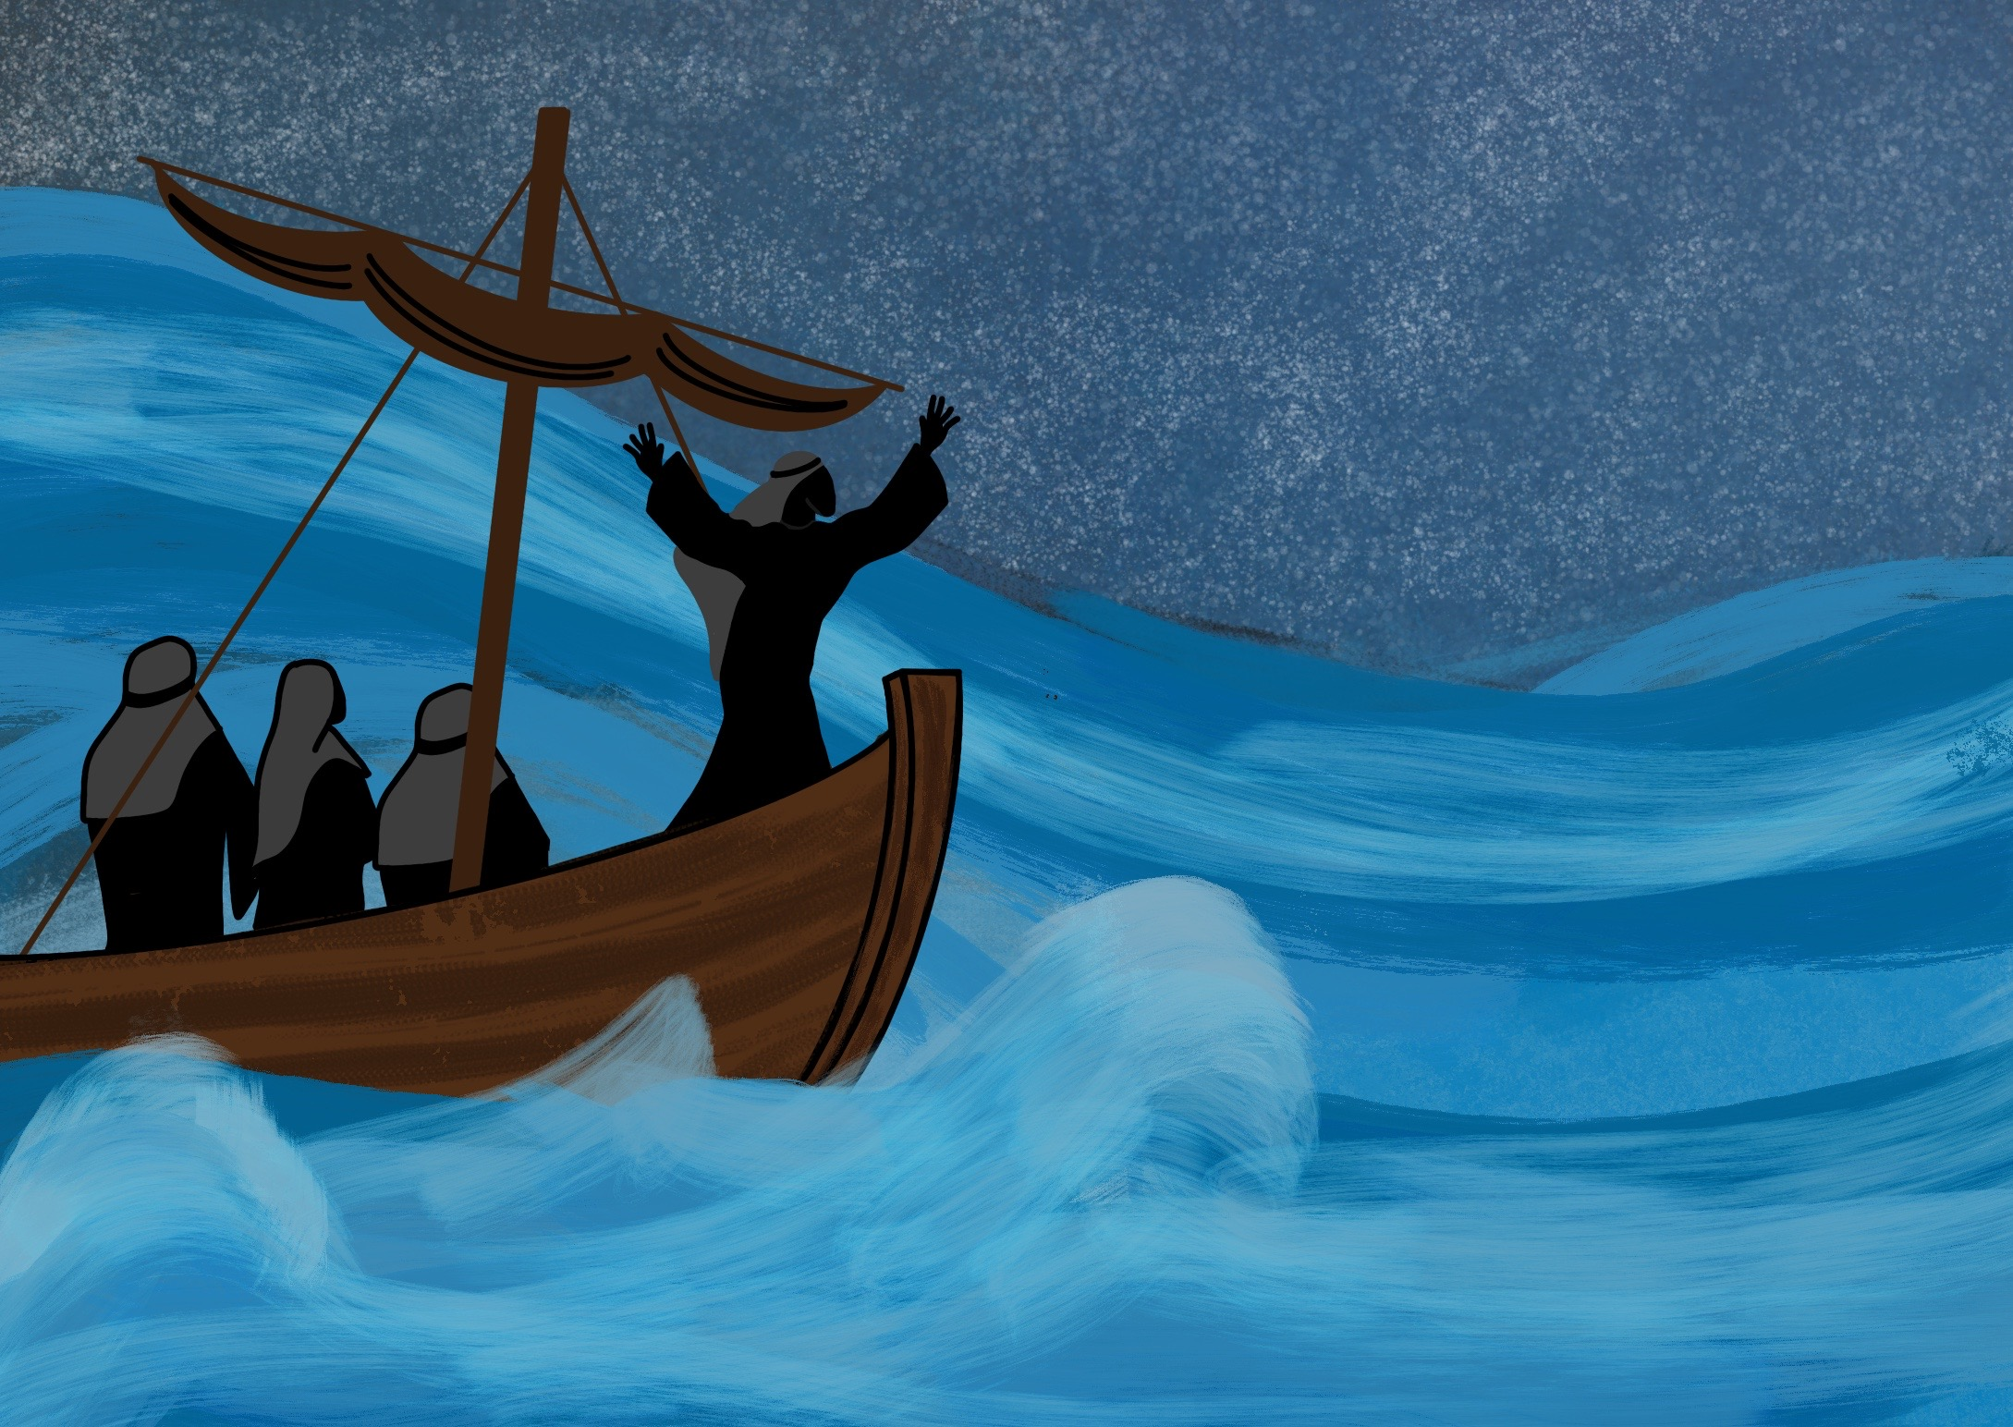

Slide 4
As Jesus, God’s Son, came to live on the Earth.

Slide 5
Our Father God sees what we do in secret

Slide 7
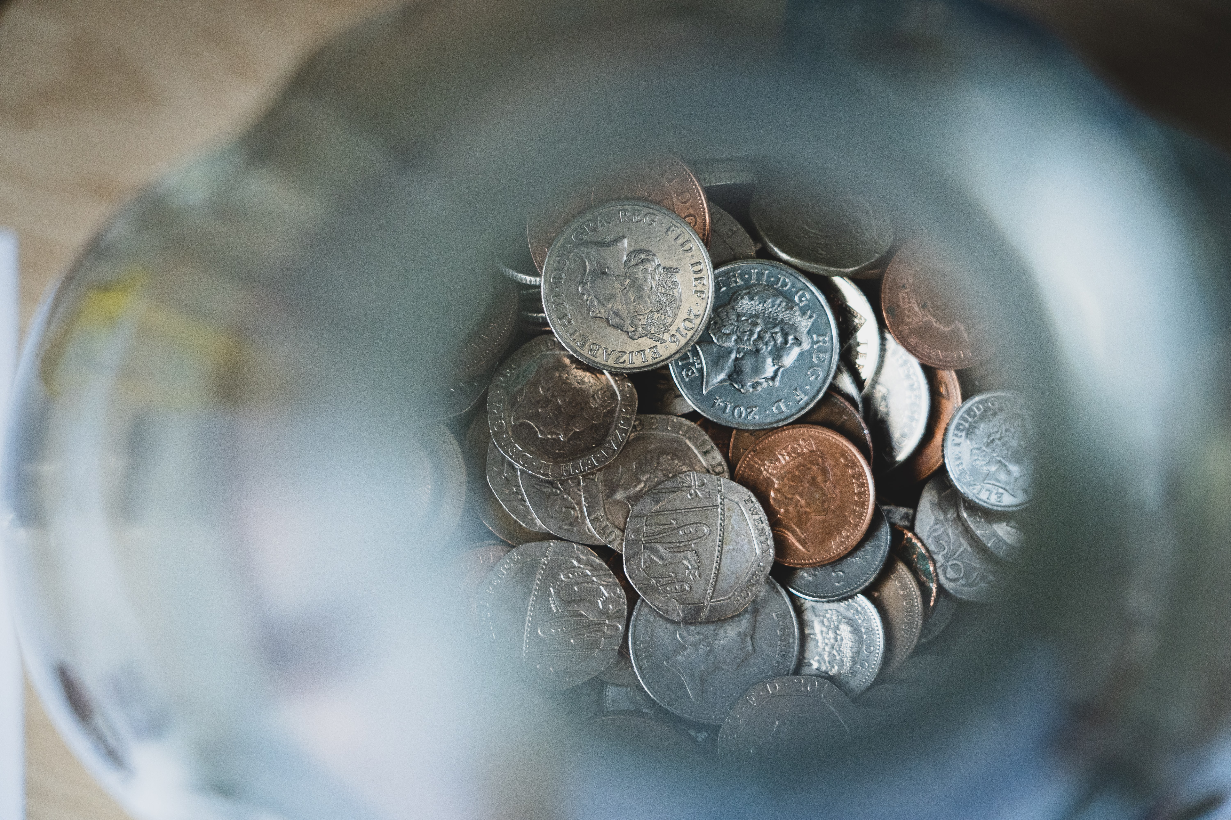

Slide 10
