Slide 3
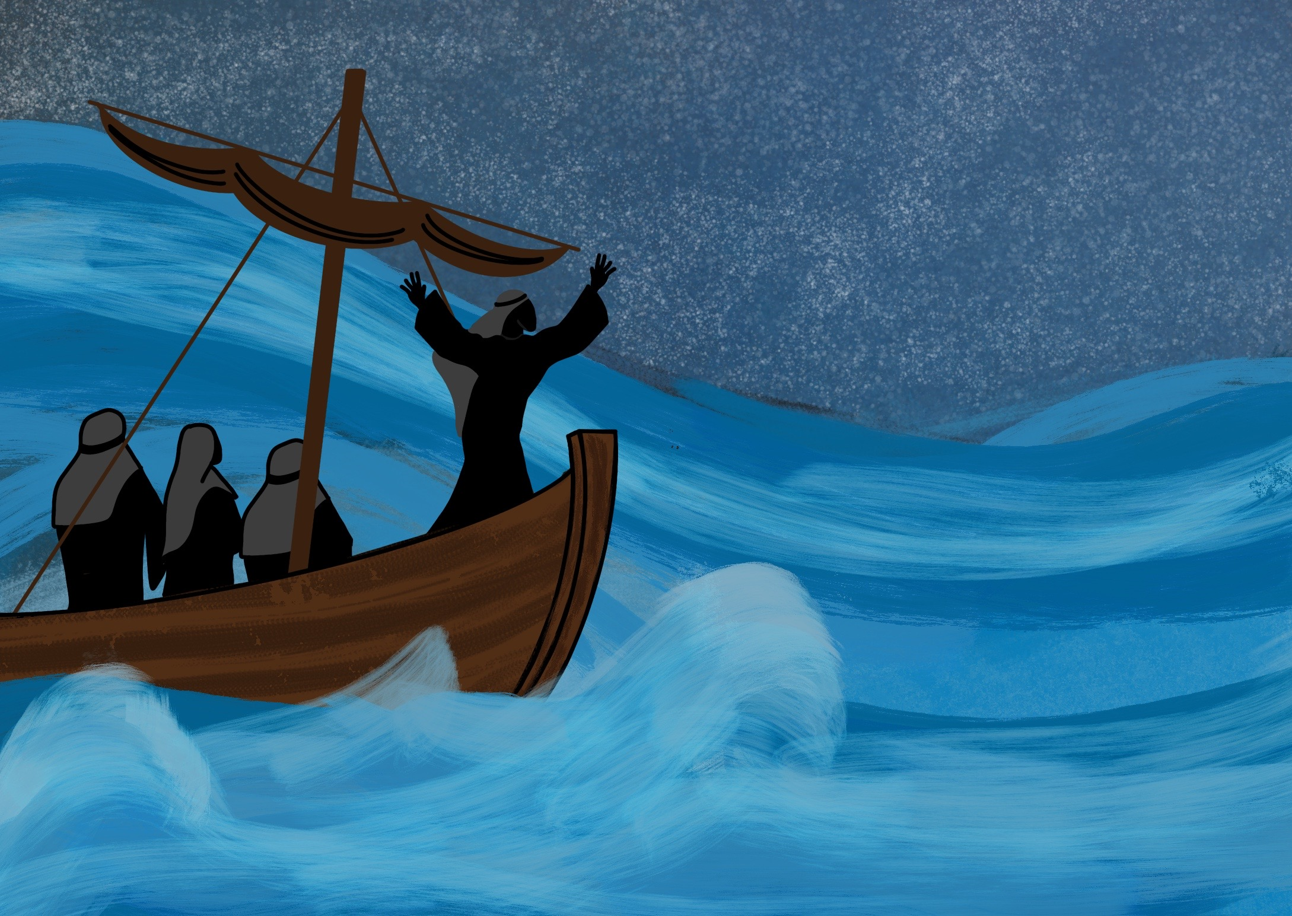

Slide 4
As Jesus, God’s Son, came to live on the Earth.

Slide 5
Our Father listens to our prayers

Slide 6
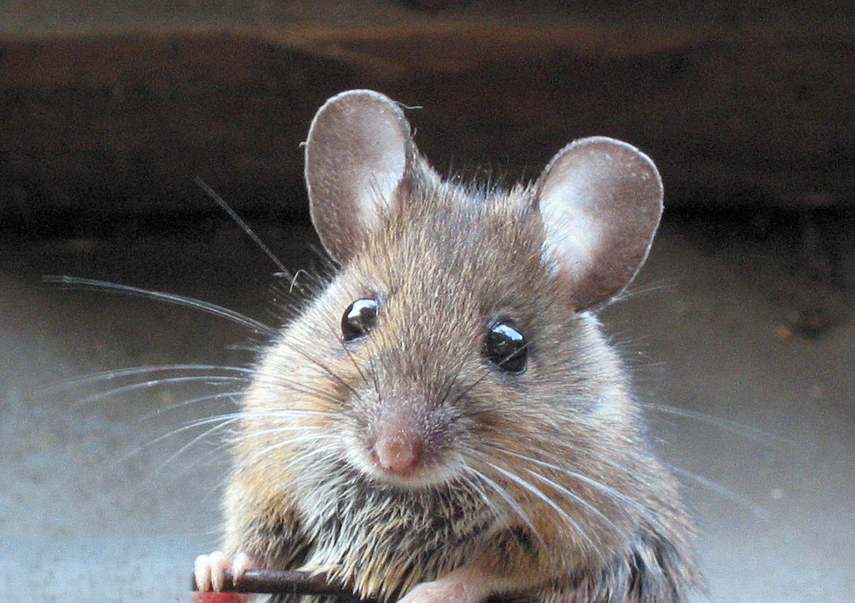

Slide 7
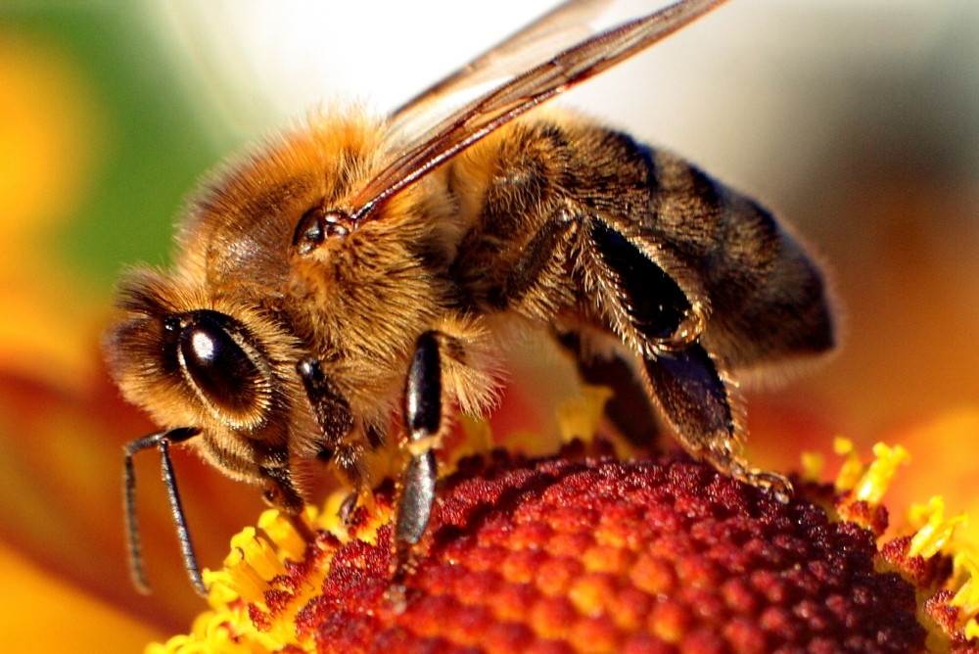

Slide 8
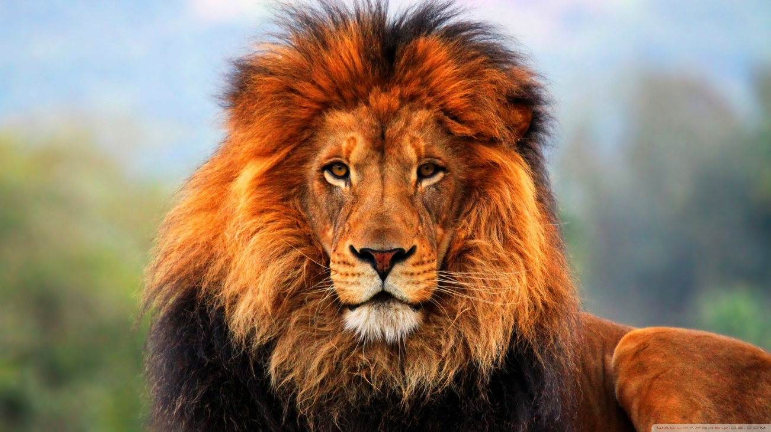

Slide 9
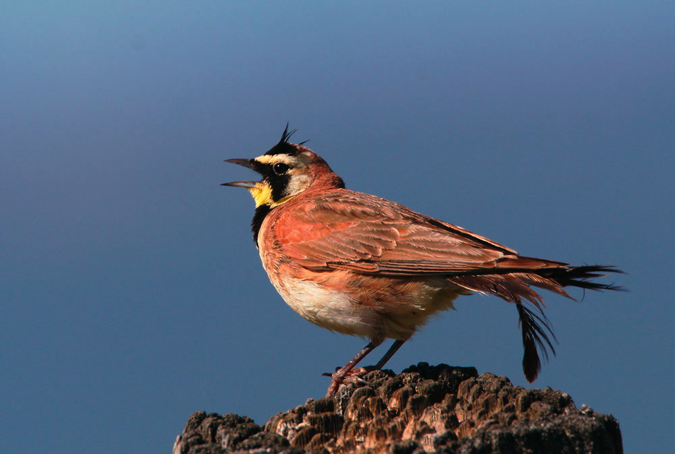

Slide 10
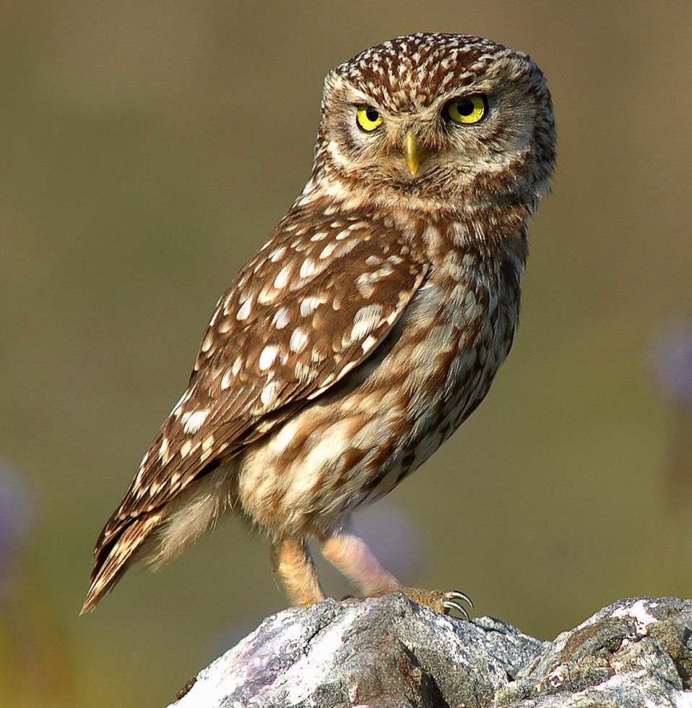

Slide 11
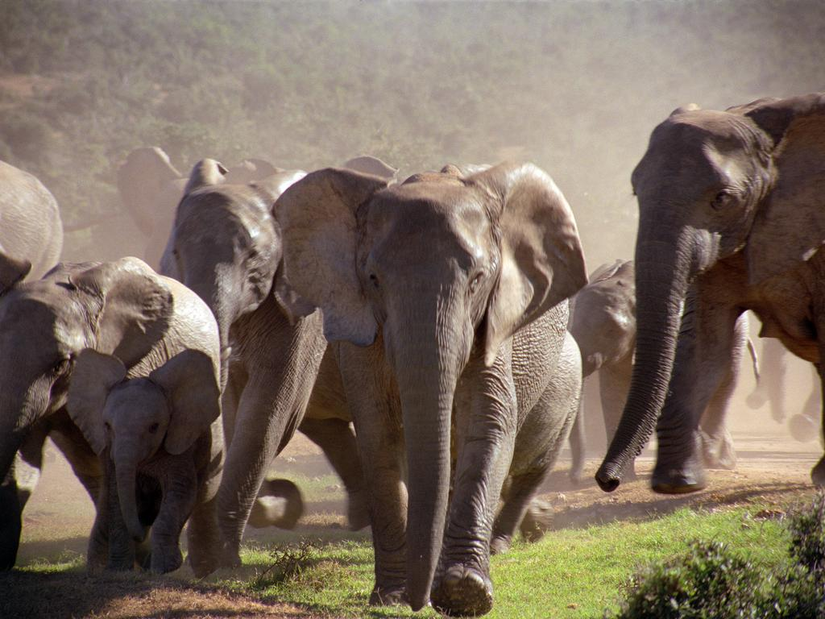

Slide 12
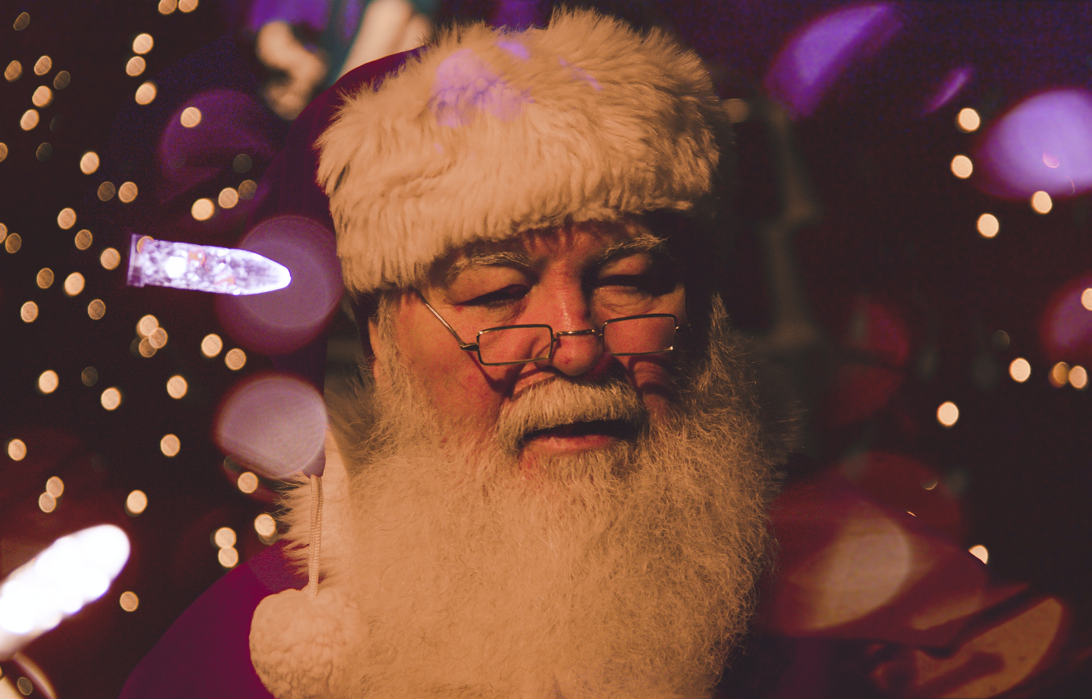

Slide 14
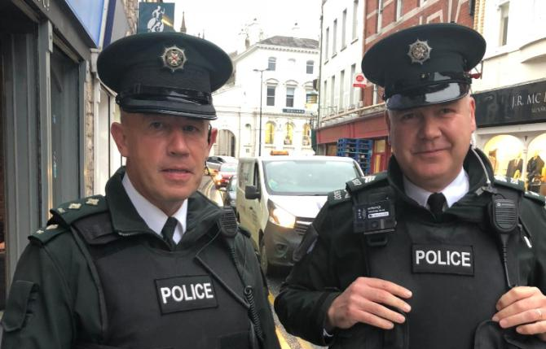

Slide 15
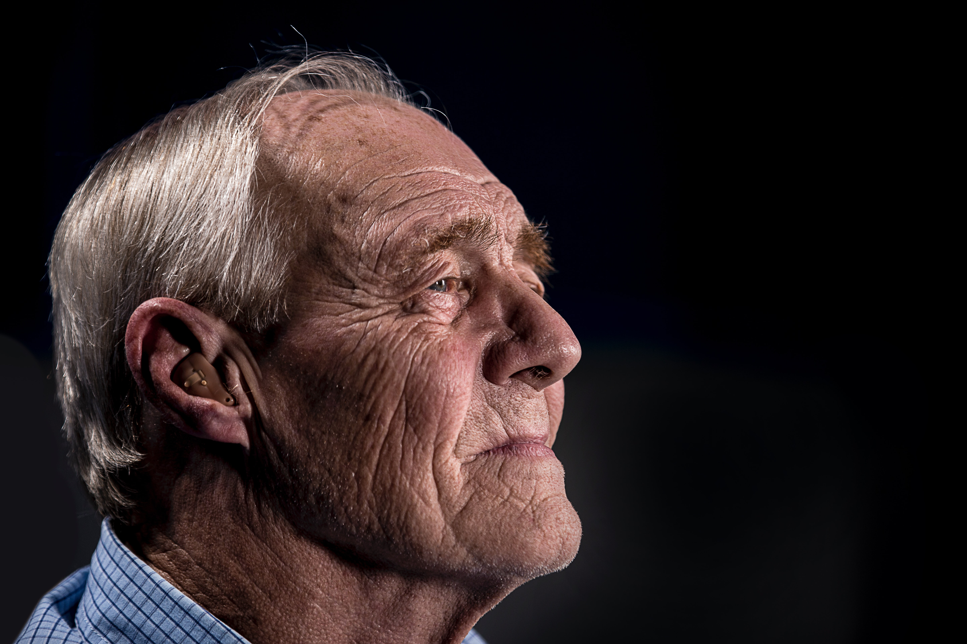

Slide 16
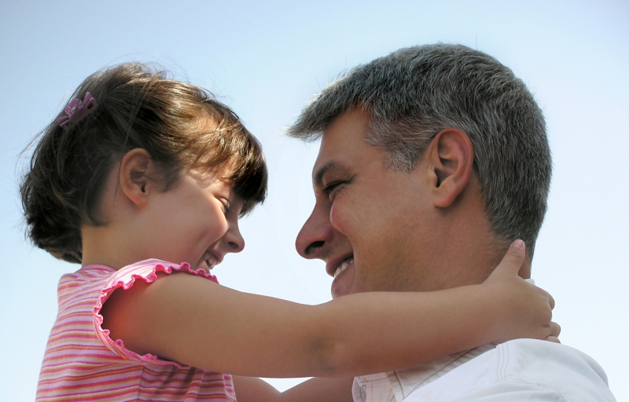

Slide 17
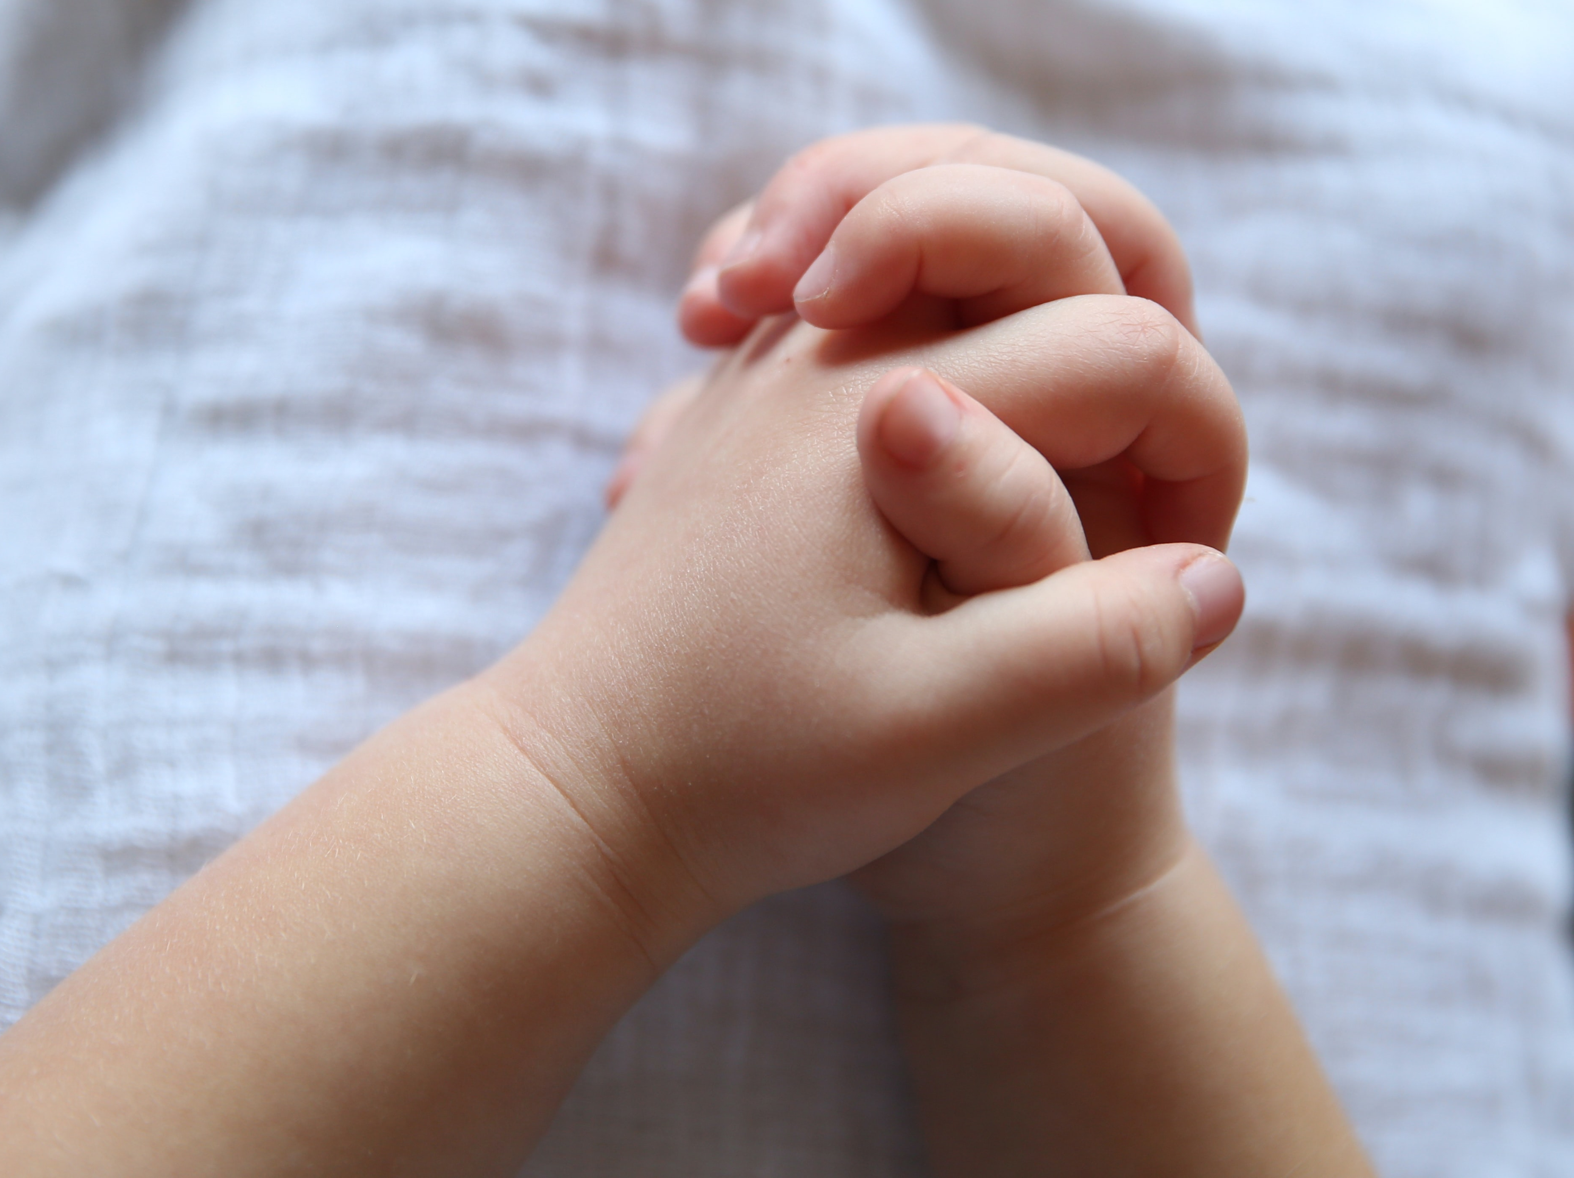
Our Father in Heaven,
we want to honour you and do what pleases you.

Slide 18
Please
give us
what we need each day.

Slide 19
Forgive us for the wrong things we do and help us to forgive others too.

Slide 20
Help us not to give in when we are tempted but keep us safe from all that is evil.

Slide 21
You are great and you are good. Nothing is impossible for you.
Amen

