Slide 1
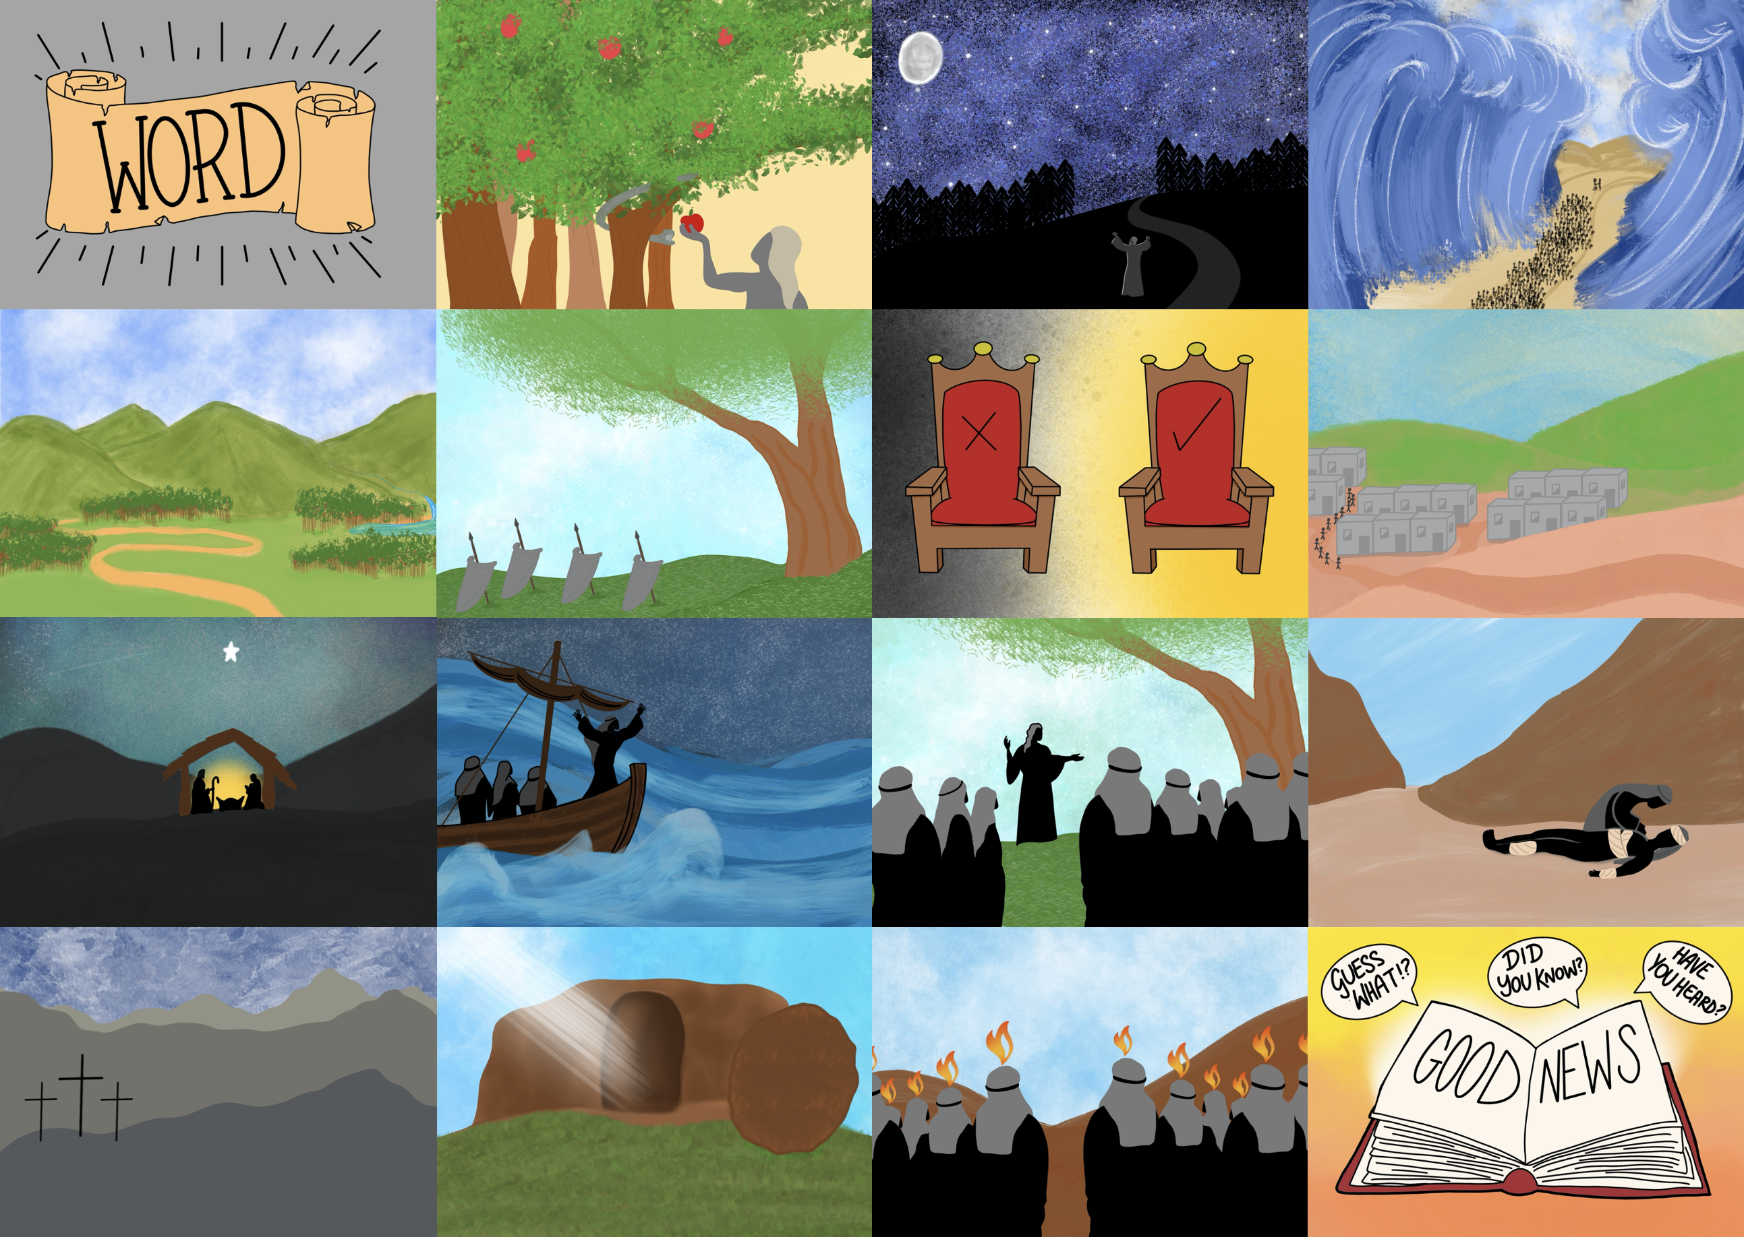

Slide 3
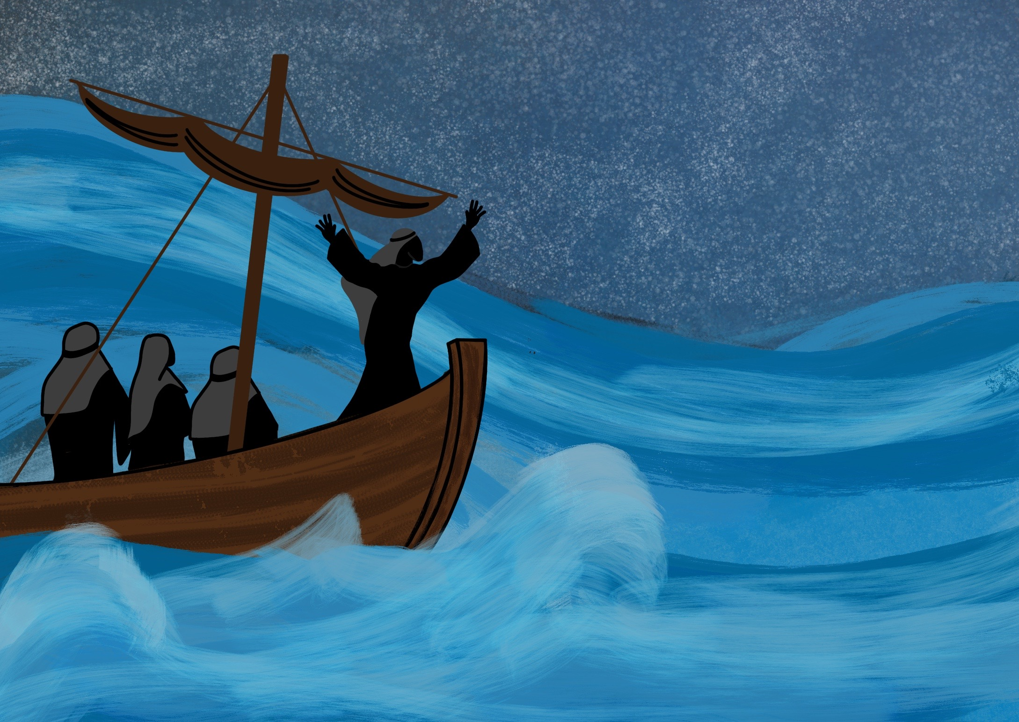

Slide 4
As Jesus, God’s Son, came to live on the Earth.

Slide 5
As the Son of God, Jesus is able to use us

Slide 6
2 + 2 =

Slide 7
3 x 4 =

Slide 8
2x = 8

Slide 9
5 + 4 =
3

Slide 10
32 =

Slide 11
5L + 2f =1m2 r 12b
5000p

Slide 12
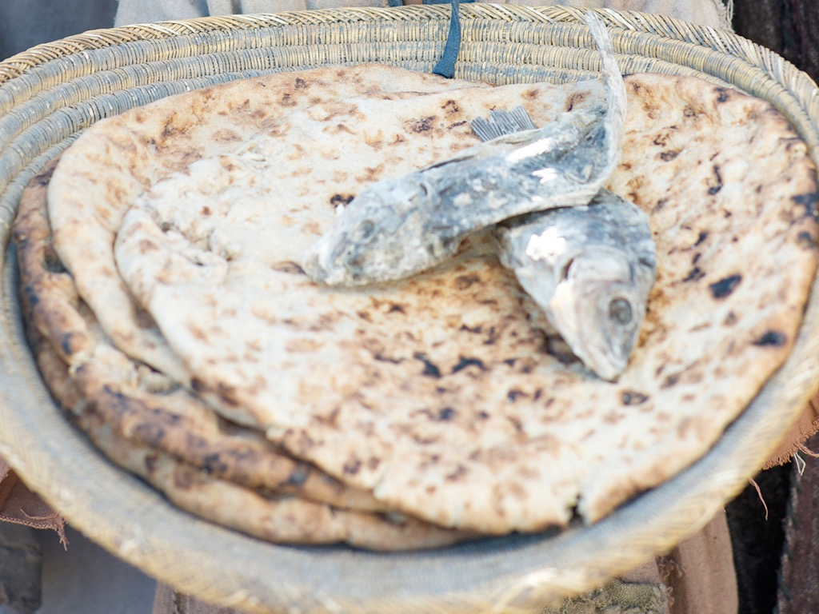

Slide 13
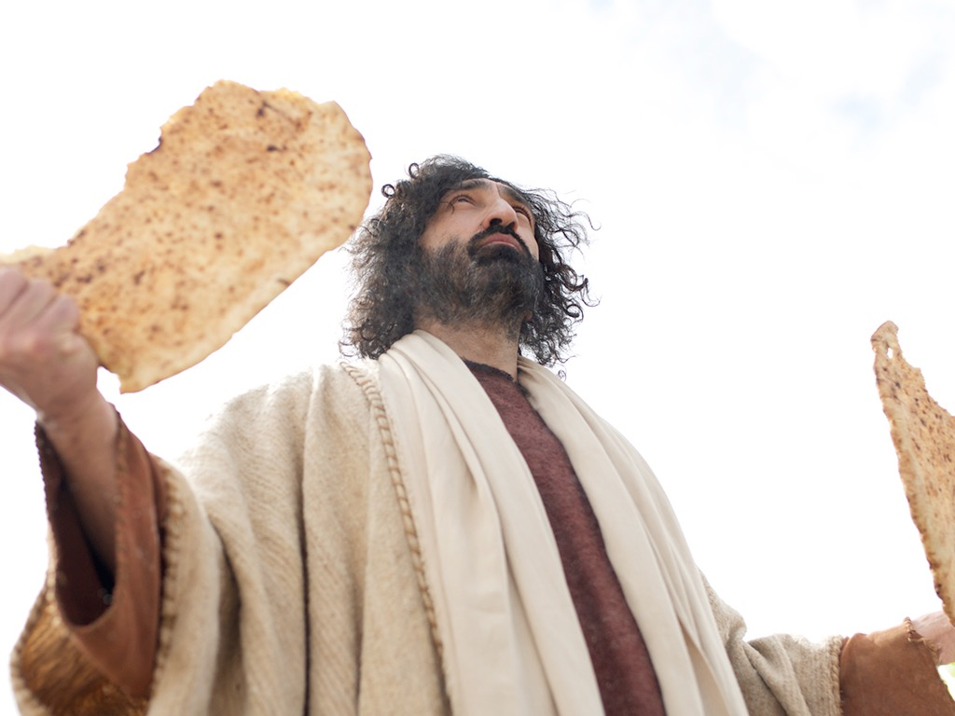

Slide 14
