Slide 3
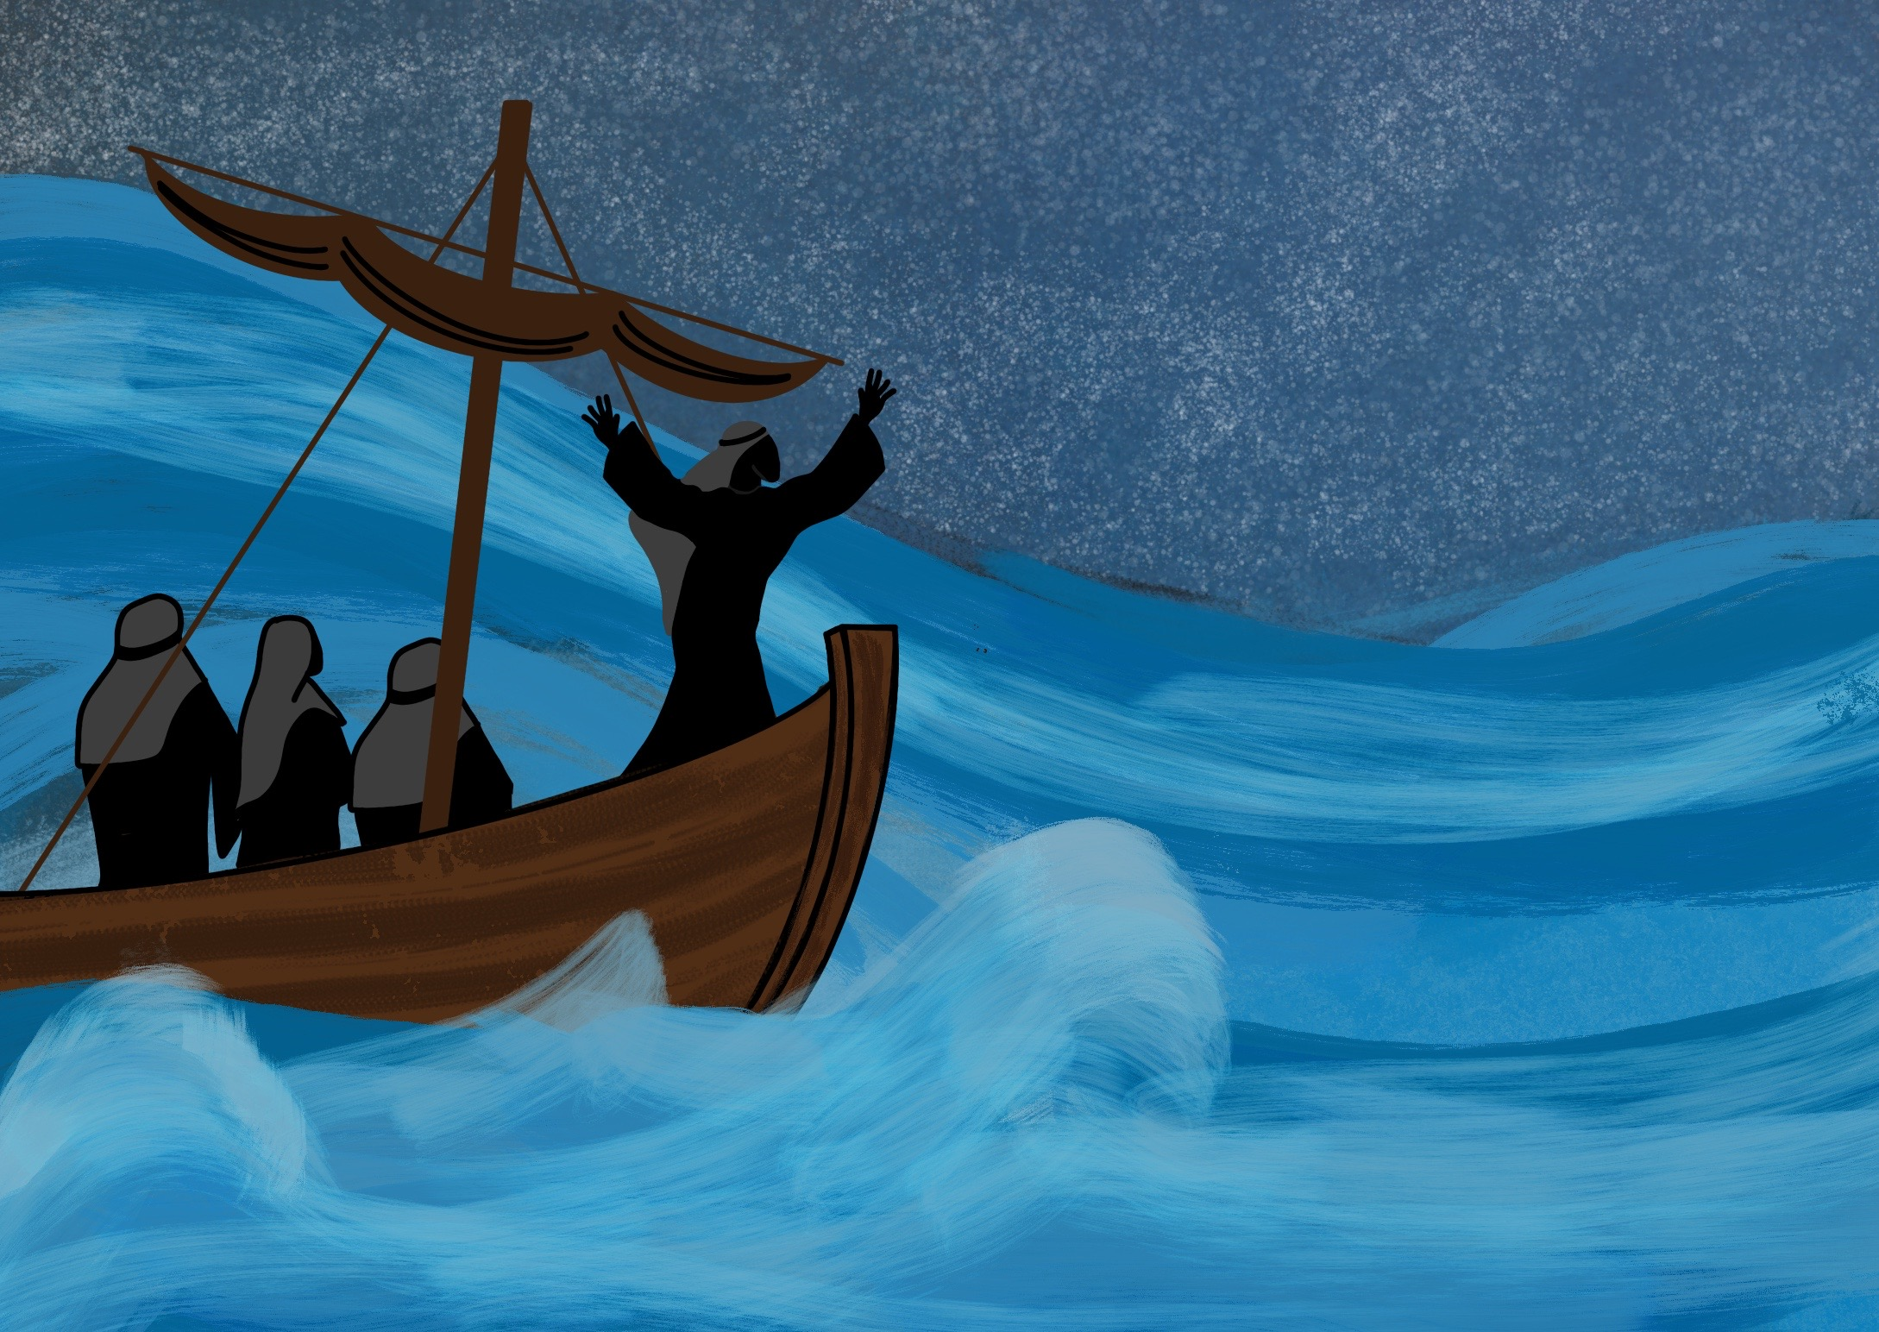

Slide 4
As Jesus, God’s Son, came to live on the Earth.

Slide 5
As the Son of God, Jesus is able to take care of us

Slide 6
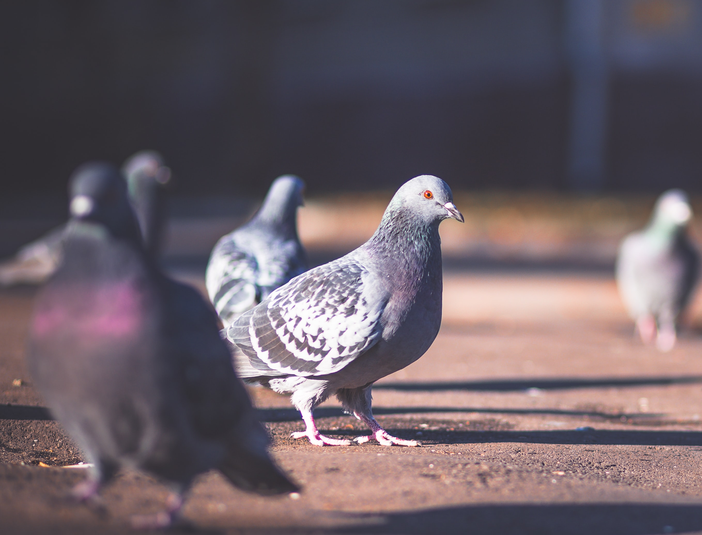
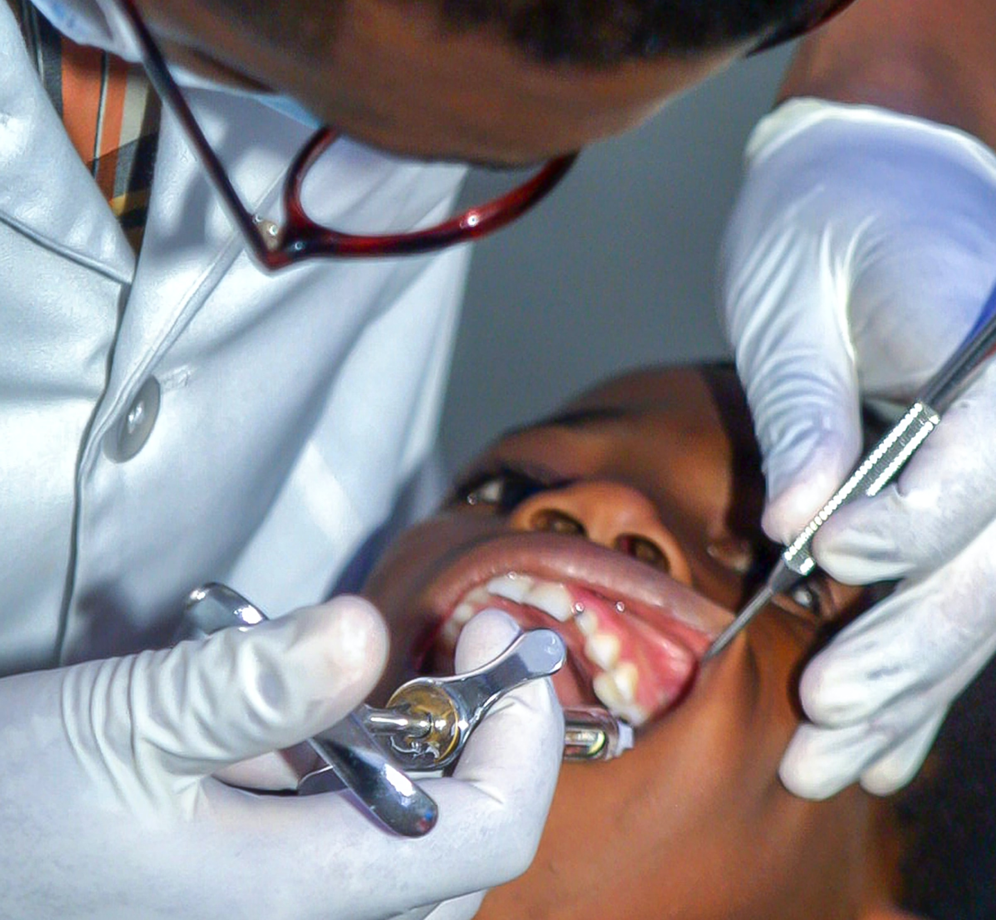
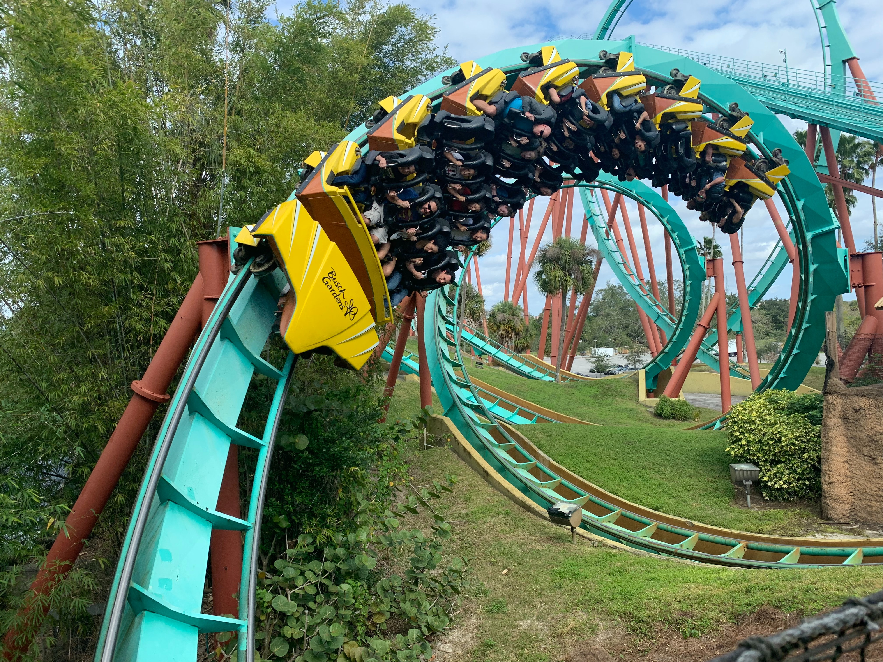

Slide 8
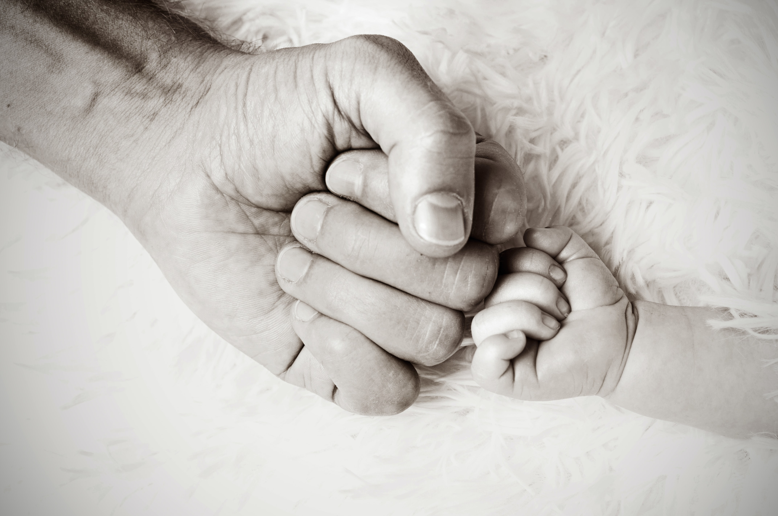
PRESENCE – He has promised to be with us

Slide 9
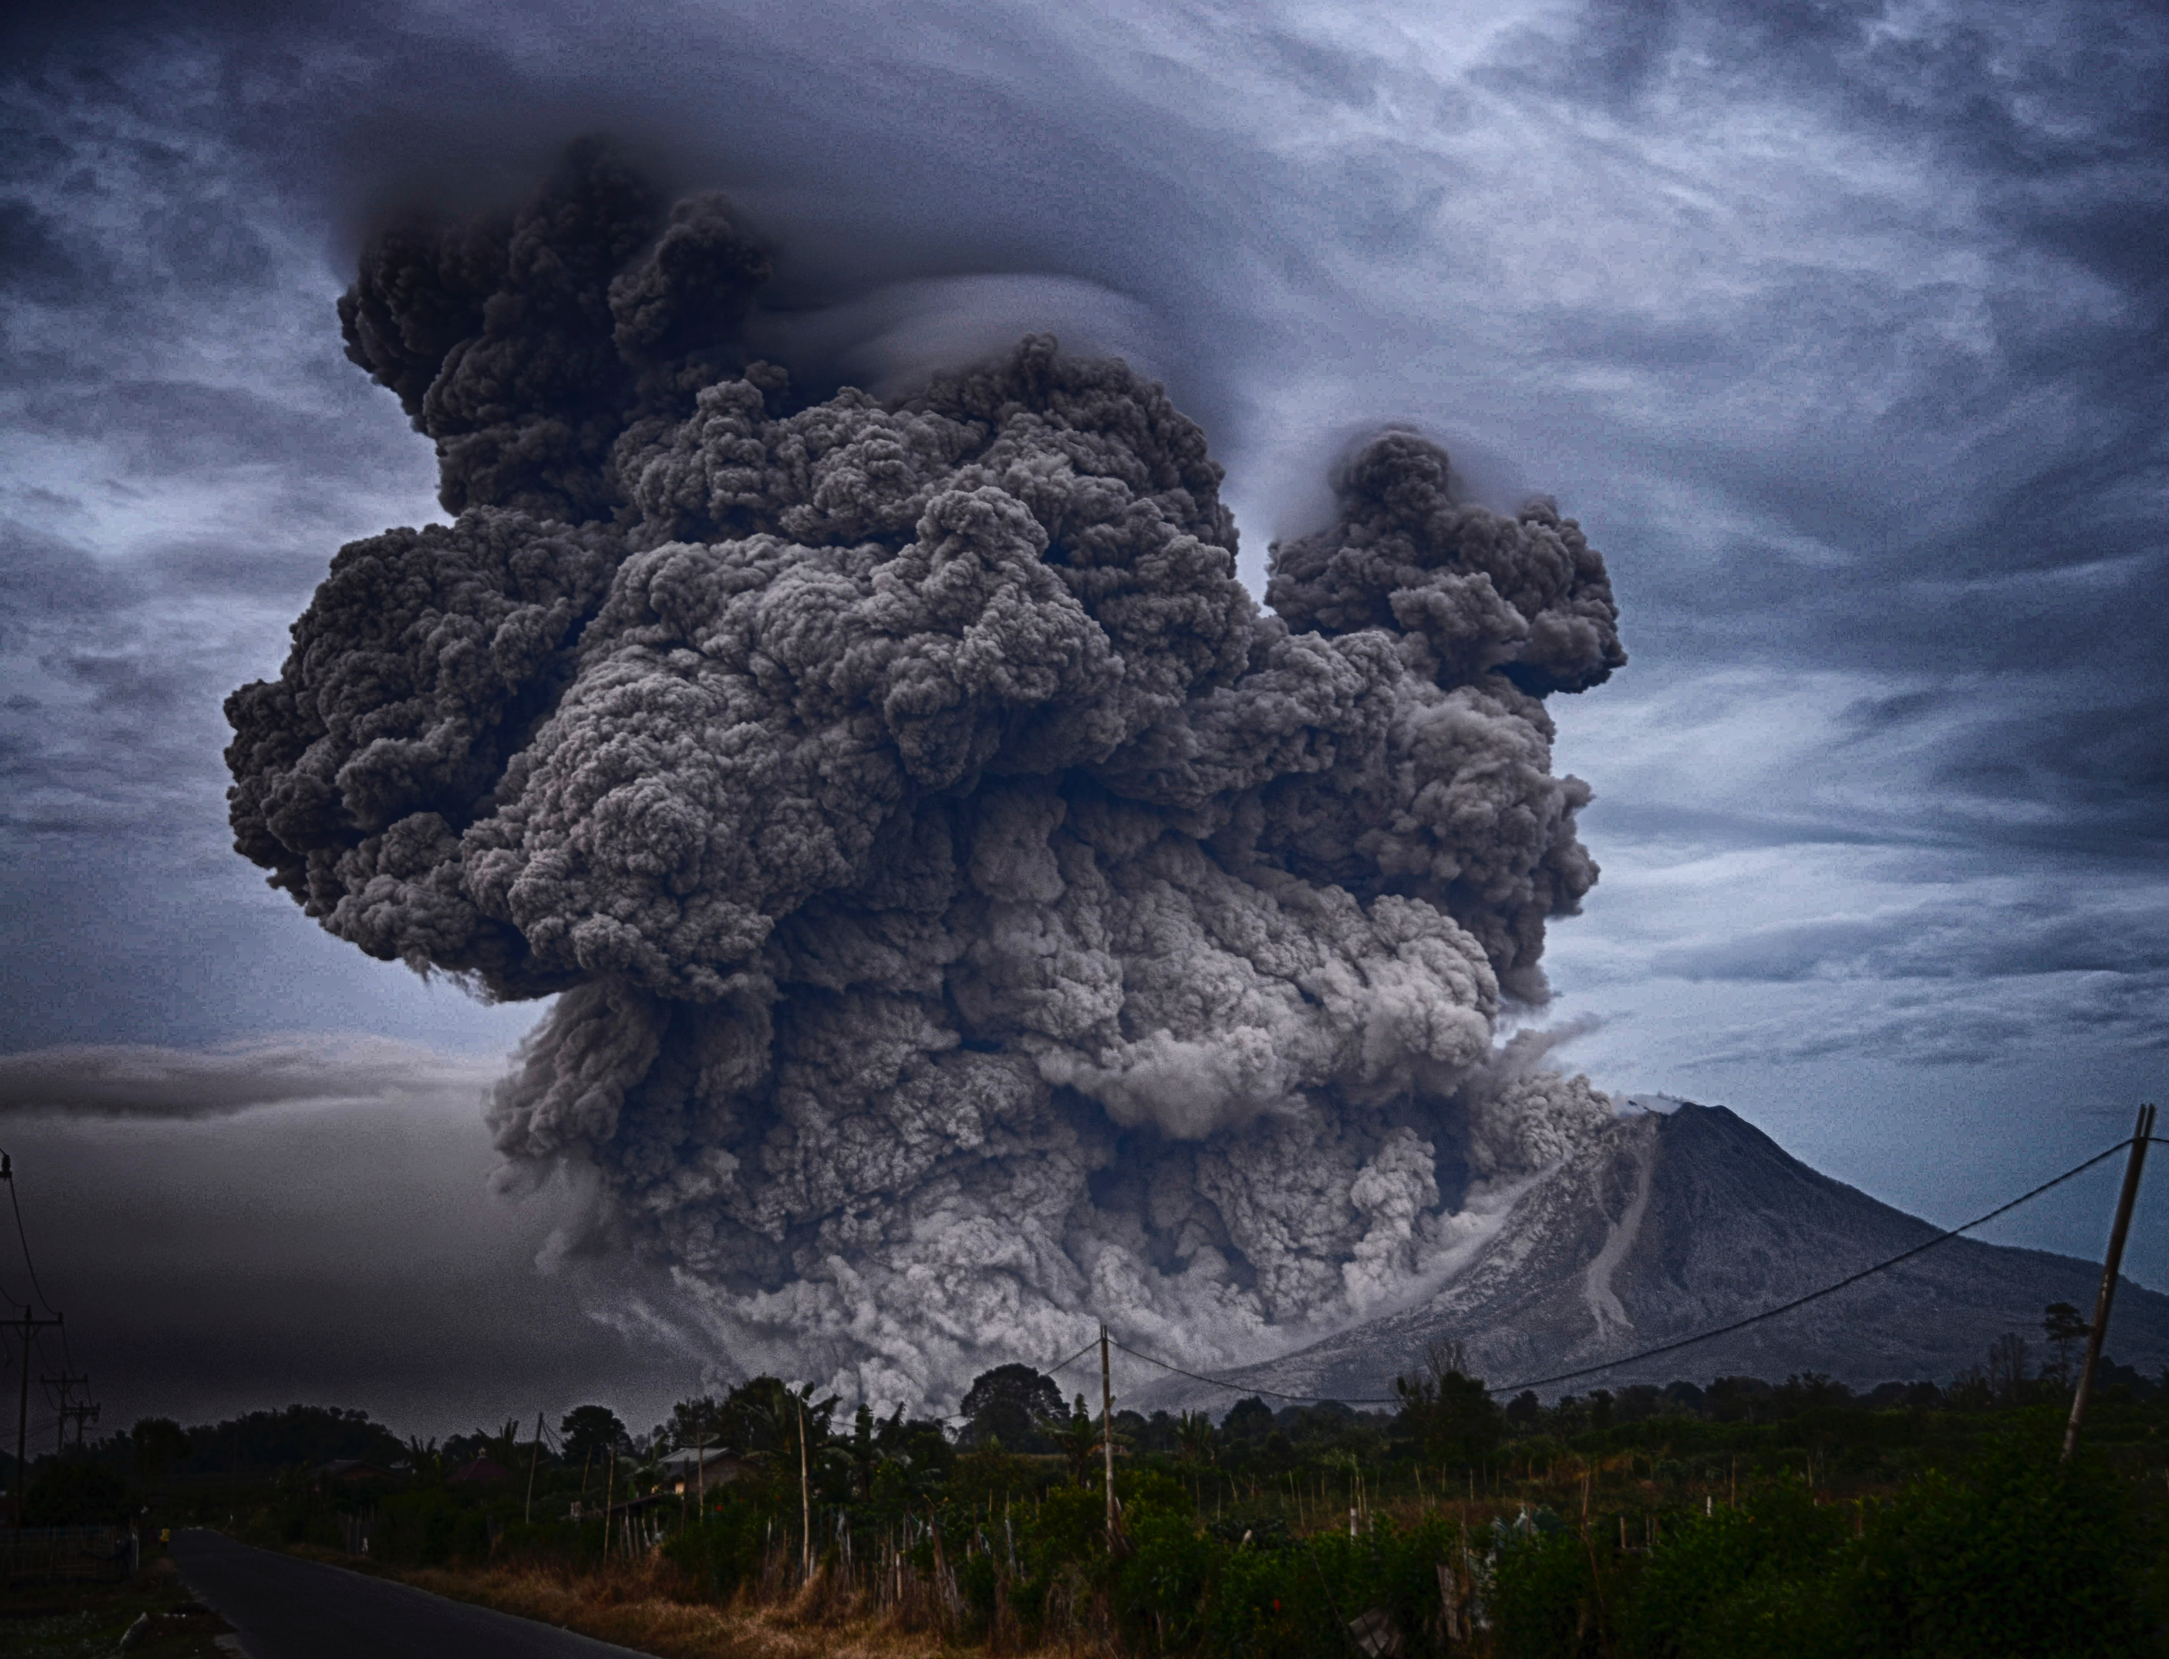
POWER – He is able to take care of us

Slide 10
PEACE – He wants us to trust Him

