Slide 1
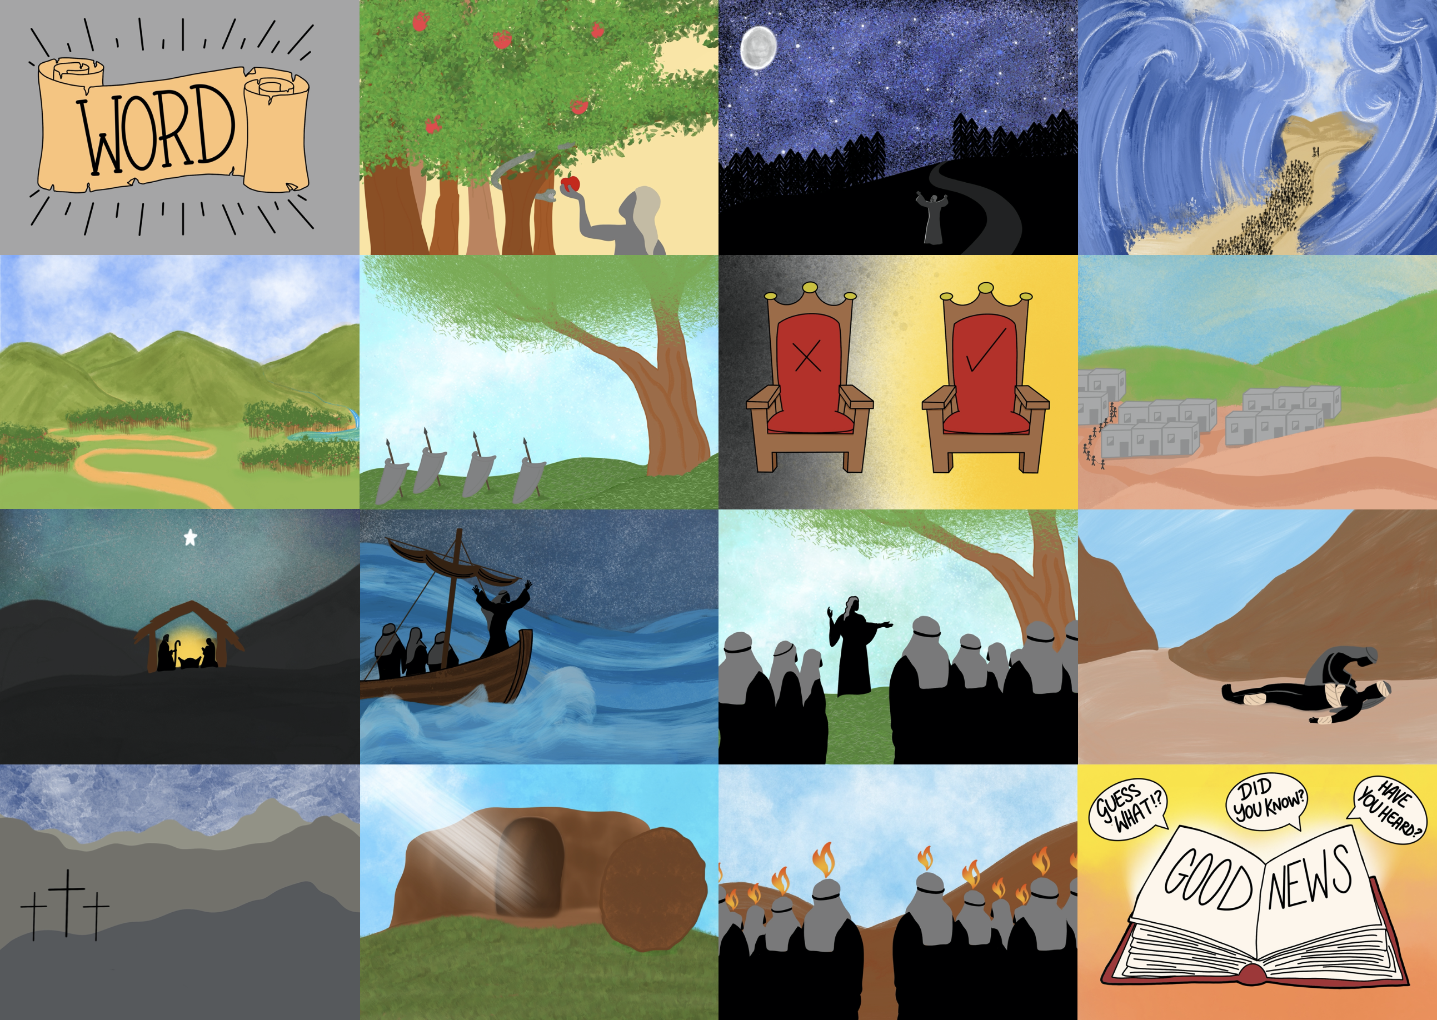



Slide 3
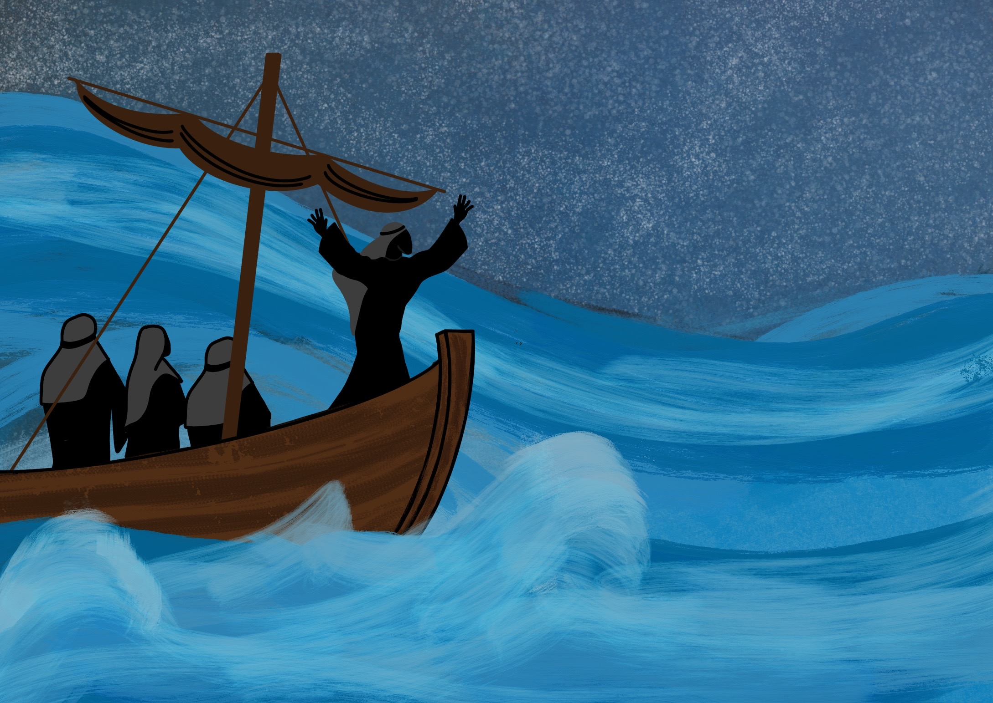

Slide 4
As Jesus, God’s Son, came to live on the Earth.

Slide 5
As the Son of God, Jesus is able to forgive our sins

Slide 6
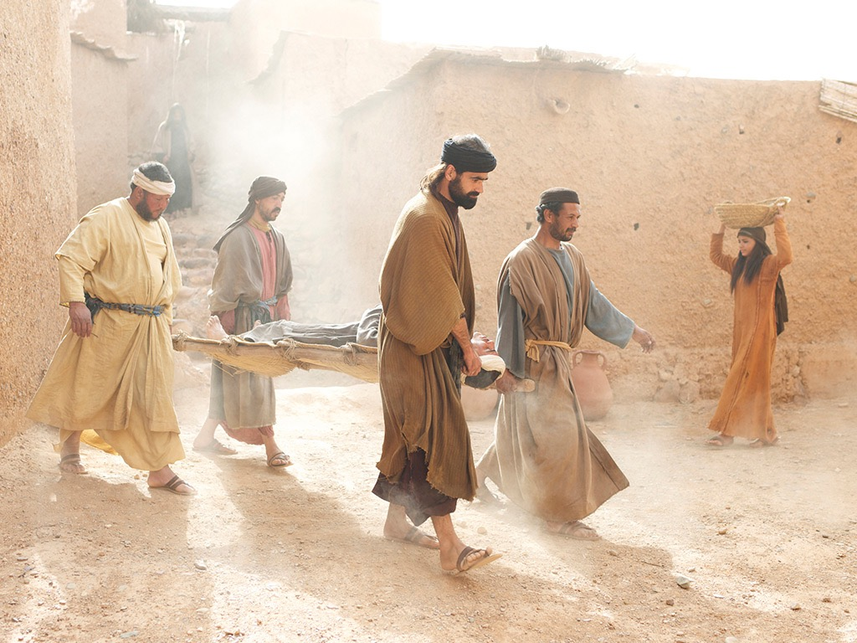

Slide 7
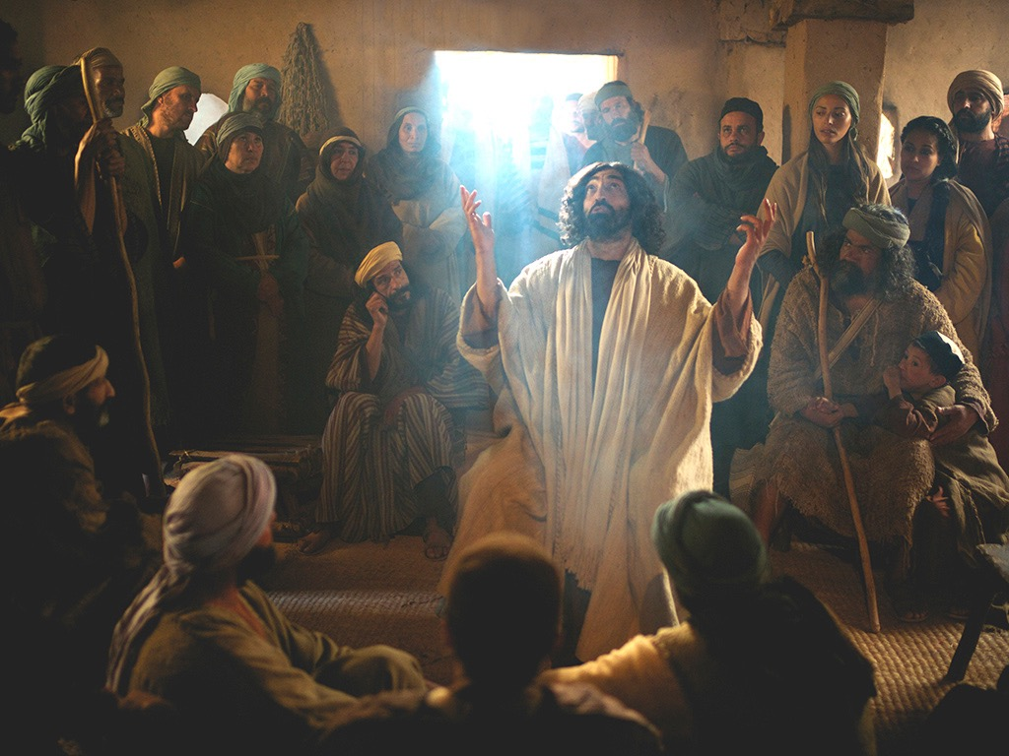

Slide 8
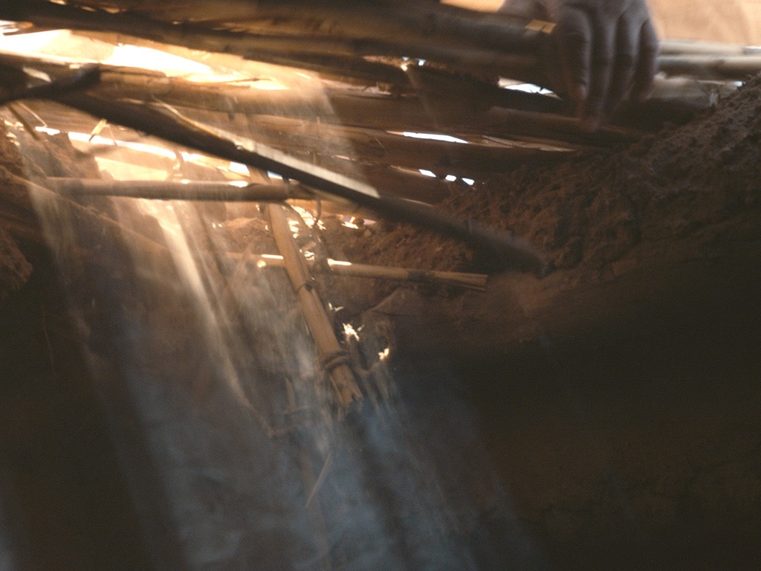

Slide 9
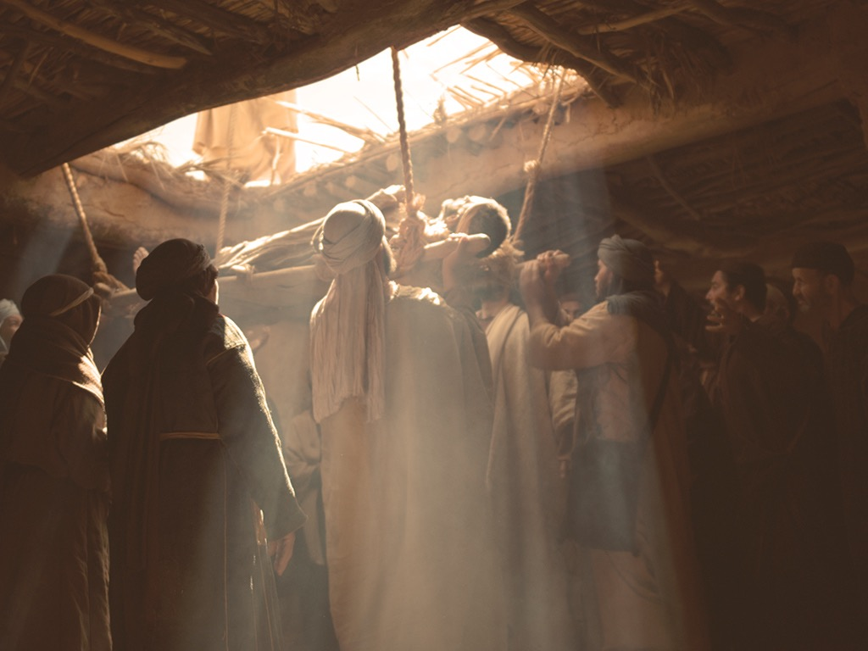

Slide 10
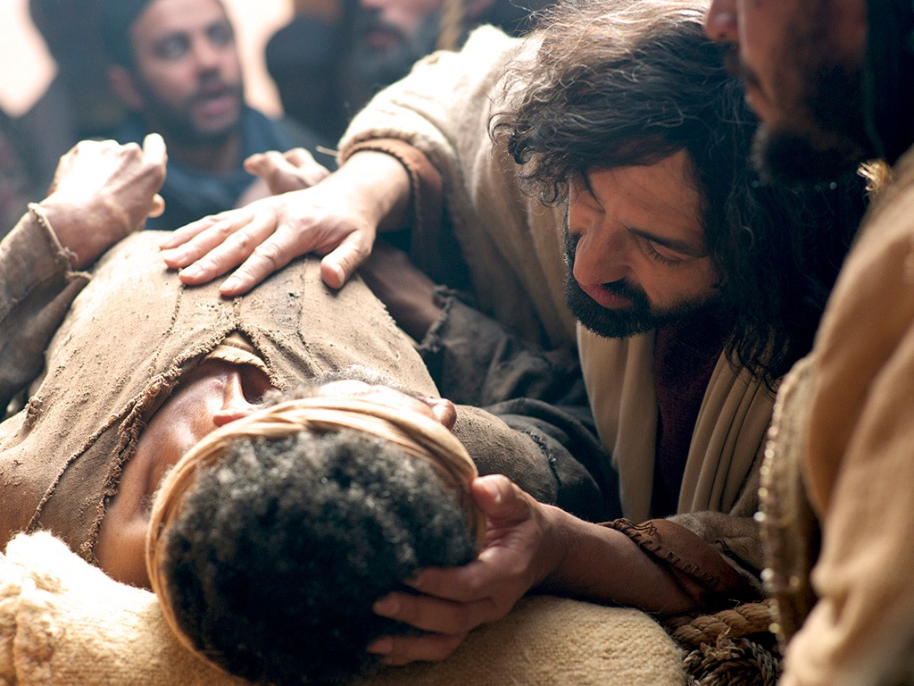

Slide 11
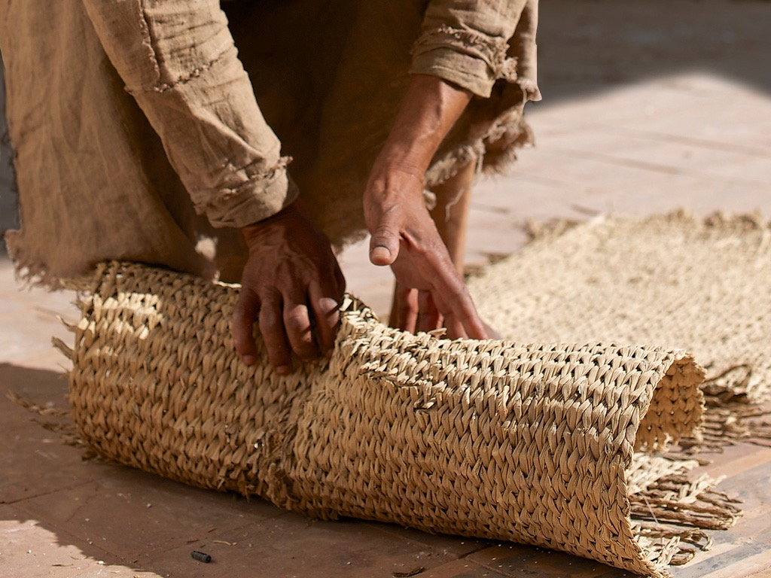

Slide 12
We need to be forgiven.
Jesus is able to forgive us.

Slide 13
Busy Little House
(optional song lyrics)

Slide 14
Once there was a house,
A busy little house
And this is all about
The busy little house.
Jesus Christ had come,
Teaching everyone
So everyone had run
To the busy little house.

Slide 15
Everyone was there,
You couldn’t find a chair;
In fact you had to fight for air
In the busy little house.
A man who couldn’t walk
Was carried to the spot
But the place was chock-a-block
In the busy little house.

Slide 16
‘Whatever shall we do?
Whatever shall we do?
We’ll never get him through
Into the busy little house.’
‘We’ll open up the roof,
We’ll open open up the roof.
And then we’ll put him through
Into the busy little house.

Slide 17
Then Jesus turned His eyes,
And saw to His surprise
The man coming from the skies
Into the busy little house.
Then Jesus turned and said:
‘Get up and take your bed
And run along instead
From the busy little house.’

Slide 18
The man went on His way;
The people cried, ‘Hooray!
We’ve seen great things today
In the busy little house.’
Once there was a house,
A busy little house
And that was all about
The busy little house.

