Slide 3
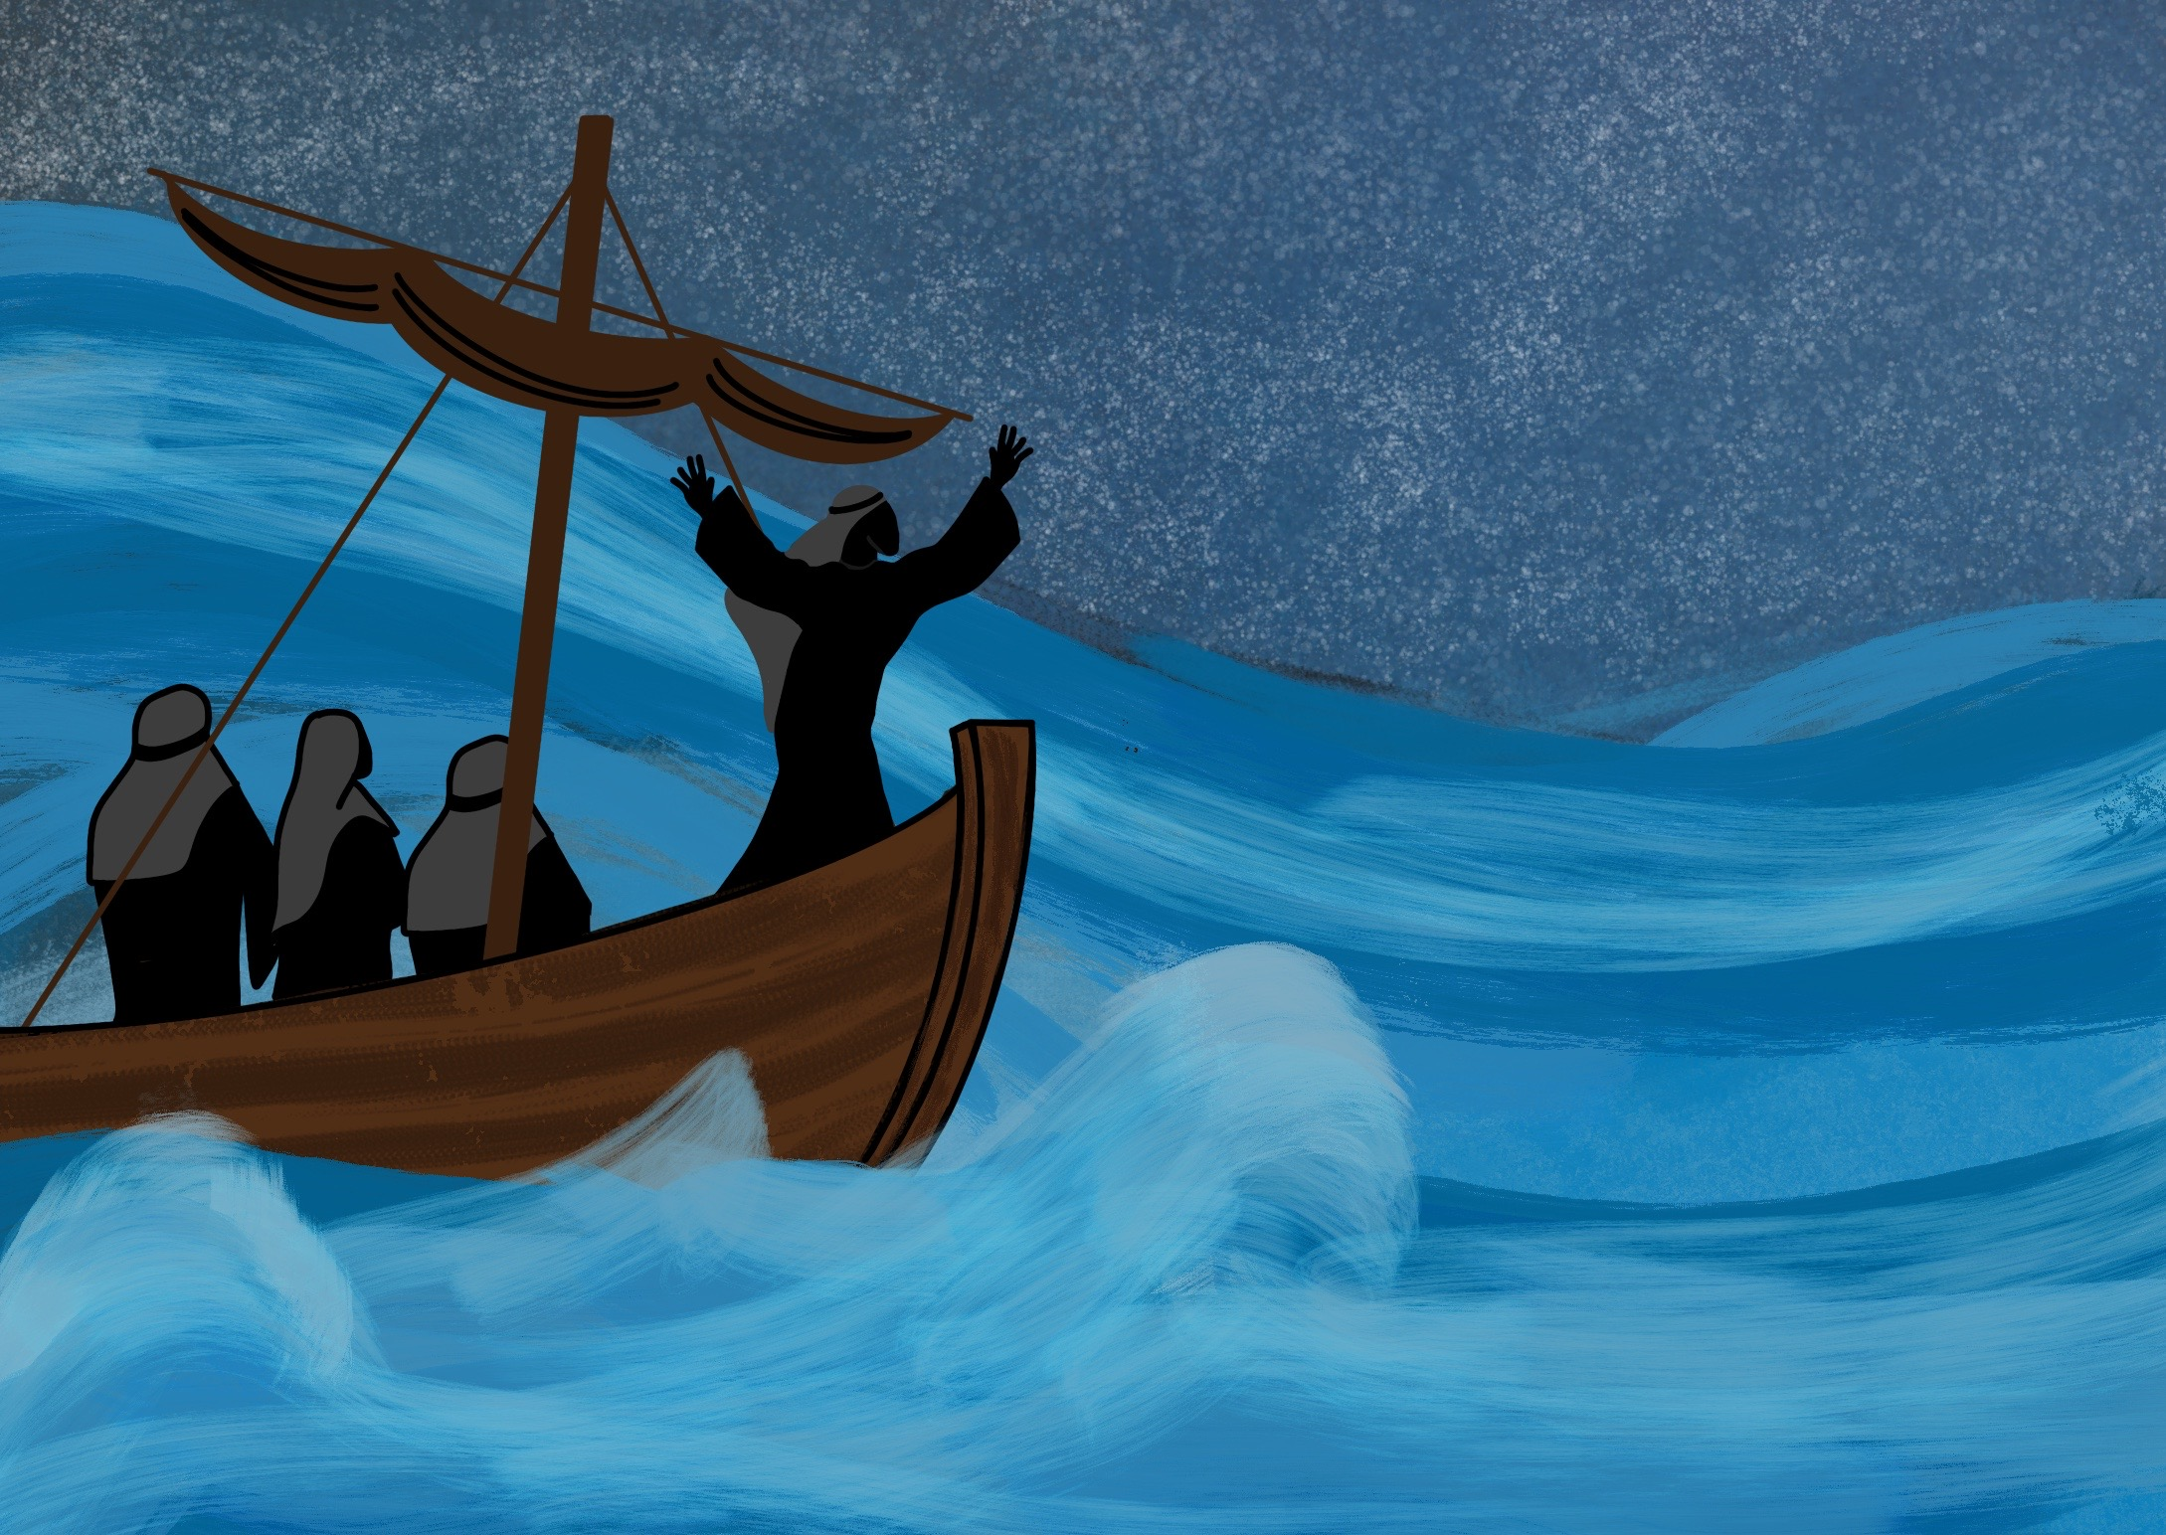

Slide 4
As Jesus, God’s Son, came to live on the Earth.

Slide 5
As one of us, Jesus is able to help us when we are tempted

Slide 10
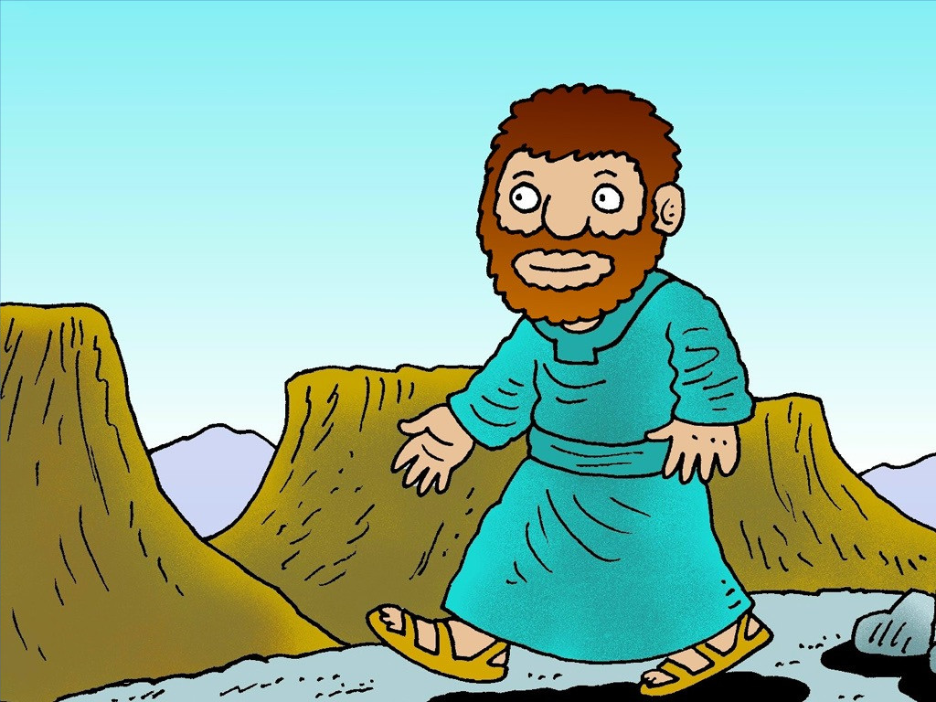

Slide 11
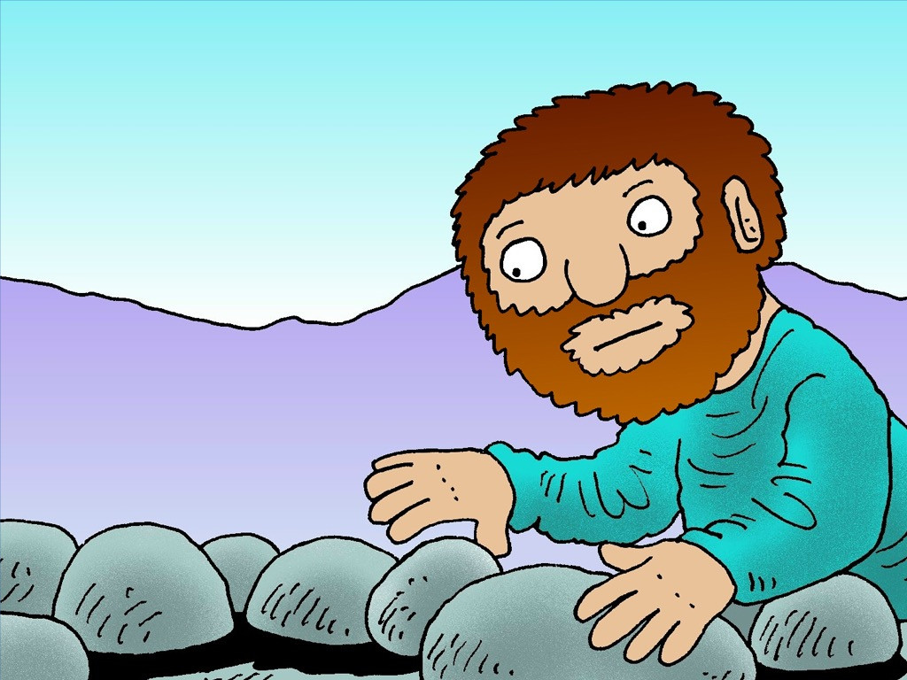

Slide 12
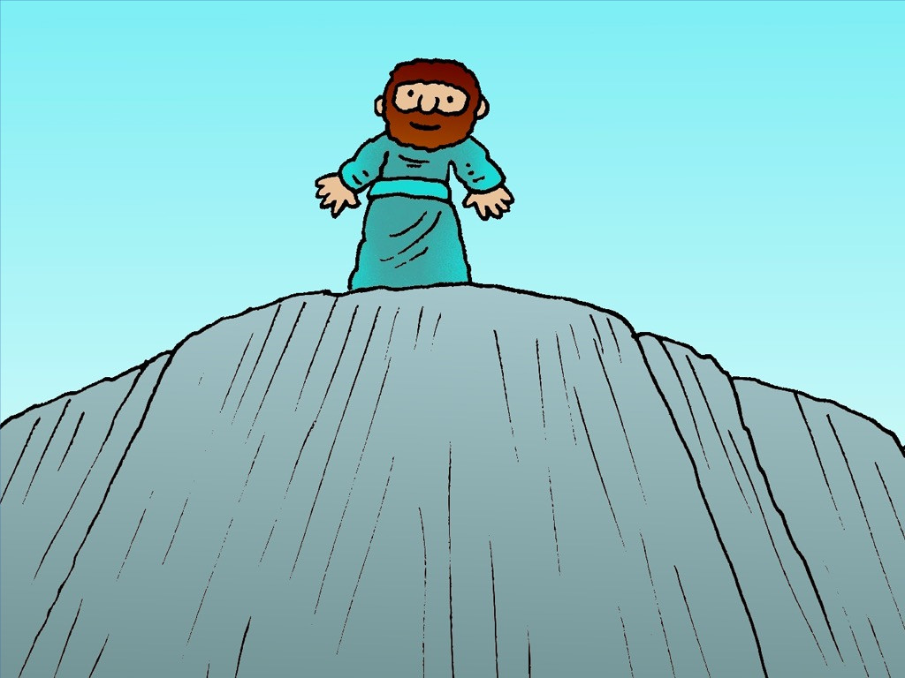

Slide 13
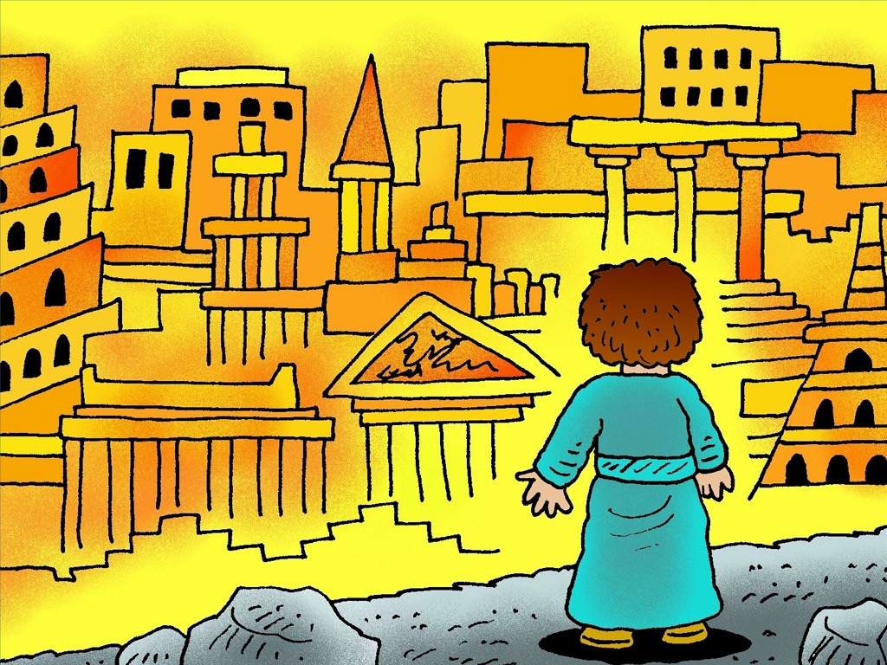

Slide 14
He [Jesus] has been tempted in every way, just as we are – yet he was
without sin.
Hebrews 4:15

