Slide 1




Slide 3
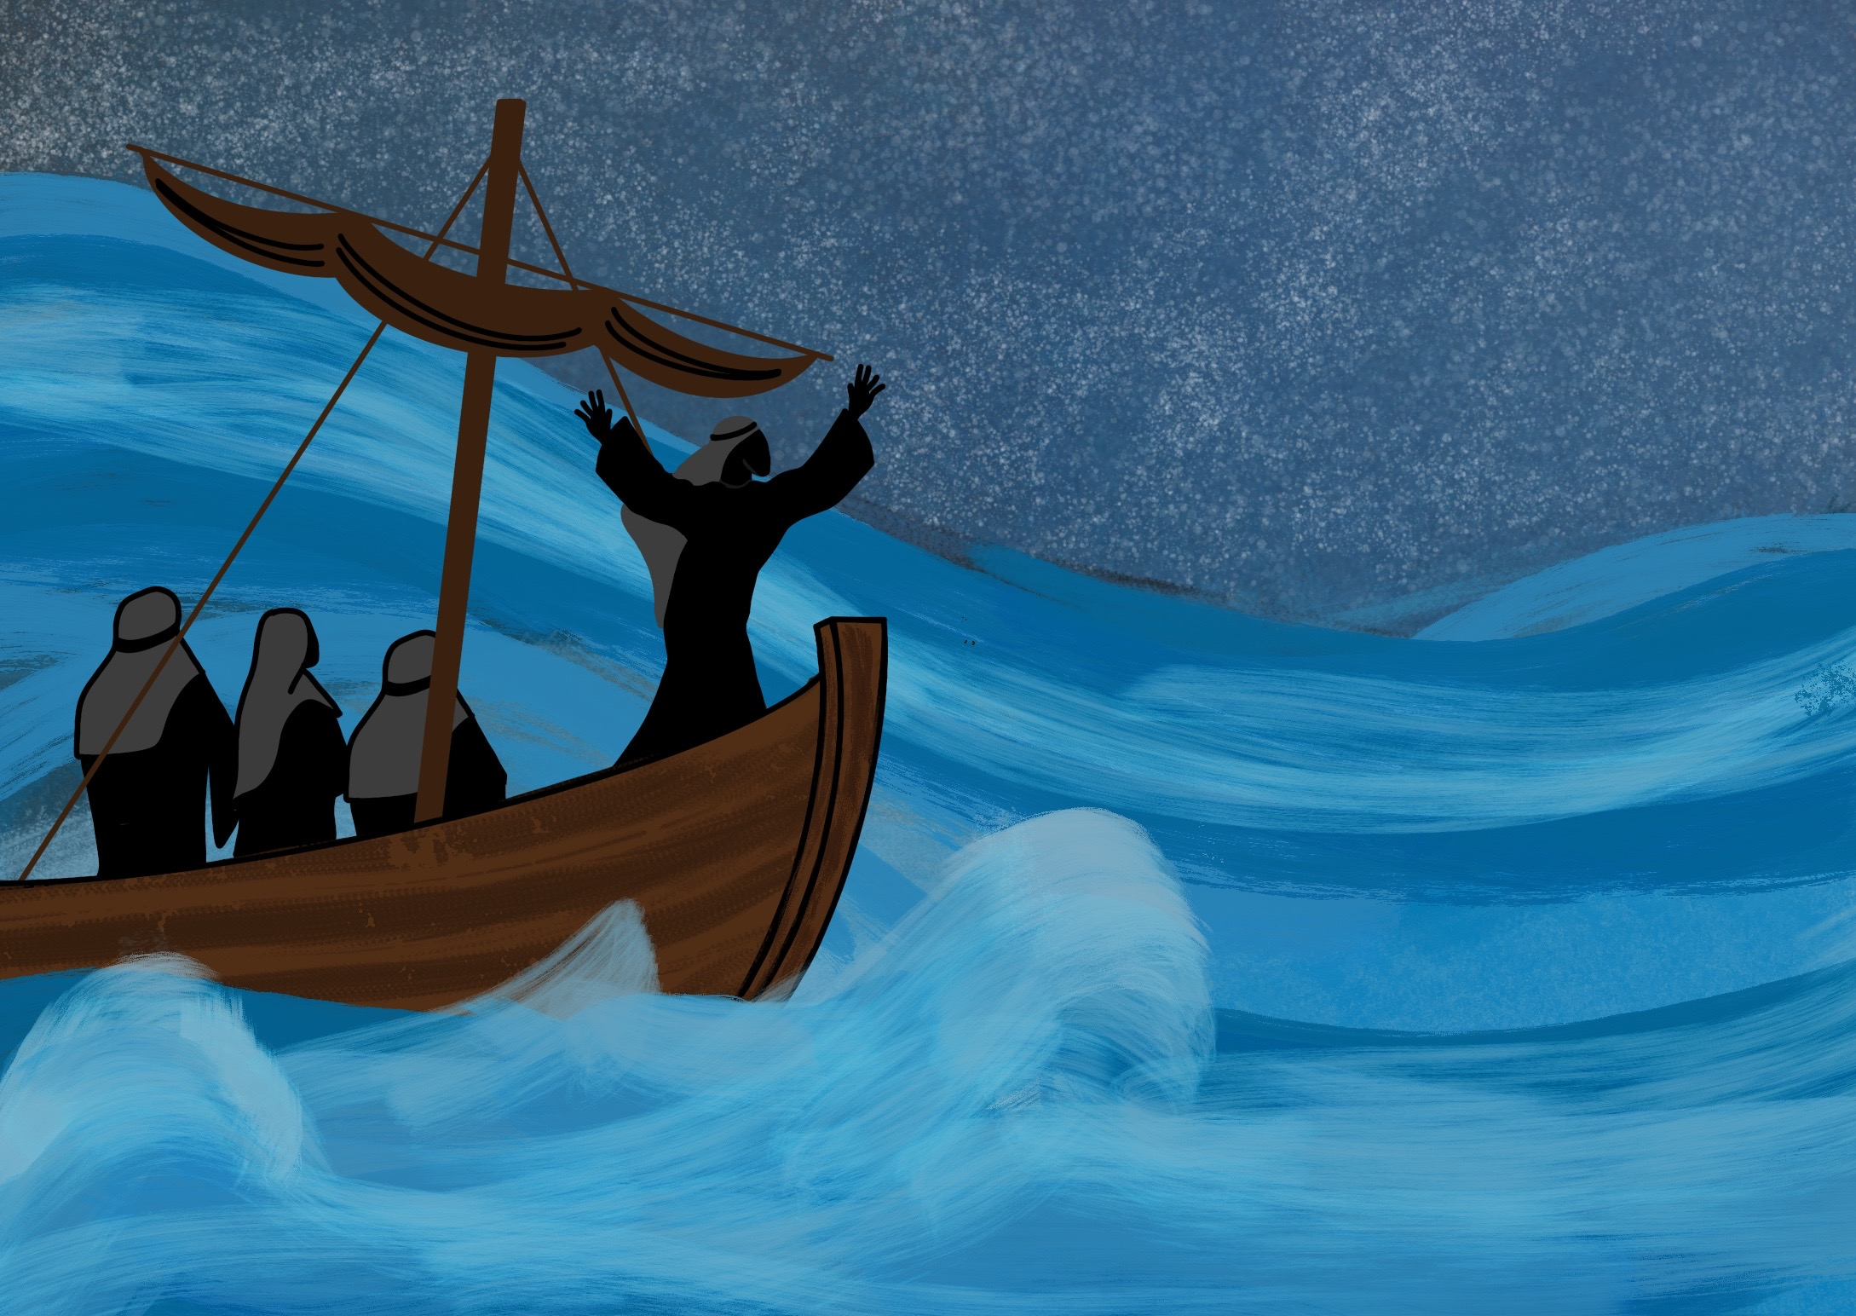

Slide 4
As Jesus, God’s Son, came to live on the Earth.

Slide 5
As one of us, Jesus is able to take our place

Slide 8
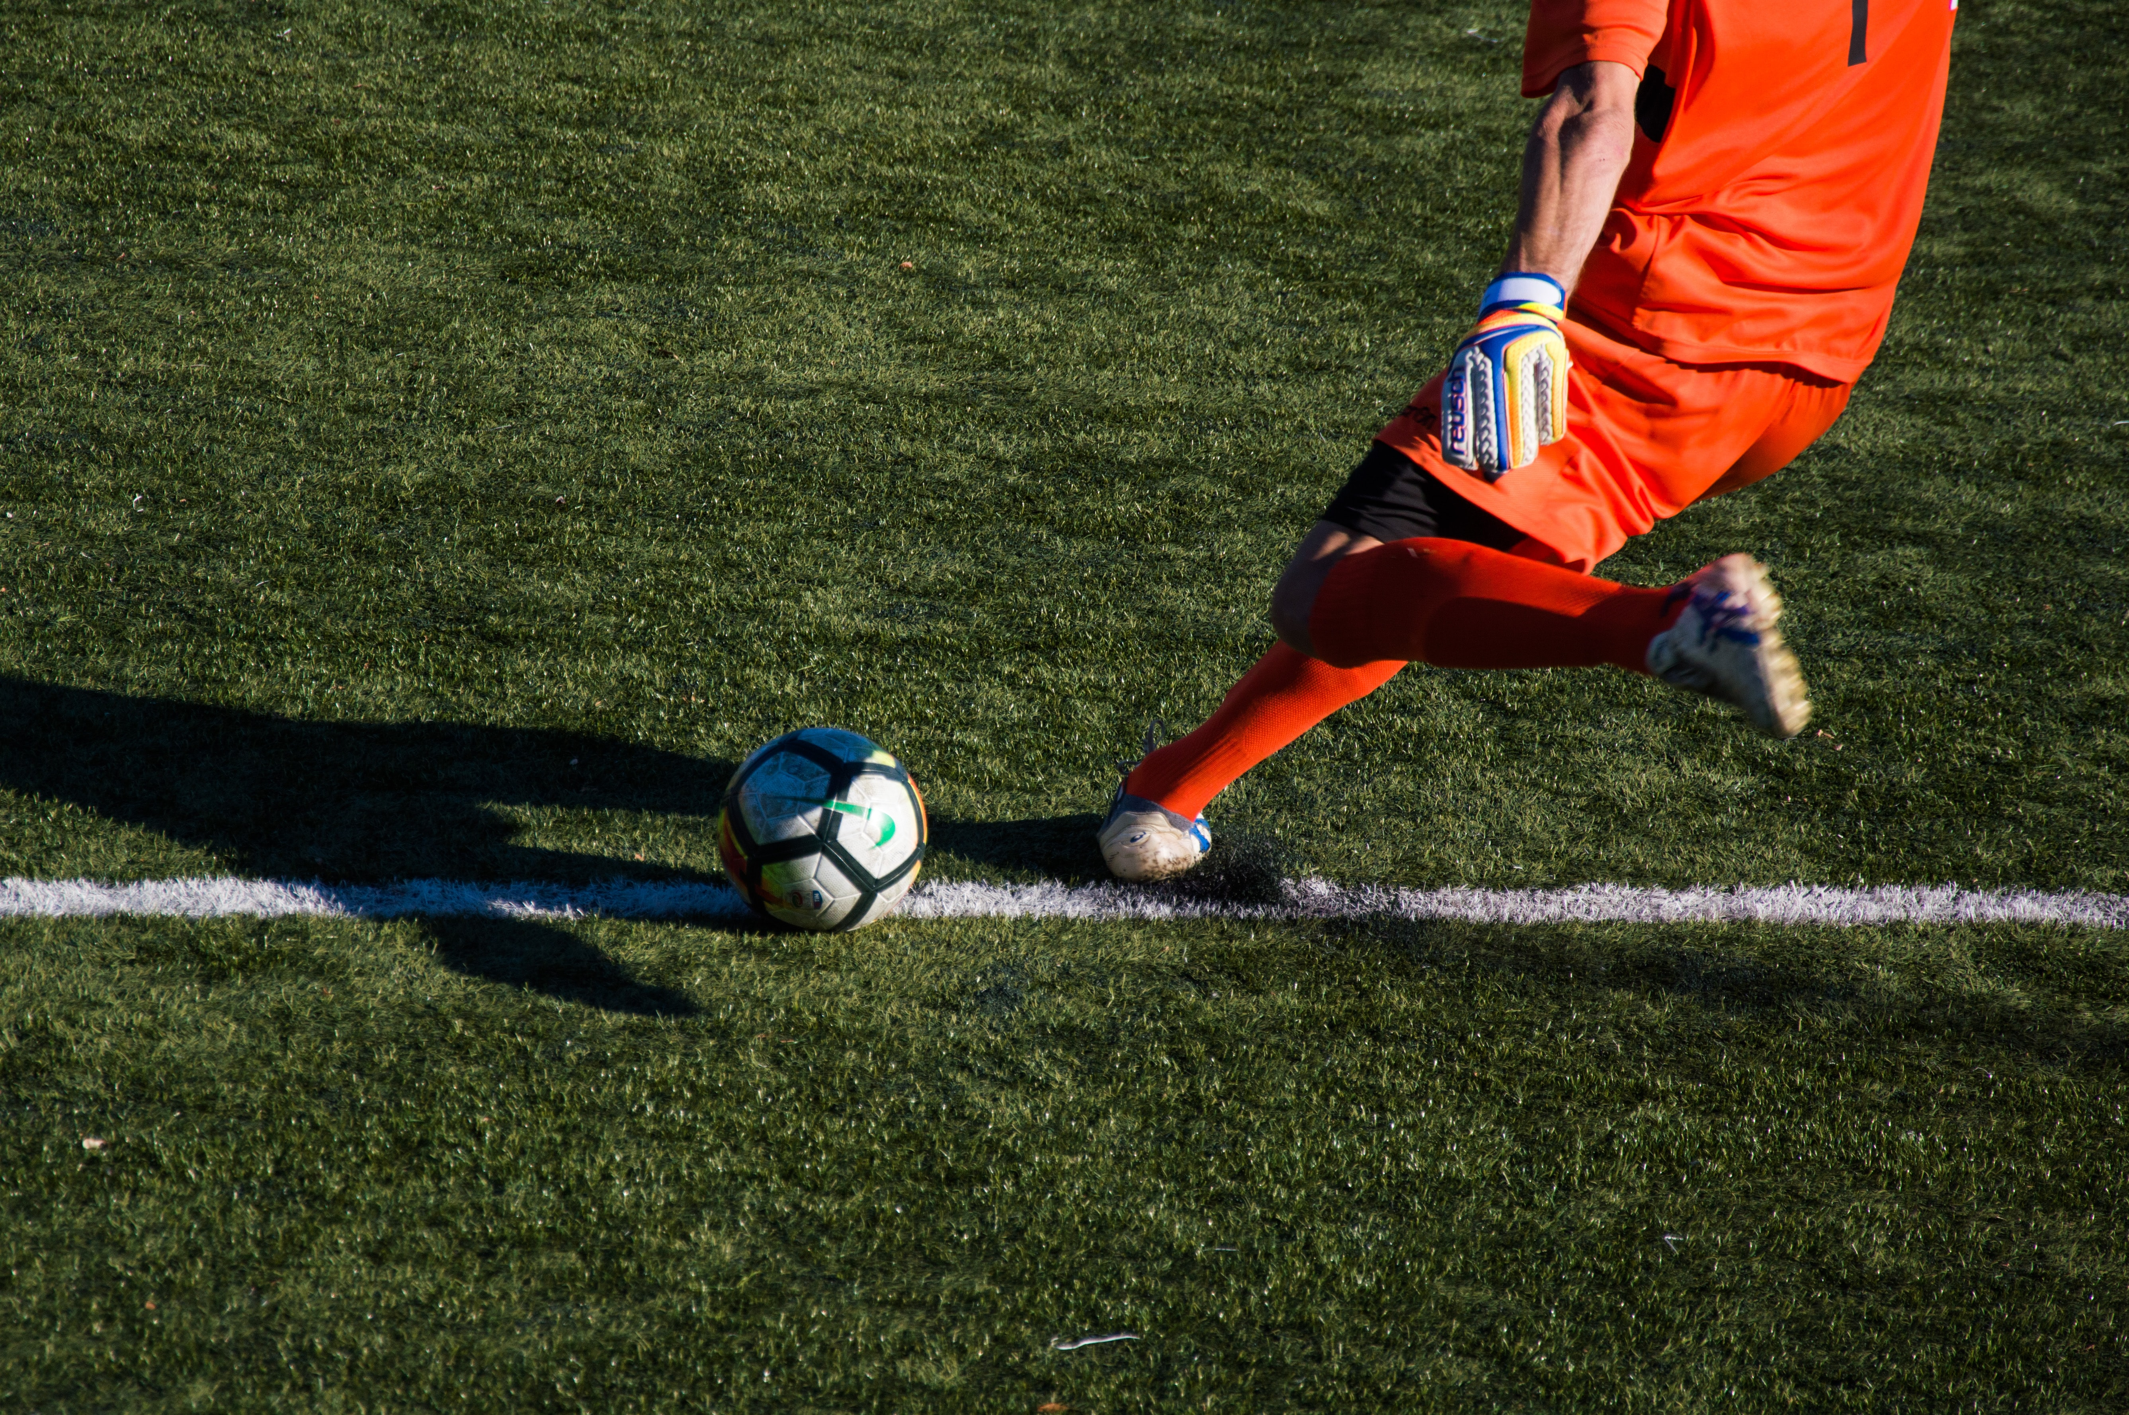

Slide 10
Look!
The Lamb of God who takes away the sin of the world.
John 1:29

