Slide 1
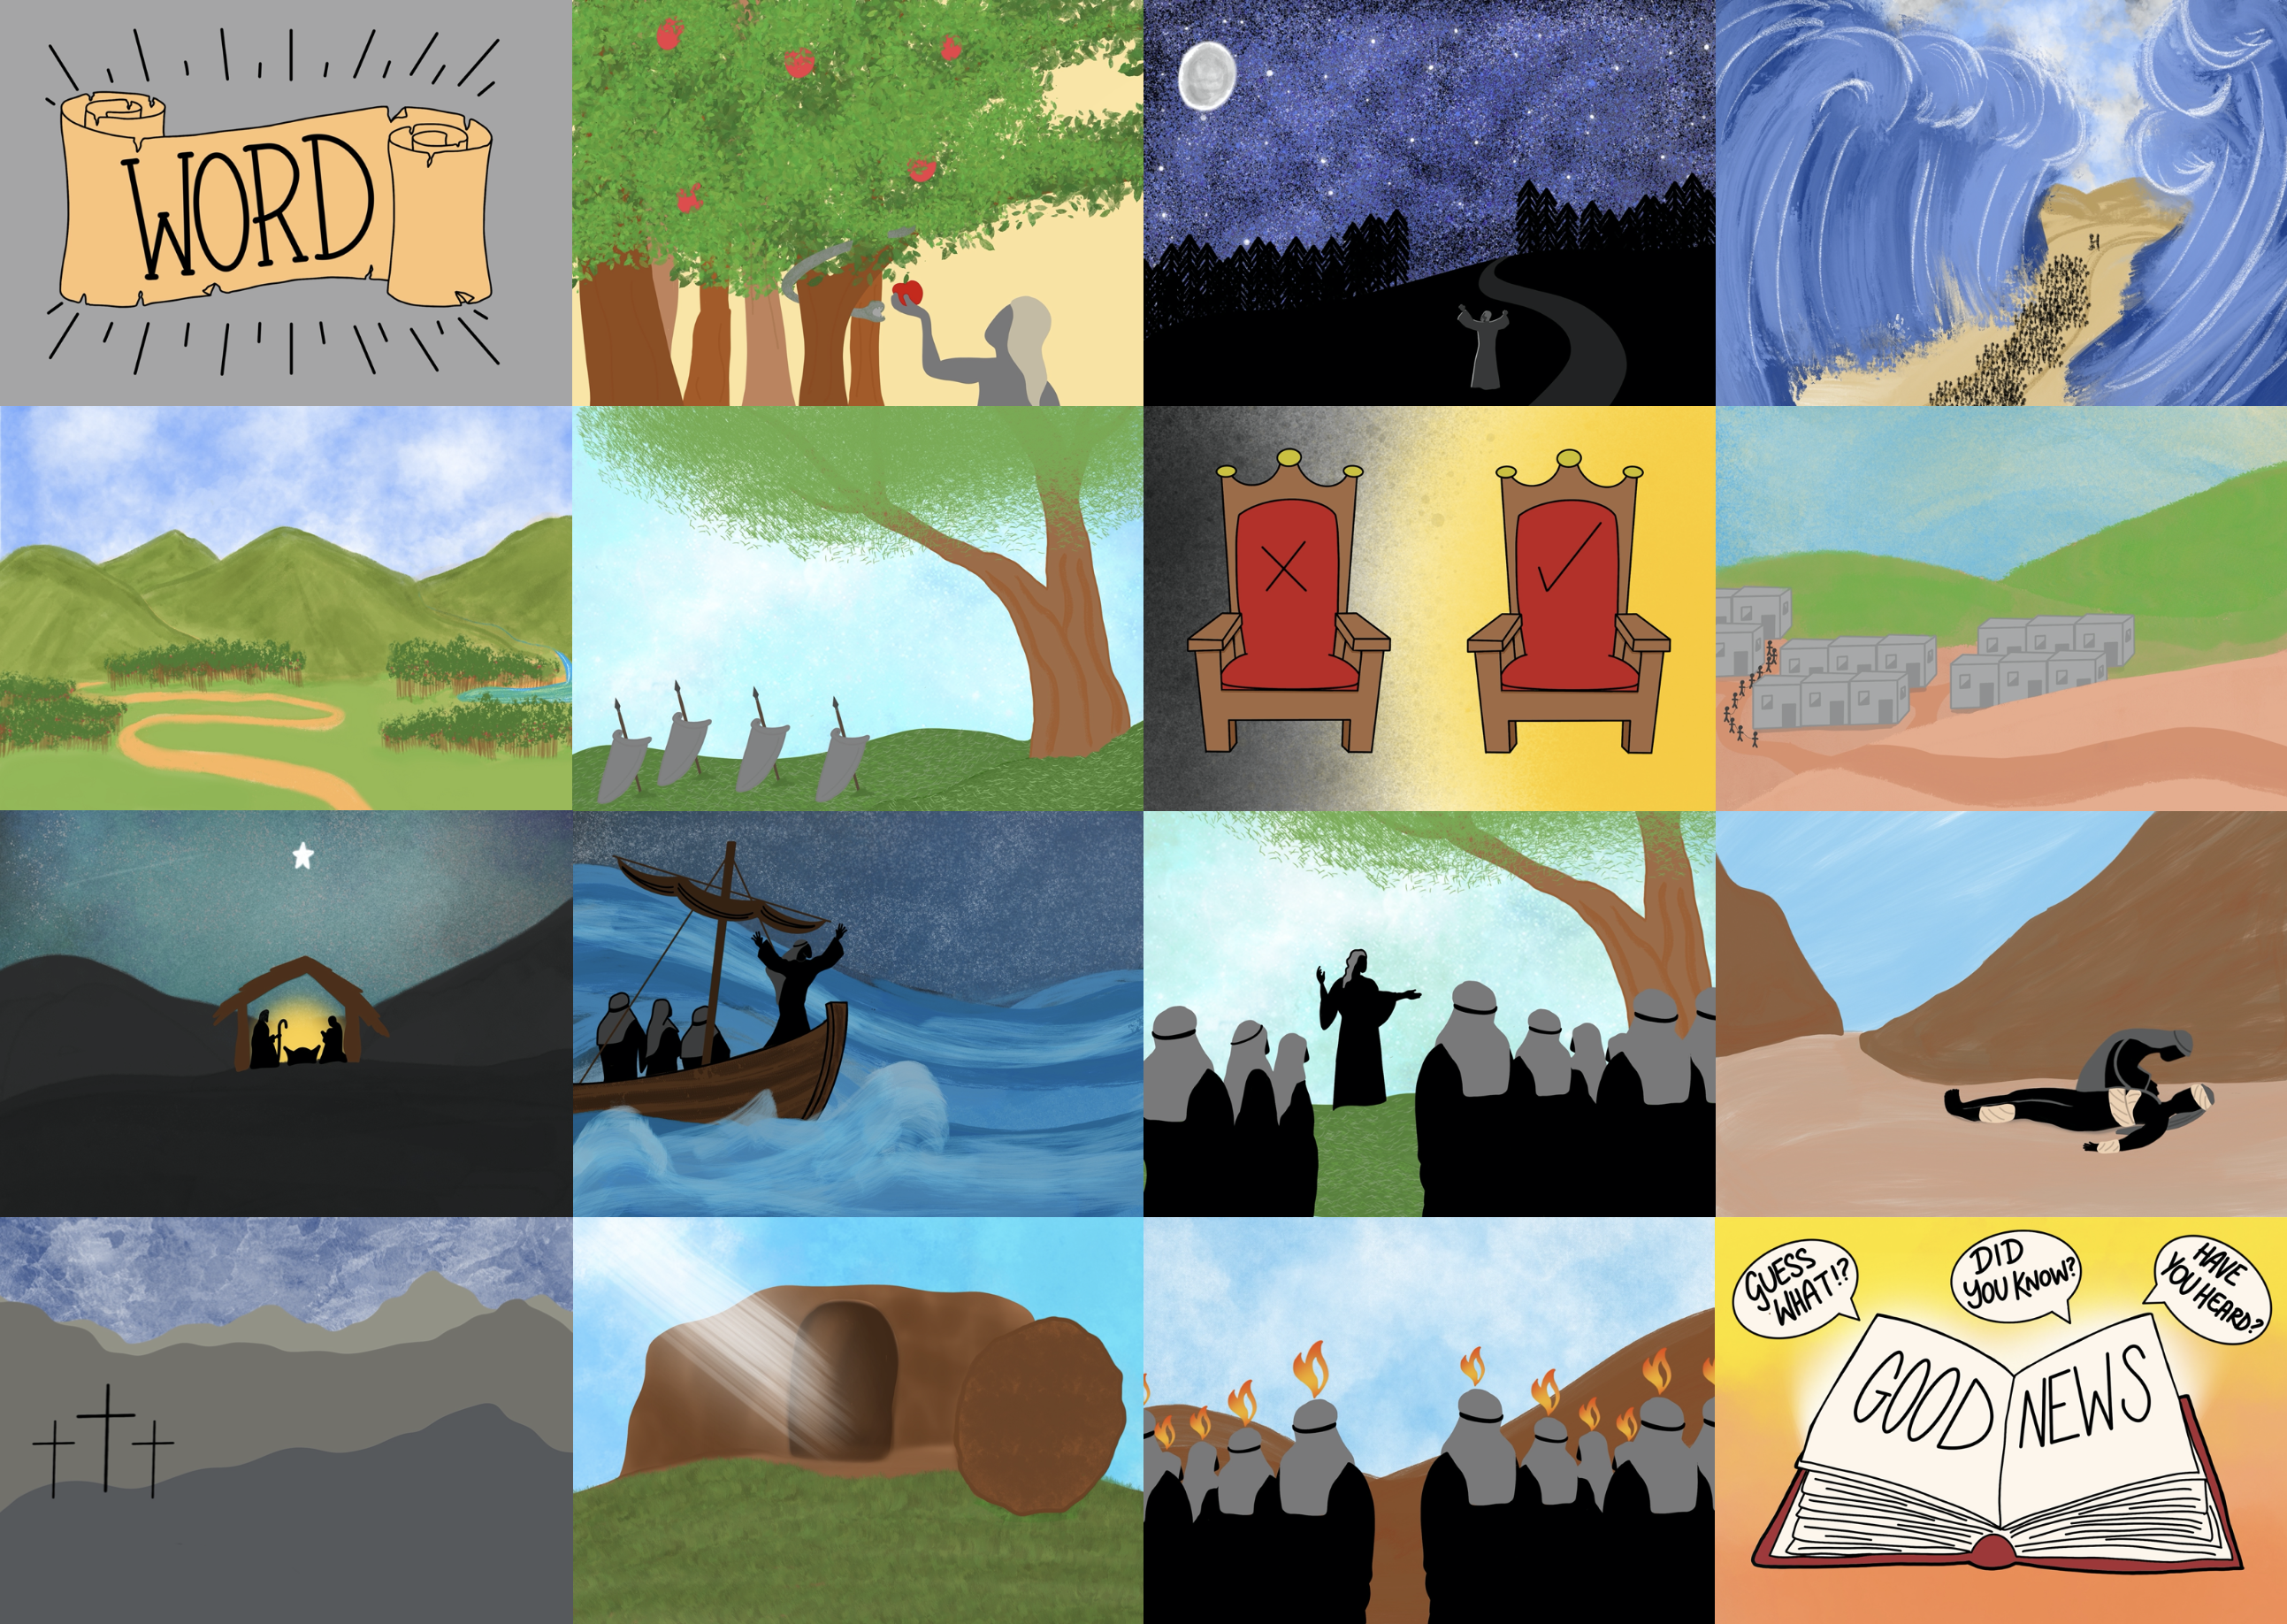



Slide 3
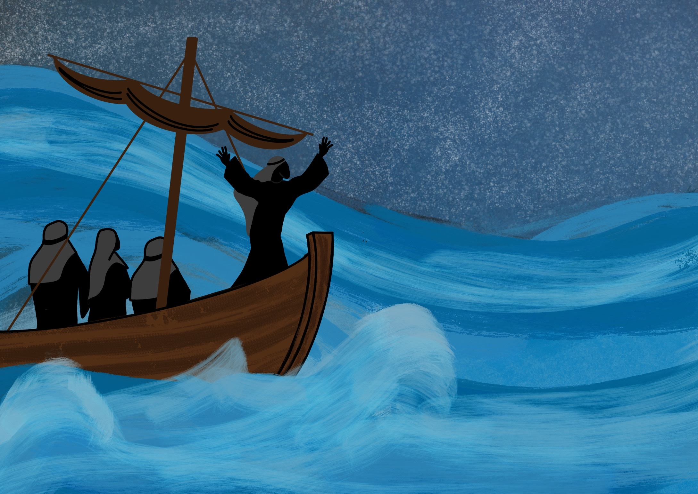

Slide 4
As Jesus, God’s Son, came to live on the Earth.

Slide 5
As one of us, Jesus is able to understand us

Slide 19
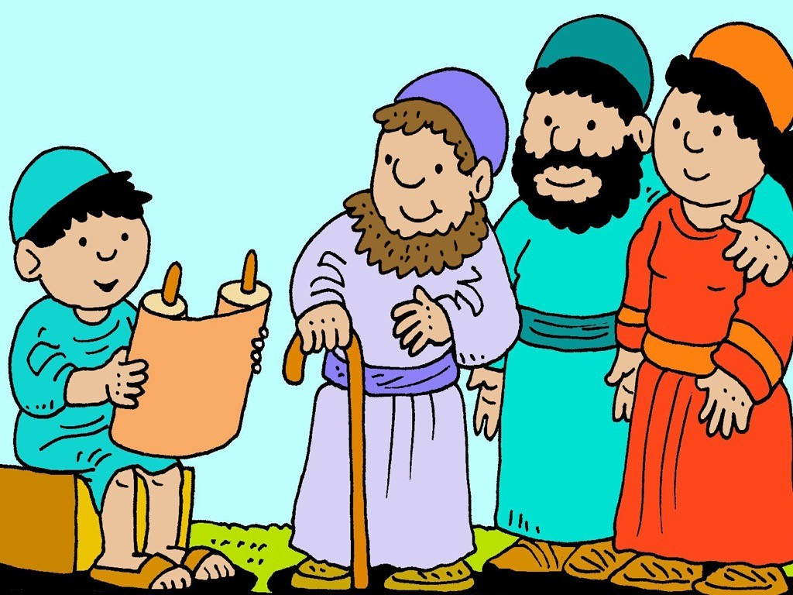
Jesus grew in wisdom and stature and in favour with God and man.
Luke 2:52

