Slide 1
How can we make a difference?
Music ‘once again’ courtesy of bensound.com

Slide 2
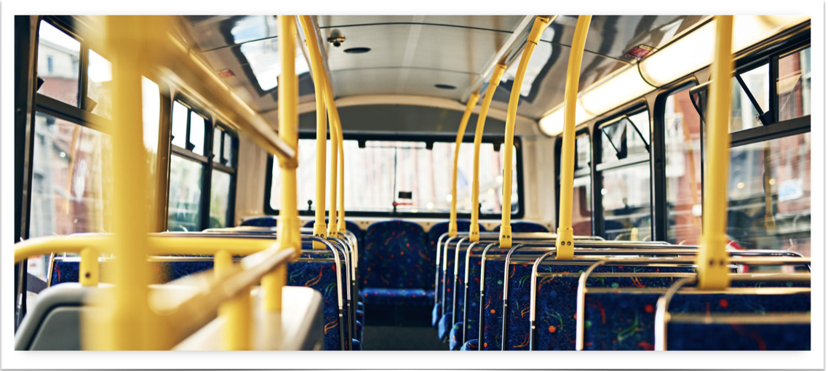
…on the school bus?

Slide 3
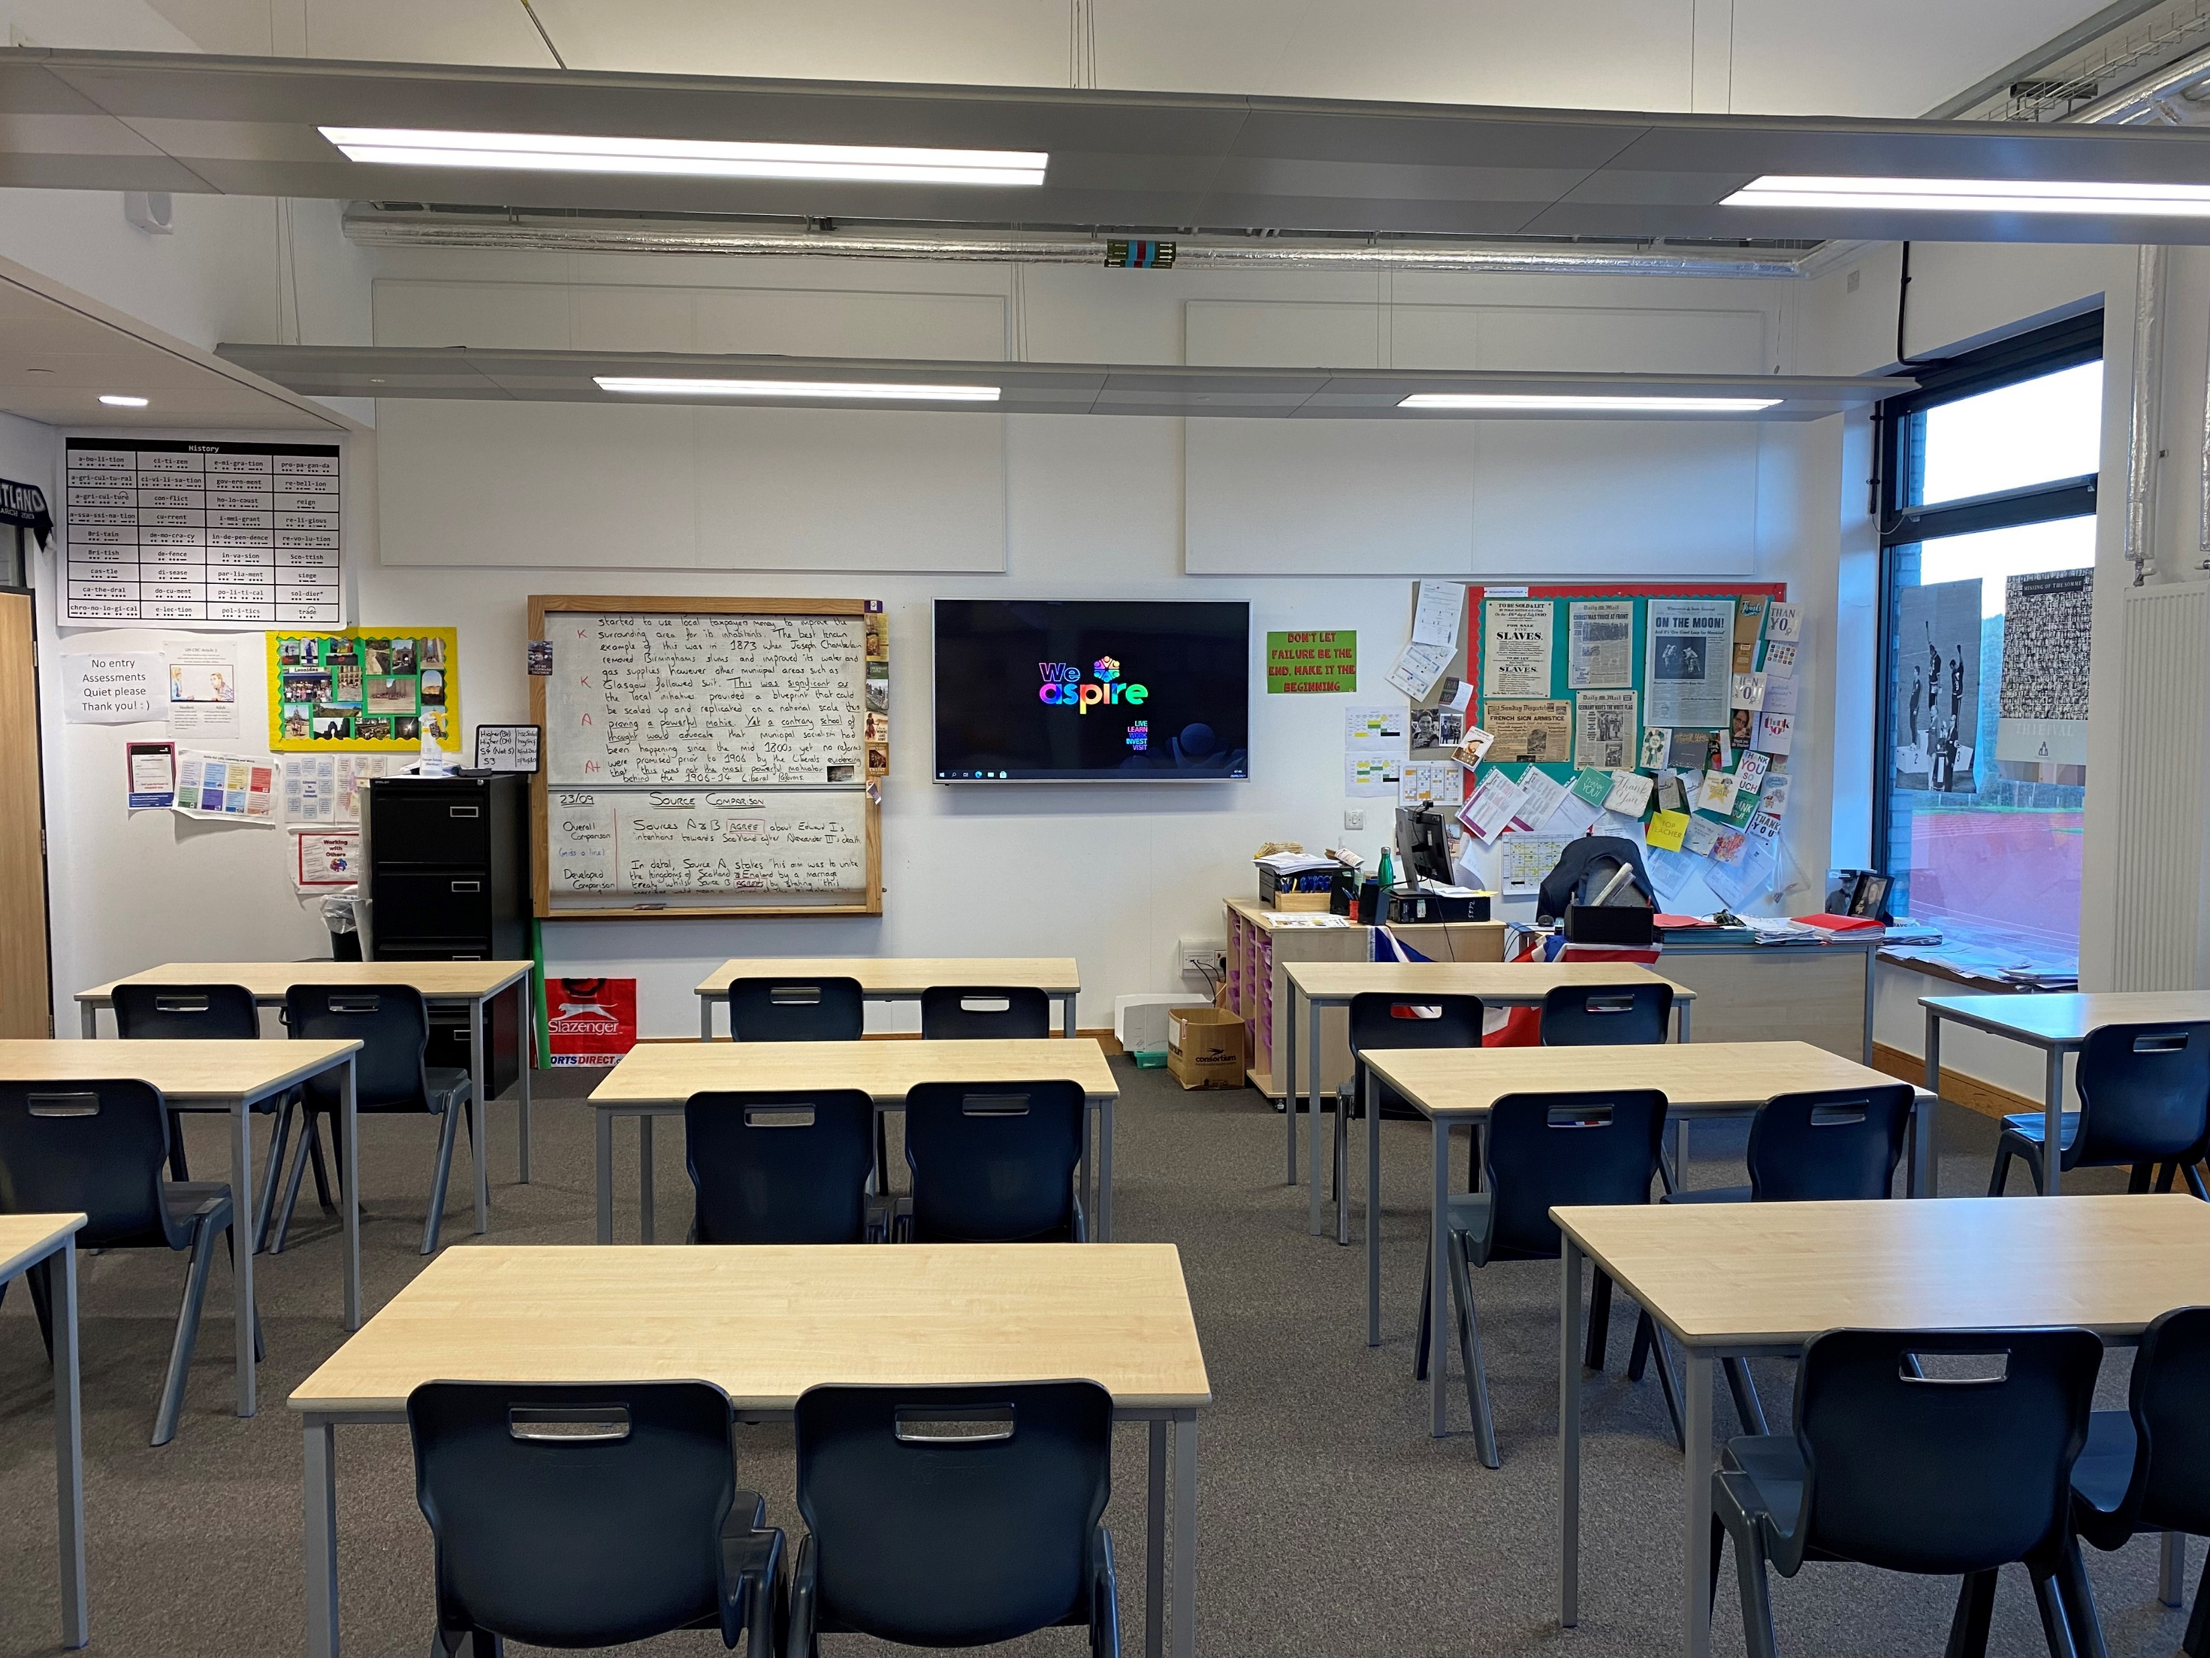
…in the classroom?

Slide 4
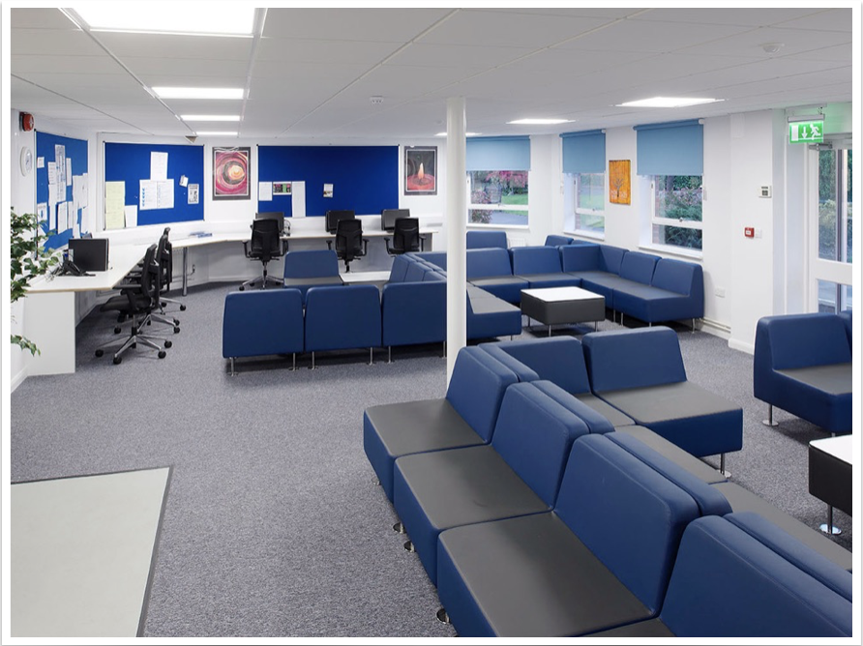
…in the staffroom?

Slide 5
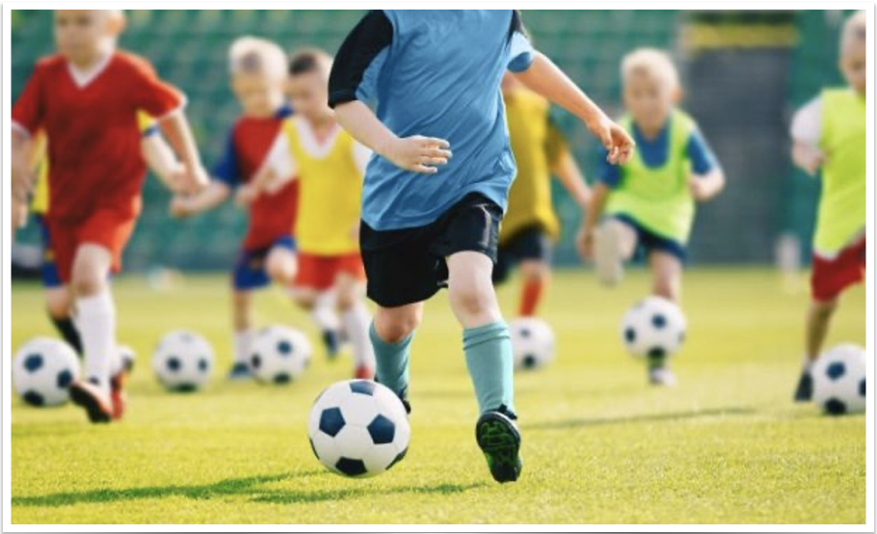
…on the sports field?

Slide 6
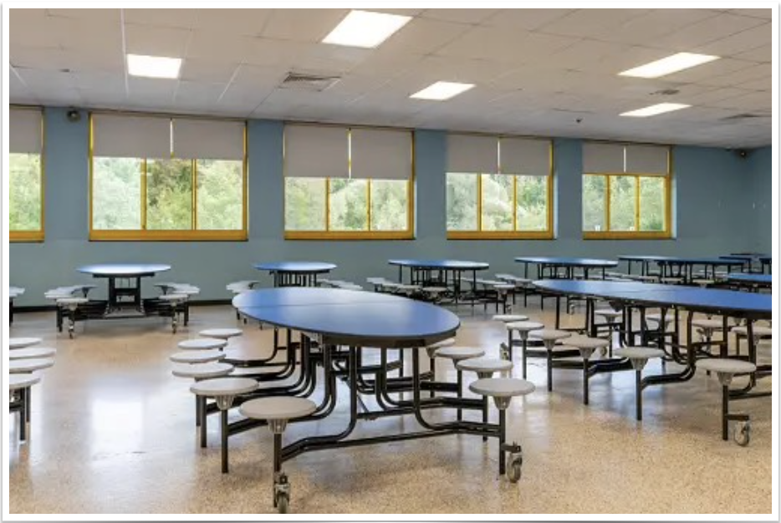
…in the canteen?

Slide 7
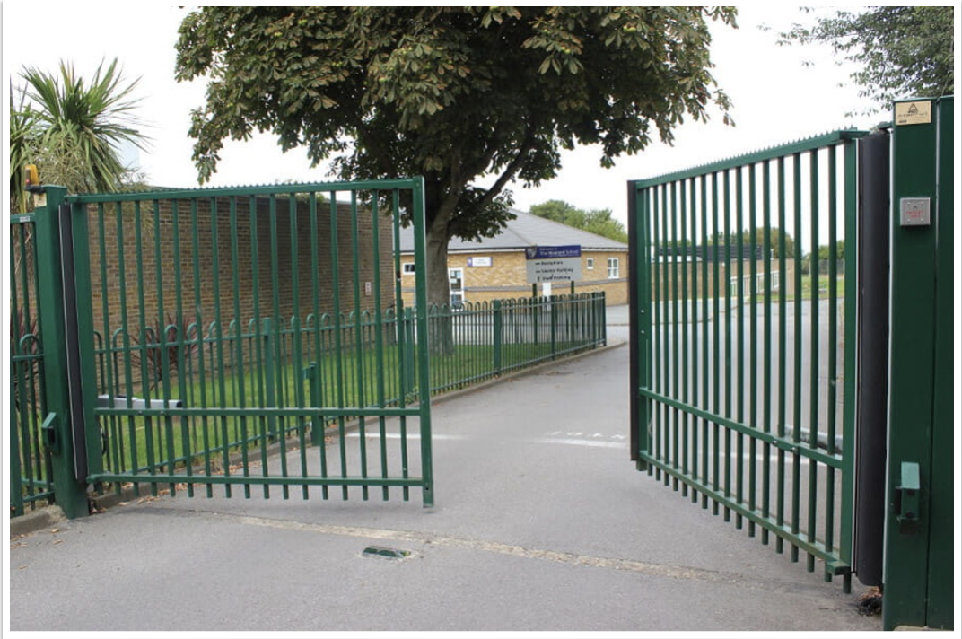
…at the school gate?

Slide 8
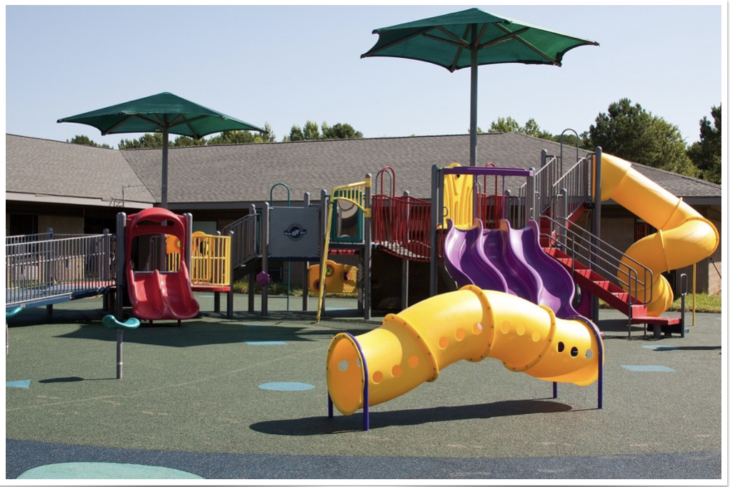
…in the playground?

Slide 9
May others spot the difference Jesus makes!
Music ‘once again’ courtesy of bensound.com

