Slide 1
Welcome to our
service today!

Slide 2
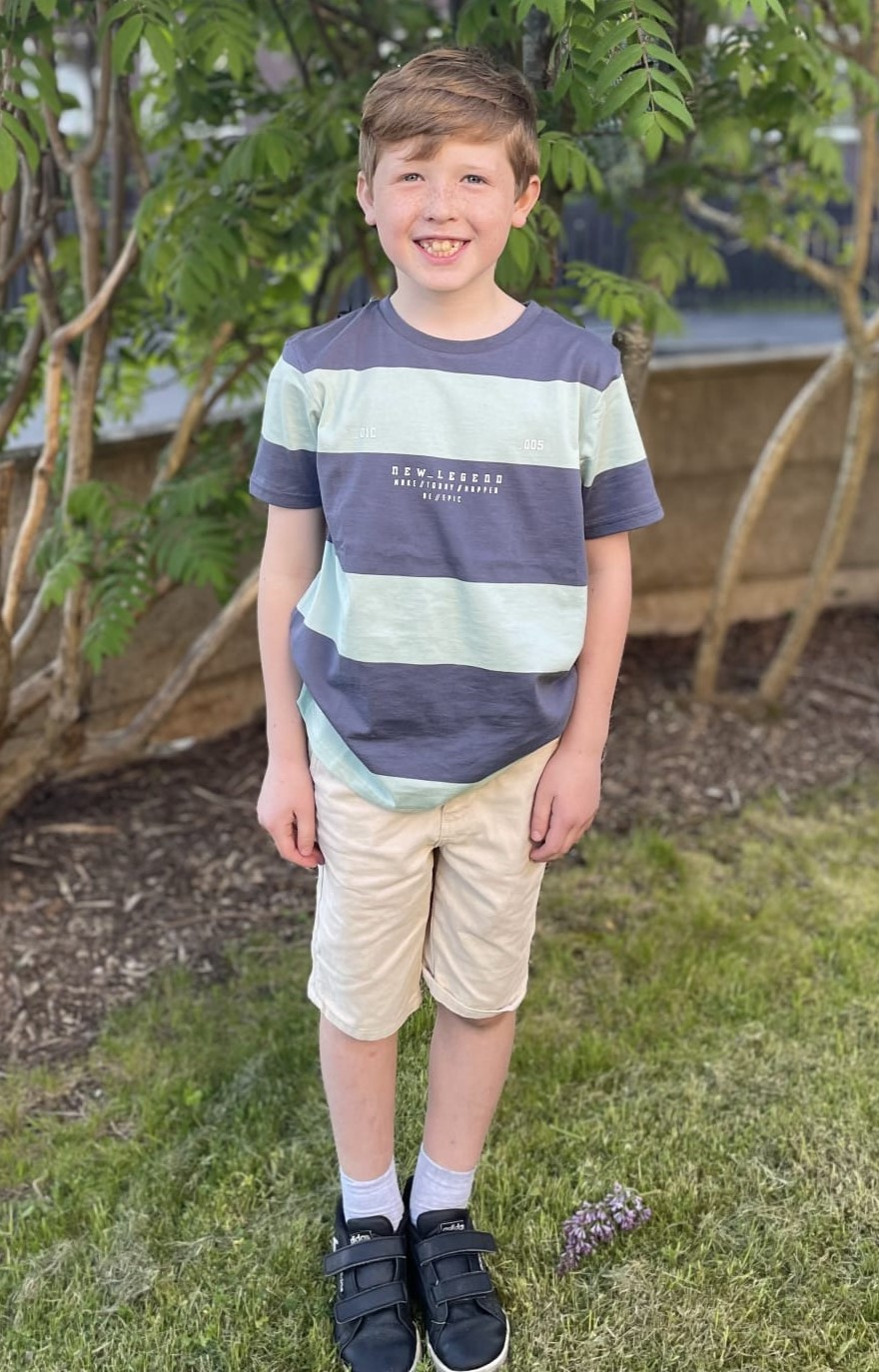
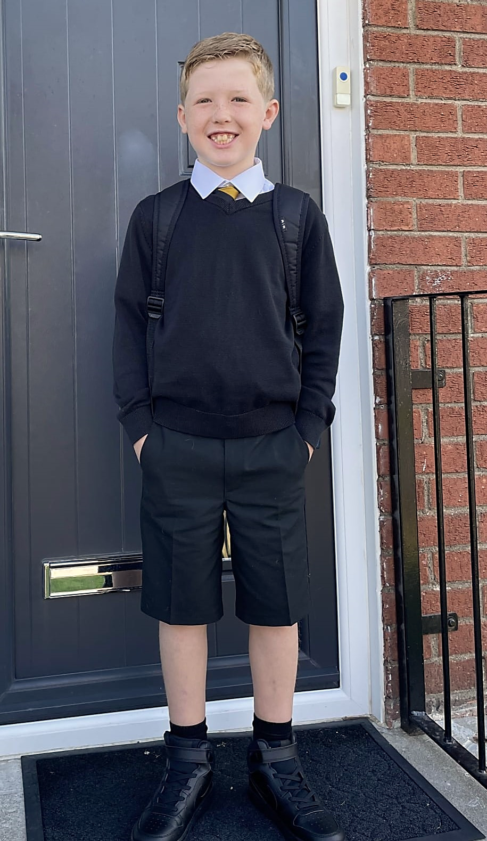

Slide 3
Jesus Christ is the same yesterday, today and forever.
Hebrews 13:8 (NIV)

Slide 4
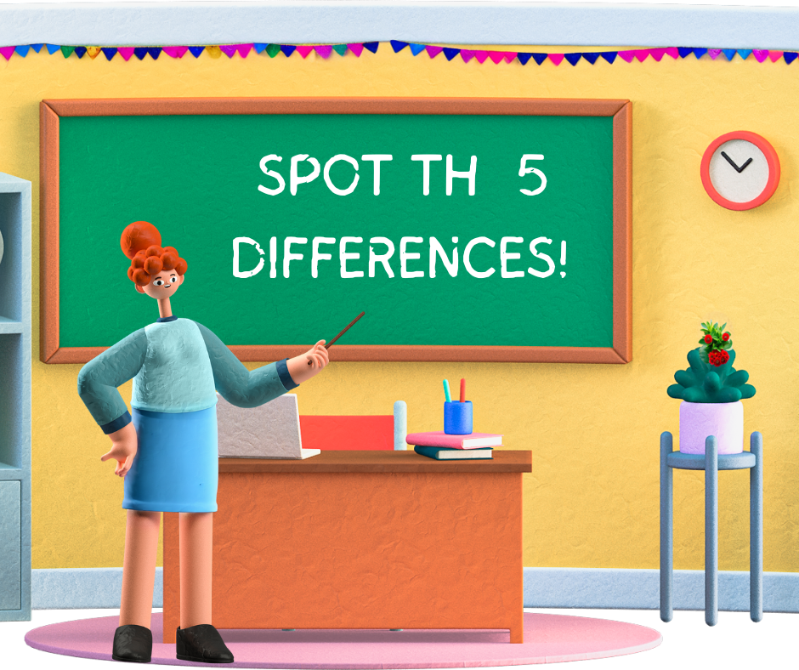
Spot the difference!
1
2

Slide 5
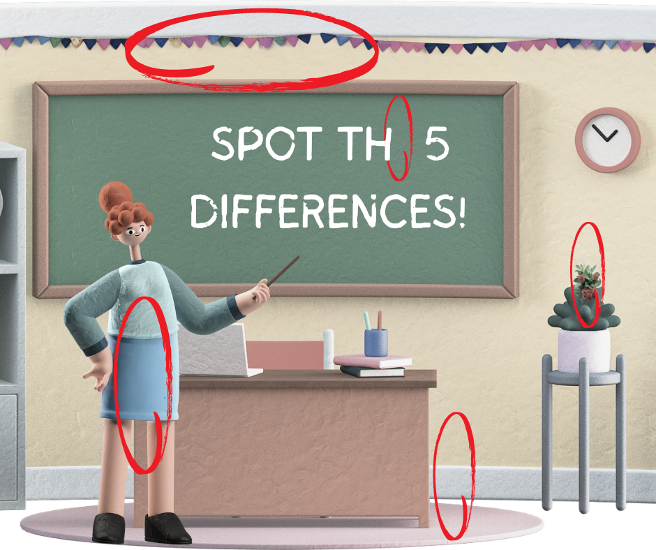
Spot the difference answers!

Slide 6
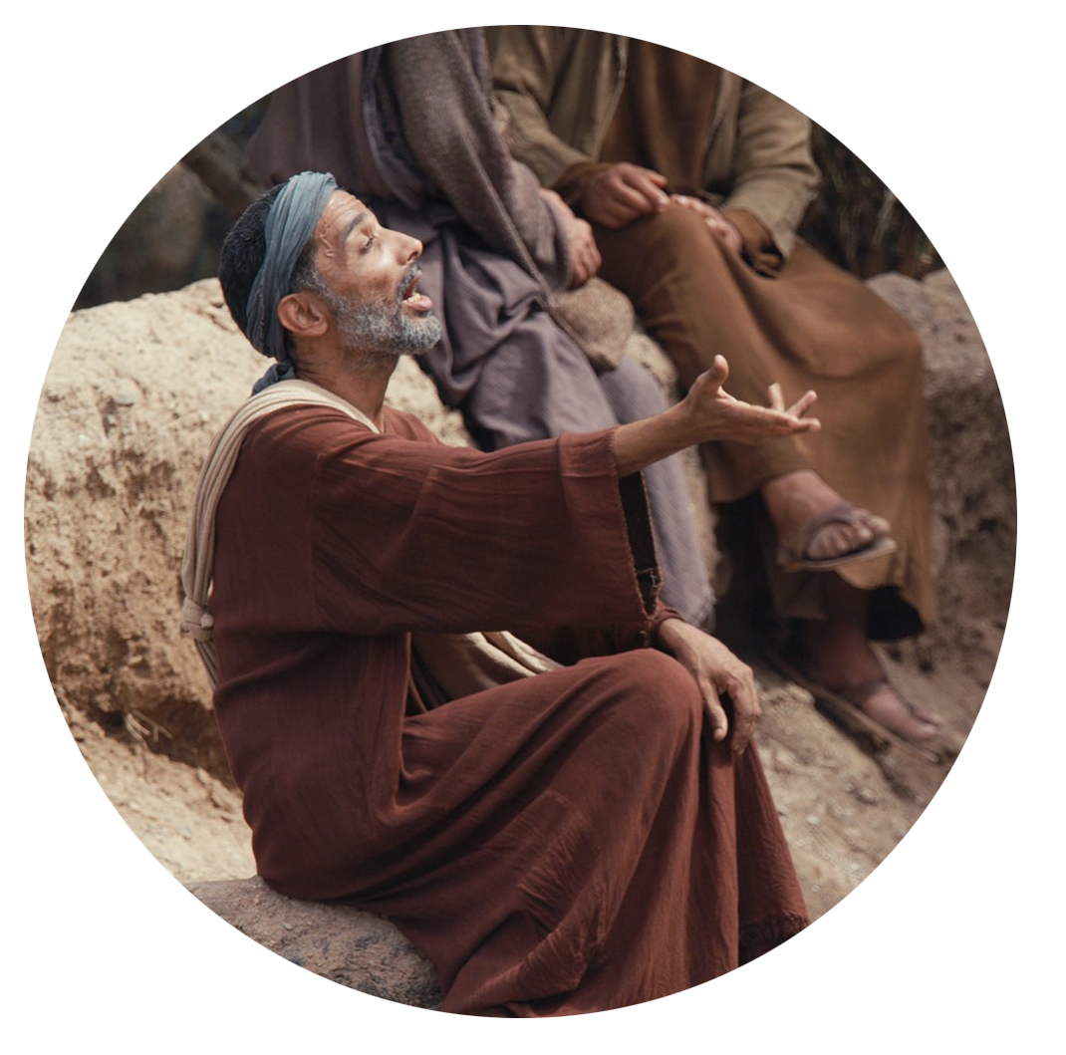
A Blind Beggar Receives His Sight Luke 18 v 35-43
As Jesus approached Jericho, a blind man was sitting by the roadside begging. When he heard the crowd going by, he asked what was happening. They told him, “Jesus of Nazareth is passing by.”
He called out, “Jesus, Son of David, have mercy on me!”
Those who led the way rebuked him and told him to be quiet, but he shouted all the more, “Son of David, have mercy on me!”

Slide 7
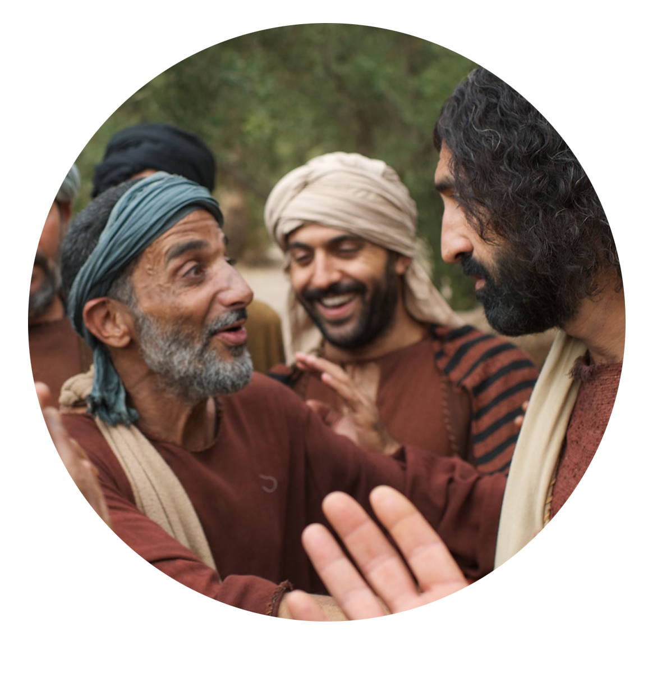
Jesus stopped and ordered the man to be brought to him. When he came near, Jesus asked him, “What do you want me to do for you?”
“Lord, I want to see,” he replied.
Jesus said to him, “Receive your sight; your faith has healed you.” Immediately he received his sight and followed Jesus, praising God. When all the people saw it, they also praised God.

Slide 8
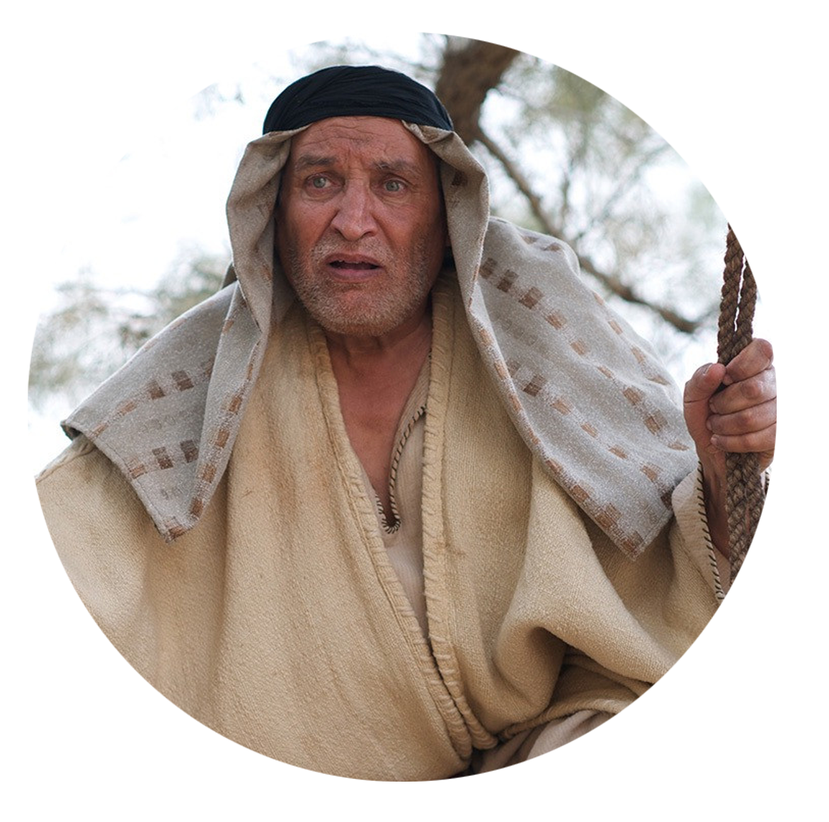
Zacchaeus the Tax Collector Luke 19 v 1-10
Jesus entered Jericho and was passing through. A man was there by the name of Zacchaeus; he was a chief tax collector and was wealthy. He wanted to see who Jesus was, but because he was short he could not see over the crowd. So he ran ahead and climbed a sycamore-fig tree to see him, since Jesus was coming that way.

Slide 9
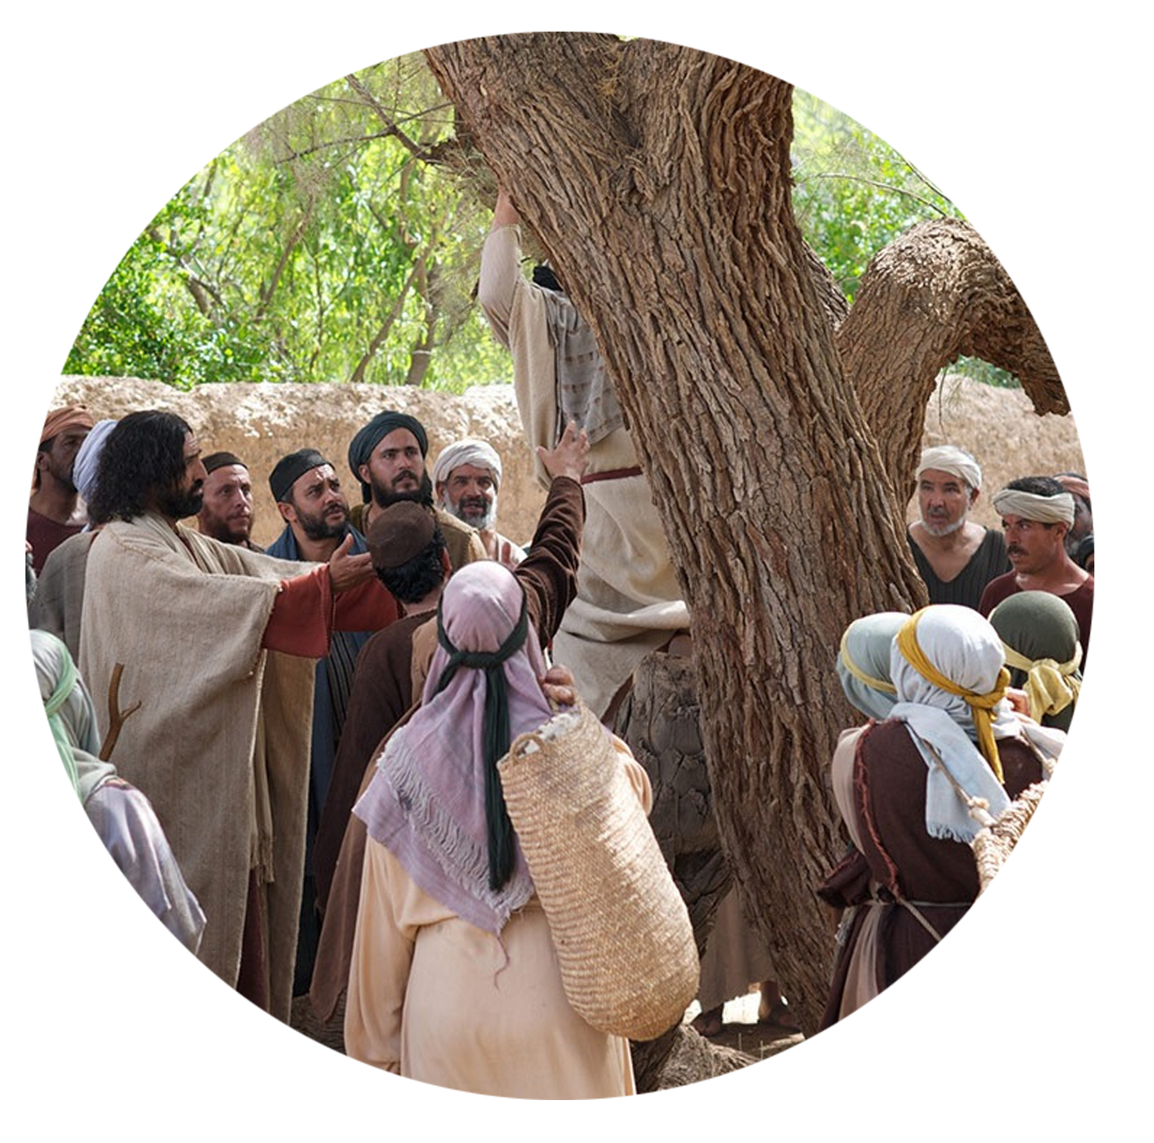
When Jesus reached the spot, he looked up and said to him, “Zacchaeus, come down immediately. I must stay at your house today.” So he came down at once and welcomed him gladly.
All the people saw this and began to mutter, “He has gone to be the guest of a sinner.”

Slide 10
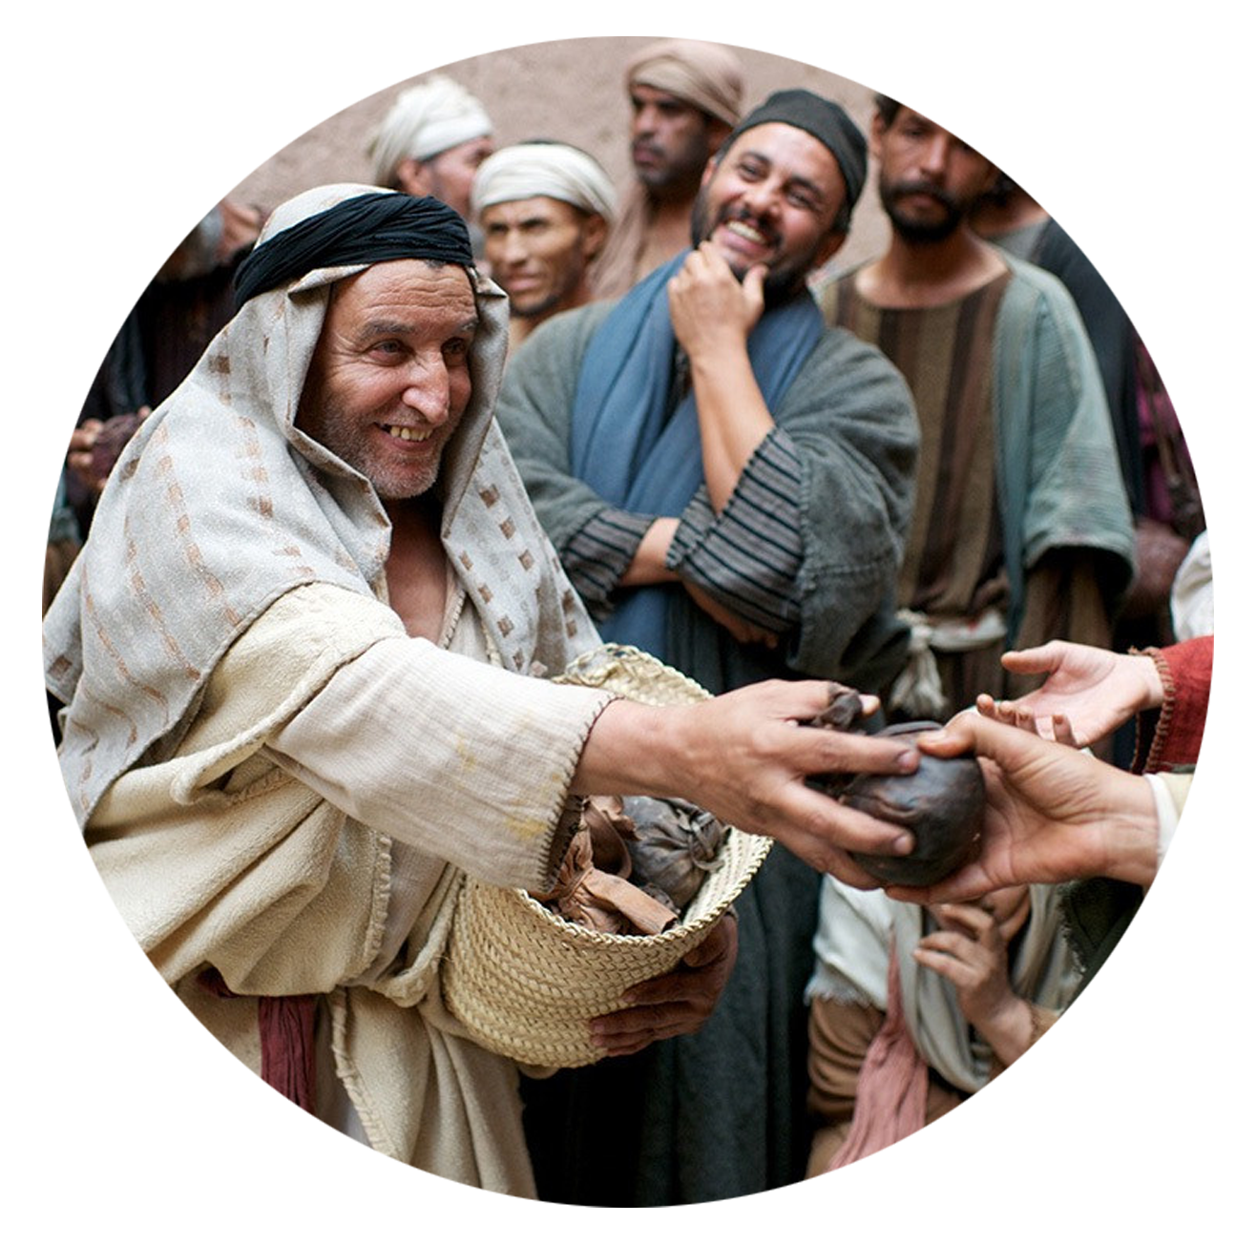
But Zacchaeus stood up and said to the Lord, “Look, Lord! Here and now I give half of my possessions to the poor, and if I have cheated anybody out of anything, I will pay back four times the amount.”
Jesus said to him, “Today salvation has come to this house, because this man, too, is a son of Abraham. For the Son of Man came to seek and to save the lost.”
Photo credits: www.LumoProject.com

Slide 11
Can you spot any differences between the blind beggar and Zacchaeus before, during, and after they met Jesus?
I wonder, if you were the blind beggar or Zacchaeus, how would you have felt when Jesus spoke to you?
I wonder, if you had been in the crowd that day, what would you have gone home and told people?

Slide 15
Their attitude to Jesus
Their response to Jesus
1. The way they met Jesus
2. The way Jesus changed them
3. The way they responded to Jesus

Slide 16
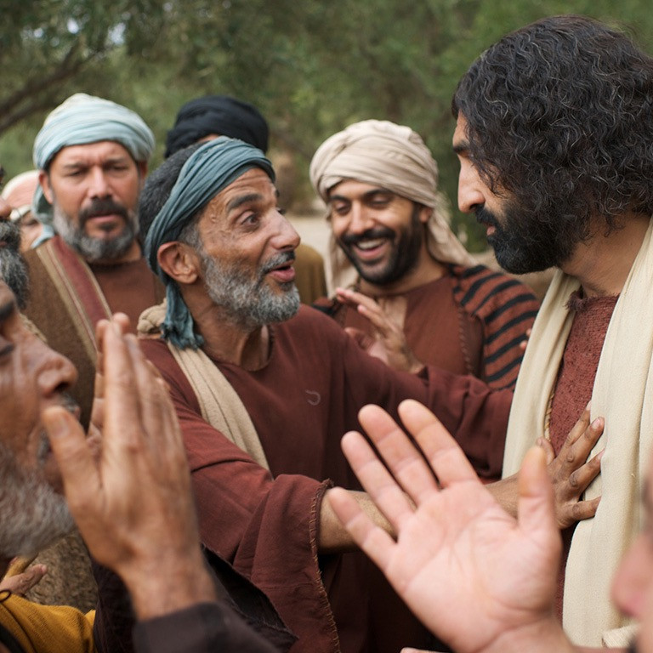
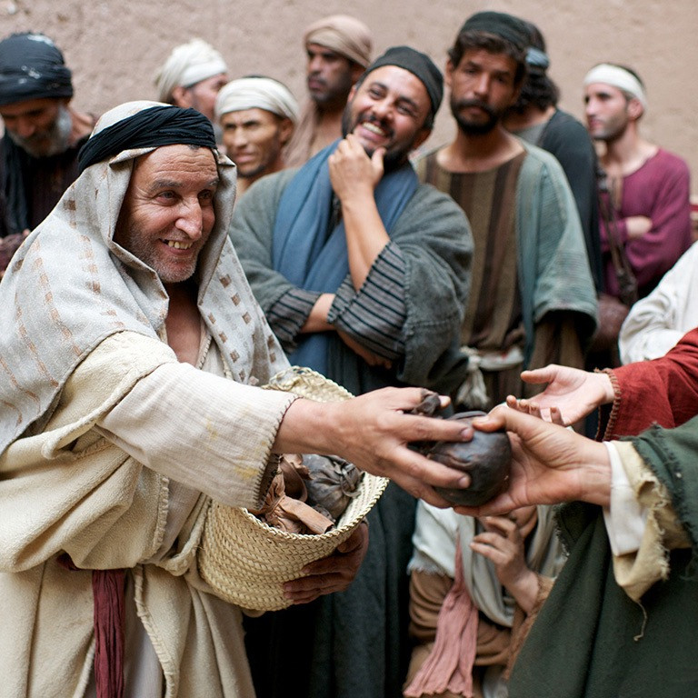

Slide 17
May others spot the difference knowing Jesus makes!

